Slide 2
Exploring Funding and Engagement Models
Scarlett Varga
Head of development, Bruegel & Co-founder, The Brussels Binder
scarlett.varga@bruegel.org

Slide 3
1. Fundraising mentality 2. Funding models/ sources 3. Fundraising cycle 4. What is a succsessful proposal?

Slide 4
Fundraising “mentality” for non-profits
“ What is your overhead rate? “
“It is too low. We systematically under-invest in human resources, financial management, and program management to keep it that way. By doing so, we have a nice, low overhead number to put on grant applications like this one. Please send money.” (Nonprofit AF- full list)
the imbalance of power between funders and nonprofits leads to the lack of honest communication and feedback
if the nonprofit sector is to realize its potential, think tanks need to stop apologizing for the value of the work they are trained to do. Do not overpromise, but avoid under-selling
think tanks should not be afraid of advertising how and why flexible funding is vital to executing their strategy
strategy first: strategy is a fundraising necessity, not a luxury (Jeremy Avins)

Slide 5
Funding (1) vs independence
“can any think tank still accept funding from any source without immediately coming under suspicion of having been “bought” by some public or private vested interest?” (Transparify)
Independence and the research agenda
execution of Research Programme is independent
scholars encouraged to exchange with funders while conducting research but NO consensus sought on research conclusions
outputs signed by scholar(s), published under editorial responsibility of the Director- no institutional standpoint
Independence and transparency
Finances: every euro cent of income is shown in the annual report (+ levels?)
Staff: Fellows required to adhere to a Statement of Research Integrity
Scholars declare outside interests annually (academic, media, political, national, commerical, financial etc.) and publicly
Research: Review Task Force, Scientific Council assessing quality of research output
No consultancy or lobbying activities undertaken

Slide 6
Funding models/ sources (2)
Funding Model
10 Key Models, e.g -> Member motivator/Big Bettor/ Policy Innovator (Stanford)
Government based/ Foundation based/Corporate based/ Diversified
Funding Sources
Foundations
Donors
Clients
Sponsors
Private sector
Crowdfunding
Public sector
Funding Model
“methodical and institutionalized approach to building a reliable revenue base to support an organization’s core programs and services” (Stanford Social Innovation Review)
+ Sustainable ?

Slide 7
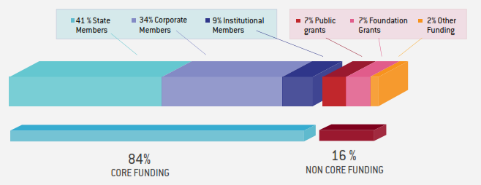
Funding models/ sources (3)
Case study of Bruegel
Goal of broad public/private balance (Minimum 33% private finance)
State members: 5 categories, from ca. €33,203 to €199,203
Corporate members: €50,000 per year, regardless of size
Institutional members: €50,000 per year (€25,000 for Central Banks of Members)
Additional resources from participation in multi-partner research projects, research grants, etc.
no party currently contributes more than 3-5% of the total budget
Notes:
Diversified

Slide 8
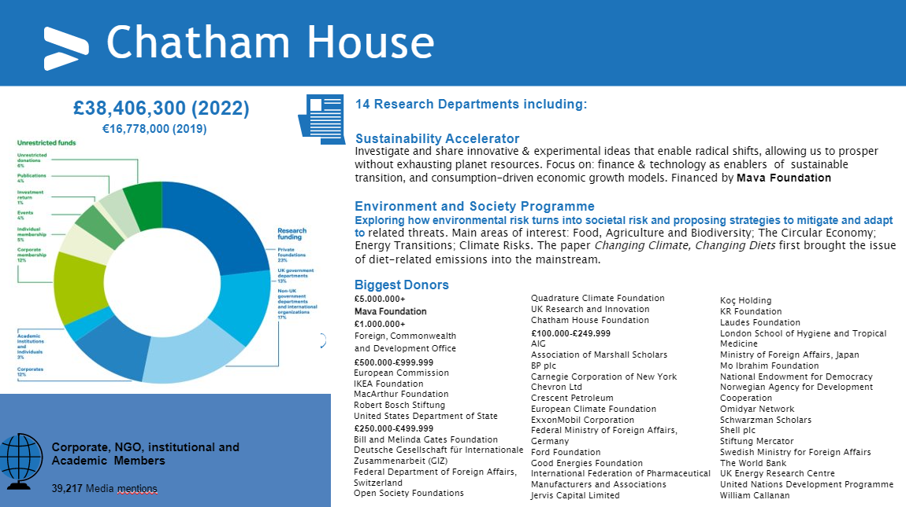
Other models: quick look
Notes:
Foundations- Big Bettor?
Big Bettor | There are a few nonprofits, that rely on major grants from a few individuals or foundations to fund their operations. We call their funding model the Big Bettor. Often, the primary donor is also a founder, who wants to tackle an issue that is deeply personal to him or her. Although Big Bettors often launch with significant financial backing already secured, allowing them to grow large quickly, there are other instances when an existing organization gets the support of a major donor who decides to fund a new and important approach to solving a problem.

Slide 9
Other models: quick look
Notes:
Public funding - based

Slide 10
Other models: quick look
Notes:
Big bettor, endowment-like

Slide 11
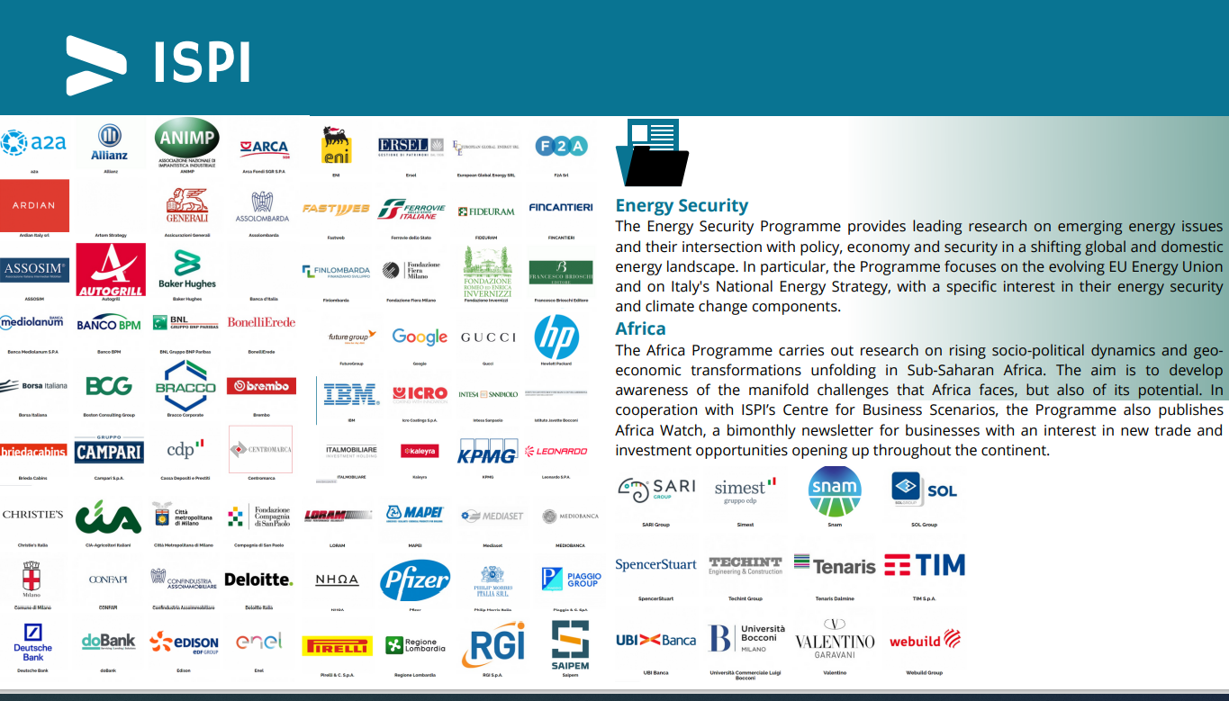
Other models: quick look
Notes:
Member motivator, Corporate- based

Slide 12
Fundraising cycle
Prospect/Monitor for opportunities (incl. collaboration with research community to share personal networks, ex-ante preparation for events, etc.)
Evaluate and decide – not every opportunity is for you
Relationship building (turning a logical discussion into an emotional one)
Develop a proposal/ Value proposition (1/ budgeting expertise is not trivial; 2/ have full buy-in from people involved/ named in the proposal 3/ develop a sound concept paper and edit/ expand it later)
Follow-up and reporting (do not get comfortable)

Slide 13
What is a succsessful proposal?
Know your donors: timeline of calls, application process and requirements
Know yourself: internal strategy, goals and objectives (both short- and long-term), vision
Match interests
General objective (IMPACT): your project will contribute to what? (e.g. deepest understanding of a specific issue)
Specific objective (BENEFIT): what are the direct benefits created by your project?
Results (OUTPUT): what are the expected results?
Activities (TASKS): once you defined objectives and results, you can then develop the list of activities

