Slide 1
Communications David Watson MD Communications and Publishing dwatson@chathamhouse.org

Slide 2
Agenda
Chatham House
Why bother with comms
How to communicate, including how CH does it
What is CH doing well and how are we promoting strategic comms?
Communications strategies key elements, including horizon scan, comms plan
Questions
Exercise

Slide 3
Chatham House
Independent international affairs think tank – Independent Thinking
Founded in 1920
Chatham House rule
Events and convening, dialogue, research and analysis, empowering next generation
15 thematic and geographic programmes and teams
Membership model
‘Our mission is to help governments and societies build a sustainably secure, prosperous and just world’

Slide 4
Communications outputs
FY 2021-2022
59 publications
+ 21 meeting summaries
273 pieces of digital written content
56 podcasts
6 issues of
The World Today
+ digital content
44,292 media mentions
1,078 marketing emails
232 videos
+168 not publicly disseminated
6 issues of International Affairs
+ digital content, events

Slide 5
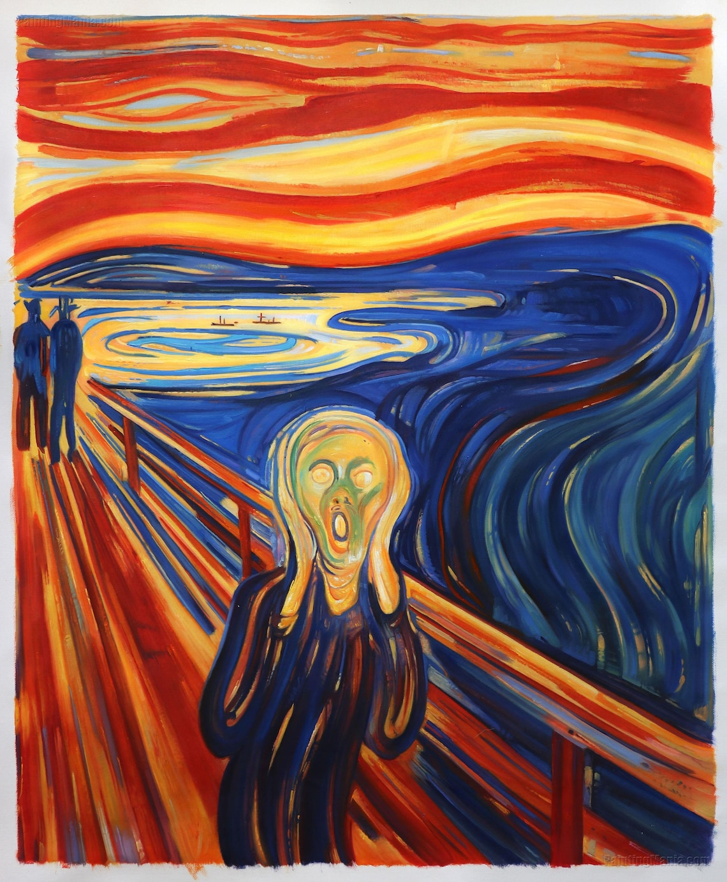
Why bother?

Slide 6
Why bother?
Evidence, analysis and ideas are not sufficient to influence policy
Decision-makers and influencers have plenty of alternative sources – we are all competing for attention (audiences won’t just find you!)
Time is at a premium and attention must be grasped quickly
Research is rarely immediately translatable into practical recommendations
Presenting the facts is only half the job – and compelling research deserves properly communicating
Establish credibility, reputation and brand for future influencing
Bring research alive! To stand out. It’s fun!
Attract funding and partnerships
(The Review did not include membership communications, which are handled by the External Relations team, or our approach to events and convening)

Slide 7
How to communicate?
Depends on the objectives and audience
Don’t just press play - why does this matter? Tell your story
Think carefully about what comms activities will help you get results
Not every problem has a report-shaped solution
Team effort between research and comms – not a bolt on at the end
Resource and plan it properly
Options include publications, digital, media, events, public affairs
Public, targeted, private engagement – The Rule
Do the work so your audience don’t have to…
‘I didn’t have time to write a short paper, so I wrote a long one’
(The Review did not include membership communications, which are handled by the External Relations team, or our approach to events and convening)

Slide 8
How do we do it? Our orchestra
External communications to support CH research, expertise and convening
Member and academic publications
Digital infrastructure and marketing
Digital content editing
Media
Publications
The World Today
International Affairs
External Relations
Events and convening for members, stakeholders and public
In addition there are 2 communications professionals embedded in research programmes. Some video and podcast content is produced by research programmes. All major design work is outsourced. There Cyber Policy Journal is managed outside of comms.

Slide 9
Why does CH do comms well?
Comms is an institutional priority and comms is represented on ELT
Main comms functions and channels in place
Skilled and happy team
Strong brand
Good mix of in-house and outsourcing
Linking our work to current affairs
Planning and delivery processes and systems
Best practice guidelines and policies

Slide 10
How are we promoting strategic communications?
Trying to be more purposeful in our activity planning
Working with research colleagues at the bid and proposal stage
Do more strategic engagement planning
Horizon scanning for opportunities to influence
Prioritising activities then taking a campaign approach
Making better use of data and evaluation
(The Review did not include membership communications, which are handled by the External Relations team, or our approach to events and convening)

Slide 11
Communications strategies
All the following content slides can be any of the 5 theme colours
Having a clear vision: why are we doing this and what does success look like?
Understanding the strategic context for change through intelligence gathering and horizon scanning
Identifying CH’s place in the influencing ecosystem then being clear about our added value
Knowing your audience – how do they want to be influenced?
Action plan: long-term, key influencing moments, rapid reaction, staying nimble
Building and leveraging relationships, working in partnership and alliance building
Deploying the best comms activities to achieve objectives
Being propositional and offering solutions, not just more eloquent descriptions of the problems
Resourcing, budgets and responsibilities
Clear KPIs to evaluate progress – stats, stories of change, feedback
Repeat, repackage, repeat, recycle, repeat again!
You should aim to restrict the amount of text shown on slides. Where possible, use images to tell the story in place of words.

Slide 12
Horizon scan key external moments and events

Slide 13
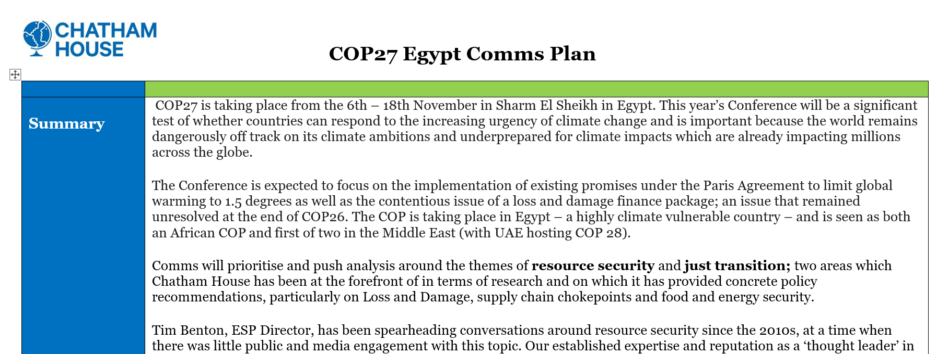
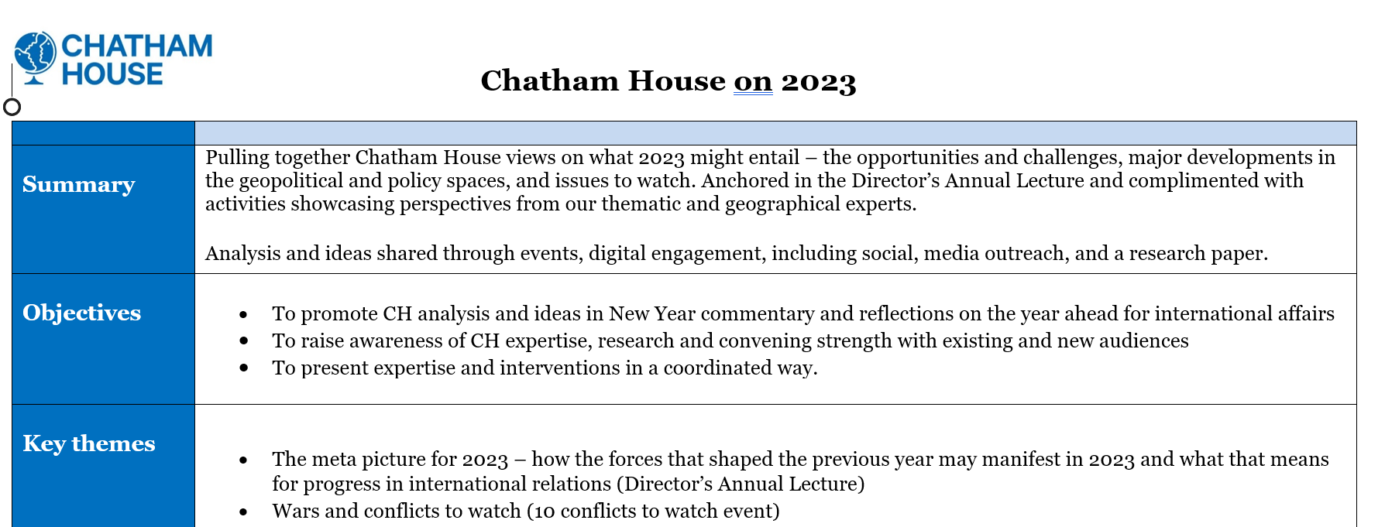
Campaign approach comms plans
Summary
Objectives
Key messages and themes
Spokespeople
Target audience
Approach and content
Risks and challenges
Measures of success

Slide 14
Questions
Is there an organisation-wide strategy and/or objectives to guide comms strategy?
Is comms more tactical, focusing on making activities more purposeful?
Should the comms offer be universal or differentiated, and if the latter how?
Should we aim for fewer, better interventions or let 1000 flowers bloom?
Do we focus on stats or impact?

Slide 15
Exercise
New UK prime minister September 2022
High level comms plan
CEO expert comment on prioritising Europe
Multiauthor expert comment on priorities – published ahead of the new PM taking office
Twitter space on likely challenges – timed to follow new PM’s speech
Event on a new place for the UK in the world – day after PM takes office, in person and livestreamed, live tweeted
Promoted on website, through social media, to media contacts and via email newsletter
Media note sharing expert quotes and availability to comment
Media quotes and appearances by CH experts shared via the Twitter account
Clips from the event and Twitter space promoted via social media.

Slide 16
Exercise
What do you make of this intervention?
What did CH do well? What could it have done better?
How would your think tank engage with a similar political moment?
What might you do similarly? What might be different?
What questions does this provoke?

