Slide 1
Improving systems: learnings from social entrepreneurs Olga Shirobokova Co-Lead of Knowledge

Slide 2
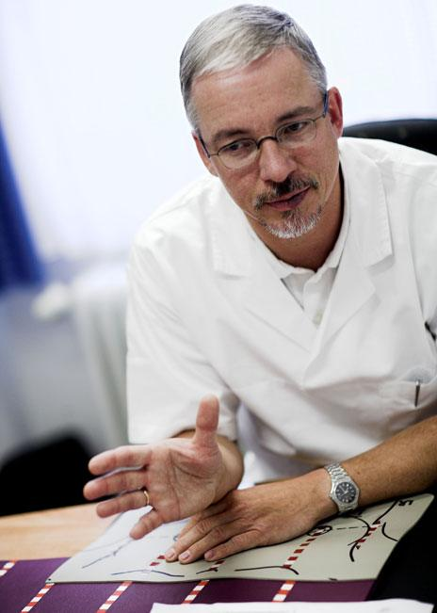
Frank Hoffman, Discovering Hands

Slide 3
Dorica Dan

Slide 4
RARE DISEASE CARE
1,000,000 million (mostly undiagnosed) patients in Romania alone
19% of the population are affected directly (as a patient)
or indirectly (as a family member or caregiver)
Average time people wait for diagnosis and treatment is 4-7 years

Slide 5
Dorica Dan, NoRo & Romanian Prader Willi Association
Rare disease care in Romania
Direct service:
United families with children of the same rare disease for peer support
Created a first of its kind Center of Expertise for Rare Diseases.
Multiplied the number of Centers of Expertise to 23
Systemic work:
A coalition of 38 rare disease organizations
There is a National Action Plan on Rare Diseases, new therapies and medications for RD available, increased budget allocation
Rare disease care embedded in the curriculum for doctors
Community nurses being trained as case managers
200+ journalists trained on the topic
Coordination of care between different parts of the healthcare system = structured care pathway

Slide 6
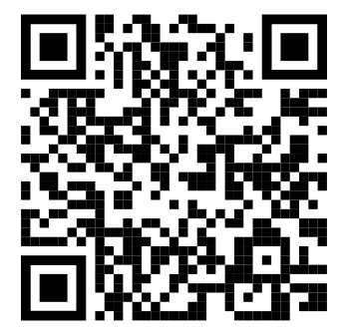
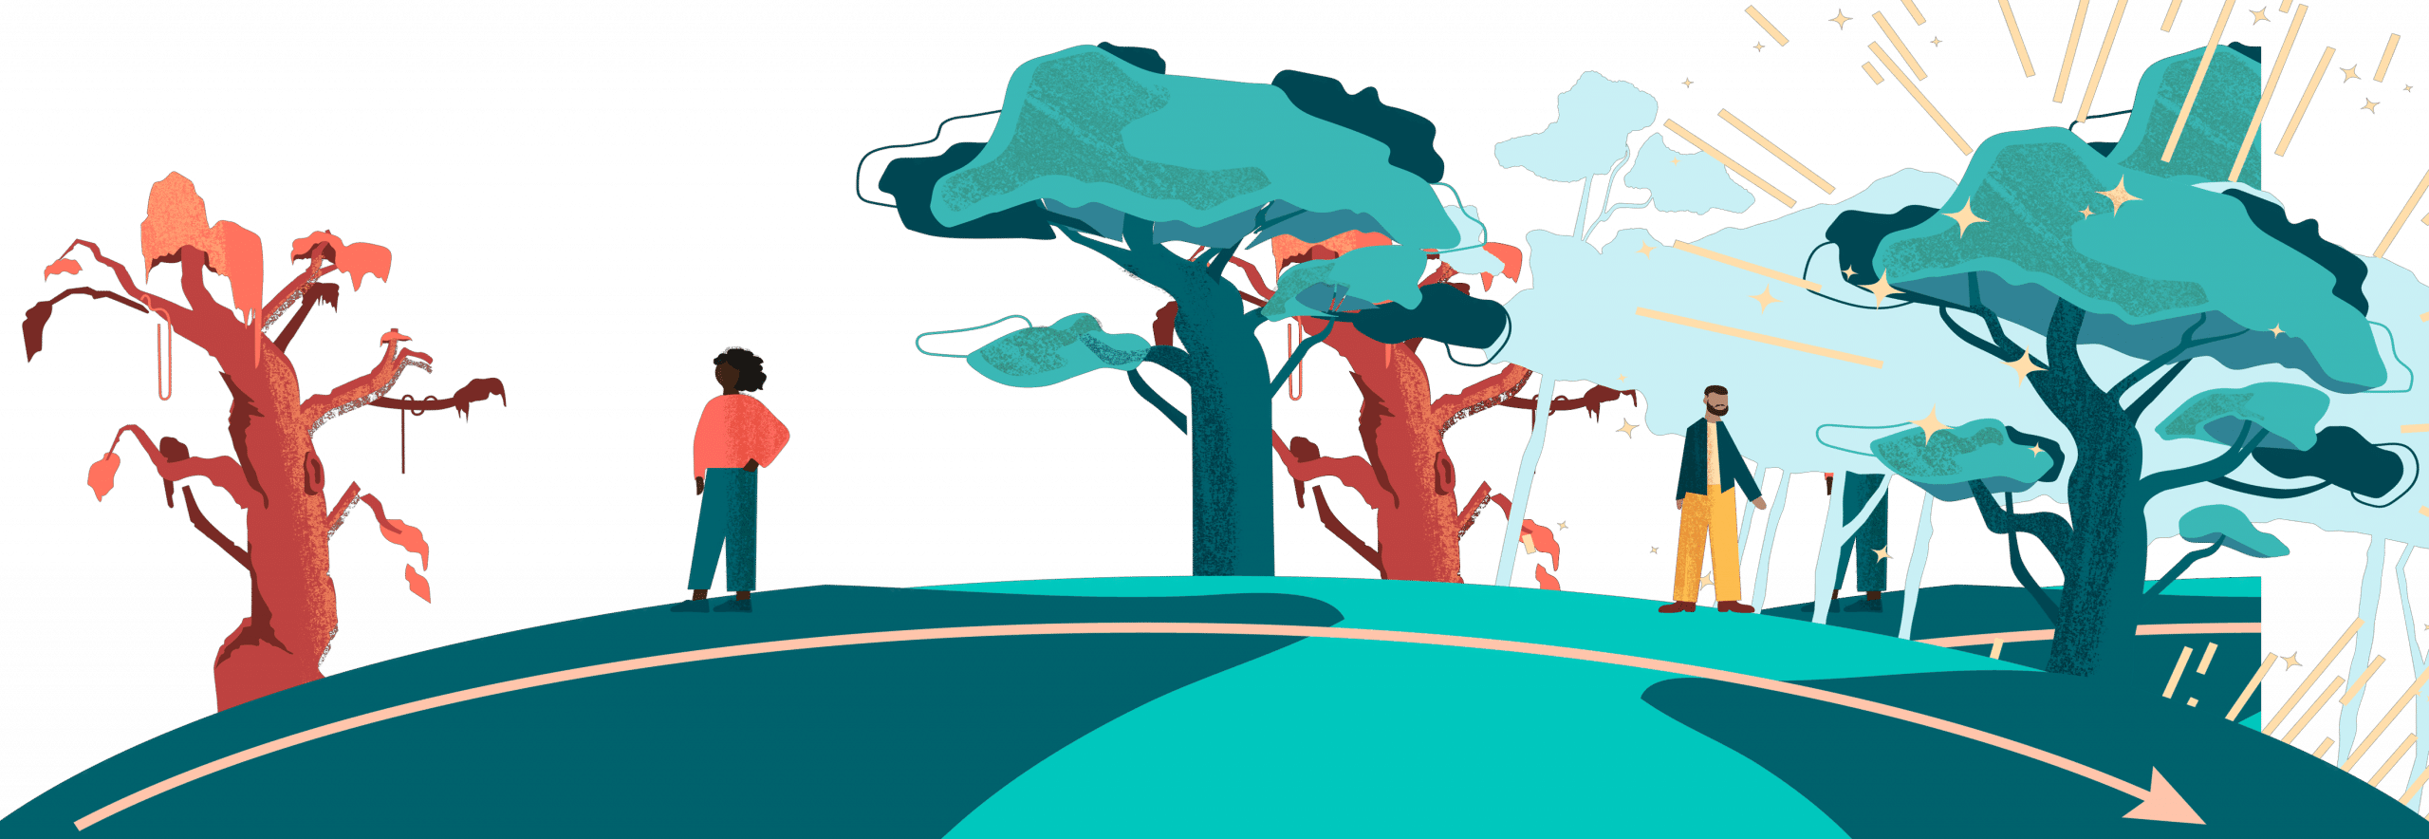
online course Systems change masterclass
This systems change course provides you with the theoretical background and practical exercises to refine your systems change strategy. It is a masterclass that has been developed incorporating decades of collective experience working with almost 4,000 leading social entrepreneurs from across the global Ashoka network.

Slide 7
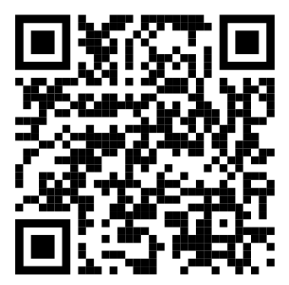
online course Working with government as a pathway to systems change
Government is an important stakeholder in many systems around us. It is responsible for setting rules for society, diverse public services, defence, the economy and foreign affairs. This course gives insights into potential roles, strategies, and tactics for social entrepreneurs to effectively work with government to achieve systemic impact.
Notes:
https://youtu.be/oCDFYDhfrXw?t=545

Slide 8
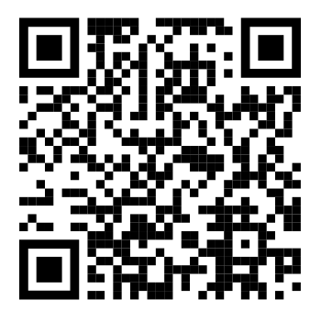
online course How to influence the way people think to change how society works
The ways of thinking shared across large parts of society play a critical role in establishing and maintaining systemic structures. In this course we explore how to influence mental models in people’s heads, and thus provide basis for shifting systemic structures responsible for the problem of our
Notes:
https://youtu.be/bMFjPxY-kDI

