Slide 2
Creating Communication Strategies
Stuart Coles

Slide 3
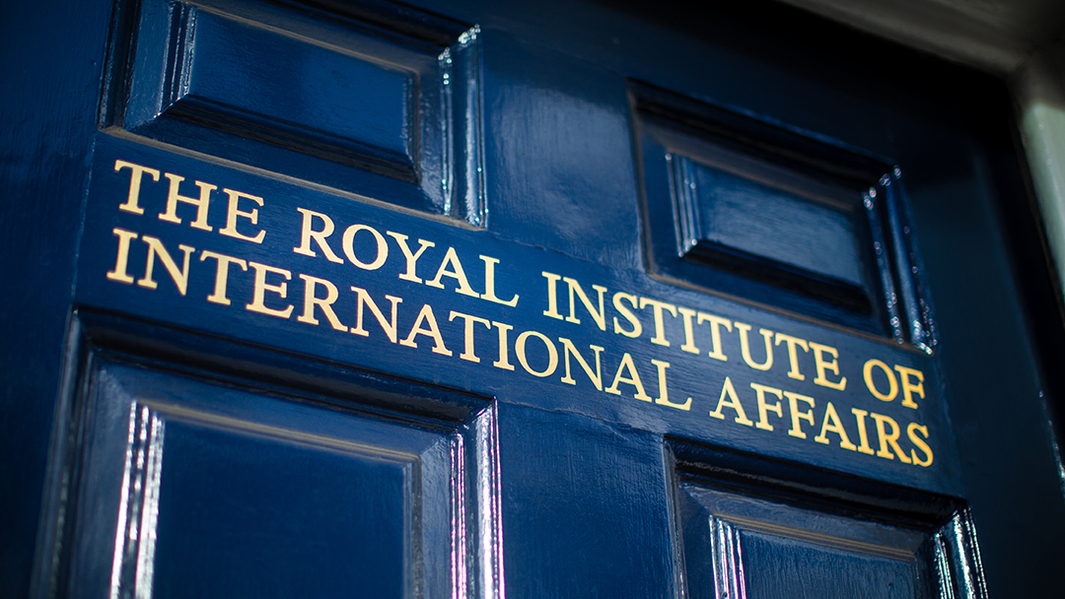
Chatham House
Independent international affairs think tank – Independent Thinking
Founded in 1920
Chatham House rule
Events and convening, dialogue, research and analysis, empowering next generation (c 500 per year)
15 thematic and geographic programmes and teams
Membership model
‘Our mission is to help governments and societies build a sustainably secure, prosperous and just world’

Slide 4
Communications team
External Communications
Member and academic publications
Digital infrastructure and marketing
Comment & Digital content
Media
Publications
The World Today
International Affairs
External Relations
Events and convening for members, stakeholders and public

Slide 5



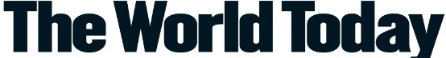




Communications outputs
2023
42 publications
+ 13 special outputs
273 pieces of digital written content
45 podcasts
6 issues of
The World Today
+ digital content
47,700 media mentions
1,078 marketing emails
192 videos
6 issues of International Affairs
+ digital content, events

Slide 6
What does CH do well?
Prioritising communications –an institutional priority
We have a skilled and motivated team
Good planning and delivery processes
Strong sense of linking to the outside world
Strong sense of quality, brand and voice

Slide 7
What are we trying to improve?
Better, more purposeful planning!
Working closer with research at early stages
Working smarter- more integration & campaign approach
Better use of data & evaluation
More strategic engagement and public affairs

Slide 8
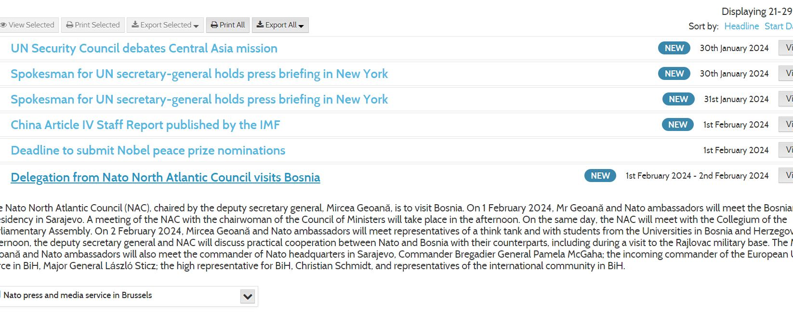
Horizon scanning

Slide 9
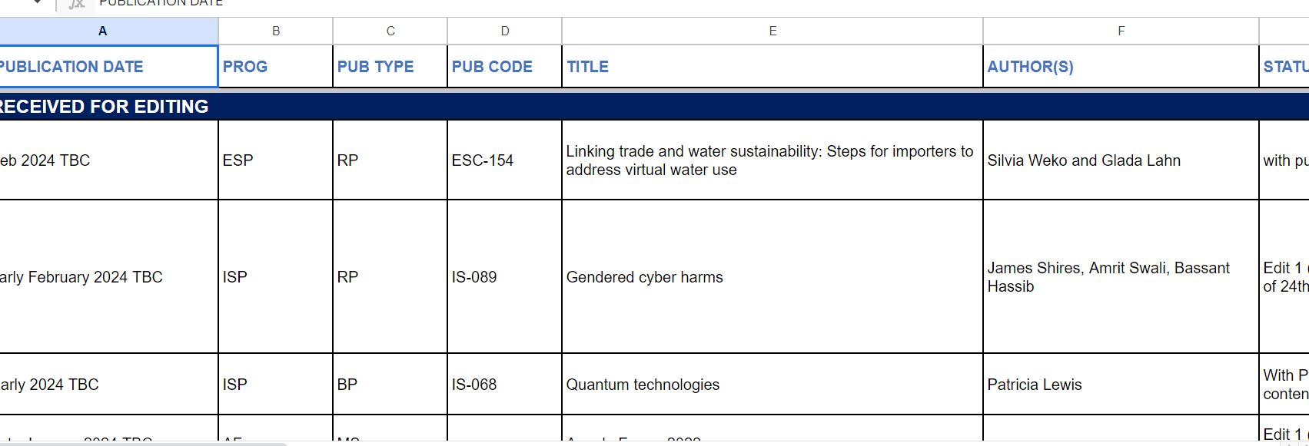
Horizon scanning

Slide 10
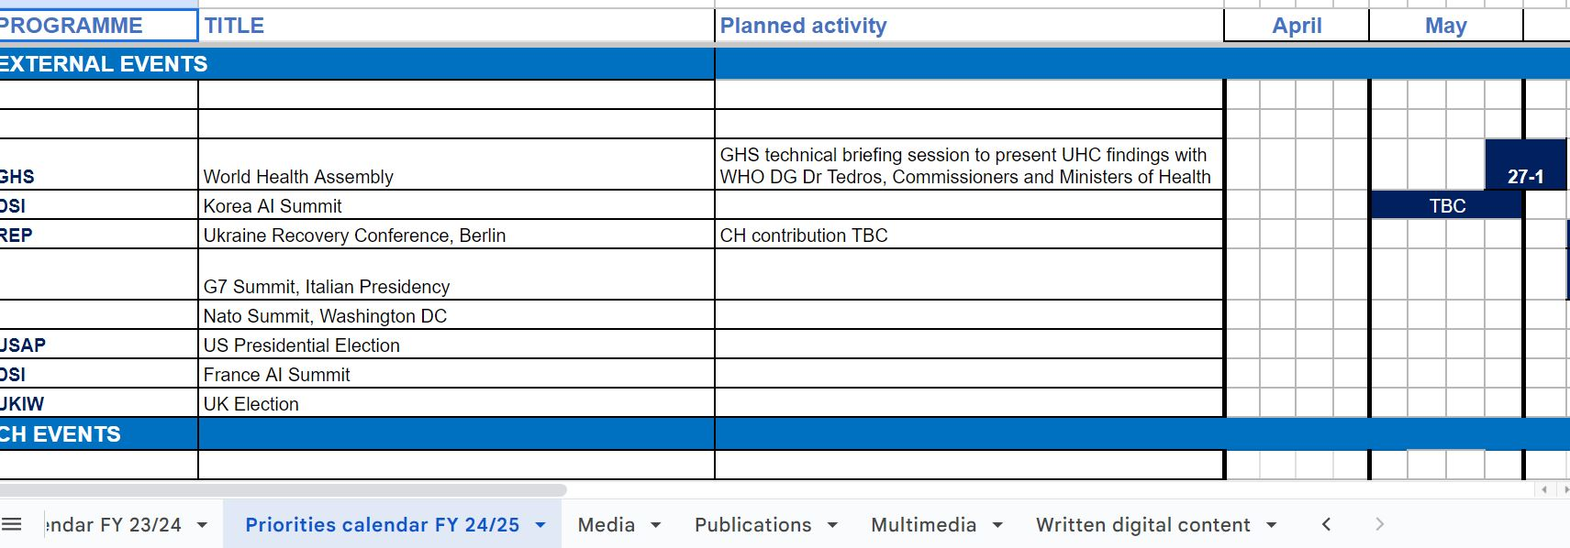
Horizon scanning

Slide 11
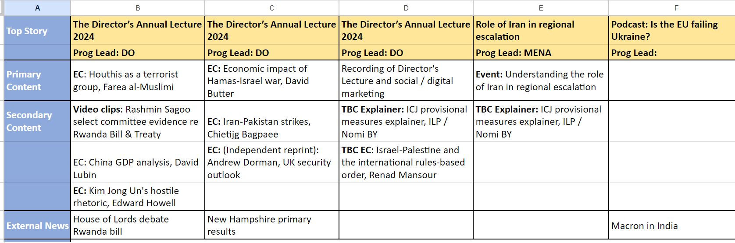
Comms grid

Slide 12
Comms plans: What’s it all for?
What are you trying to achieve?
Who are you trying to reach and influence?
What would a successful plan look like?
How would we measure & know it is a success?

Slide 13
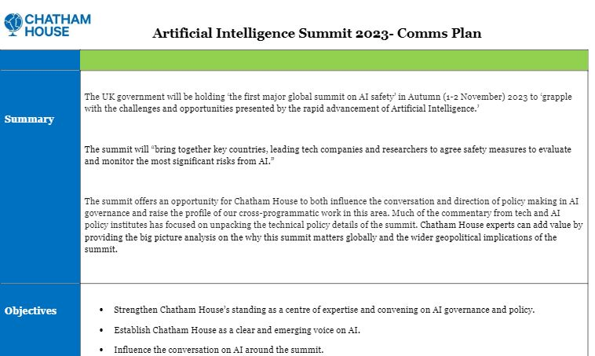
Comms plans
Summary
Objectives
Key messages and themes
Spokespeople
Target audience
Approach and content
Risks and challenges
Measures of success

Slide 14
Timing is…everything

Slide 15
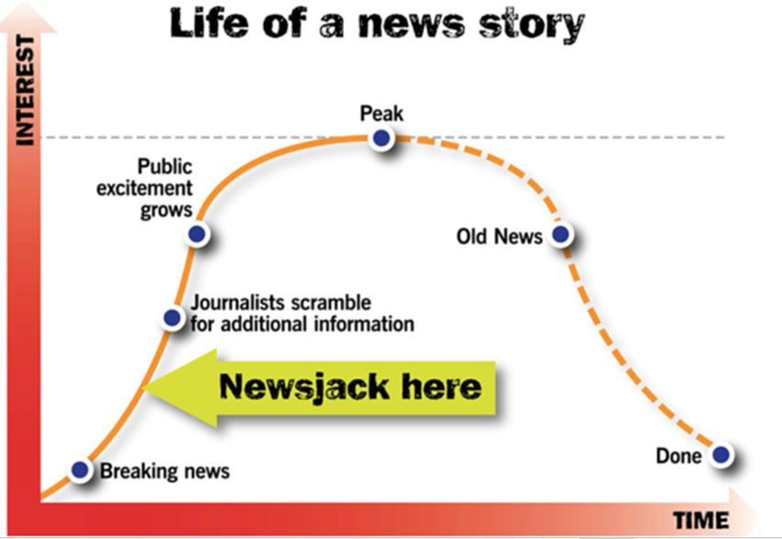

Slide 16
Plans in action

Slide 17

When plans go..to plan

Slide 18

When plans go..to plan

Slide 19

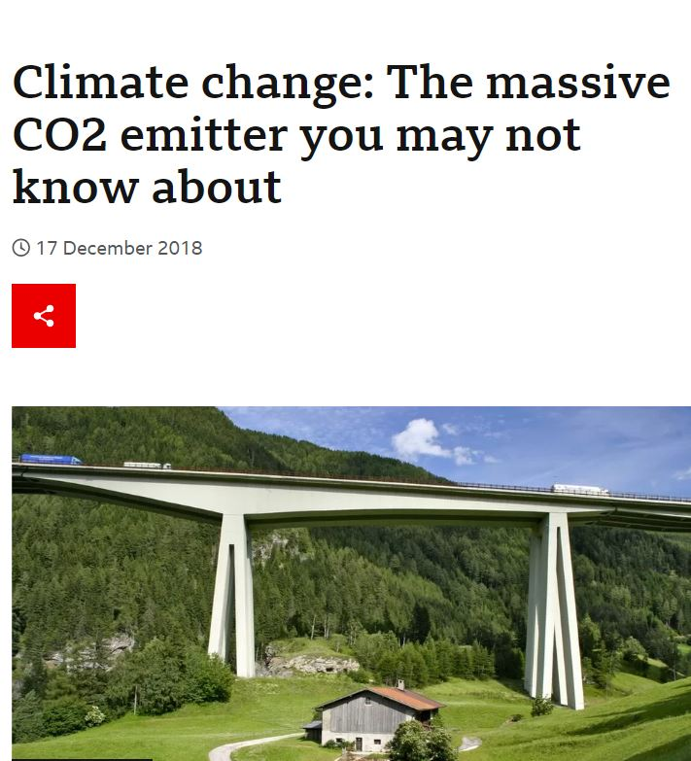
When plans go..to plan

Slide 20
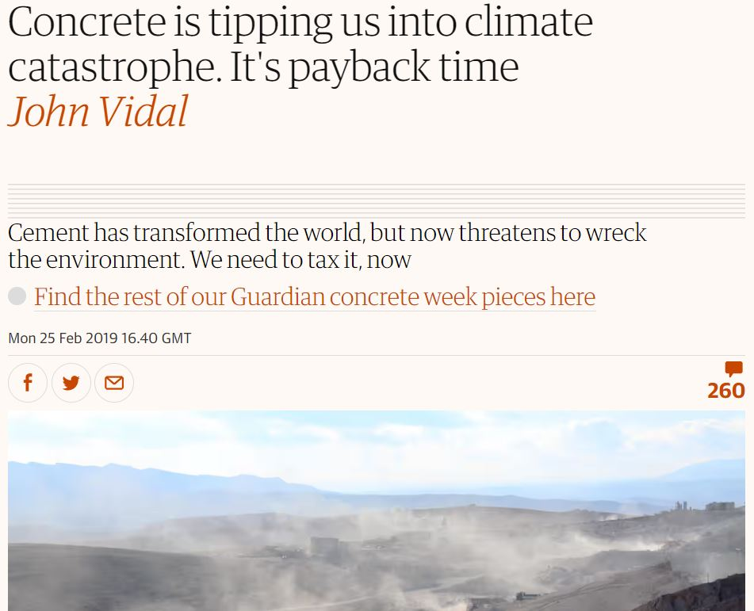

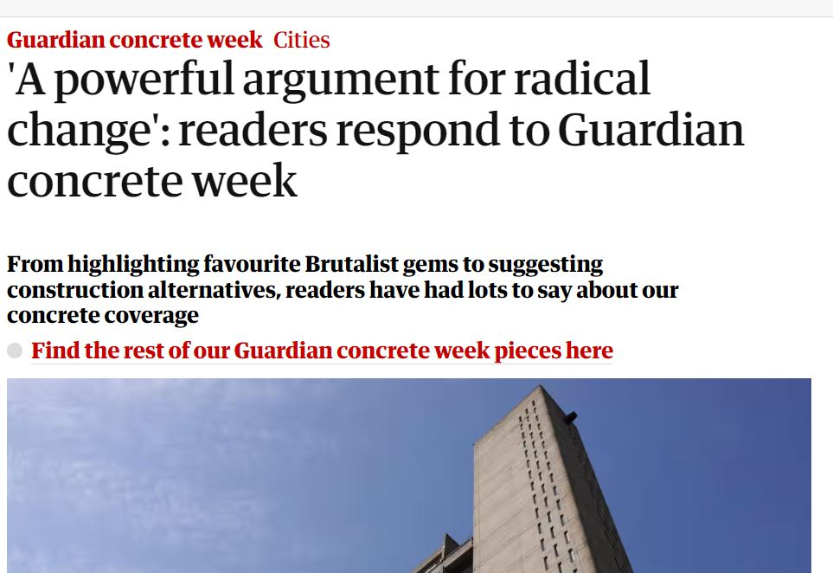
When plans go..to plan

Slide 21

When plans go.. mainly to plan

Slide 22
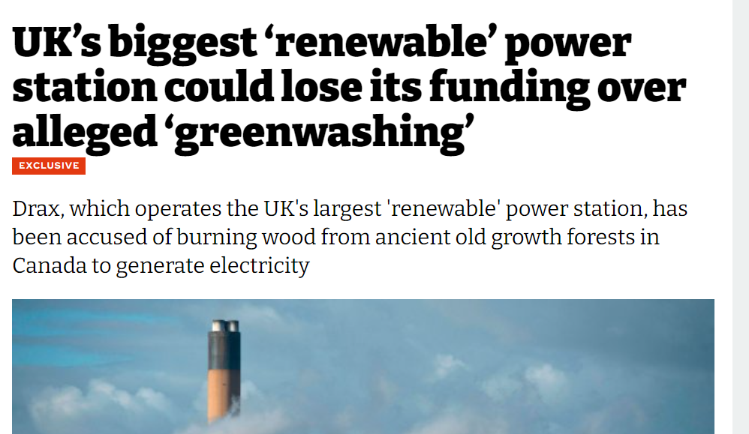
When plans go..mainly to plan

Slide 23
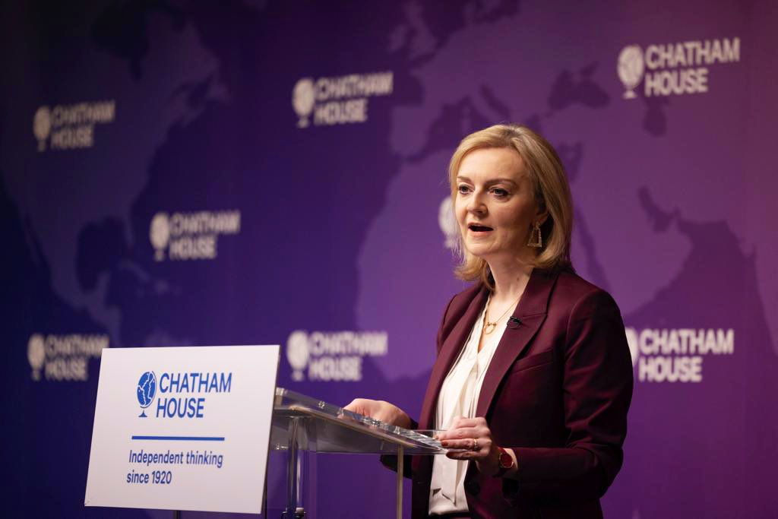
When plans go.. to a different plan

Slide 24
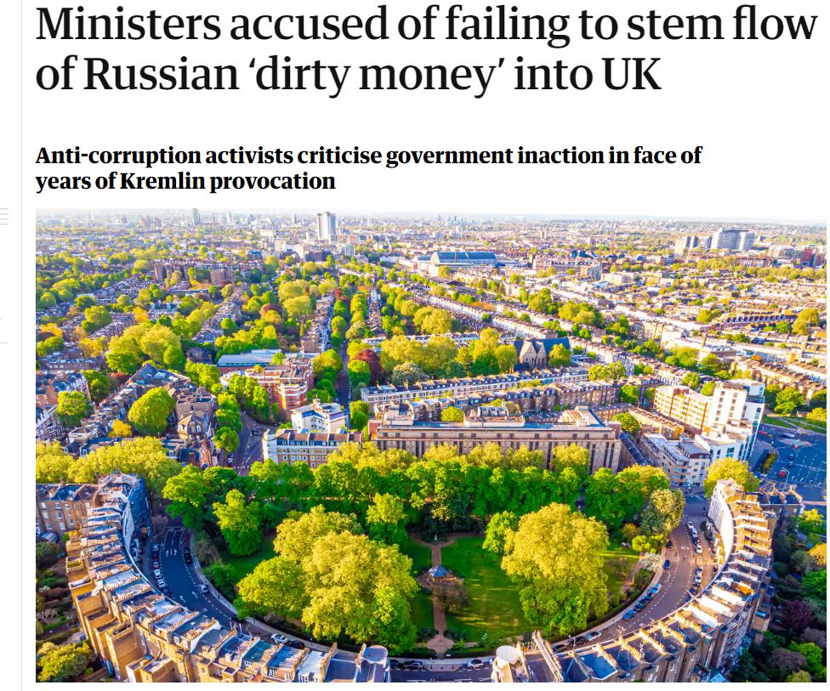
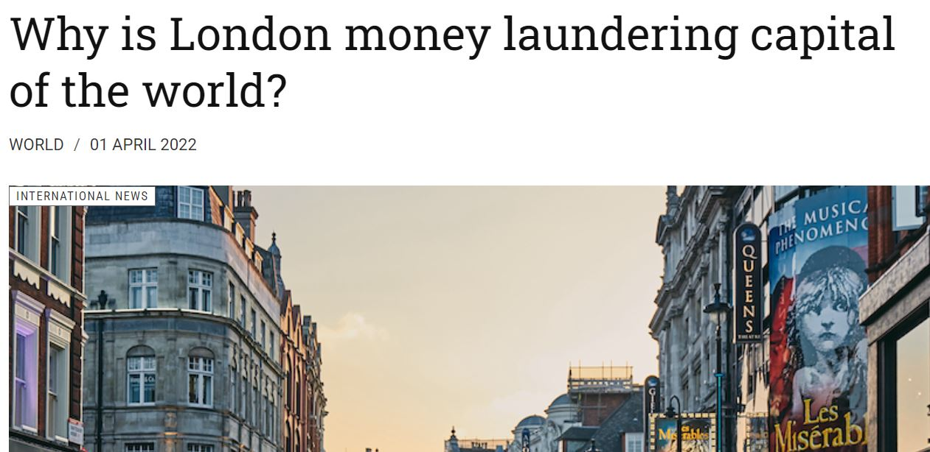
When plans go.. to a different plan

Slide 25

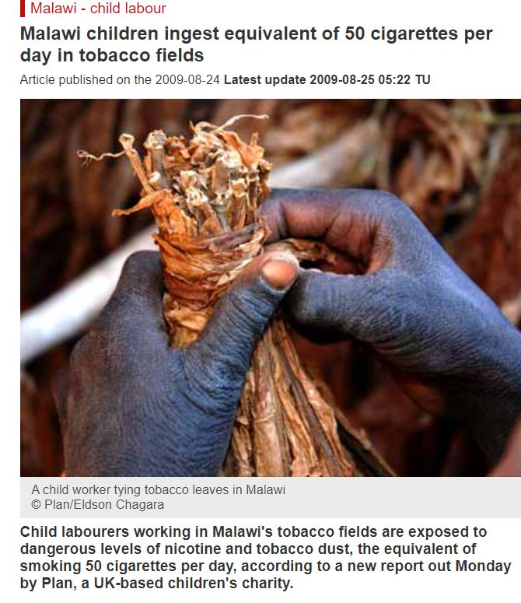
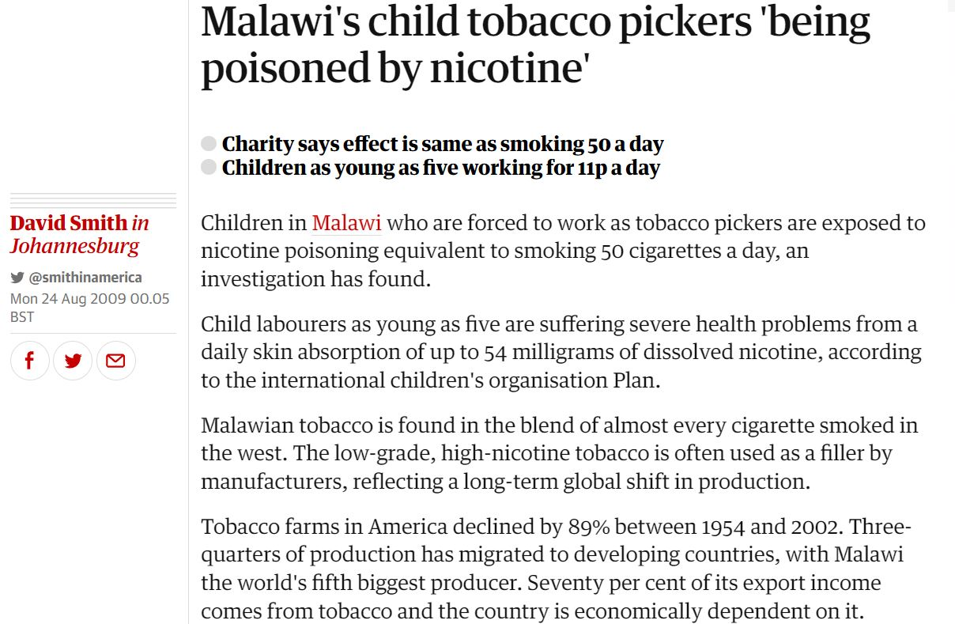
When plans go.. to a different plan

Slide 26

So….

Slide 27
In summary..
What are you trying to change?
What’s the (one) big idea?
Be realistic -and agile
K.I.S.S..

Slide 28
Merci Thank you Gracias

Slide 29
Comms challenge

Slide 30
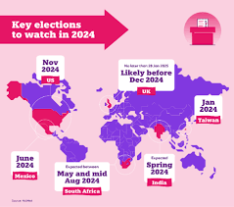
Communications challenge
There will be an unprecedented number of elections in 2024 – with more than 70 countries going to the poll, + 2 major conflicts – plus increasing climate risks.
How on earth do think tanks approach this momentous year?

