Slide 1
Mobilising messages – Event management and practical tips
Katja Knežević
School for Thinktankers 2024

Slide 2
Know your audience
Use databases, analytics and profiling
Collect information (with permission, GDPR in the EU)
Have an overview and understand your stakeholders
Decide what you want to tell them and how you want to communicate with them (awareness raising, knowledge transfer, relationship)

Slide 3
Audience management
Think of the audience and how to target them
What output is suitable for whom and for what messages?
Events → Conversations
Press → Establishing networks
Social Media → Building and maintaining brand

Slide 4
Lifecycle of an event
Idea Set the date Build a panel Promote the event (invitations, reminders, social media) Day of the event Promote the outputs (recordings, notes) Analytics
Idea: what is the aim? How does it fit into the larger plan?
Date: may depend on speakers’ availability or institutional calendar
Panel: content and diversity
Promotion: database, invitations and follow-ups, social media
On the day: catering, livestream, welcoming speakers and participants.
Post-promotion: email campaigns and/or social media
Analytics: database, respective platform analytics

Slide 5

Event management = crisis management
This year’s 10 most stressful jobs and their stress scores are
Enlisted military personnel: 72.58
Firefighter: 72.38
Airline pilot: 61.20
Police officer: 51.94
Broadcaster: 51.27
Event coordinator: 51.19
Newspaper reporter: 49.96
Public relations executive: 49.48
Senior corporate executive: 48.97
Taxi driver: 48.17
Source: Business News Daily

Slide 6
“You know you’re an event planner when everything goes wrong, but nobody notices.”
speaker changes and cancellations
lack of diversity
calendar overlaps
high dropout rate
technical glitches
Always have a Plan B. It is impossible to over-invite.
Start with under-represented groups. Keep yourself accountable using analytics.
Keep an eye on all relevant calendars (from other institutions and organisations).
Invite. Remind. Repeat.
Test in advance. Try not to panic.

Slide 7
Practicalities and tips
Build a database
Hire an engineer.
Learn by looking at analytics and seek new inspiration.
The best marketing is the product itself.

Slide 8
Database of contacts = foundation
Salesforce, Airtable, Mailchimp, other CRM tools
Collecting, managing, profiling contacts
Takes a lot of time to grow organically (GDPR constraint in the EU)
Best longterm investment

Slide 9
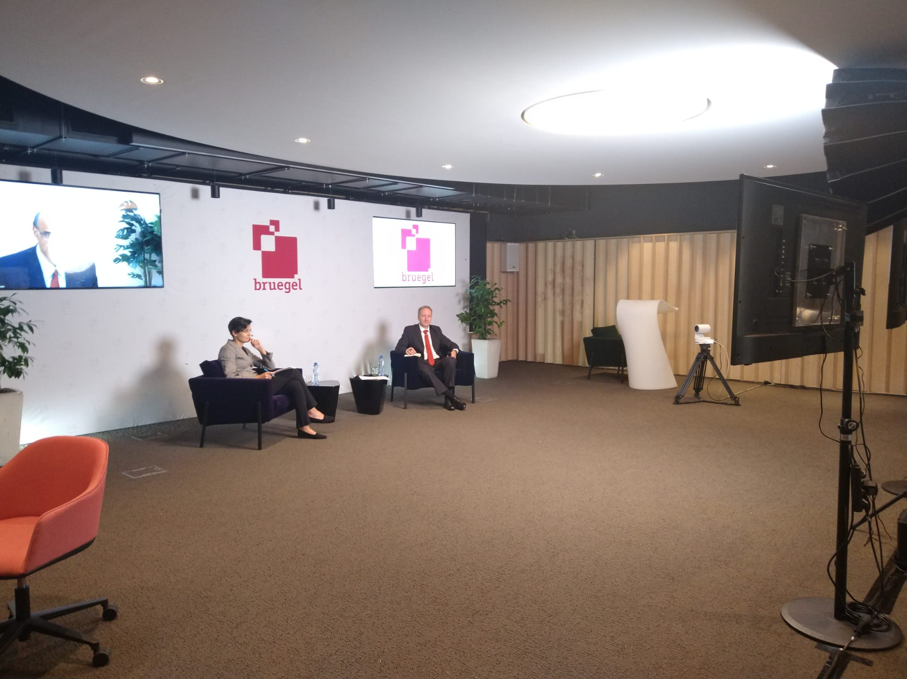
Tech
Expanding channels (Meta, X, Youtube, Linkedin) and observing how people interact on them
Equipment: strong computer, flexible platforms (Vimeo, Wirecast, Riverside, etc.), good lighting and even a better microphone
Constant keeping up (Streaming on different social media? Podcast channel?)

Slide 10
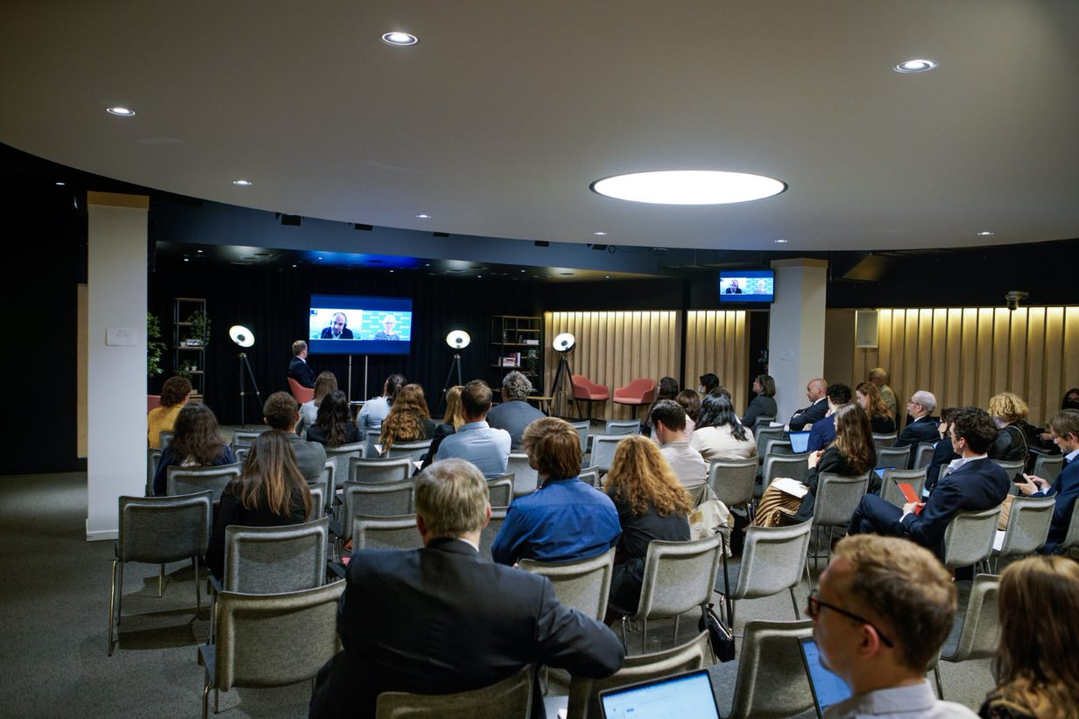
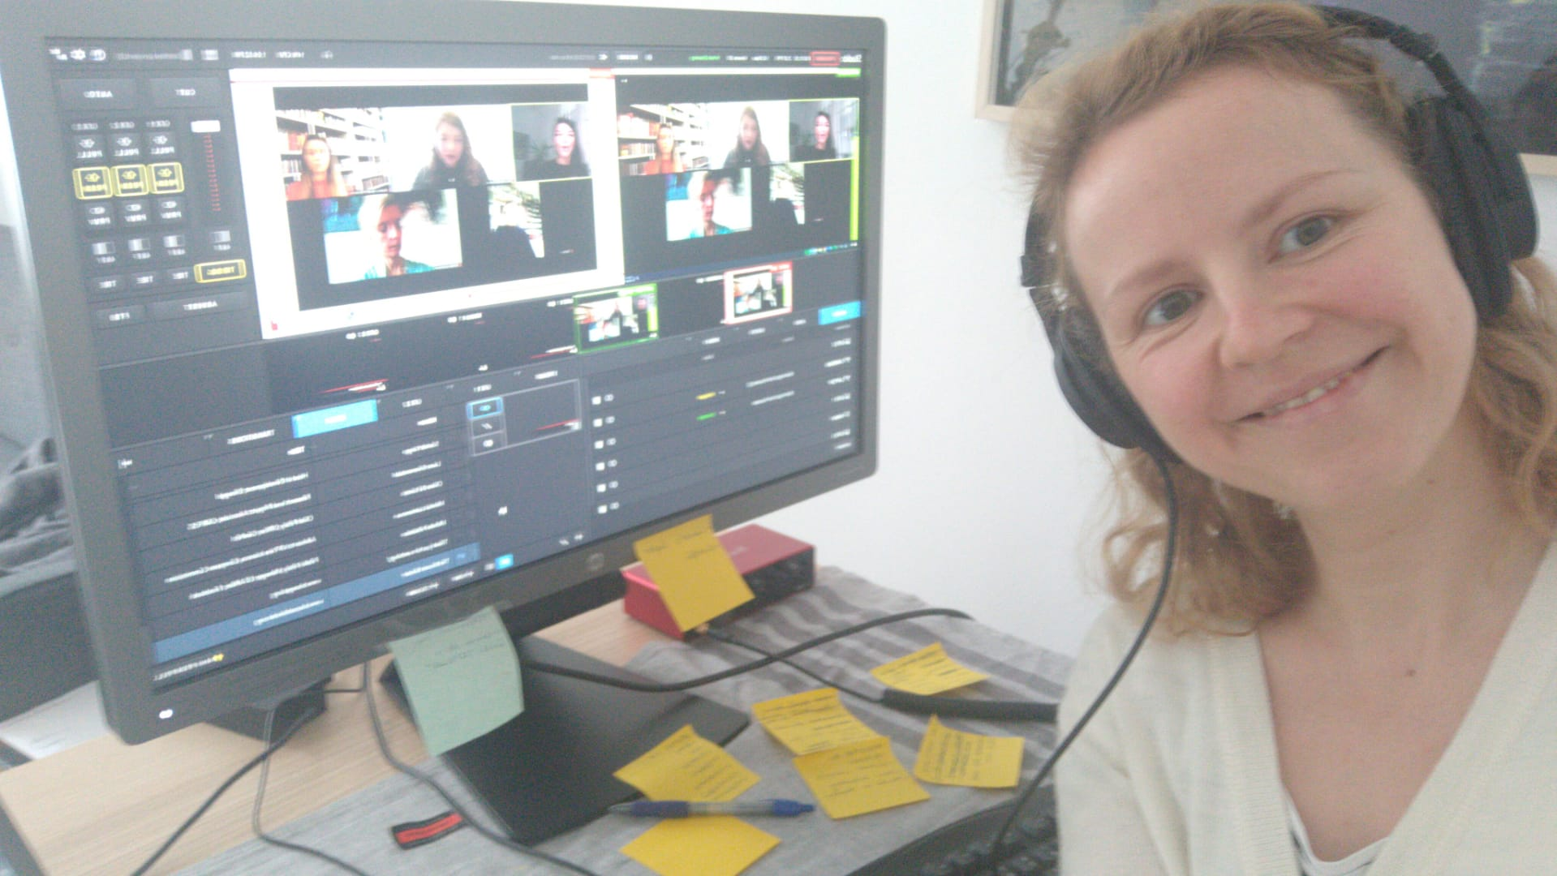
Adapt and scale
Large hybrid conference
‘Moonshine’ livestream

Slide 11
Adapt and scale
Invest in a 2h audio-visual consultation – what can you achieve with XY budget?
Mix of paid products and free online platforms
Prioritise:
good is better than perfect
technically, the most important element of an event is sound; if you must choose between a good camera and a good microphone, go for the microphone
What is the goal – networking, outreach or conversation?
Solution for every size: from simple Zoom livestream to multi-camera hybrid conference, what matters the most is the content

Slide 12
Analytics
What do you want to know?
Think of what information you may need and design your process accordingly.
Track progress and influence strategy
What you decide to do next depends on what you know.
Rely heavily on CRM database
Data = knowledge
Data analytics and visualisation courses

Slide 13
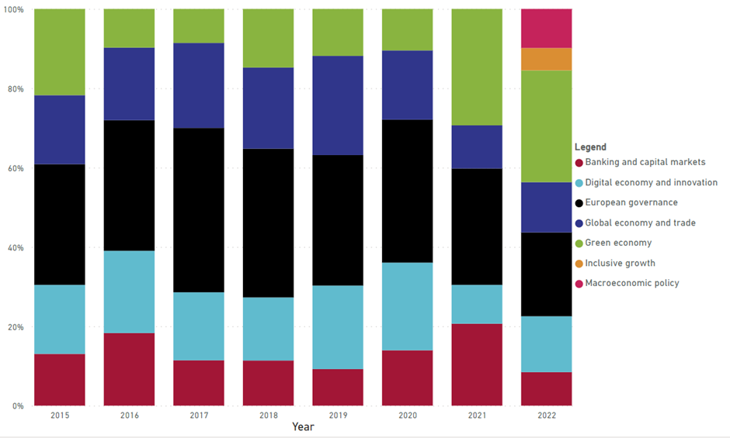
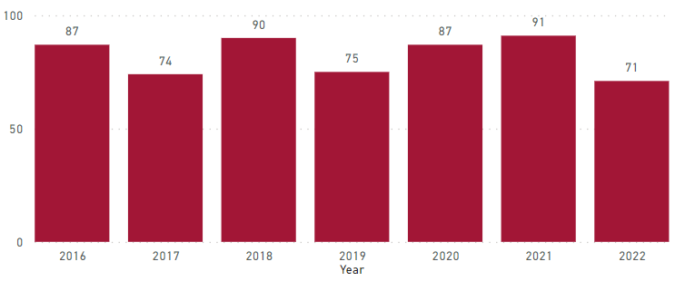
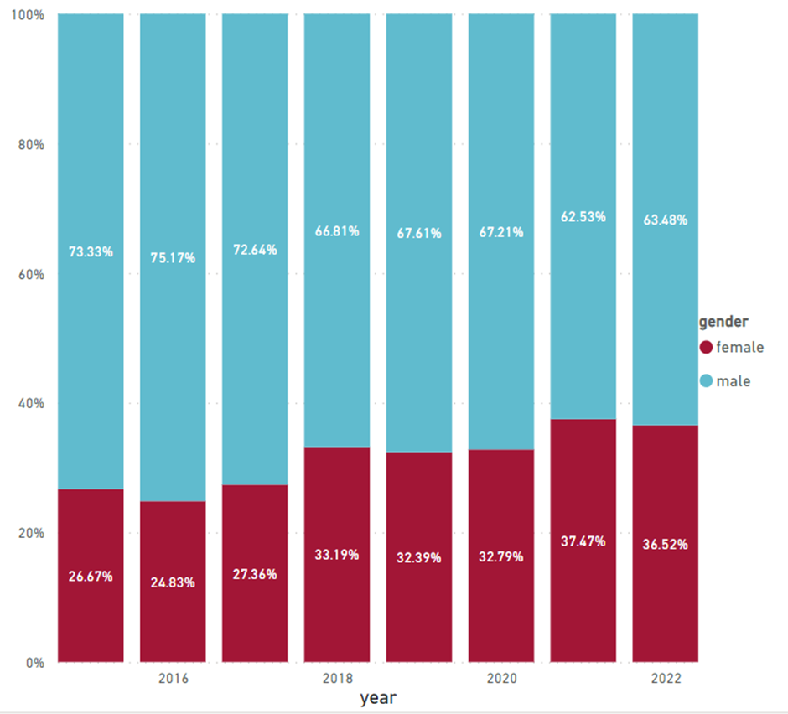
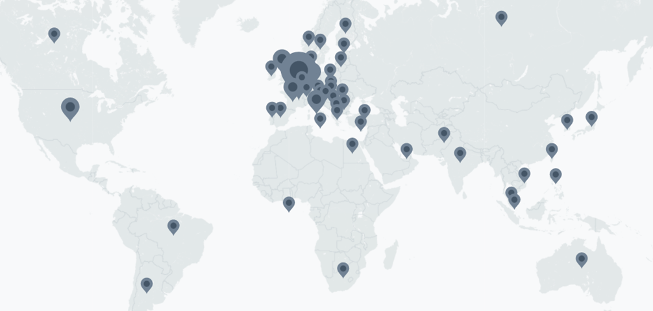
Analytics

Slide 14
Event management summary
Necessary tools: database, livestreaming tool, event space, Excel, social media.
Necessary skills: time and workload management, audio-visual technical skills, data visualization and analysis. Most important: huge emotional stamina. ☺

Slide 15
Press
Long-term investment
Building friendships, finding common interest
Understanding what the other side needs
More two-way relationship

Slide 16
Social media
Consistency (time, frequency, quality) of output
If organic, slow build over time
Results show only in the long-term

Slide 17
Get feedback
Surveys
Informal chats
Formal review

