Slide 2
Funding for Think Tanks: deconstructing complexities
Alma Kurtovic

Slide 3
1. Fundraising challenges 2. Funding vs. independance 3. Sources of revenue and funding models (=examples) 4. Fundraising mentality 6. What is a successful proposal?
Notes:
1, List different aspects challenges that need to be taken into consideration and try to adress them during the presenation
2, What we mean by « independece « and how funding can saveguard or jeopridize that
3. Specific acractheristic of each of them, what we should be aware of when opting for one or another source of revenue as our primary source
4, Funding mentality – how to put ourselves on the right « state of mind » to be successful and confident
4 and 5 – specific tips and advice on what we should pay attention to in planning and shaping a successful proposal

Slide 4
What are the challenges of fundraising for a think tank?

Slide 5
Fundraising challenge: Money vs knowledge production
Challenges:
Secure a sustainable income to carry out organisation’s mission
Ensure intellectual independence and accountability
Align funding strategy to organisational/ programmatic strategy
Balance resources between fundraising and programme planning /execution
Notes:
Thinks tanks are knowlege producing organisations – specific knowledge that has a purpose to inform, influence and imrpove policy making. Producing public good, will have externalities
Think tanks are mostly non-profit organisations (profits are not distributed to the shareholders and directors of the company, but they are redirected to programmatic activities - mission of an organisation).
Historically, this decision, for a majority of think tanks, to be a non profit, was a strategic business decision necessary to gain access to philantrophic organisations, were otherwise were forbidden to give money to profit making companies.
Knowledge production and intellectual inteventions should not be supplied by profit companies due to the risk of opportunistic behaviour and biaises in favor of specific groups of funders.
Think tanks, therefore, have a multiple challenges, not only to secure a sustainable income for their programmatic and operational activities, but also to make sure that the sources of income don’t jeopridize their independence and authenticity, or how they are perceived externally. (Give example: EU législations on competition rules in digital/ tech sector. Gatekeepers as funders of a report? We will later on show Bruegel addresses those challenges.
In aligning fundrasiing and organisational strategies, questions to be answered: what is our key audience, or beneficiaries, who are our stakeholders/ partners. How long should research project last in order to be relevant for specific policy development? What s the right balance between long-term planning and programmes, and immediate reactions to current events?
How much time should be invested in fundraising, vrs. Planning and executing programmes? Who is in charge of fundraising? How to make these efforts efficient and low-cost?

Slide 6
Funding vs independence
“can any think tank still accept funding from any source without immediately coming under suspicion of having been “bought” by some public or private vested interest?” (Transparify)
Execution of the Research Programme
Execution of Research Programme is independent
Scholars encouraged to exchange with funders while conducting research but NO consensus sought on research conclusions
Outputs signed by scholar(s), published under editorial responsibility of the Director- no institutional standpoint
Transparency
Finances: every euro cent of income is shown in the annual report
Scholars required to adhere to a Statement of Research Integrity
Scholars: declare outside interests annually (academic, media, political, national, commerical, financial etc.) and publicly
Research: Review Task Force, Scientific Council assessing quality of research output
Notes:
Statement of Research Integrity - like Hippocratic Oath
What are the measures that we can put in place to secure the intellectual dependence, BUT also to DEMONSTRATE to external stakeholders that we are not carrying out lobbying or consultancy?

Slide 7
Sources of revenue
Government (public) funding
Reliable and predictable source of funding
Difficult to secure and imply a lot of management and administrative tasks
High amount of reporting, strict deadlines, very precise deliverables
Delayed payments, issues with cash flows
Very restricted revenue, low overheads (cca 7% for EU grants)
Donations/ private grants
More volatile and peripheral source of revenue
Highly unpredictable and don’t allow organisations to base their programmatic strategies according to them
Earned revenue, service fees/ membership fees / return on investments
Less restricted and allow more flexibility in distributing te resources internally (cca 15-20% overheads)
Sources of core funding
Give more control over the content, structure and timing of management tasks
Notes:
The literature on non-profit organisations groups the sources of revenue into three-four main types/ categories.
Governmment grants: Reliable and predictable source of funding; multiannual; Difficult to secure and imply a lot of management and administrative tasks; High amount of reporting, strict deadlines, very precise deliverables; Delayed payments, issues with cash flows
Private donations/ grants: More volatile and peripheral source of revenue (smaller portion of total revenue in comparison to gov grants and earned income); Less restricted and allow more flexibility in distributing the resources internally (cca 15-20% overheads); Unpredictable and difficult to base their programmatic strategies according to them
Earned revenue/ service fees/ membership fees : selling publications, charging for events, letting the venue for conferences and events,
Give more control over the content, structure and timing of management tasks

Slide 8
Sources of revenue and funding models
Funding Model
“methodical and institutionalized approach to building a reliable revenue base to support an organization’s core programs and services” (Stanford Social Innovation Review)
PRIVATE DONATIONS/ GRANTS
GOVERNMENT GRANTS: CONTRACTS
EARNED REVENUE
FUNDING MODEL
CONCENTRATED (>60%) OR DIVERSIFIED
INDEPENDENCE
FIN. STABILITY
MISSION-STAKEHOLDERS
No ‘one-size-fit-all’ model!
Notes:
Depending on its type, its mission, services and products it offers, organisation will receive funds from one or more different sources or revenue.
Each organisation, therefore, has its individual mix or revenues that is more or less diversified or concentrated.
Each source carries its own risks and a different level of predictability (just like in a financial portfolio).
No “one-size-fits-all” advice – each organisation needs to determine what model is optimal for the type and size of impact they want to have.
Public money based
Foundations based
Members based

Slide 9
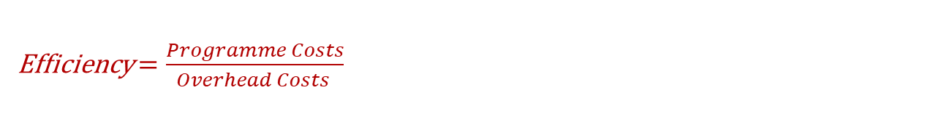
Fundrasing mentality
Efficiency $=\frac{Programme Costs}{Overhead Costs }$
Attractive to Funders!
But, be aware of…!
Starvation cycle – cutting on overhead costs leads to reduced resources and endangers viability of the organization
Think tanks should not be afraid of advertising how and why flexible funding is vital to executing their mission and strategy!
Notes:
Overhehad costs include adlinistrative costs, such as legal fees, accounting fees and executive salaries, in addition to fundraising costs. A frequent hypothesis is that the lower levels of overhead costs mean greater efficiency of organisations, and therfore attract more funders and help in securing future funding.
Strong competition and scarce resources force nonprofits to reduce their overhead expenses. In order to do that, organisations will either need to reduce the number of employees, decrease the fundraising costs, or cut down on other spending. This will further increase the risk of not securing the needed resources and endanger the viability of the organisatio – starvation process.
There is no absolute guidance on what efficiency value ought to be, neither the proporstion of less predictable sources of revenue, but we can go through a few examples and case studies.

Slide 10
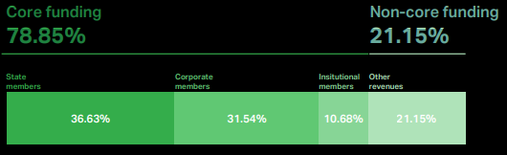
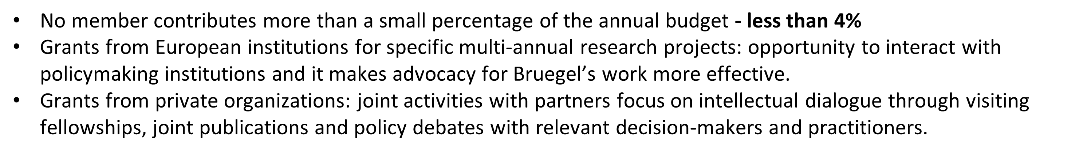
Bruegel funding model
Safeguard for sustainability, intellectual independence and stakeholders engagement
7 million
Bruegel members:
EU governments (17)
The UK government
Corporations (44)
Central banks and autonomous institutions (19)
Notes:
Goal of broad public/private balance (Minimum 33% private finance)
State members: 5 categories, from ca. €33,203 to €199,203
Corporate members: €50,000 per year, regardless of size
Institutional members: €50,000 per year (€25,000 for Central Banks of Members)
Additional resources from participation in multi-partner research projects, research grants, etc.

Slide 11
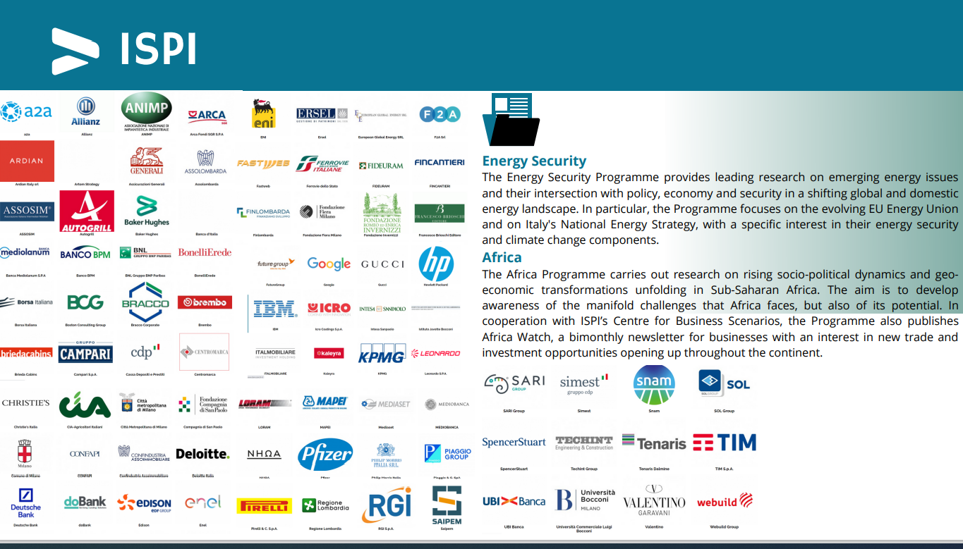
Other models: quick look
Notes:
Italian Institute for International Political Studies
Member motivator, Corporate- based - benefits for members?
Corporate programme:
Future leaders Progarmme
Ad-hoc courses for businesses
ISPI also offers training courses tailor-made training for companies , starting from associated ones, public and private bodies, foundations and non-governmental organizations .
The courses concern the topics that are the subject of ISPI's permanent research or training activities and are designed to respond to specific needs , with narrower and more selected targets. Themes, structure, duration, delivery methods and costs are therefore agreed ad hoc .
Scenario conferences
Invitation-only lectures

Slide 12
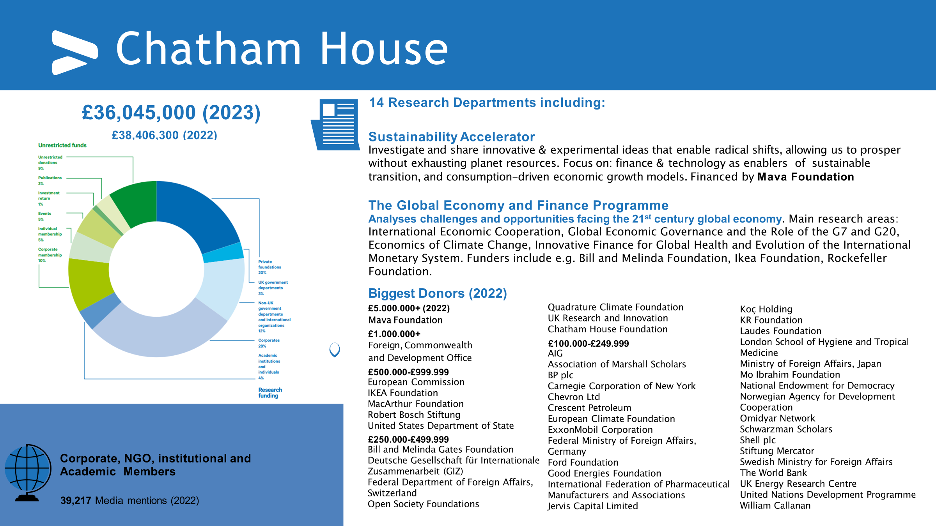
Other models: quick look
Notes:
Foundations- Big Bettor?
Big Bettor | There are a few nonprofits, that rely on major grants from a few individuals or foundations to fund their operations. We call their funding model the Big Bettor. Often, the primary donor is also a founder, who wants to tackle an issue that is deeply personal to him or her. Although Big Bettors often launch with significant financial backing already secured, allowing them to grow large quickly, some existing organization gets the support of a major donor who decides to fund a new and important approach to solving a problem.
Unrestricted funds (earned money): publications, investment return, individual membership, corporate membership
Research funding: private foundations, UK government, international organisations, corporates

Slide 13
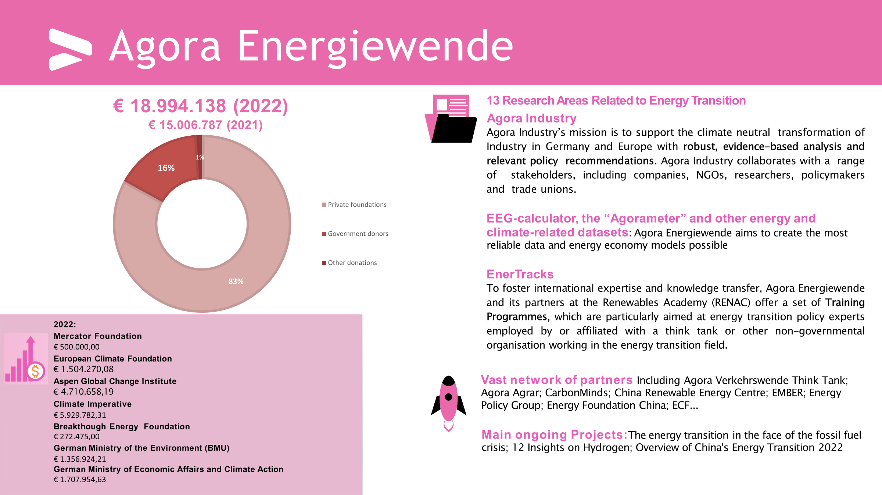
Notes:
Big Bettors often launch with significant financial backing already secured, allowing them to grow large quickly,

Slide 14
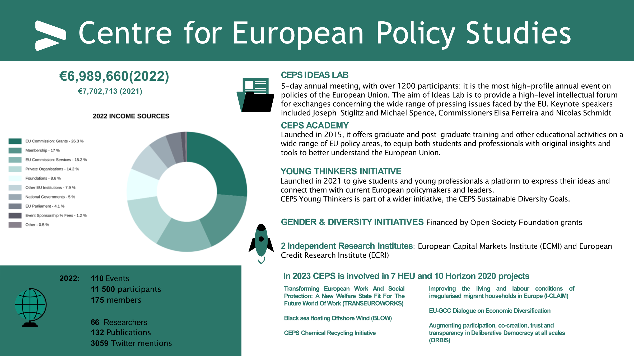
Other models: quick look
Notes:
Public funding - based

Slide 15
What is a successful proposal?
Objectives/ outcomes (IMPACT):What problem does your project wants to address and why? What are the expected outcomes? SMART: specific/measurable/ achievable/ realistic/ timely.
Results (OUTPUT): What are the expected results, specific products of this project?
Target audience (STAKEHOLDERS): Who do we want to address? Who benefits from this work?
Methodology (ACTIVITIES) once you defined objectives and results, you can then develop the list of activities
Measures of success (KPIs): show your funder the clear ways you will measure your success
Know your donors: timeline of calls, application process and requirements
Know yourself: internal strategy, goals and objectives (both short- and long-term), vision
Match interests
THEORY OF CHANGE -> ‘a method that explains how a given intervention, or set of
interventions, are expected to lead to a specific development change, drawing on a
causal analysis based on available evidence.’ UN Sustainable Devlopment

