Slide 2
Governance and Management
Sonja Stojanović Gajić,
1 February 2024

Slide 3
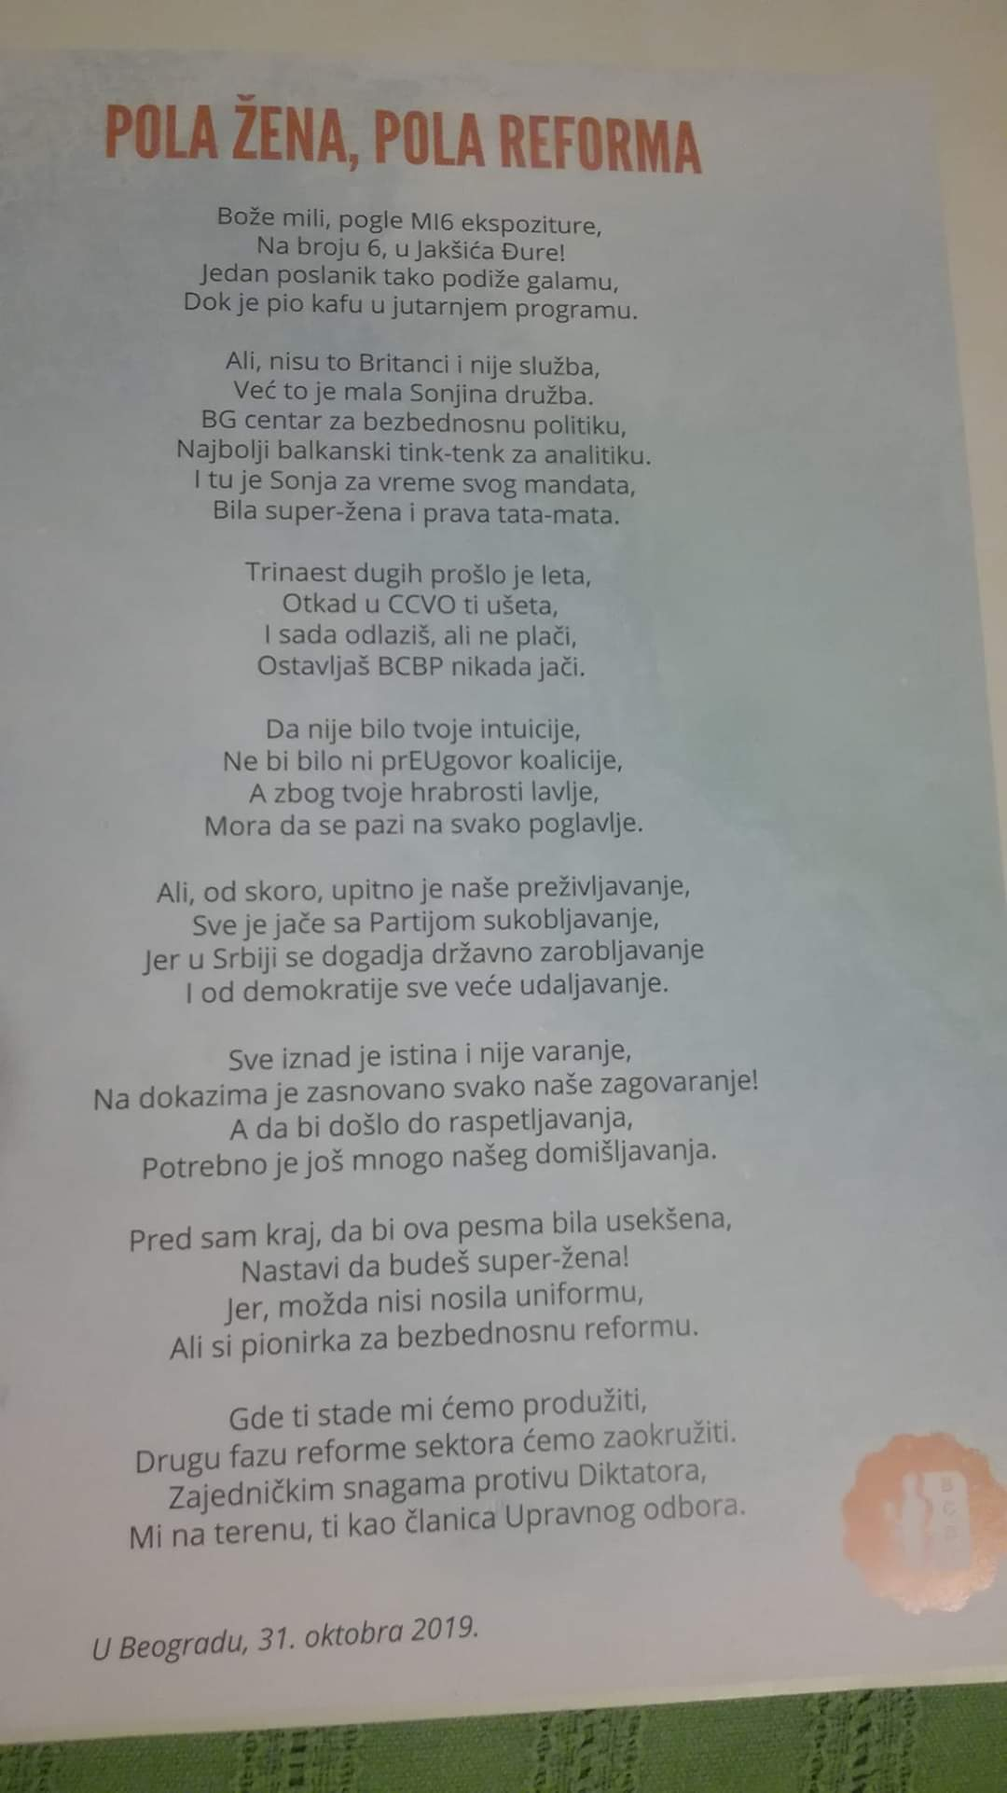
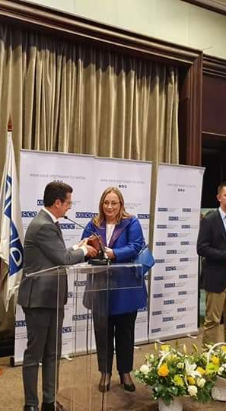
Sonja Stojanovic Gajic
In activism since I was 16. I led a student organization without budget and hierarchy. I worked for big IGO and in academia
2006-2019 Director of Belgrade Centre for Security Policy (BCSP) and helped it transform from national NGO into the internationally recognized think tank on security policy
Mixed job description: management and programme
Self-educated manager - learned by doing it and leading an organisation through change process
Set up networks and communities of practice to resolve cross-national issues
Assisted also the organisations in East Europe, Middle East and Latin America

Slide 4
Meetings
How much time (%) do you spend in meetings every week?
How much time within your organisation is spent on different regular meetings within your team?
What kind of decisions are made at different meetings?
Who is included?

Slide 5
Think tank is only as good as it is governed and managed

Slide 6
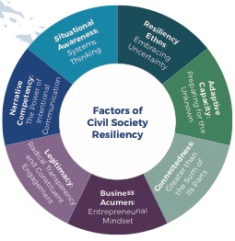
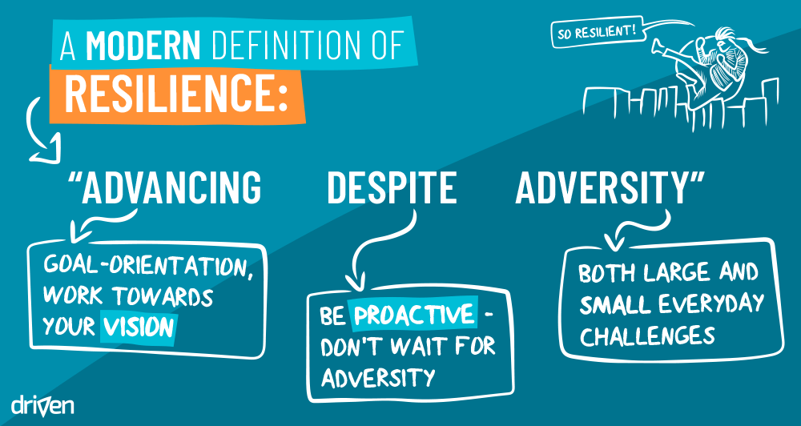
Organizational Resilience
The greater the extent of internal vulnerabilities, an organization is the more at risk in increasingly hostile external environments.

Slide 7
GOVERNANCE how we are organized within the think tank to make strategic and day-to-day decisions
Notes:
8 responses – 18 trainers

Slide 8
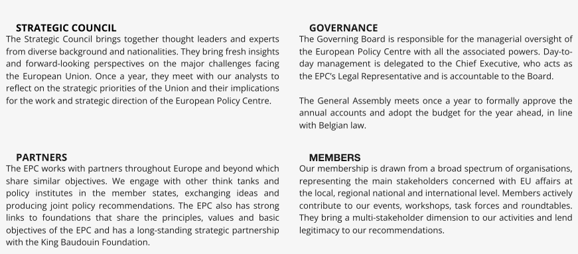
The structures of governance
What these structures are trying to achieve?
Centre for European Policy (Belgrade and Brussels)

Slide 9
Bruegel https://www.bruegel.org/about/
Bruegel’s highest decision making forum is the General Assembly consisting of Bruegel’s members. It confirms the Board and elects six of its members directly.
The Board decides on strategy, adopts the research programme and budget and appoints the Director and the Deputy Director each for a period of three years renewable twice. Bruegel’s former chairs Leszek Balcerowicz and Jean Claude Trichet are honorary chairmen of Bruegel. Mario Monti is the founding chairman of Bruegel.
The Director – is responsible for the executive management of Bruegel, with the assistance of the Deputy Director, and other managers. They prepare the Board meetings, the research programme, annual work plan, budget, and annual report and present them to the Board. The Director and Deputy are responsible for the editorial direction, exercise editorial oversight of publications and control the quality of output. Bruegel takes no institutional standpoint and publications reflect the views of the authors only.
Bruegel’s Scientific Council advises on research and provides regular academic appraisals of published papers. It is appointed by the Board and advises Bruegel’s management and staff, as well as the Board, on research. It also evaluates the quality of Bruegel’s research. The chairperson of the Scientific Council attends Board meetings. Every three years the scientific council delivers an evaluation report. This report informs the research strategy and serves as a basis for the work of the review task force, a diverse and independent group appointed by members every three years to evaluate all aspects of Bruegel’s work, from research to management (Review Task Force Report 2019).

Slide 10
Governance
  What are we making decisions about?
  What kinds of relationships are these structures supporting?
  Whose voices/engagement are included?
    A board or governing body responsible for overarching decisions and the long- term vision (independent from management).
    Executive direction: a competent manager at the centre of the organisation.
    Senior managers/decision makers with oversight over three main aspects of the
    think tank’s work: research, communications and management.
    Institutional structures that bring people, teams and roles together

Slide 11
Decisions | Board | Management with the Board | Management
STRATEGY
Mission | X
Strategic planning | X
Annual plan | X
Implementation of annual plan |  |  | X
Evaluation of strategic plan | X
Plans for major cooperation, partnerships | X
PROGRAMS
Introduction of new programmes and services | X
Policy for grant-making |  | X
Donations |  | X
Programmes evaluation |  | X
MANAGEMENT
Structure and size of Board | X
Selection of Board members | X
Selection of external audit | X
Appointment of internal audit/control |  | X
HUMAN RESOURCES
Management structure | X
HR policies | X
Recruitment and employment |  |  | X
Compensation policy |  | X
Career development plans |  | X
FUNDRAISING
Approval of fundraising plan | X
Setting annual targets |  | X
Gift/donation policy | X
Decisions on receiving grants |  | X
Capital gift/investment | X
OUTREACH
Logo/change of image | X
Communications for specific initiatives |  |  | X
Contracting advertising agencies |  |  | X
LAW - LEGAL MATTERS
Statute | X
Initiating legal procedure | X
Evaluation of legal service |  |  | X
Contracting procedure | X
FINANCE
Financial targets |  | X
Approval of operating budget | X
Capital spending | X
Costs over 1000€ outside of budget |  | X
Investment policy and targets | X
Credits | X
Reporting on financial work |  | X
Report on spending |  | X
Financial control |  | X
Financial audit |  | X
Selling property or transferring | X

Slide 12
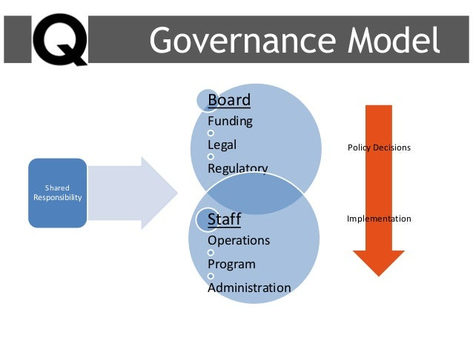
What are roles of Board(s)?
1. Legal responsibility for:
financial health of TT
compliance
risks
2. Protector of mission (delivering the change in the world) and staff
3. Supervisor of executive director (appoints, ensures transition)
4. Advisor
5. Ambassador
How to engage Board(s) in a meaningful way?

Slide 13
Assess meaningful engagement of your board
If an observer joined the board meeting, she’d know exactly whose meeting it was (the chair’s).
The board meeting agenda is well designed so we are talking about things that really matter.
I receive all the board meeting materials at least 1 week ahead of time.
The pre-meeting materials are not overwhelming. They are written not to impress me but to inform and enrich me, and I read them all thoroughly so I am prepared for the meeting.
The board feels comfortable asking the Executive Director difficult questions about strategy and impact.
We conduct a formal review of our Executive Director annually.
The staff communicates with us about accomplishments, stories we can tell, and offers us various ways to be of help to the organization. I don’t feel nagged to sell tickets, attend events, or be more diligent about fundraising.
I can clearly articulate the 5 - 7 key annual goals for the organization and how they fit into the overall plan.
I feel that all of what I bring to board service (my experience, my enthusiasm, my professional skills and my insights) add real value to the strategy and impact of this organization.

Slide 14
A planning guide for Board meetings agenda

Slide 15
Even without Boards the structure can be established in flat organisations vs. ‘we are family’ myth
Agreements and clarity and transparency
clarity of roles and division of responsibilities and the right to change
lines of responsibility (who is responsible for what...), and where is the autonomy
ways of coordination way of decision-making - democracy within the organization

Slide 16
Leadership ⌿ Management
Notes:
8 responses – 18 trainers

Slide 17

Lets picture
an Ideal Think Tank Leader
Competences
Soft skills
Education
Experience
https://docs.google.com/document/d/1HsVn9KTEDwPU5I1wdvda6qfNhWhgHBHZ/edit

Slide 18
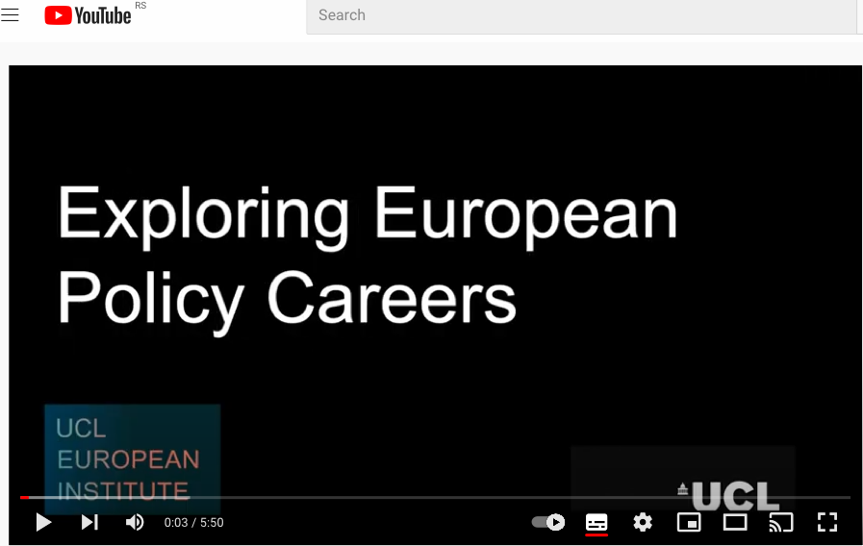
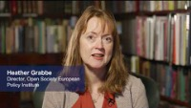
What is the job od director in European policy organisations?
https://www.youtube.com/watch?v=hY6pvXNMclI

Slide 19

Not ideal, but good enough leader
I always say that think-tank Directors are doomed to fail, because the job description is so wide. How can you be the world’s best researcher, best communicator, best fund-raiser, best leader of change, and best manager, all at once? Of course, you can’t.
Simon Maxwell, former director of the Overseas Development Institute.

Slide 20
Differences of responsibility
DIRECTOR | MANAGER
Manages managers | Oversees staff
Corporate initiatives | Day-to-day concerns
Strategic vision (what would success look like) | Project/team success (deadlines, outcomes…) or implement existing strategies
Organizational processes | Implement procedures
Management, involves the practical aspects of the organisation’s functioning: team and project management, staffing, line management and so on (Mendizabal, 2014)

Slide 21
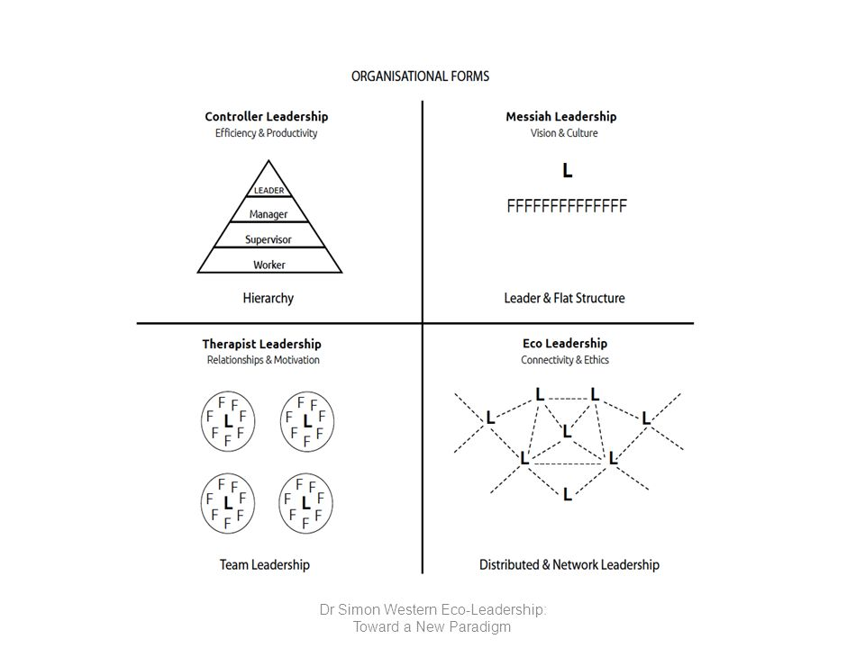
Networked Leadership
(especially in the context of hybrid work)
https://www.ecoleadershipinstitute.org/what-is-eco-leadership

Slide 22

What keeps directors awake at night?

Slide 23
Internal relations
Notes:
8 responses – 18 trainers

Slide 24
Internal relations
HR relationships within (the team – research role)
HR – profile of the think tankers (young graduates vs. established individuals)
Career opportunities (professional development) – what is career progress? Compensation and employment policy. Where do people go afterwards?
Management of non-permanent or volunteer staff
Development of team leaders and middle management: How to transition from technical ‘expert’ position to the management role?
In unstable context - how to protect staff from external threats and burn out

Slide 25
Team Relationships
Status and purpose - recognition of value, pride and awareness of power and privilege in the team
Certainty - predictability through routines, boundaries and thinking about the future
Autonomy - possibility of choice, voice and control
Connection - social connections give us a sense of security
Fair relations - fairness within the organization
Leading by example - 75%
Space for conflicts
Room for mistakes
Pride and purpose
Connection

Slide 26
External relations
Notes:
8 responses – 18 trainers

Slide 27
External relations/partnerships, politics
How important are external contacts and networks?
Politics
Relationships with other stakeholders

Slide 28
How to manage external risks?
Plan B – getting ready to respond to risks and how to use non-violent techniques
let's reduce external uncertainty through joint reflection
  why we do what we do and
  what we won't do marathon stride prediction
  Foresight - Anticipating future scenarios instead of constantly reacting
  linking with important partners
trauma prevention and recovery support - support groups

Slide 29
Key takeaways:
Governance is the time you dedicate to working ‘on’ your business, rather than ‘in’ it.
Design governance systems that fit your context, organisational cultures, mission. Governance is not about formal structures, but also processes, practices, routines, people and culture nurtured.
Successful boards are diverse and engaged in a meaningful way, without interfering with day-to-day management of organisation.
Leaders are not born, but made. The successful leader is the one that helps others be their best and take responsibility for the organisation.

Slide 30
Useful resources
Notes:
8 responses – 18 trainers

Slide 31
Useful resources on governance and Boards
https://onthinktanks.org/series/think-tanks-governance-management/
https://onthinktanks.org/articles/creating-an-environment-conducive-for-success-a-think-tank-is-only-as-good-as-it-is-managed-and-governed/
Composition and structure: https://onthinktanks.org/articles/think-tank-boards-composition-and-practices/
Tools for Board members https://leadingwell.org/resources/
Boards in NPOs https://www2.deloitte.com/content/dam/Deloitte/ca/Documents/public-sector/ca-en-public-sector-effective-npo-board.pdf
Distributed leadership https://buildingmovement.org/wp-content/uploads/2019/08/Structuring-Leadership-Alternative-Models-for-Distributing-Power-and-Decision-Making-in-Nonprofit-Organizations.pdf

Slide 32
Useful resources on leaderhsip
Think Tank Leadership: Functions and Challenges of Executive Directors https://onthinktanks.org/wp-content/uploads/2021/06/OTT_WP9_Think-Tank-LeadershipFINAL.pdf
Ajoy Data on networked leadership
https://onthinktanks.org/articles/what-shapes-the-authority-and-power-of-leaders-and-their-followers/
https://onthinktanks.org/articles/in-charge-but-not-in-control-lessons-from-leading-teams-in-a-networked-world/
Enrique Mendizabal https://onthinktanks.org/articles/what-keeps-think-tank-directors-up-at-night-reflections-on-funding-staffing-governance-communications-and-me/
Think Tank Director Profiles and how to replace them https://onthinktanks.org/articles/directors-profiles-and-how-to-replace-them/
Why pay attention to management
https://onthinktanks.org/articles/why-pay-attention-to-management-the-managing-think-tanks-series/

Slide 33
Stay in touch
Sonja Stojanović Gajić
Twitter: @StojanovicSonja
LinkedIn: @SonjaStojanovicGajic
Academia: https://ucl.academia.edu/SonjaStojanovicGajic
ResearchGate:
E-mail: sonja.stojanovic.gajic@outlook.com

Slide 34
Finance for
Non-financial Managers
Sonja Stojanović Gajić
01 February 2024

Slide 35
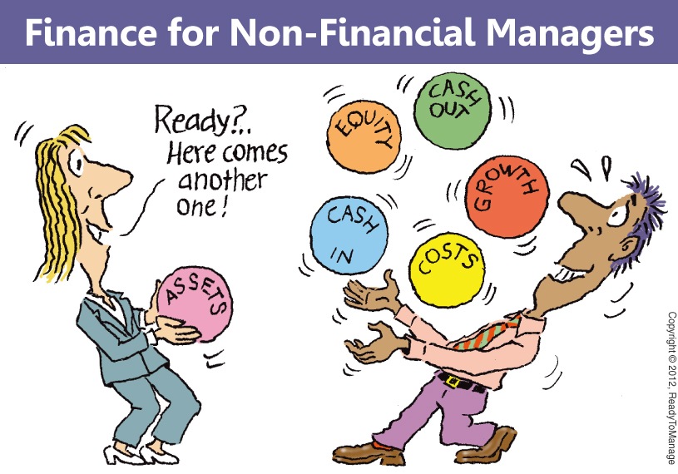
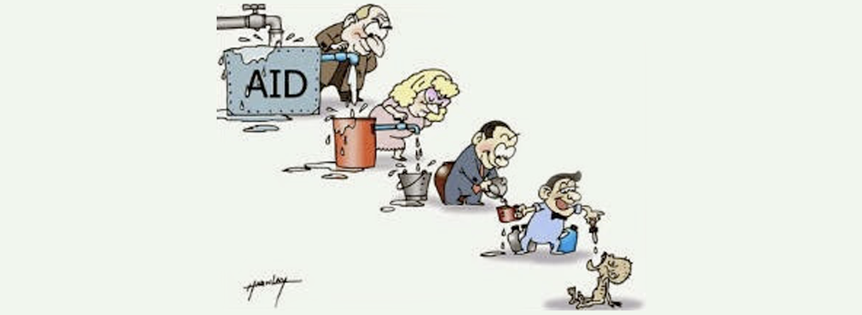

FOCUS
FINANCIAL MANAGEMENT &
LEADERSHIP IN OLD NORMAL
FINANCIAL HEALTH
IN THE CRISIS

Slide 36
BCSP budget over years in Euros
The oldest organisation in the Western Balkans focussing on accountability of security institutions (police, military, intelligence….) since 1997
Among bigger ones in the region of South-East Europe – mid-income country
2008. | 2009. | 2010. | 2011. | 2012. | 2013. | 2014. | 2015.
340,337 | 378,649 | 374,574 | 411,637 | 404,632 | 522.805 | 667.694 | 589.659
2016. | 2017. | 2018. | 2019. | 2020. | 2021. | 2022 | 2023
446.000 | 509.878 | 471.285 | 417 | 636.111 | 700.000 | 1 054000 | 1220000

Slide 37







How do you feel about finance management and fundraising?

Slide 38
INTRO SURVEY https://docs.google.com/forms/d/e/1FAIpQLSfP67FsDVfRcRvMVcLuZxy5uy0wWMkRVnDrJG6bgPS4PVpcsQ/viewform

Slide 39
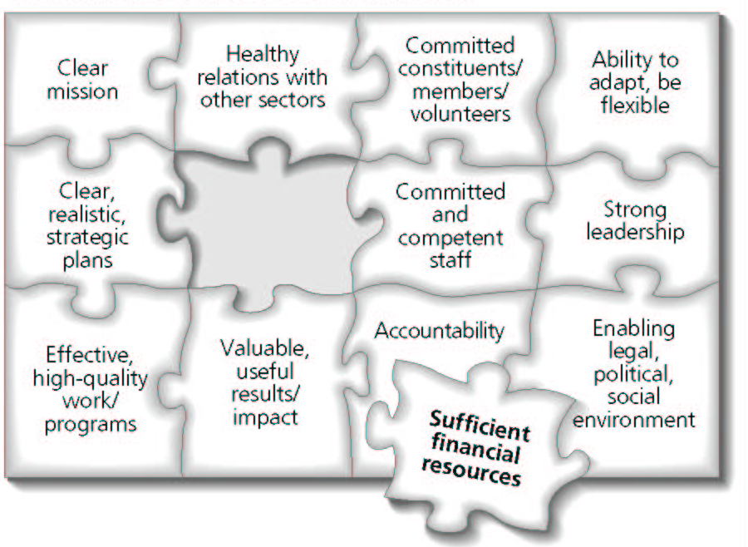
Financial Suistanability is just a componet of Organizational Sustainability
Organizational sustainability is not strictly a financial consideration;
Financial sustainability is only one of several factors contributing to a TT’s overall sustainability and resilience;

Slide 40
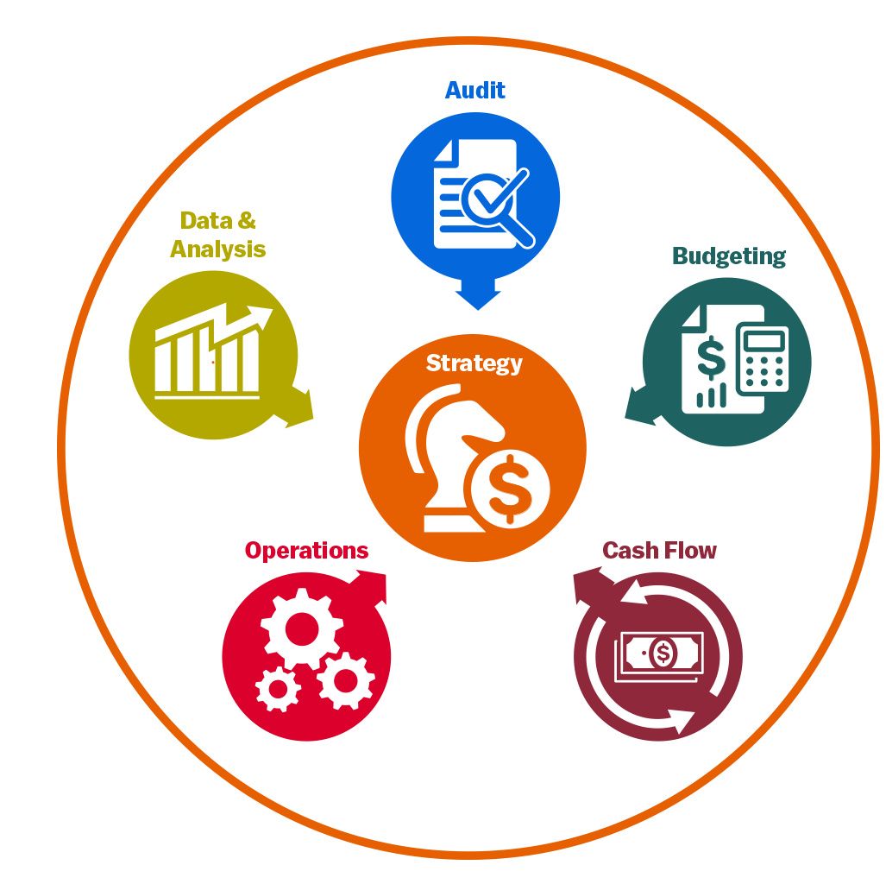
Pillars of Financial Management
Business and Financial Model
Budgeting (costing, revenues and operating reserves)
Budget monitoring cashflows
Operations: division of labour, responsibility and reporting
Accountability, transparency and integrity

Slide 41
Difference between business and funding models

Slide 42
 | Business Model | Funding Model
Focus | Value creation (unique) and delivery, cultivation of trust and reputation | Revenue generation – what kind of sources? What is the proportion of different sources in the budget? What is duration/funding circles? The cost structure: % operational costs (rent, research, overhead…), partner costs…
Activities | Research performed and communicated | Raise, receive, account for, report on funds
Staff | All staff, Board, peer-reviewers | Director, Financial Officer (+book-keeper, auditor), Board Project Officer or Researchers or specialized fundraising team
Goal | Organisation is empowered to achieve its mission on a continuous basis | cash in the bank, audit reports signed off, funders’ support maintained over time due to correct financial processes and management
Key stakeholders | Research community writ large, policymakers, private sector and third sector actors, donors, ordinary citizens | Donors (individuals, companies, governments, philanthropic organisations)

Slide 43
 | Business Model | Funding Model
Example statement | Organisation X conducts and disseminates original research on key public policy issues in Country Y. It receives financial support from: three sources, which enable it to employ the services of a team of professionals, including a high-level and widely cited and respected policy researcher. The director of Organisation X is widely regarded too by the research community, and its Board is made up of individuals that leverage their positions to create new policy influence and funding opportunities. | Organisation X derives 20% of its budget from subscriptions to its flagship publication; 30% from research contracts; and 50% from international sponsors. This funding model requires the full-time services of a book-keeper, the part-time services of a financial manager, and an external audit partner. The inputs of middle-management and the organisation’s director are also required month-on-month to ensure steady revenue generation and correct financial reporting.

Slide 44
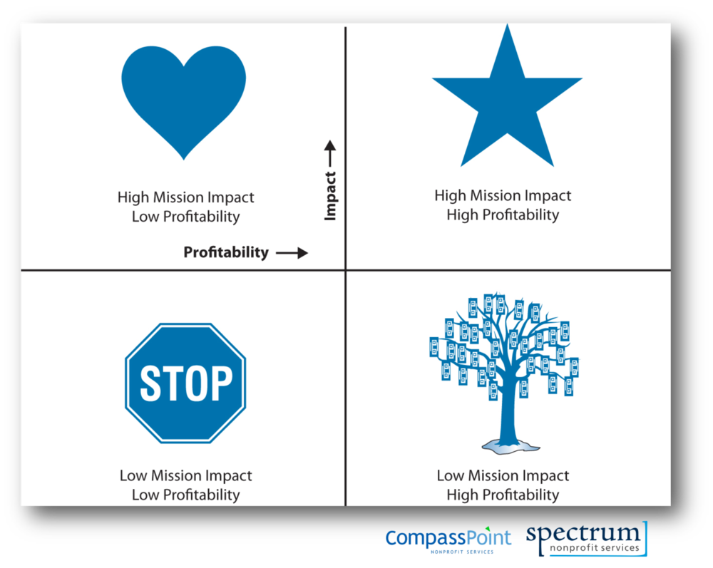
Suistanability Matrix
It is about finding the right mix for your organisation:
Fits your mission
Combination of sources and types of funding (not all eggs in one basket)
Allows you to do your core work (long, reasonable costs)
https://nonprofitquarterly.org/the-matrix-map-a-powerful-tool-for-mission-focused-nonprofits/

Slide 45
The adaption to the external context is required to continue succeeding e.g.
What are sources of money to be found?
Policy environment: Is there demand for research?
Thinking about the Implications on:
  human and other costs of running organisation: Research, Staff & Project Management, Communications, and Policy influence.
  in the project market (partnerships, brand communication, quality control, transparency and strategic orientation)
  in managing relationships with funders: balancing demands and interference (how to guarantee independence?)

Slide 46
The Transformation of BCSP’s business and financial model to the context
Years | Context | Business Model | Capacities | Funding Model
1997-2000 | Authoritarian Closed Country under international Sanctions | Activist NGO | Ideas and activism of 2 founders supported by friendly CSOs | No money, no trouble
2000-2006 | Democratic Transition Golden Area of donors’ interest No competition | NGO with focus on research | Founders and external research associated All in 1 person admin/finance | Projects from donors
2006-2012 | Democratic Consolidation Increased national competition | Transformation into Think Tank until 2010 Regional Leadership | 2 members in the Finance Team + 1 all other admin Comms team | Institutional Funding with smaller other projects

Slide 47
The Transformation of BCSP
Years | Context | Business Model | Capacities | Funding Model
2012- 2015 | EU Integration and the EU as a main donor in town Peace Talks on Normalisation of Relations with Kosovo Dense regional and national competition | Think Tank with Regional Focus Policy Broker on Dialogues | Same Project writing for all research staff as project management is with researchers Advance financial procedures and organisational audit | Phasing out institutional support 2015: no 2014: 10% 2012: 40%
2014 - 2019 | State Capture Closing civic space and media freedoms Huge competition from other types of organisations (investigative journalists, fake NGOs) EU is the biggest and most cumbersome donor, bilateral donors retreat | Think Tank focusing more on citizens and other democracy-defenders | 2 person finance EU funding Income-generating activities Thinking of professionalization of project management & fundraising role | Mixture EU different types International donors (govs and foundations) Income through consultancy work No gov funding

Slide 48
The context matters for funding opportunities
POLICY ENVIRIONMENT: Is there demand for research and what is a competition?
A lot of media interest in security topics, but on wrong topics. The War in Ukraine shifted the focus away and more to the geo-political competition. Democratisation agenda is almost dead on donor’s agenda. How to stay true to the mission?
FUNDING ENVIRIONMENT: Is there money to be found?
Foreign funding sources for civil society: the biggest is EU, but few cumbersome opportunities as it is very demanding for administration (co-funding demand, liquidity), Bilateral donors retreat from the Balkans except Kos & BiH. A number of small grants by individual foundations and embassies. De-legitimisation of foreign funded NGOs
Government funding: The biggest donor at the local level – non-transparent, funding technical & QUANGOs. Not any more independent oversight bodies (e.g. Anti-Corruption Agency, Ombudsperson) used to have transparent competition for NGO funding
Private/corporate funding for our policy area is limited and dubious
Increased opportunities for consultancy work and academic and international partnerships
Crowd-funding for think tanks is a terra incognita

Slide 50
FUNDING MODEL | Research Agenda | Policy Influence |  |  | Staff | Fiscal Stability
 |  | Allows to conduct relevant research? | Allows to take advantage of policy windows? | Covers operating costs
Core/Institutional funding
Grants/ Project Funding
Corporate or Private Sector Funding
Government funding
Membership
Crowd-funding
Consultancy work (service and product sold commercially)
Academic research funding
Endowment

Slide 51
Revenues: Understanding the Options
Gifts and Grants
Here are some typical sources and pros and cons.
Source Description | Pros | Cons
Individuals | Donations tend to be less tied to specific program outcomes, more untied revenues. Can provide ongoing revenue streams if repeat donors. Individuals can be cultivated over time for larger gifts. | Building an individual donor base of repeat donors who give increasing amounts is a long term process that requires continuous communication.
Corporations | Tend to fund projects with high levels of visibility and marketing opportunities. | Often ask for names to appear on publications, events etc. also smaller amounts for the most part. Fluctuate with corporate profits.
Foundations | Tend to fund innovative projects | With a few exceptions fund the same organization for no more than a few years
Government | Fund larger scale projects or smaller short term one year projects, risk of politization | Require a great deal of report detail. Restrictions on line items expenditures Change with each election
National/ International Agencies | Grants tend to be significant size and require significant capacity to manage | Discontinue funding when region no longer of strategic interest. High reporting requirements

Slide 52
Funding Mix – Types of Revenues
REVENUES (EUR) | 2015 | 2016
Grants (International Contributors) | 83,9% | 82,9%
Grants (Domestic Contributors) | 10,4% | 2,8%
Earned Income - Consultation Services (International Contributors) | 0,2% | 9,2%
Earned Income - Consultation Services (Domestic Contributors) | 5,3% | 2,0%
Other income (Reimbursement of maternity leave, etc) | 0,2% | 3%

Slide 53
SUCCESSFUL FUNDING

Slide 54

Is this Sustainable Think Tanks Financing?
more steady flow of secured income - reliability
diverse funding sources, decreased dependence - diversification
more unrestricted income (reserves) - flexibility
ability to think and plan more long-term

Slide 55
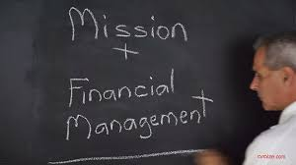

Under which conditions are we getting funds?
Relationship to mission: Does this source enhance or detract from your mission? Does it enhance or detract from your reputation?
Acceptable conditions: Whatever administrative, contractual and/or programmatic conditions are attached to funds, they should enable the think tank to do their policy work to the best of their abilities.
Independence: A basic condition of a good funding model is for it to guarantee that a think tank remains independent to govern itself and define its policy research agenda: deciding how to run the organisation, which issues to pursue, etc.
Transparency: A growing concern related to funding models has to do with being able to track the origin of funds that think tanks receive and the main conditions attached to them.
Visibility: Does this source have positive public relations or visibility benefits? What are the costs to our reputation and credibility?
What are the costs and investments required in relation to benefits:
Start-Up Costs: How difficult and costly is it to begin receiving income from this source?
Continuing Costs: How difficult and costly is it to obtain this source of revenue (staff time to perform work or report, infrastructure investment, etc.)
Organizational Capacity: Do you have the capacity (staff, infrastructure, financial, cultural) to develop and maintain this source?

Slide 56
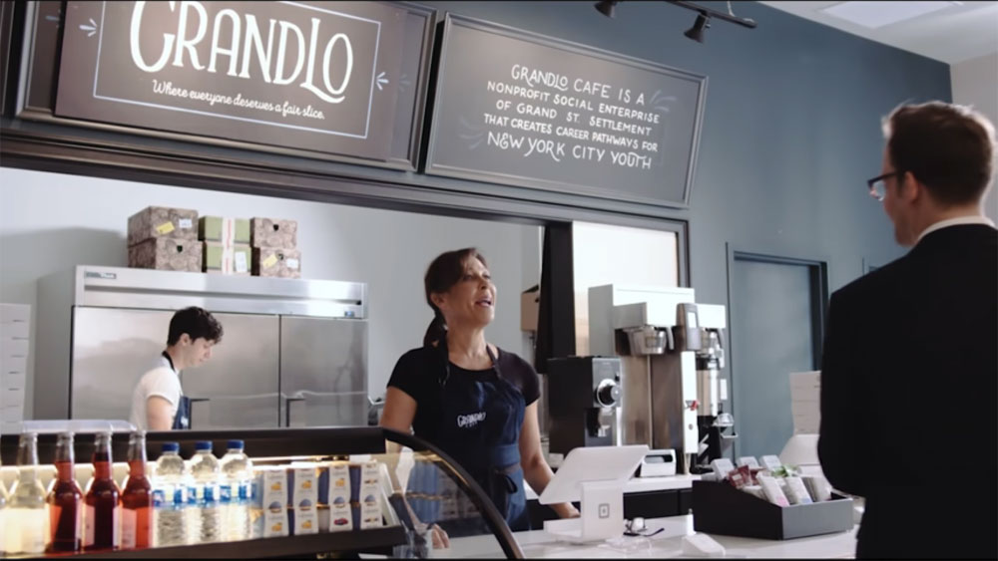
Lesson:
Make your organization’s matrix for
assessment of funding opportunities
Dillema:
Who should be in charge of fundraising: research or specialised person/team
“What if pizza shops were funded like non-profits?”
https://youtu.be/-gELZnORV4U

Slide 57
Lessons learned on budget structure
Growth is not necessarily a good thing! Increased budget over years, but not operational budget same
Partnerships are both an opportunity (for longer programme research and advocacy and defense against attacks) and challenge to manage (coordination costs and high burden on financial staff of coordinator, co-funding requirements)
Description | 2014 |  | 2015
BCBP SHARE | 269 | 58% | 510.096 | 87%
PARTNERS SHARE | 191 | 42% | 75.087 | 13%
Total EUR | 460.000 |  | 585.183

Slide 58
  A budget is your organization’s strategy expressed in currency.​
  1. Core organisational budget
  Salaries 23%
  Office costs 8% (11% with admin staff)
  2. Program costs
  Capacity building 3%
  Comm/advertisement 1%
  Public opinion survey 2%
  Publications 7%
  Other activities 23%
  3. Capacity-building and investment
  4. Contingency
  Lesson: For balanced budget, you may will need the reserve or unrestricted funds!

Slide 59
What are the resources to be used to most effectively meet your mission and that your organization remains sustainable and accountable to its stakeholders​?
Assemble a budget team (CEO, CFO – finance manager, development-fundraising person, program managers)
Create a budget calendar – enough advance time for this process
Prepare for budget process (set financial goals, reserves, data on spending for few years e.g. the types of costs donors do not want to support, kickoff mtg)
Build the budget (budget expenses: direct to delivery of services e.g. program costs, shared expenses and overhead, fundraising costs…), Revenues and risk analysis less predictable (scenario planning for risks), secure Board approval (finance committee)
Monitoring the budget
  Budget-to-actual revenue and expenses – program managers
  Executive director –budget-to-actual revenue and expenses for each program and organization-wide, balance sheet, year-end forecast,
  Board – same plus Dashboard (% against targets)

Slide 60
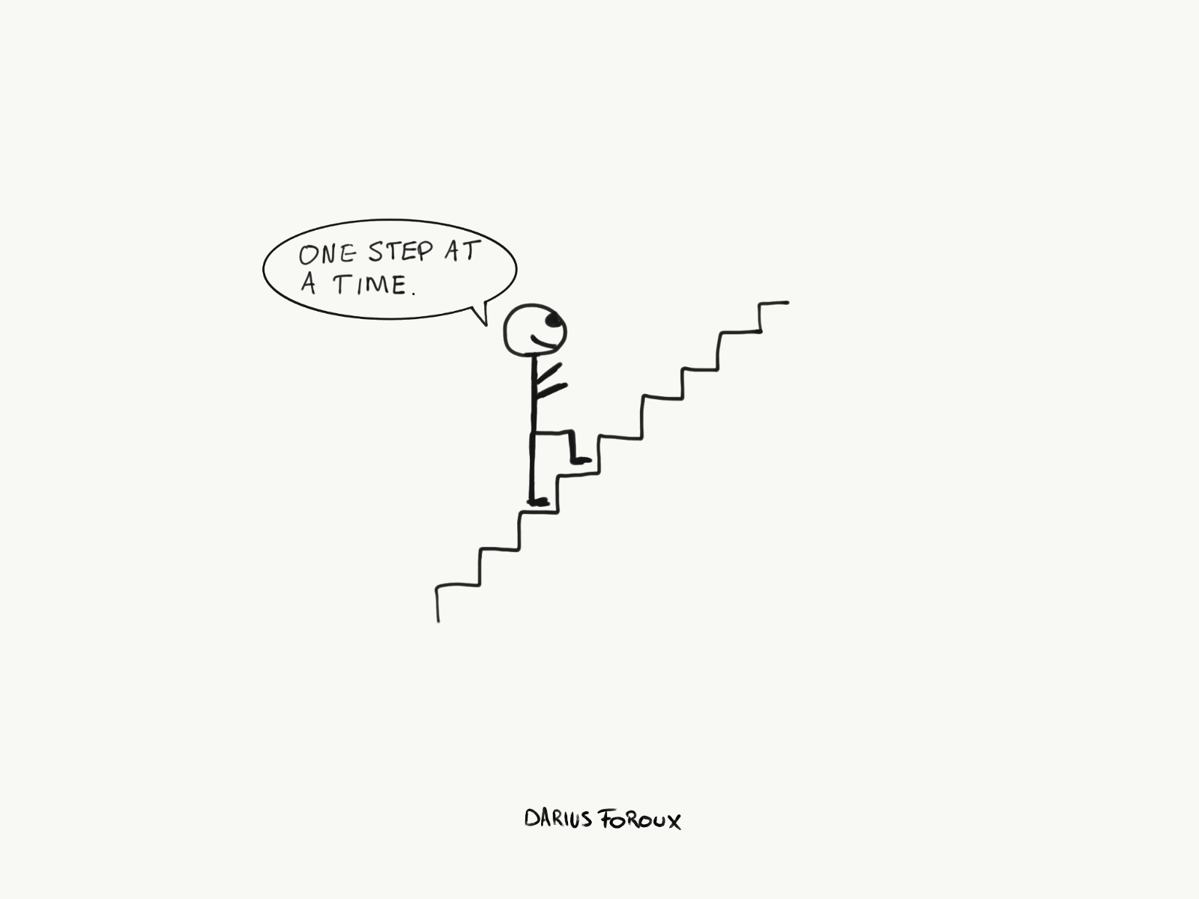
  ORGANISATIONAL CAPACITY for
  sound financial management and accountability matters for your internal and external credibility, fundraising.
  Keeping track of income and expenses.
  Which are essential procedures/organizational budget, standardized coding costs and then different attribution (project, staffing…)
  Creating a sound finance team: roles and responsibilities.
  Know your targets for fundraising and reserves!
  How to be transparent? Lessons from Transparify https://www.transparify.org
  Check out and adjust templates to your context (demands by domestic legislation, foreign funders….)
  https://www.wallacefoundation.org/knowledge-center/resources-for-financial-management/pages/default.aspx
  MANGO Guide for Financial Management for Non-profits https://humentum.org/free-resources/guide/free-downloads?

Slide 61
Mistake of forgeting about Liquidity not just what an organization’s revenues and expenses look like, but when they come and go
an organization with a balanced (or even surplus) budget can still end up running out of cash healthy cash balance doesn’t necessarily translate to cash fluidity. For instance, particularly in organizations that have multiple streams of funding for individual programs (where, as alluded to earlier, some money is restricted to certain activities), it is easy to lose track of the purposes for which each stream may be used. You may have enough money to run the program, but the money may end up being spent in ways other than what each funder requires. o the costs….
Contracts with government entities pay for services only after the services are delivered, forcing the service-providing nonprofit to cover the initial outlay of cash
Calendars of foundations vary
If neither reserves nor credit are options in a cash crunch, nonprofits may be forced to resort to less appealing means of riding out the storm.
approaching funders for accelerated or advanced payments
delaying payment of certain noncritical vendors.
a loan from a staff or board member, which could raise conflict-of-interest concerns.
the worst-case scenario is delaying payroll for some or all staff
https://www.wallacefoundation.org/knowledge-center/resources-for-financial-management/pages/cashflow.aspx

Slide 62
FINANCIAL MANAGEMENT AND LEADERSHIP DURING
A CRISIS

Slide 63
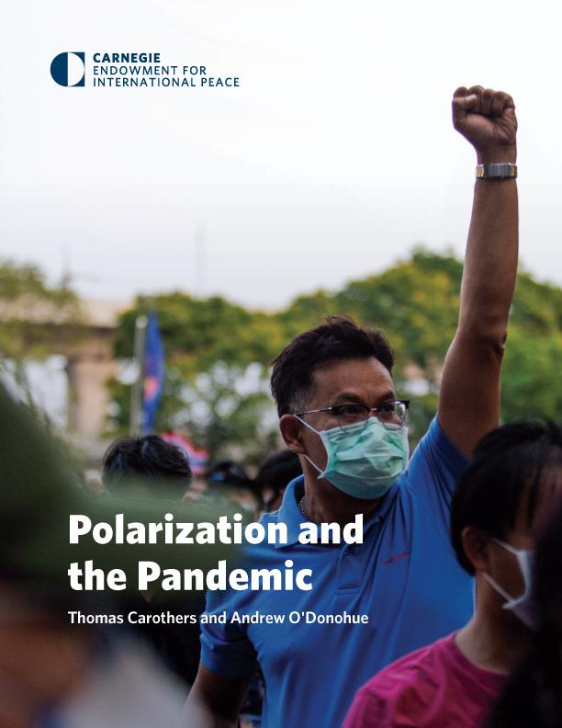
Financial management in the crisis
Increasingly unpredictable revenue
Foundations recive the income from stock market
Donors are under the pressure to re-direct funding to Ukrainian assistance and geo-political competition
Expectation of funding to decrease E.g. almost half of members (48%) of BOND, the leading UK network of INGOs leading on international development do not see themselves operaing in 2 years time
Restrictive and polarised envirionment
Foreign agent argument
”Bad” guys funding more
Notes:
Link to the surveys:
BOND https://www.bond.org.uk/news/2020/10/falling-income-redundancies-and-programme-cuts-can-ngos-survive-the-next-two-years
OTT https://onthinktanks.org/publications/covid-19-first-survey-results/

Slide 64
Group Work
Group 1 - Good practice of costing for project (how do you get money for indirect costs…)
Group 2 - List the possible ways to earn income and make reserve: sources, benefits, downfalls, best practices
Group 3 - Create demand and donor for unpopular topic or for which there is no call

Slide 65
USEFUL RESOURCES

Slide 66
Recommended reading
https://nonprofitquarterly.org/pizza-and-a-laugh-a-reminder-about-your-nonprofit-financial-stress-level/
On Think Tanks’s section devoted to funding for think tanks: www.onthinktanks.org/themes/funding-and-supporting-think-tanks
Nine webinars on sustainability https://onthinktanks.org/resources/nine-webinars-on-sustainability-for-think-tanks/ (recommend How to create a smart project budget for a think tank & Evidence-informed Fundraising Strategy)
Politics & Ideas has a collection of articles that are based on a series of online course on funding models, which were delivered to dozens of think tanks in 2015, 2016 and 2017: http://politicsandideas.org/tag/funding-model

Slide 67
Recommended reading on nonprofit finance and crisis
NPQ (2010) The Four Horsemen of Nonprofit Finance Apocalypse https://nonprofitquarterly.org/the-four-horsemen-of-the-nonprofit-financial-apocalypse
NPQ (2020) Sustanability to Survavibility: 5 Nonprofit Must-Do’s in the Time of COVID https://nonprofitquarterly.org/sustainability-to-survivability-nonprofit-finance-must-dos-in-the-time-of-covid
Cash Flow Nonprofit Model https://nonprofitquarterly.org/cash-flow-nonprofit-business-model-question-whats-whens
Bond – 4 ways funders are supporting NGOs https://www.bond.org.uk/news/2020/04/4-ways-funders-are-supporting-ngos-and-responding-to-coronavirus

Slide 68
How to manage finances in nonprofits
https://www.wallacefoundation.org/knowledge-center/financial-management-for-nonprofits/pages/default.aspx
MANGO Guide for Financial Management for Non-profits https://humentum.org/free-resources/guide/free-downloads?
Executive directors guide to financial leadership https://nonprofitquarterly.org/executive-directors-guide-financial-leadership-2
Financial stress forecasting tool https://onthinktanks.org/resources/think-tanks-stress-test-a-forecasting-tool/
Transparify - transparency of funding https://www.transparify.org/our-methodology

Slide 69
Stay in touch
Sonja Stojanović Gajić
Twitter: @StojanovicSonja
LinkedIn: @SonjaStojanovicGajic
Academia: https://ucl.academia.edu/SonjaStojanovicGajic
E-mail: sonja.stojanovic.gajic@outlook.com

