Slide 1

The Brussels Binder:
more diverse women’s voices in European (policy) debates
Scarlett Varga, SecGen @Bruegel
2 February 2024

Slide 2
Biaised much?
Caretaker
Entrepreneur
Cook
Think tanker
Firefighter
Board member
Chef
Soldier
Dancer
Minister
Police officer
CTO
Notes:
At the previous conference, there was an idea about how the performative identity of the ideal thinktanker is typically framed in masculine terms - what comes to mind of the 'expert thinktanker' is a man who prioritizes rationality, intelligence, is outspoken, confident, competitive etc. A longer conversation OTT has been having is how the think tank space itself tends to be gendered with gendered practices.

Slide 3
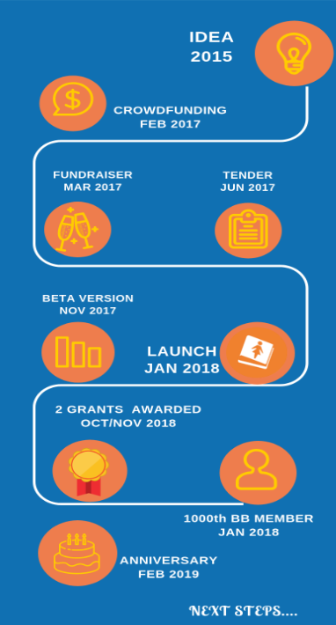
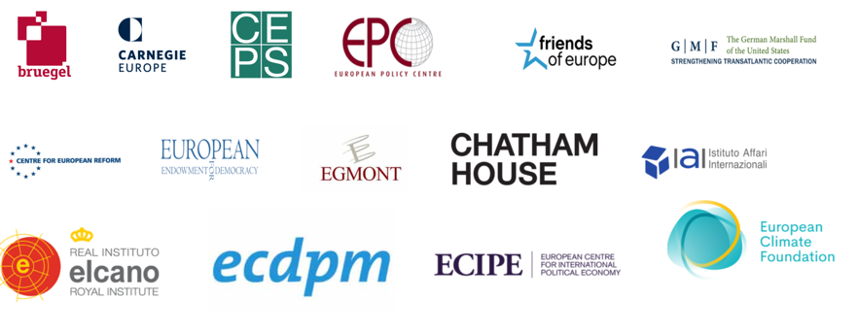
What it is
Origins: meetings of women from Brussels’ think tanks (2015)
Product: database of women experts → no excuse for all-male panels
First steps: crowdfunding; branding & comms; group of volunteers; support & endorsement → donors & think tanks
Notes:
Idea for BB was born when some of us, women working at Bxl think tanks met and realized we all shared a frustration of the underrepresentation of women in events and policy discussions in Brussels. We came up with a possible solution that could help change this: a database of women experts, which event organizers and journalists could use when searching for women speakers on a given topic.
What followed was a crowfunding campaign (breakthrough nr 1), decisions on how to brand & communicate about this initiative; finding volunteers to build and promote the database; finding partners to endorse and support the initiative. The latter included donors, individuals (ambassadors) as well as think tanks

Slide 4
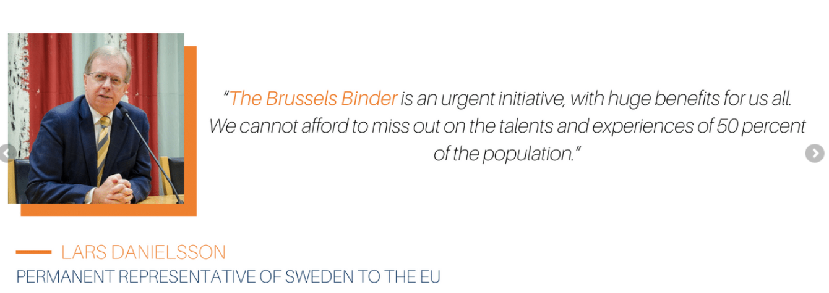
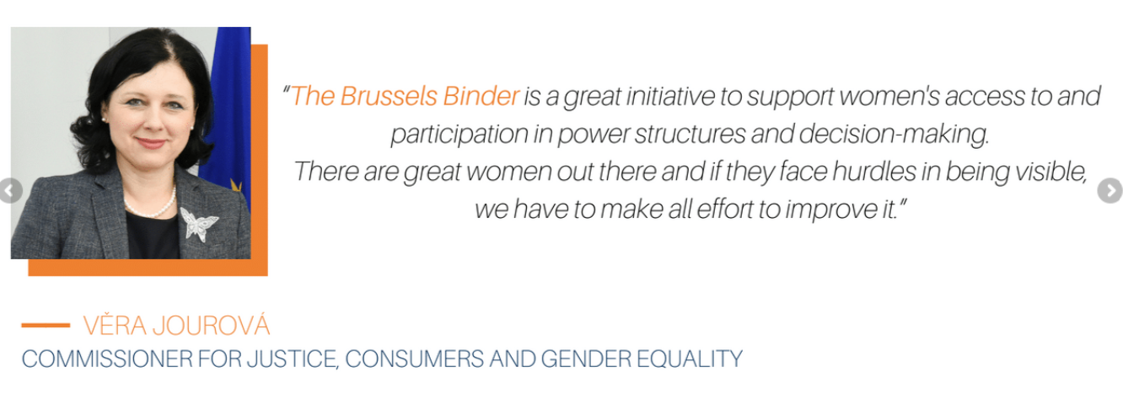
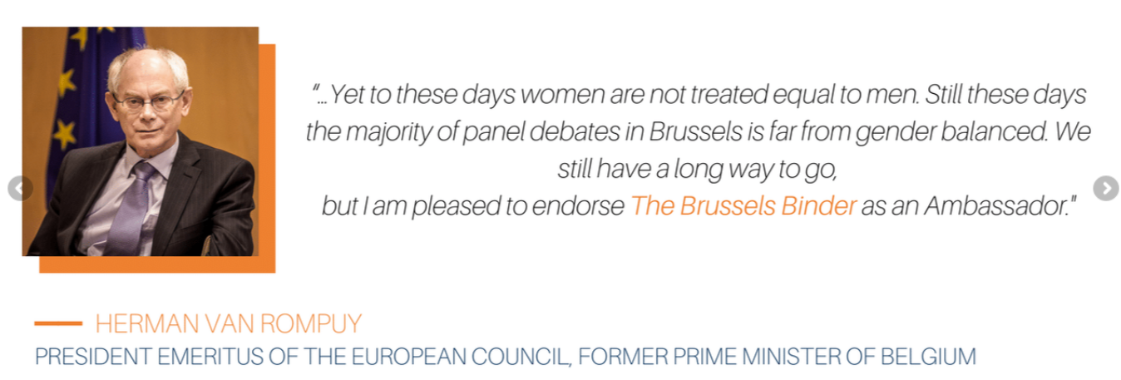
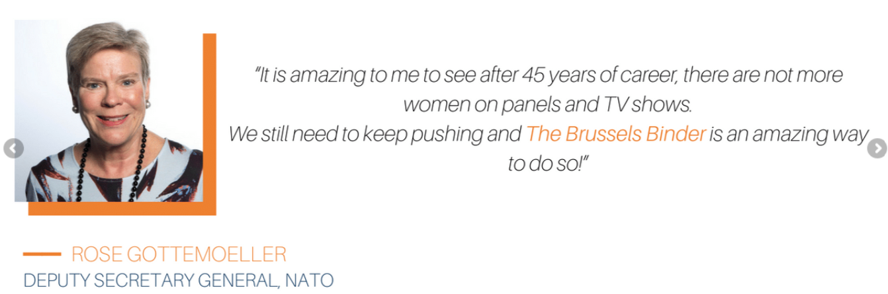
Ambassadors

Slide 5


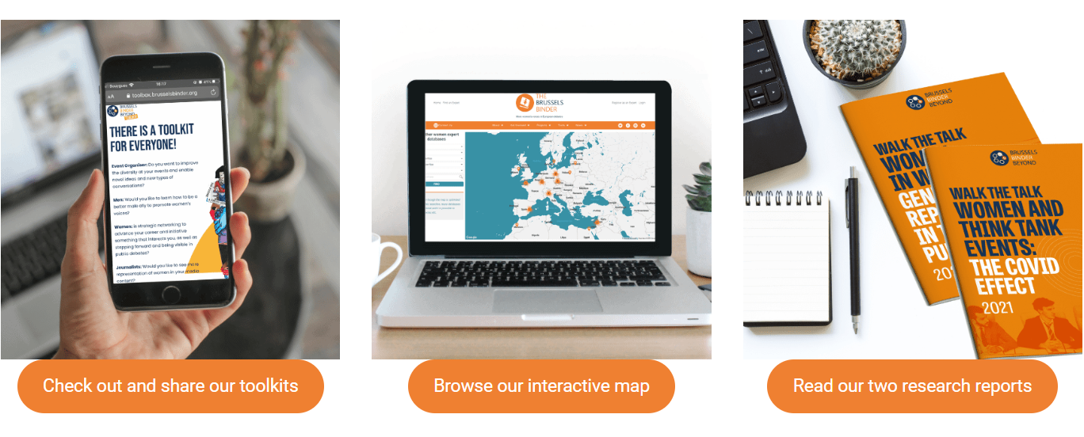
Growing up
Notes:
Breakthrough nr. 2 was the winning of two grants that offered us some stability on the medium term.
1/ One of them was a multi-annual grant from the Open Society Foundations in the framework of their own research project on manels. In 2018, OSF published a two-part report titled “An end to manels: closing the gender gap at Europe’s top policy events” where they analyzed 23 of the biggest conferences in Europe and they found that only 25% of the speakers in these events were women, and of those only 8% were keynote speakers.
2/ The second was a prestigious grant from DG JUSTICE for our BBBeyond initiative that was dedicated to take the Binder Europe-wide and link up with like-minded initiatives in European member states. This grant helped us hire our first “employee”, a project manager who helped us with the day- to-day project development
it was time to formalize our commitment by becoming a registered non-profit organisation with a board and a structure.
We have also created a Manual including all steps we have taken in building the Brussels Binder up from the ground: https://cdn.brusselsbinder.org/wp-content/uploads/2021/12/Manual_In-The-Making_The-Brussels-Binder.pdf

Slide 6
How it works
Management Committee:
Board + WG Co-leads
Board
5 + 2
Comms
WG
Advocacy WG
Partnerships WG
Events
WG
Database WG
DEI
WG
M&E
WG
Strategy
WG
Finance & Admin WG
56 volunteers

Slide 7
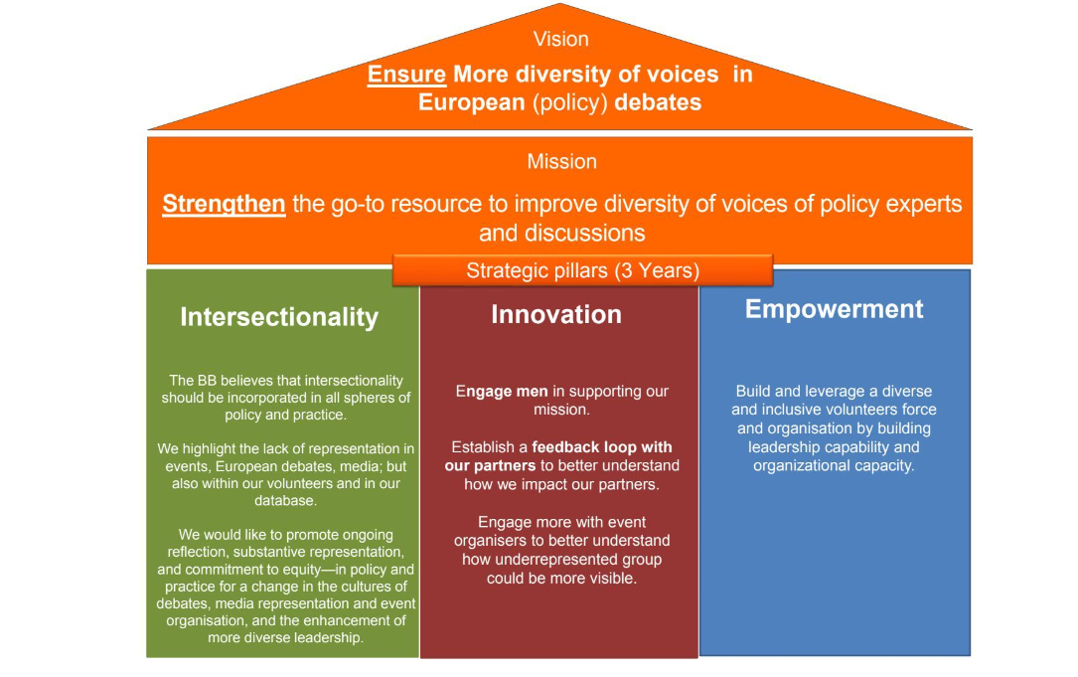
2023-2025 strategy

Slide 8
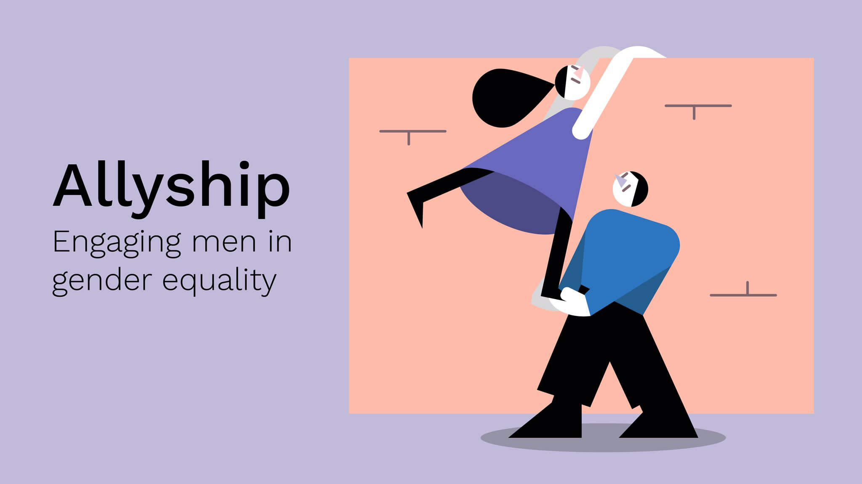

Findings from a 2023 survey
Notes:
LINK: https://brusselsbinder.org/the-brussels-binder-publishes-male-allyship-report/

Slide 9
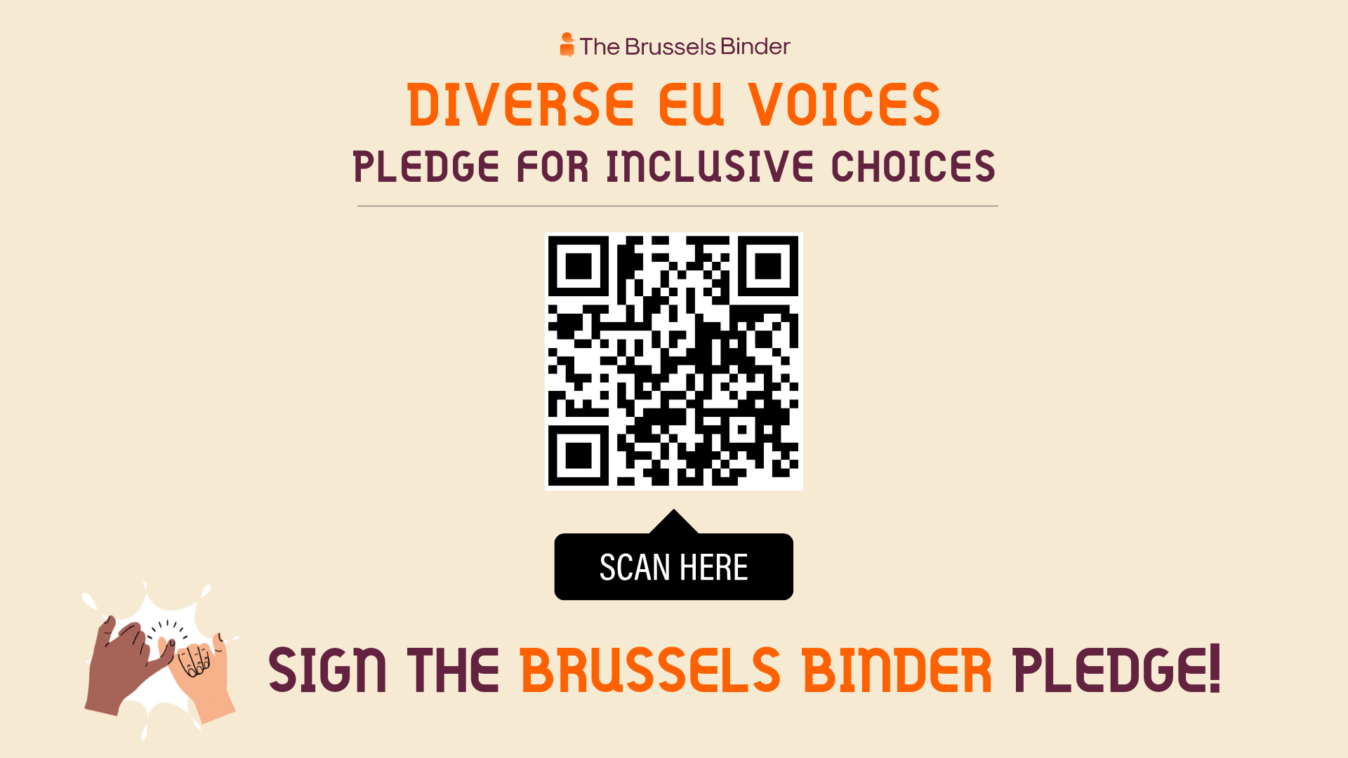
Notes:
Today, gender is not the only facet of diversity missing in EU policy debates, as was very aptly highlighted by the #BrusselsSoWhite movement that denounced the lack of racial diversity in the EU institutions. The Brussels Binder has recognised the need to fight for other forms of diversity, expanding its focus from gender equality to gender and diversity, including, but not limited to gender, ethnicity, religion, sexual orientation, age, ability, and socio-economic background. The Brussels Binder believes that unwillingness or inability to look beyond the ‘usual suspects’ to speak should not be the norm. The EU will excel and advance with representational diversity in policy debates. pledge not to moderate or participate in panels that lack diversity, including but not limited to gender, religion, ethnicity, sexual orientation, age, ability, and socio-economic background.

Slide 10
Thank you!
Keen to support? Follow our social media accounts & subscribe to the News Flash
More info & resources? https://brusselsbinder.org/

