Slide 1
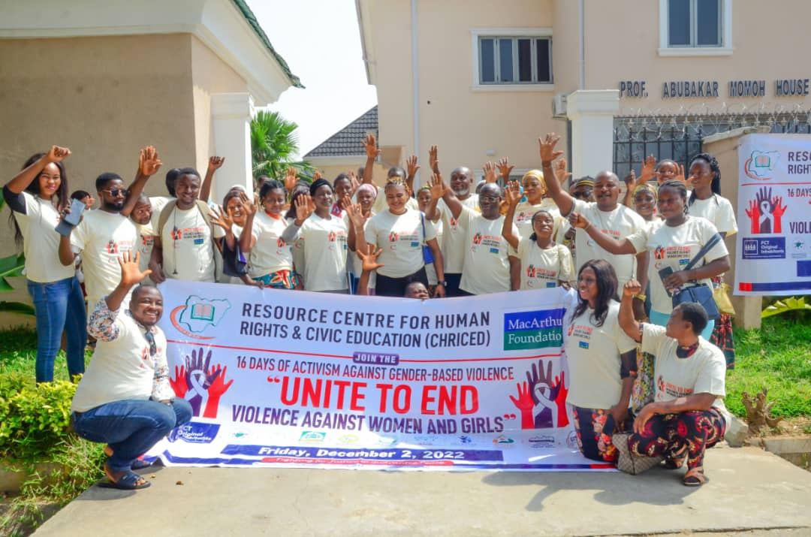

...fighting for justice to guarantee peace
RESOURCE CENTRE FOR HUMAN RIGHTS
& CIVIC EDUCATION (CHRICED)
IBRAHIM M. ZIKIRULLAHI
OMONIYI ADEWOYE
FURERA ISIAKA
January, 2024

Slide 2

About
CHRICED
The Resource Centre for Human Rights and Civic Education (CHRICED) is a Nigerian nonprofit and knowledge driven platform of active citizens promoting human rights, the rule of law, democracy, and accountability. CHRICED accomplishes this through action civics, research and publications,
education, advocacy, information sharing, grassroots organizing, and networking with other human rights bodies both within and outside Nigeria.
The core tenet of CHRICED philosophy is that civic education dissemination is cardinal to the empowerment of citizens.
...fighting for justice to guarantee peace

Slide 3
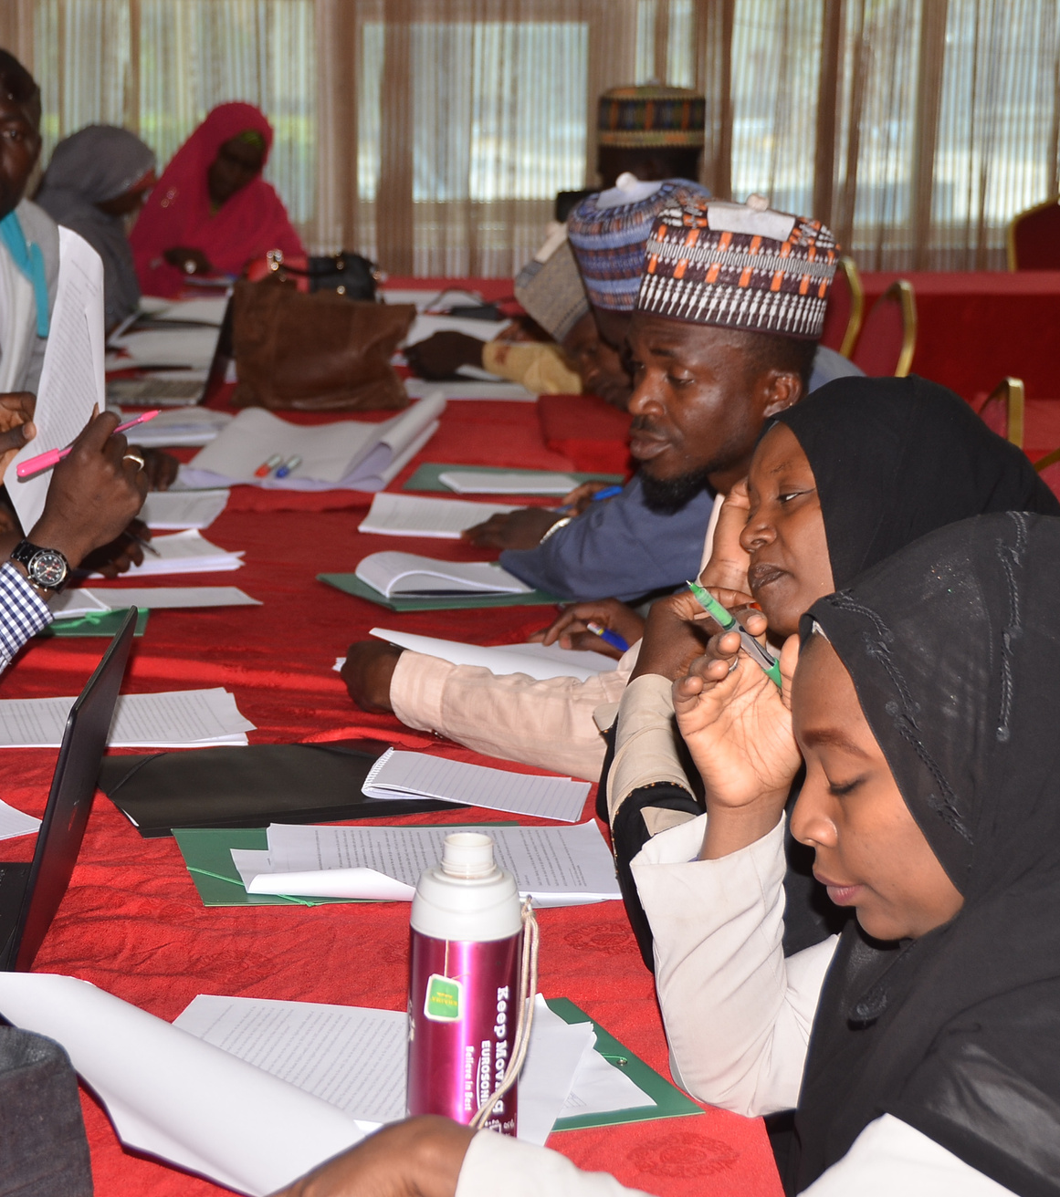
Mission
To foster accountability, inclusion, and make democracy work for all.
Vision
Our Mission &Vision
CHRICED envisions a thriving,democratic, and just Nigeria.
...fighting for justice to guarantee peace

Slide 4

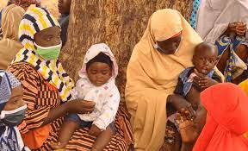
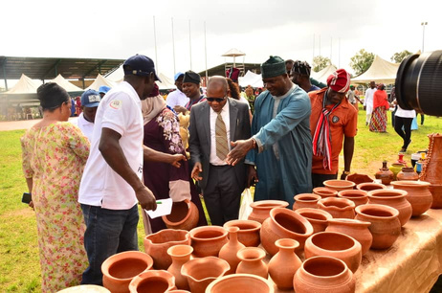
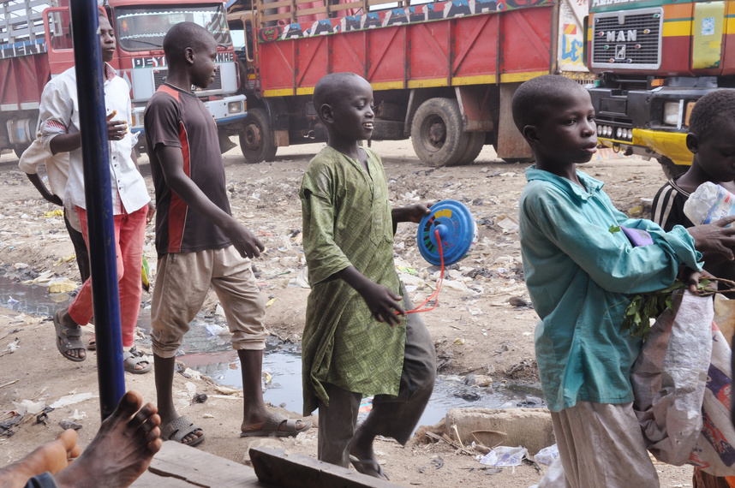
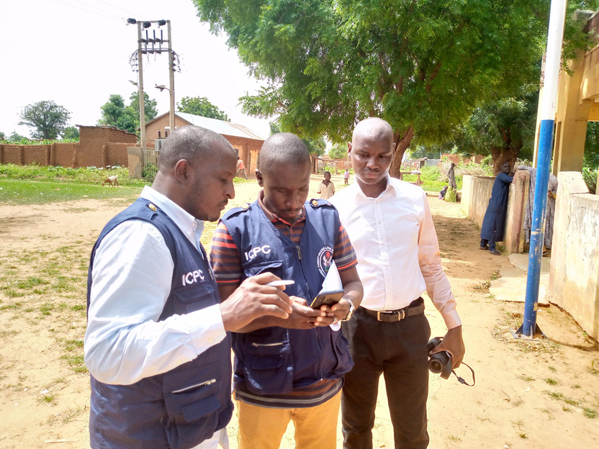
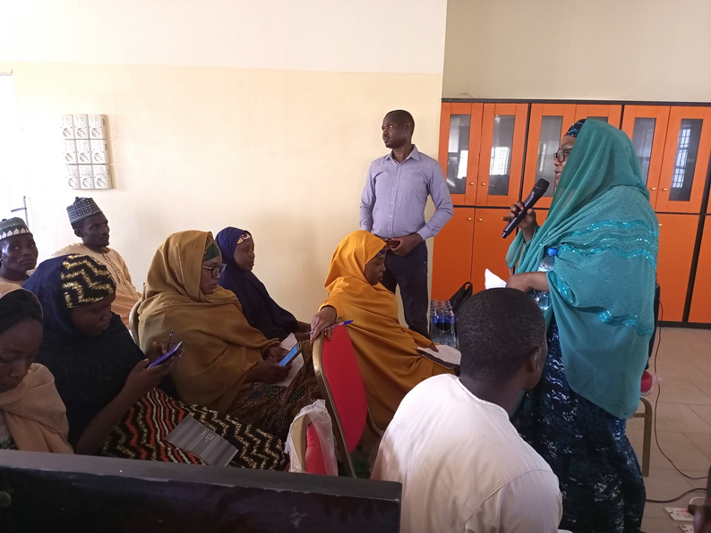
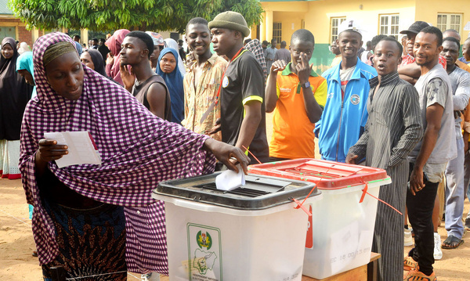
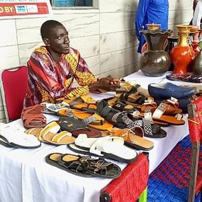
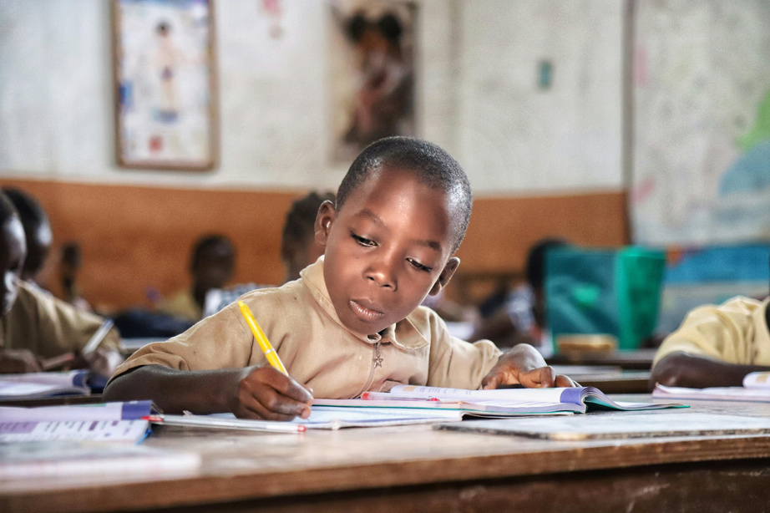
Thematic Areas
1
2
3
Maternal & Child Health
Indigenous Peoples’ Rights
Forced Child Begging
4
5
Anti-Corruption/Accountability works
Awareness Creation
6
7
8
Electoral Works
Youth Employment and Participation
Education
...fighting for justice to guarantee peace

Slide 5
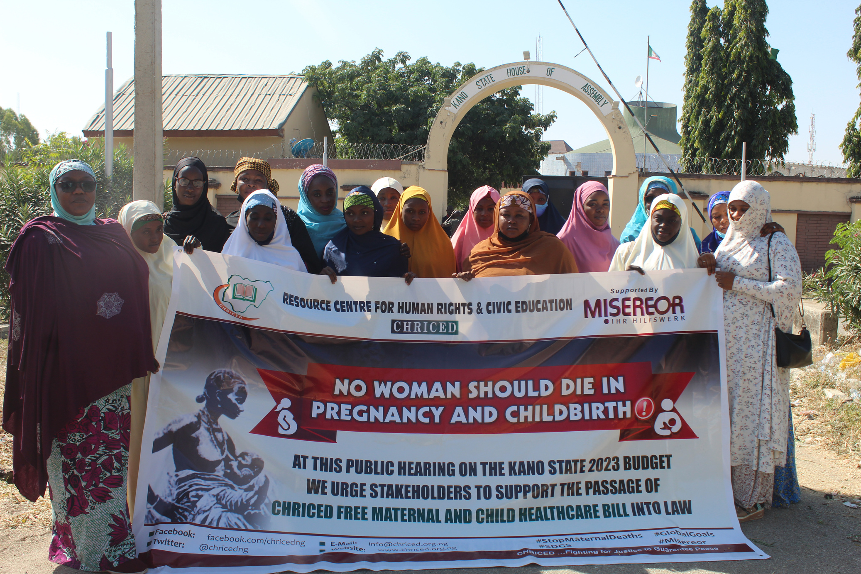
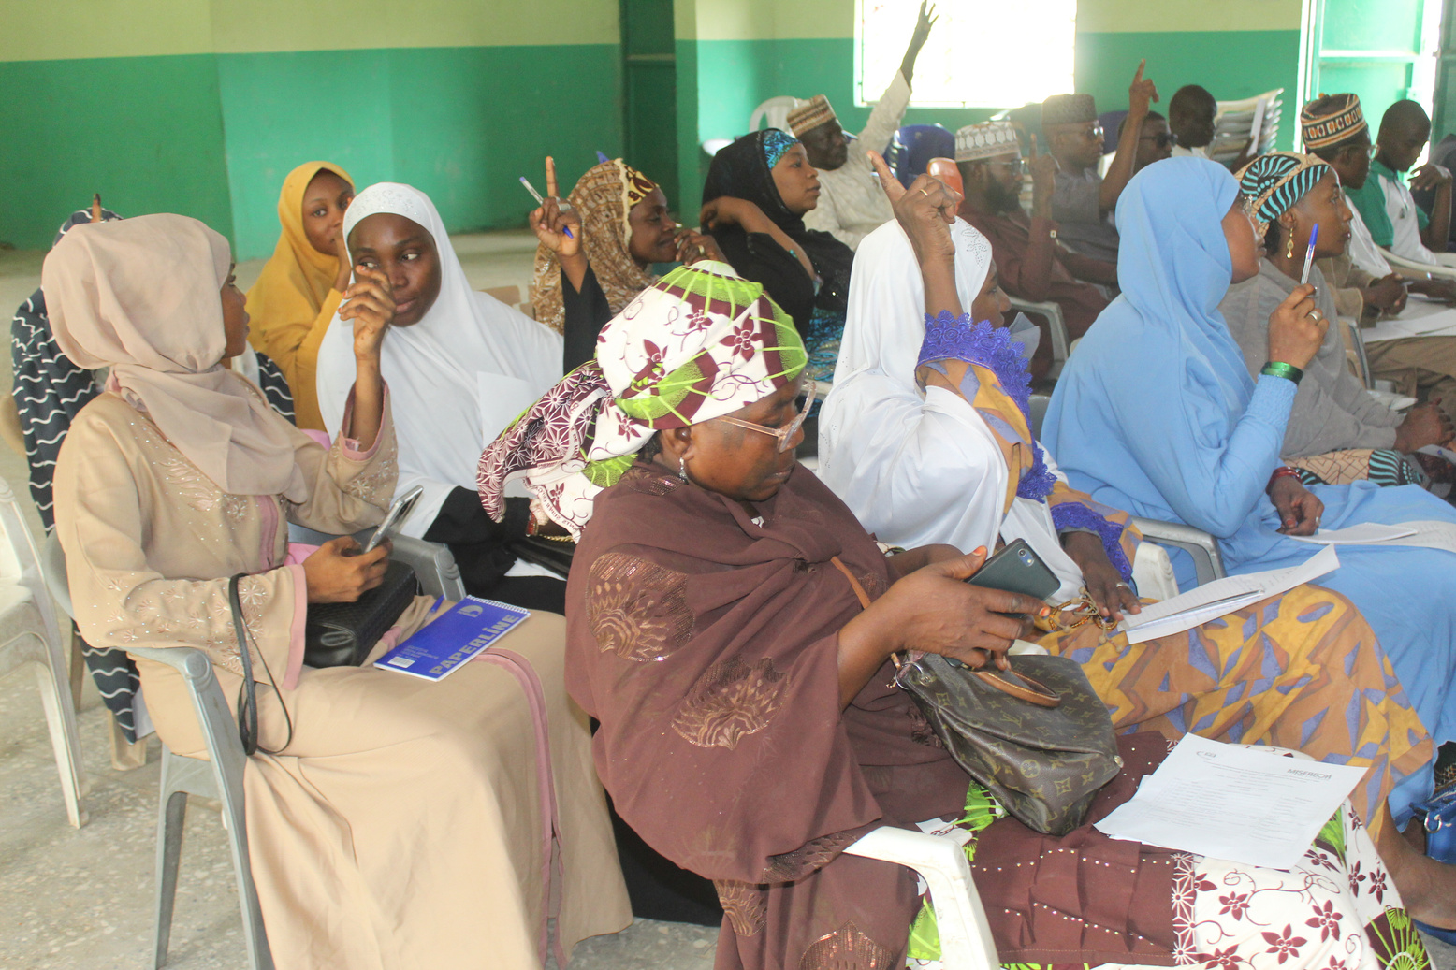
Synopsis of CHRICED interventions
Strengthening Maternal and child Health Care through Accountability Interventions:
1
With support from Misereor-KZE, Germany, CHRICED has played a pivotal role in strengthening maternal and child healthcare, generating increased public support, enacting favorable legislation, improving healthcare accessibility, and fostering a more inclusive and responsive healthcare system for mothers and children in Kano State.
Through its comprehensive approach, the project has not only achieved immediate impact but has also laid the foundation for long-term sustainable change in the healthcare sector.
According to WHO (2023), Nigeria had the highest predicted number of maternal deaths, accounting for more than one-quarter (28.5%) of the total global maternal mortalities estimated globally in 2020. To add to this alarming statistic, Kano state alone representsover 35% of these deaths in Nigeria.
1
...fighting for justice to guarantee peace

Slide 6
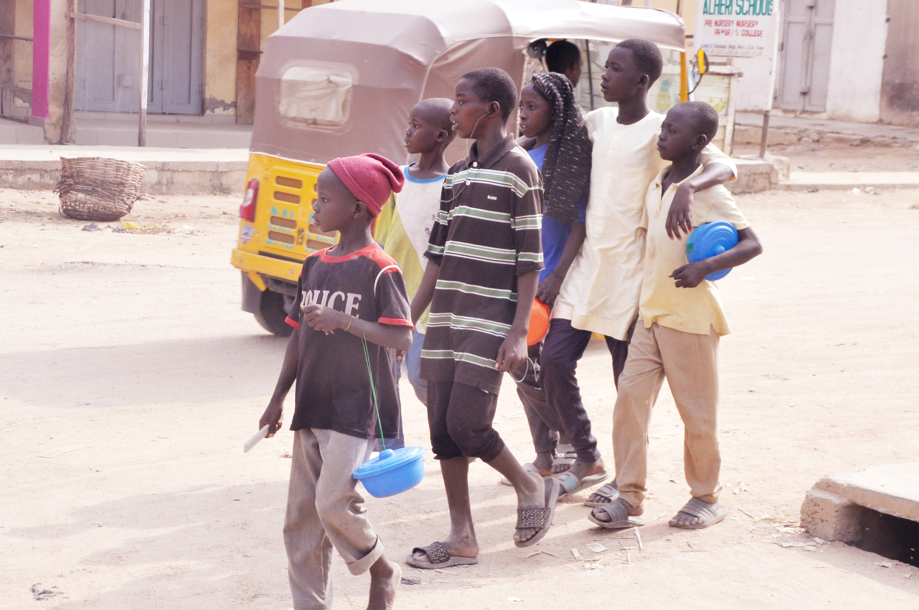
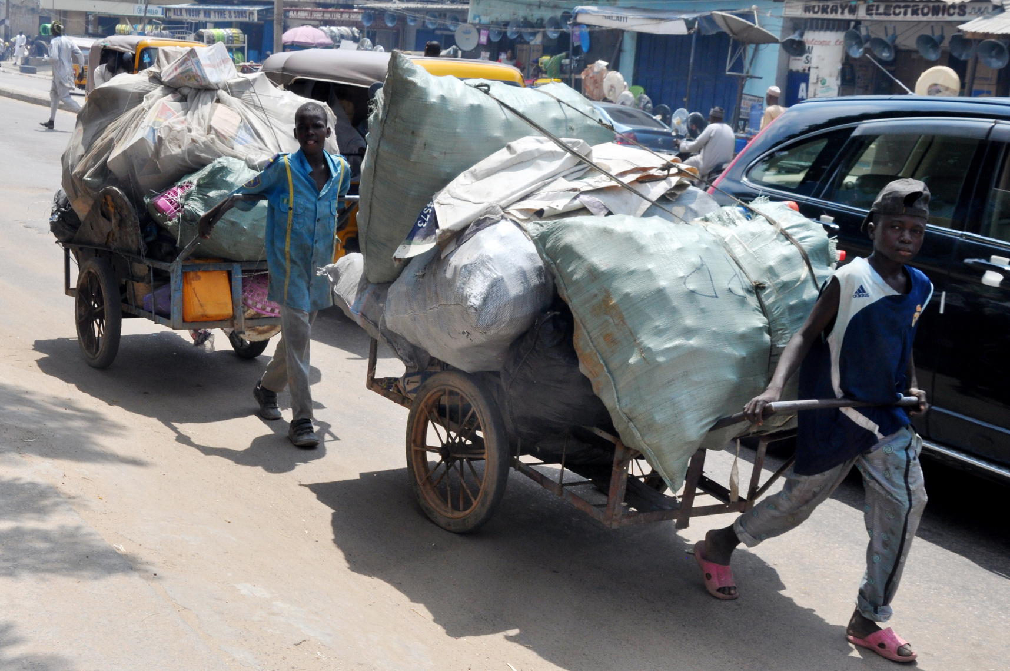
Combating the drivers of forced child begging in
northern Nigeria
2
1
Supported by the United States Department Bureau of Democracy, Human Rights and Labor Issues (US DRL) through Anti-Slavery International (ASI-UK), has closely monitored and documented the various forms of abuse suffered by the almajiri, a subset of street children principally found in the northern states of Nigeria. In addition to research and monitoring activities, CHRICED has also advocated for policy changes and legal reforms to effectively address the issue of forced child begging, including pushing for stricter enforcement of existing laws against child labor and trafficking.
...fighting for justice to guarantee peace

Slide 7
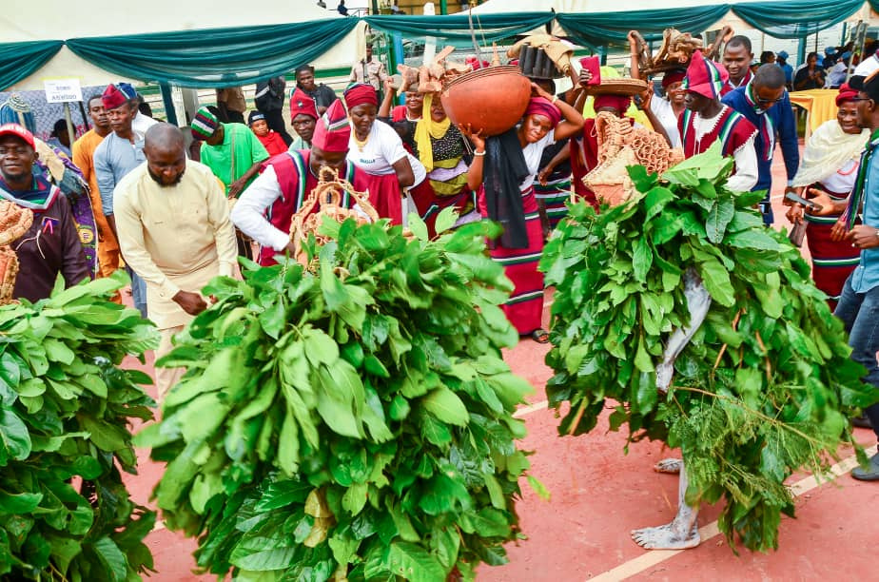
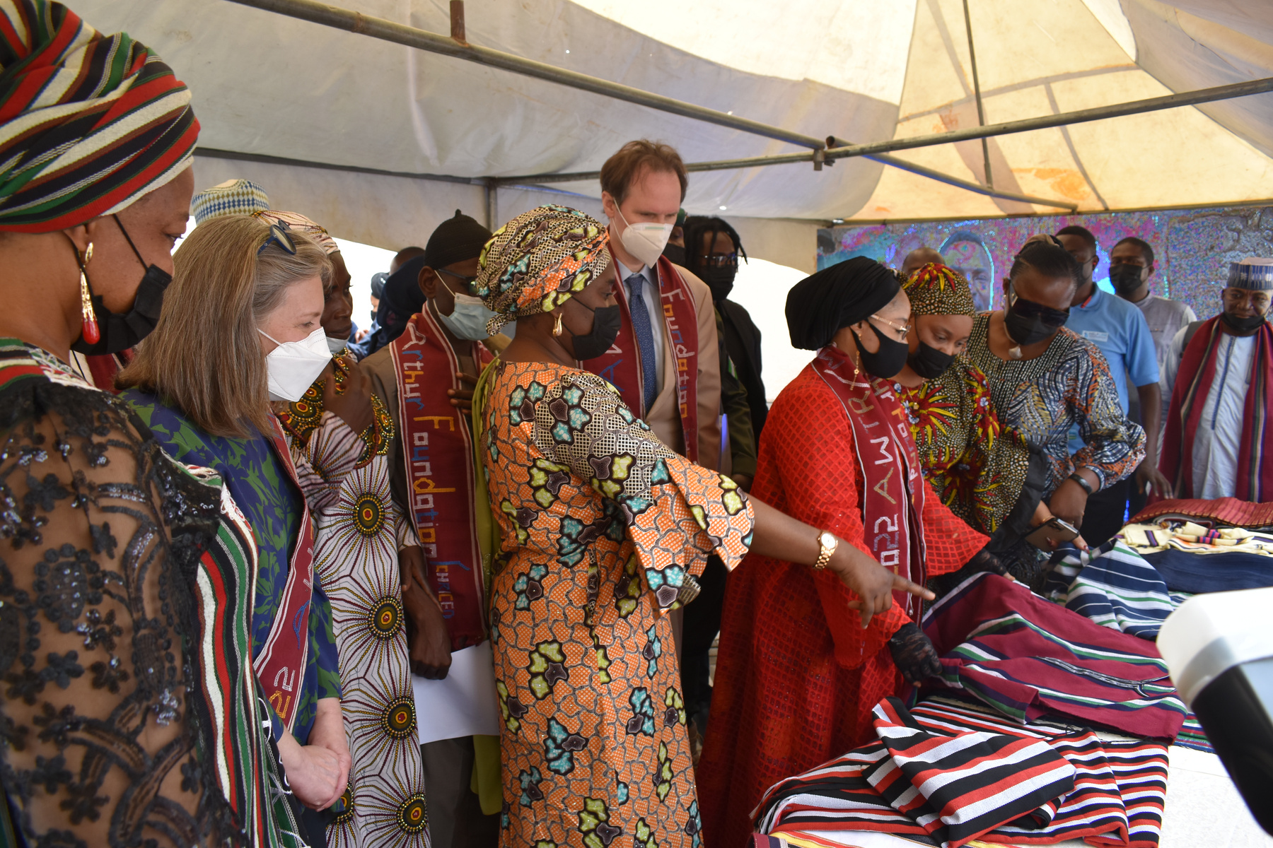
3
Promoting the Rights of Indigenous Peoples
3
In 1976, the federal government of Nigeria took over the land that is now known as Abuja, from its original inhabitants to create a new federal capital for Nigeria. The takeover left the original inhabitants landless. It dislocated their economic, cultural and social lifestyles, pushing them to various new locations. Decades of neglect have led to dilapidated schools, broken health services, unemployment, poor waste management, and a large population of out-of-school children, among other things. CHRICED, with the support of the John D. and Catherine T. MacArthur Foundation in 2021, has been actively advocating for the rights of the Original Inhabitants (OIs). Through coordination, sub-granting, and capacity building initiatives, CHRICED has empowered Original Inhabitants organizations (OIOs) in Abuja to effectively address these issues. As a result of these efforts, the OIs have made significant progress. They have been appointed to cabinet positions, receiving compensation for their land loss, established the FCT Civil Service Commission, adopted a voluntary code of conduct, and signed Community Development Agreements.
1
...fighting for justice to guarantee peace

Slide 8
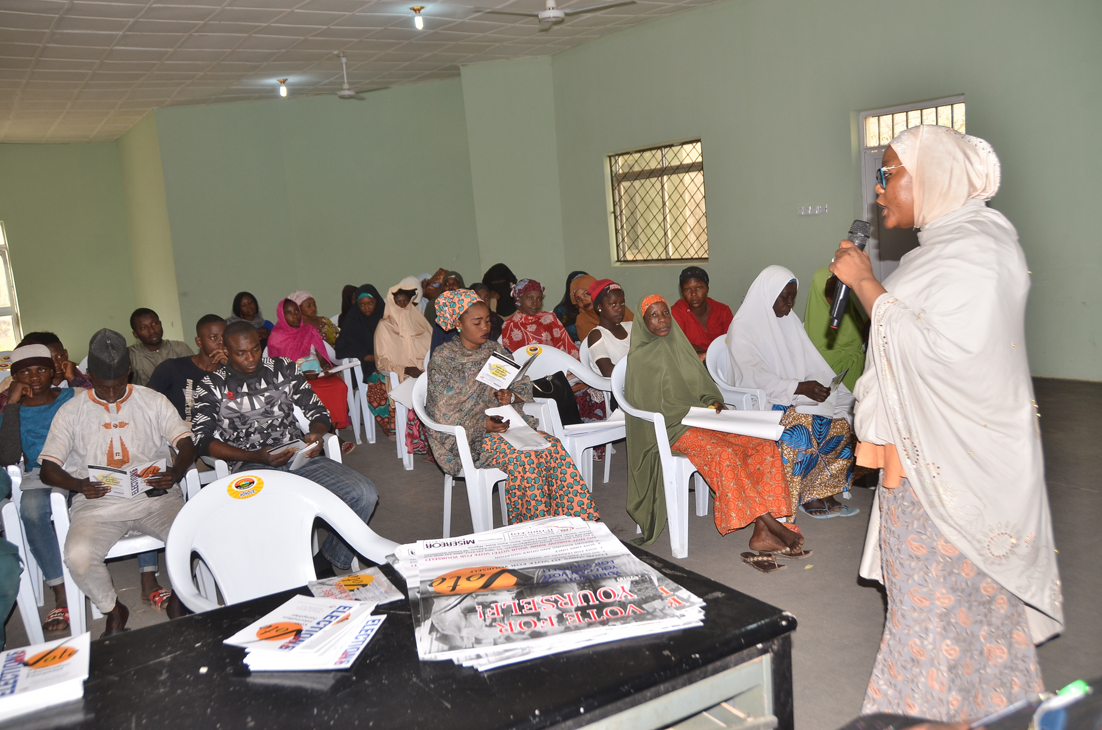
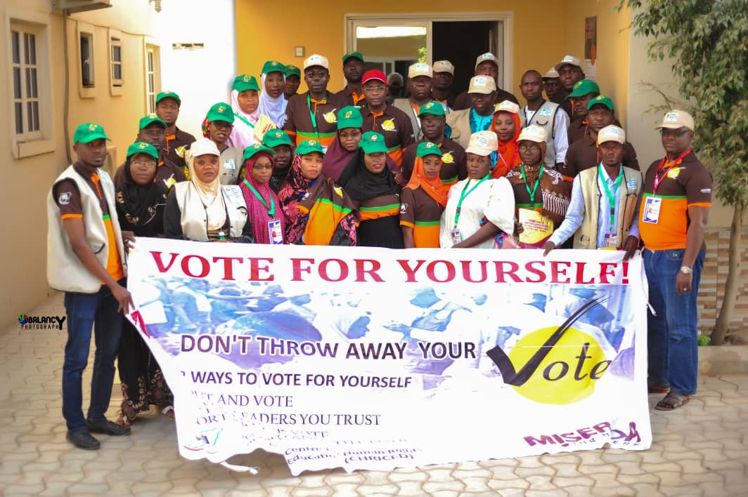
Electoral Empowerment of Citizen Project
3
4
Since 2011, CHRICED has consistently responded to the challenges of Nigerian electoral system and undertook several activities to promote sustainable long-term CSO engagement in electoral and political processes. It has collaborated with the Transition Monitoring Group (TMG), and Aminu Kano Centre for Democratic Studies (MAMBAYYA House) to improve integrity of elections through impartial observation, and accurate reporting by domestic media and electoral observers during and after each election cycle.
CHRICED has also work to reduce risk of electoral violence through increase participation by marginalized groups (women, youth and persons with disabilities in Nigerian political processes.
...fighting for justice to guarantee peace

Slide 9
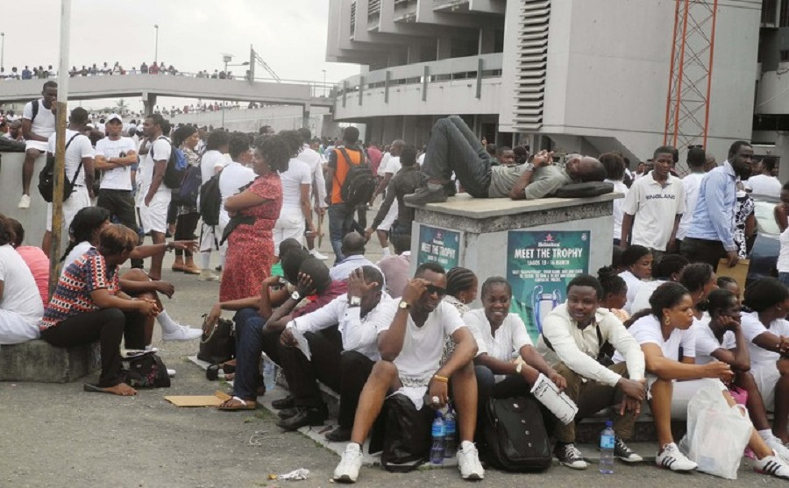
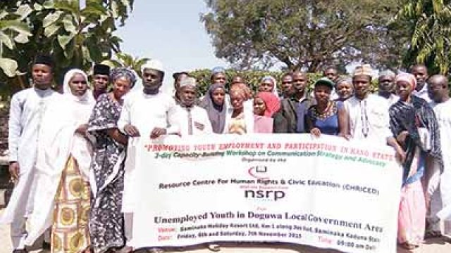
3
Youth Employment and Participation
5
1
This project supported by the British Council/NSRP has made significant strides in addressing the issue of youth unemployment and its link to violent conflicts. Through capacity training and advocacy for equitable policies, and raising awareness, the project has contributed to a more inclusive and peaceful society in Kano State.
...fighting for justice to guarantee peace

Slide 10
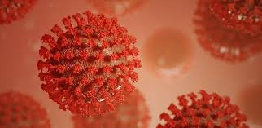
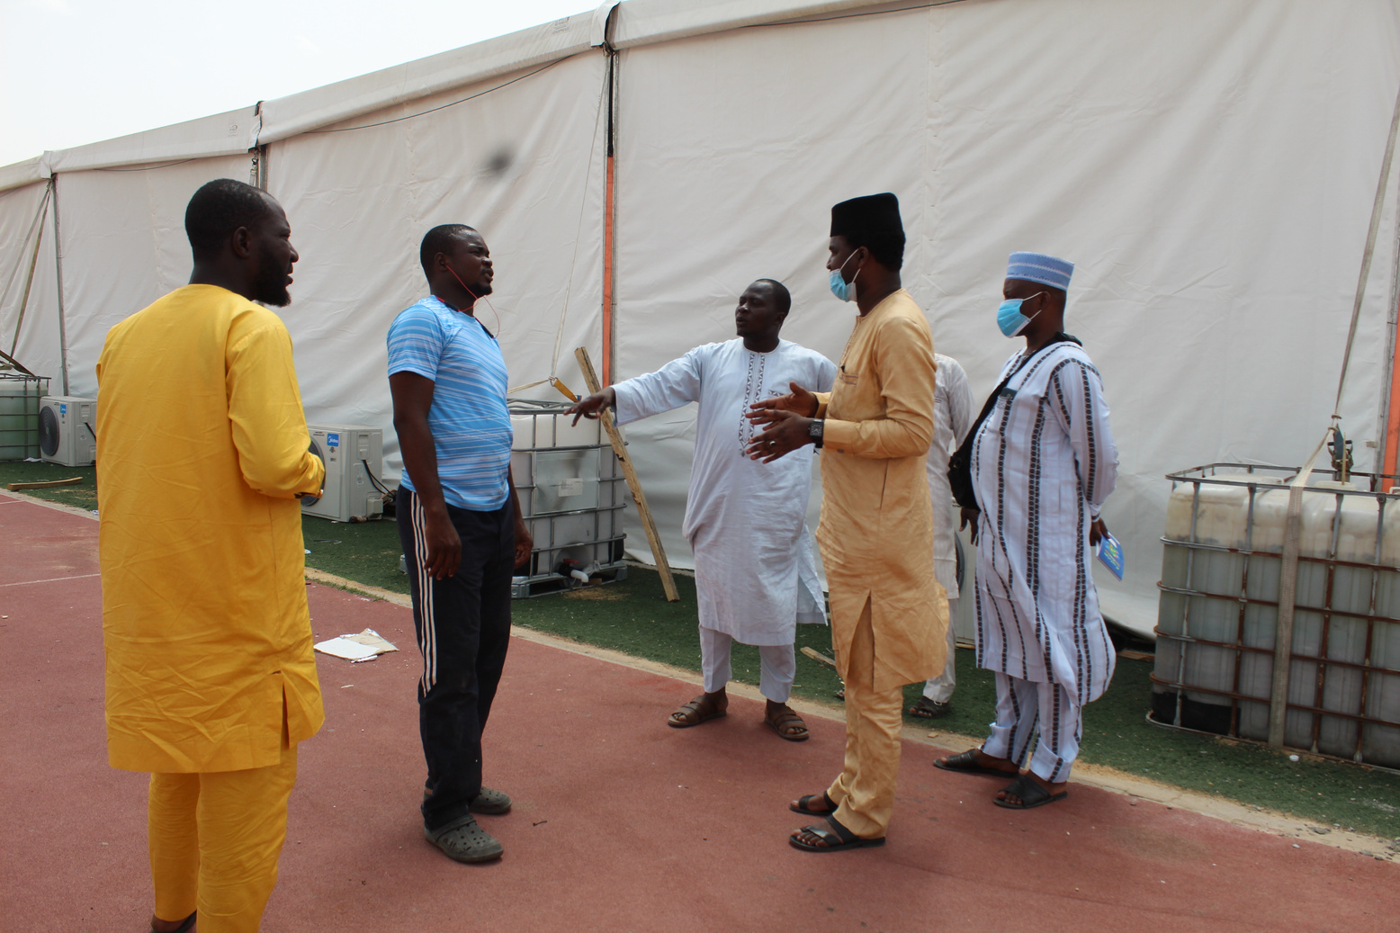
3
Promoting citizen awareness and accountability to
contain the spread of CONVID-19 in Nigeria
6
1
CHRICED's implementation of the project successfully raised awareness among citizens and fostered a sense of accountability to combat the spread of COVID-19. Through targeted campaigns, community outreach, and media platforms, CHRICED has effectively disseminated accurate information, leading to a significant decrease in infection and mortality rates, particularly among marginalized groups, such as women. The project's transparency and accountability advocacy have not only ensured a fair distribution of relief measures but also built trust and cohesion in the fight against COVID-19, ultimately saving lives and strengthening communities.
...fighting for justice to guarantee peace

Slide 11
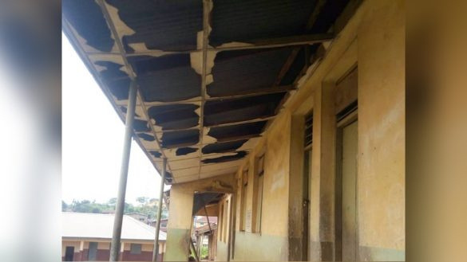
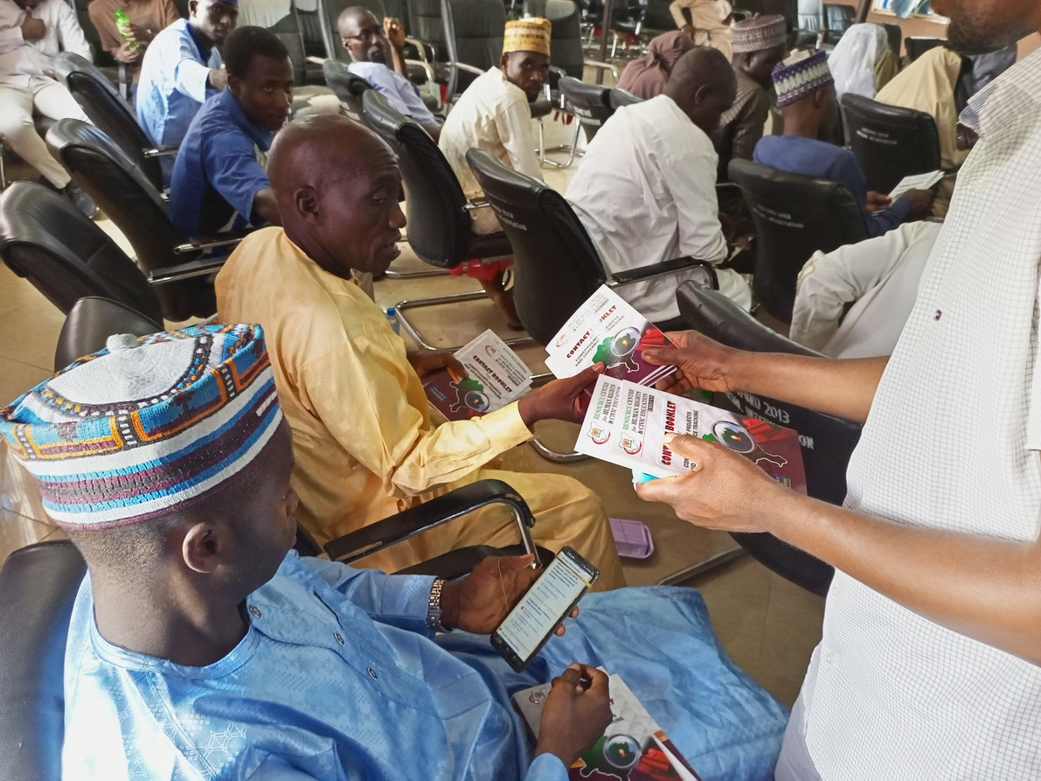
7
Promotion of Community-Driven Anti-Corruption Initiatives in Kano State Nigeria
1
CHRICED, with support from MacArthur Foundation, has significantly reduced corruption's impact on constituency project delivery through collaboration with anticorruption agencies, community actors, and CSOs. This has led to enhanced accountability, increased citizen participation in demanding accountability, strengthened community organizing capacity, and reforms in key agencies like PHCUOR and PCACC. This has resulted in more efficient utilization of public funds, improved service delivery, and improved development outcomes for the community.
...fighting for justice to guarantee peace

Slide 12
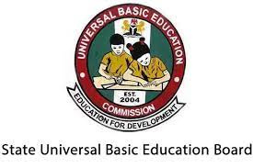
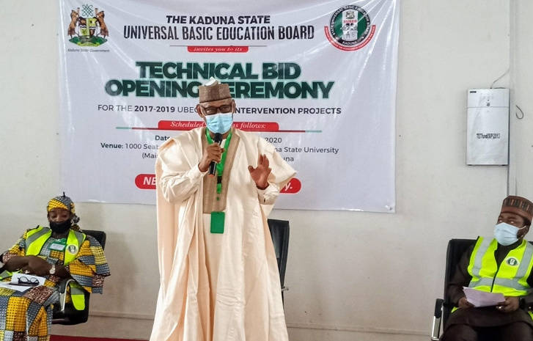
Promoting transparency and accountability in education in Nigeria
8
1
CHRICED promoted transparency and accountability in education in Nigeria through citizen activism. The project improved beneficiaries' understanding and ability to oversee UBE projects and public initiatives in their communities. A significant achievement was the adoption of an open bidding system by the Kaduna State Government for UBE projects. This demonstrates the lasting impact of CHRICED's efforts in advancing transparency and accountability in education.
...fighting for justice to guarantee peace

Slide 13

CHRICED Key Strategic Challenges and opportunities
Fundraising, excessive government regulations, a hostile environment induced by the state, finding appropriate or qualified staff, as well as political and economic uncertainty in the country are some of the key strategic challenges currently confronting our organization.
However, the key opportunities that are currently available to us include developing a philanthropic culture in which the board and staff members see themselves as an integral part of fundraising; retaining our donors; recruiting volunteers from retired public and private sector personnel; and building a coalition of nonprofit organizations to resist repressive control by state actors.
1
...fighting for justice to guarantee peace

Slide 14




Connect with us:
+234 (0) 806-585-8128, (0) 901-753-2907
info@chriced.org.ng
www.chriced.org.ng

