Slide 1

Public Policy Think tank based in Karnali Province, Nepal
Dinesh Gautam
Co-Founder/Executive Director, Hriti Foundation

Slide 2
Vision
Hriti Foundation envisions a society where individual rights and economic freedom are cherished and protected.
Mission
To promote individual and economic rights and advance liberal principles as the foundation of public policies through research, training, advocacy, and dialogue.
Working Areas
Entrepreneurship and Market Economy
Subnational Governance and Fiscal Federalism
Accountability and Transparency
Rule of Law and Public Service Delivery
Inclusion and Youth Engagement
Our Approach
Rigorous Research
Comprehensive Training
Informed Advocacy
Open Dialogue

Slide 3
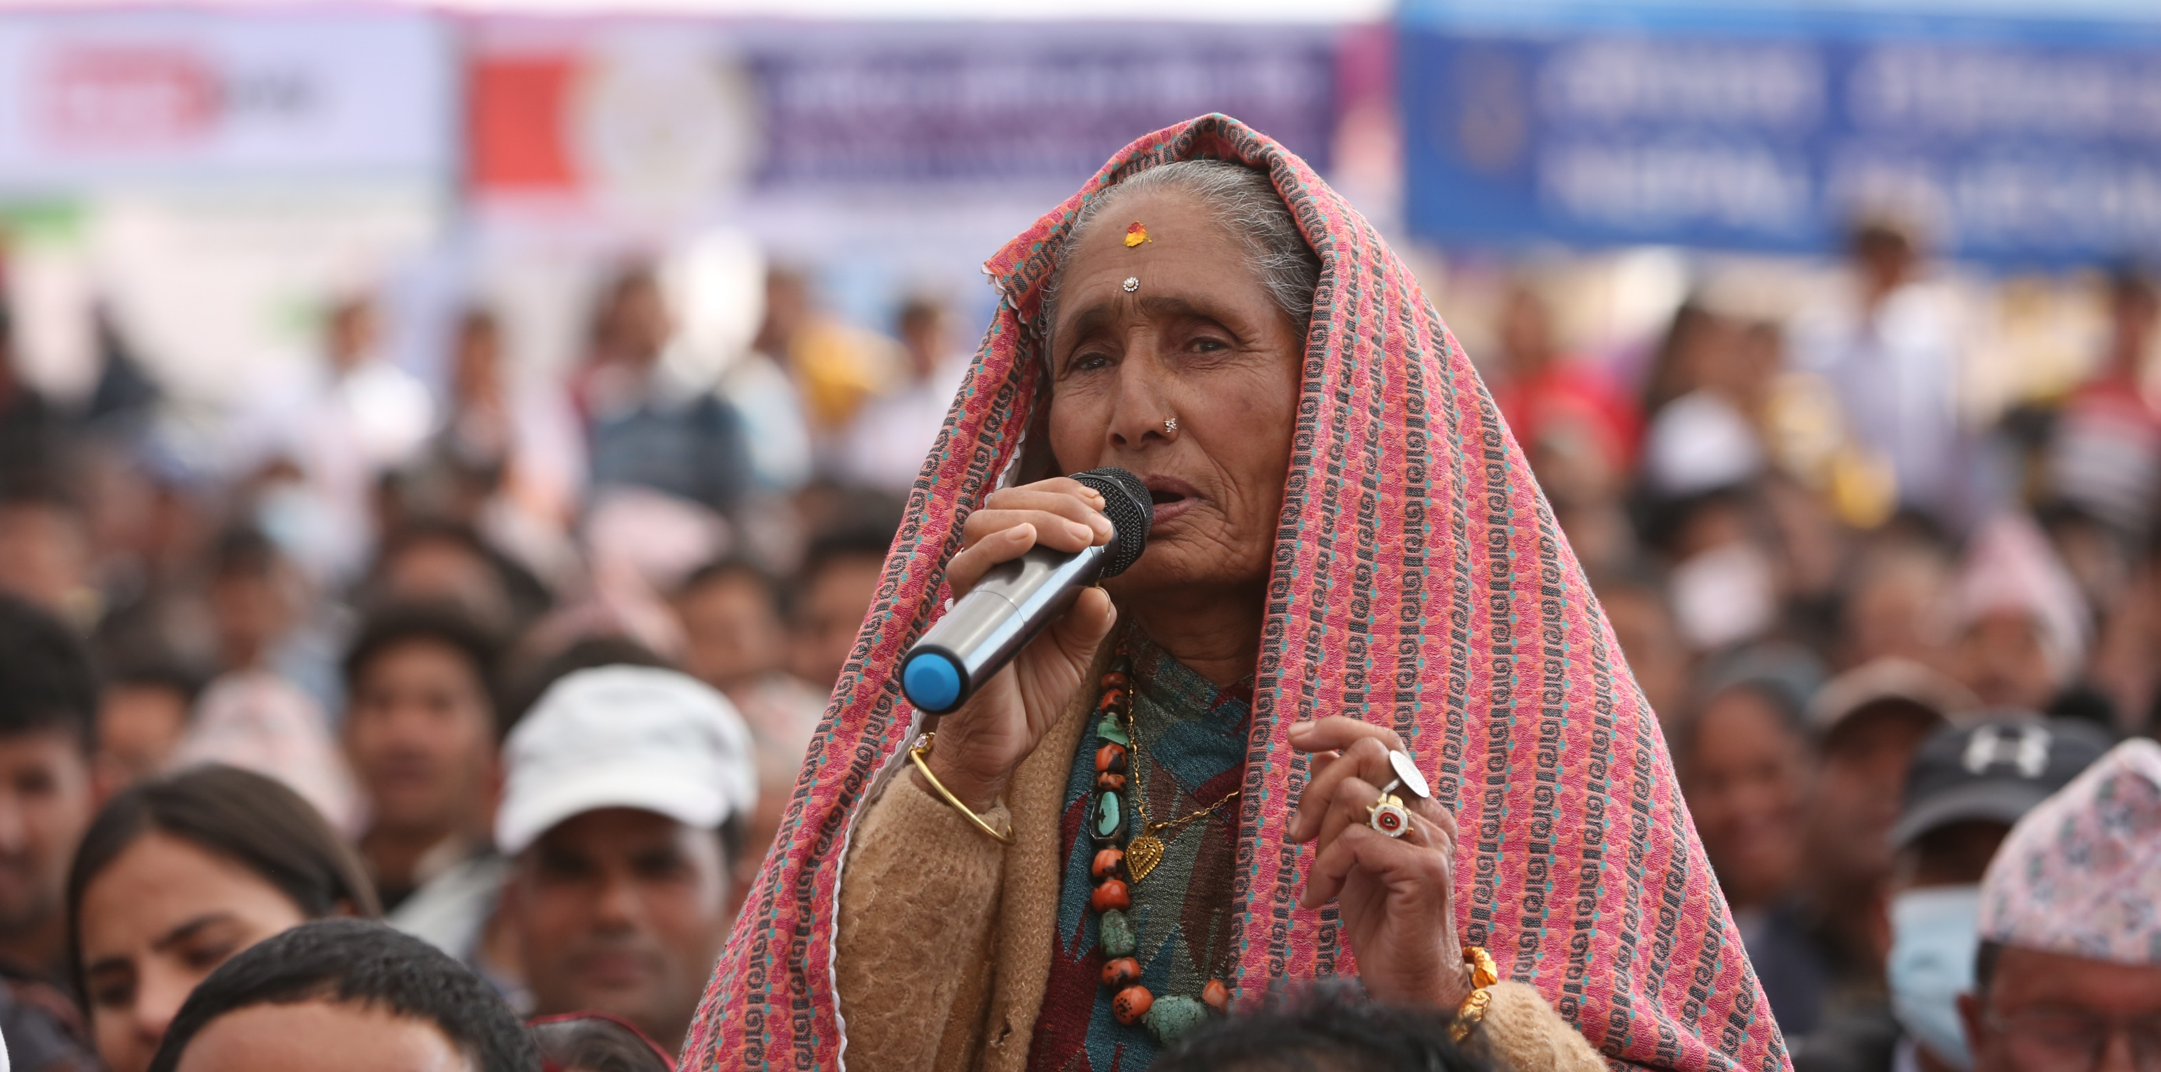
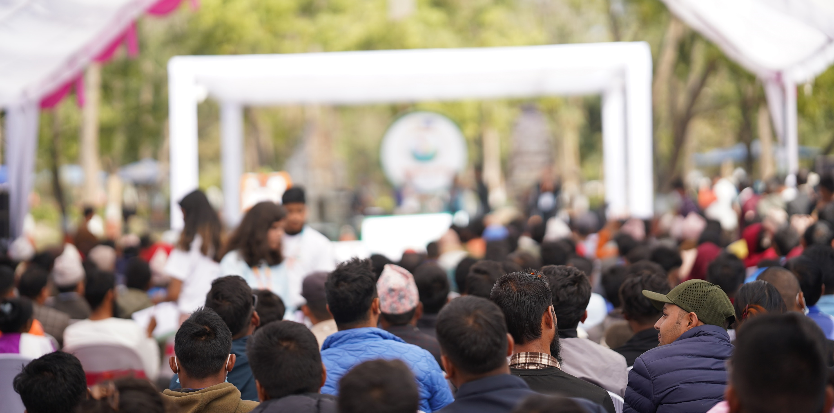
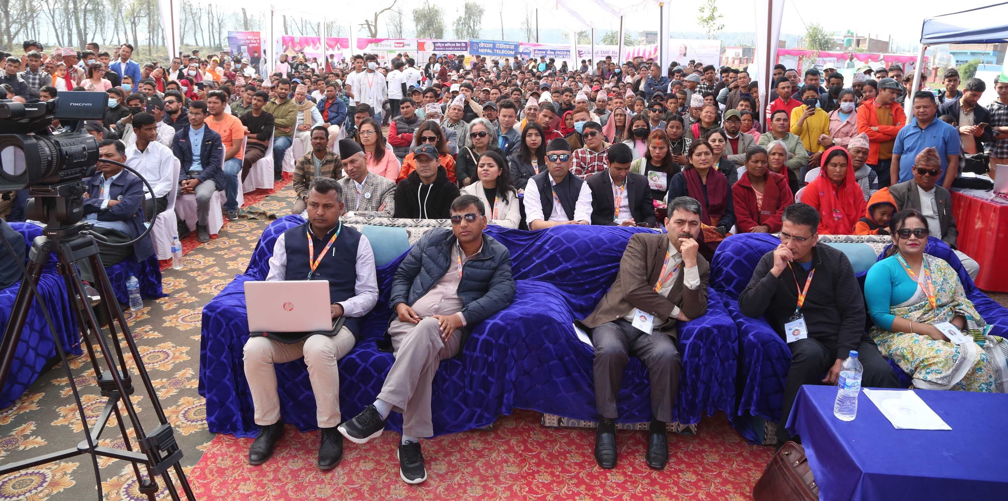
Major Programs
Karnali Utsav, ..Kuda Karnalika ( Policy Festival)
- largest policy dialogue organized in Karnali province, nationally recognized
- a three-day annual public policy festival in the last 5 years
- Open space, Birendranagar Surkhet Karnali Province Nepal
- 15-16 sessions, 70-80 Speakers, 3000-5000 participants
- Coordination with three tiers of government, private sectors, and development partners (50+)

Slide 4
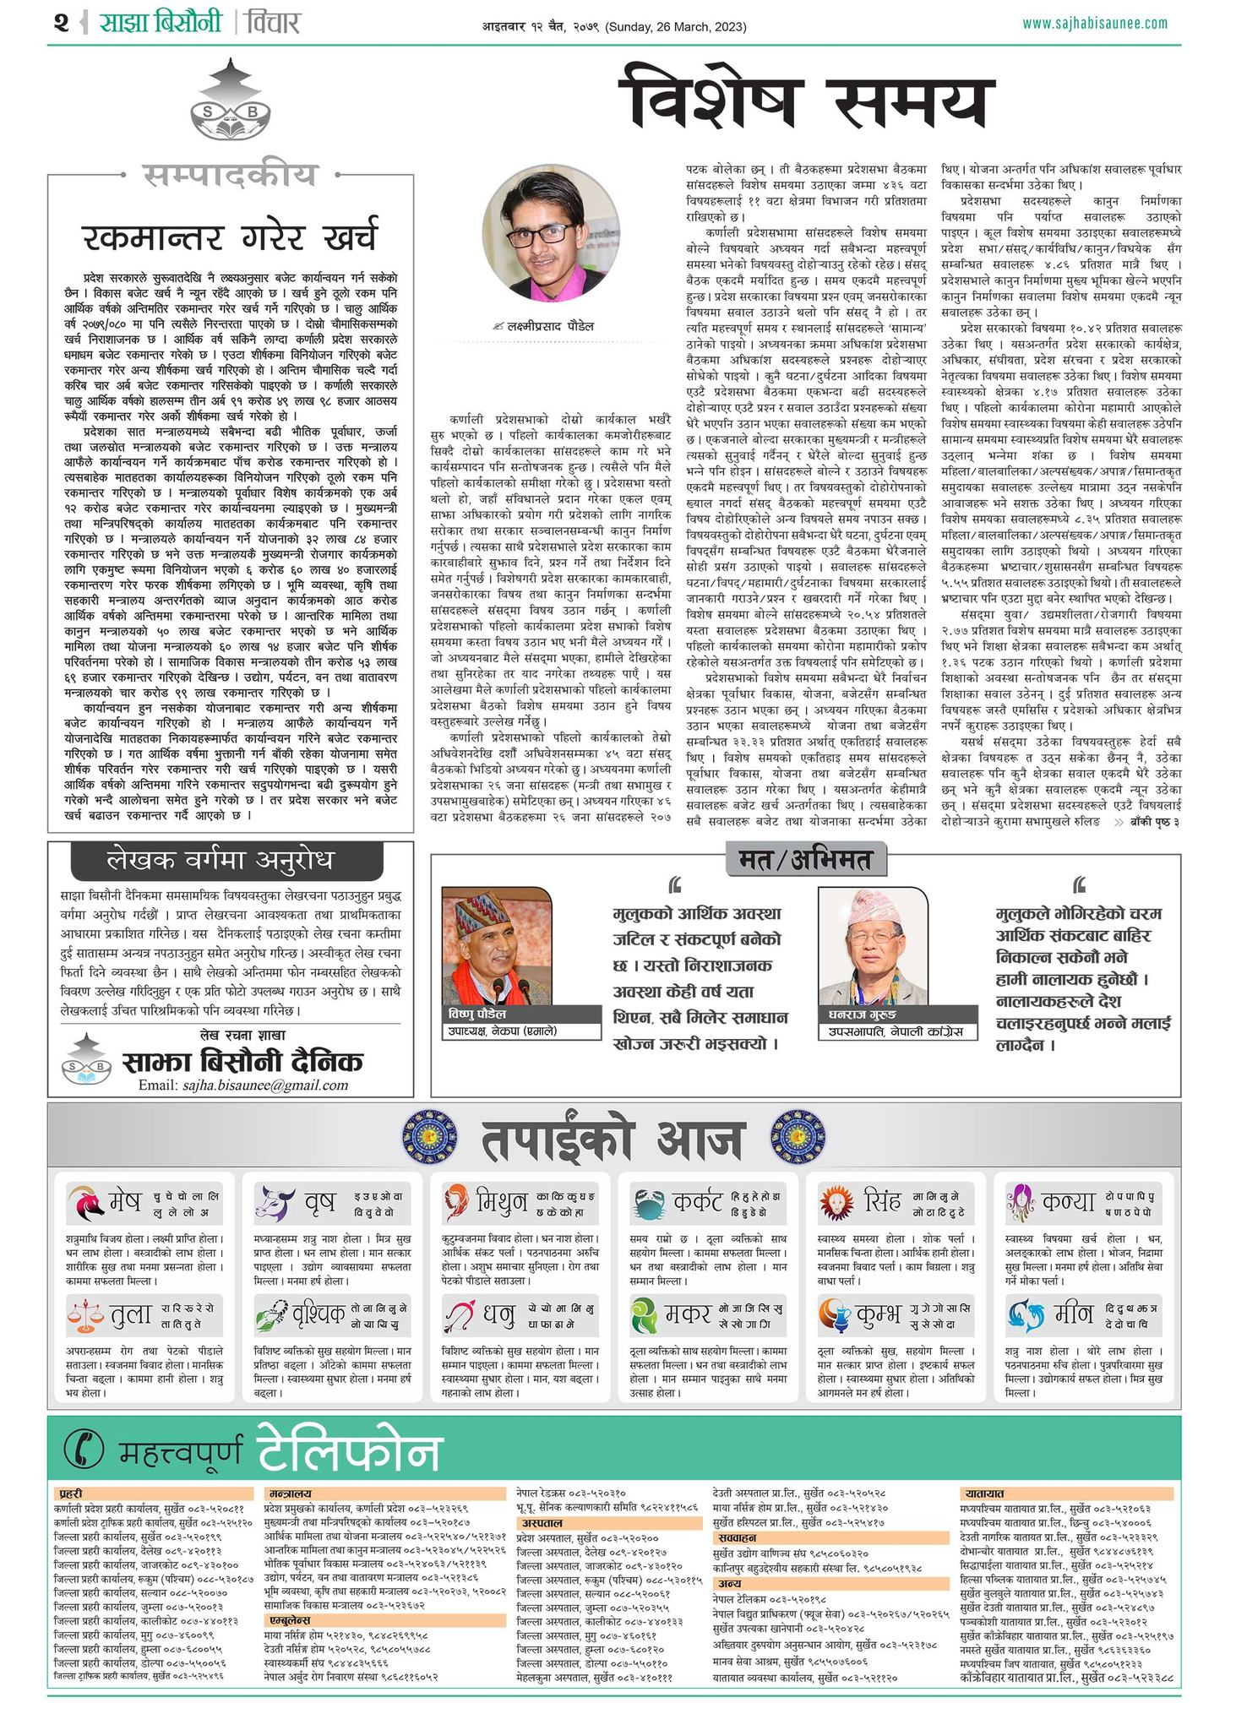
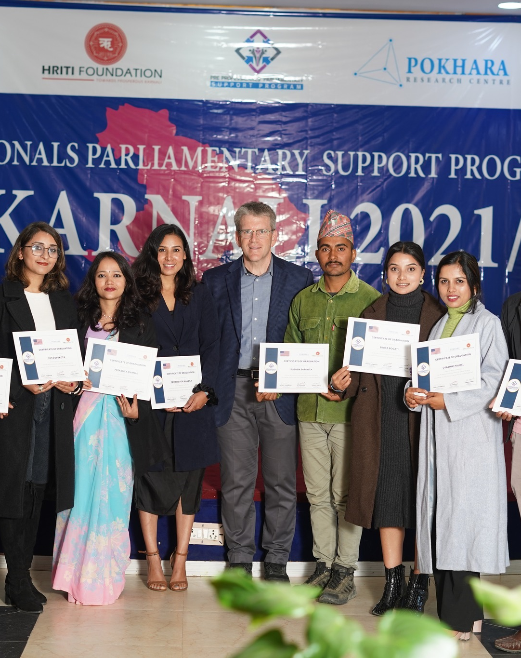
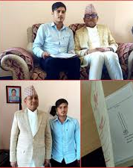
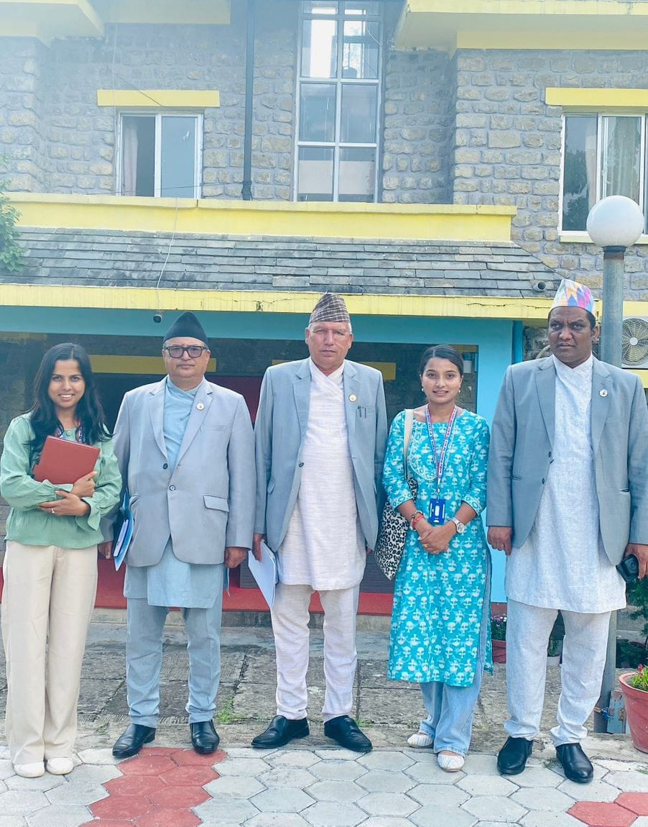
Major Programs
Parliament Watch
- Closely working with Karnali Provincial Assembly
- Conducting different parliament outreach activities
- Research support to MPs and Parliamentary Committee
- Monitoring the parliamentary performance
- Bill review, stakeholders dialogue, youth engagement in policy-making process

Slide 5
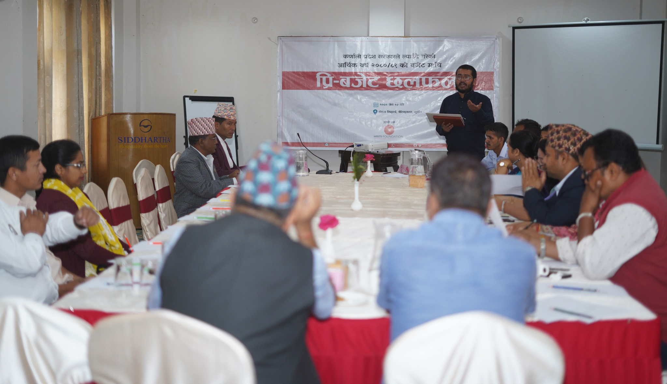
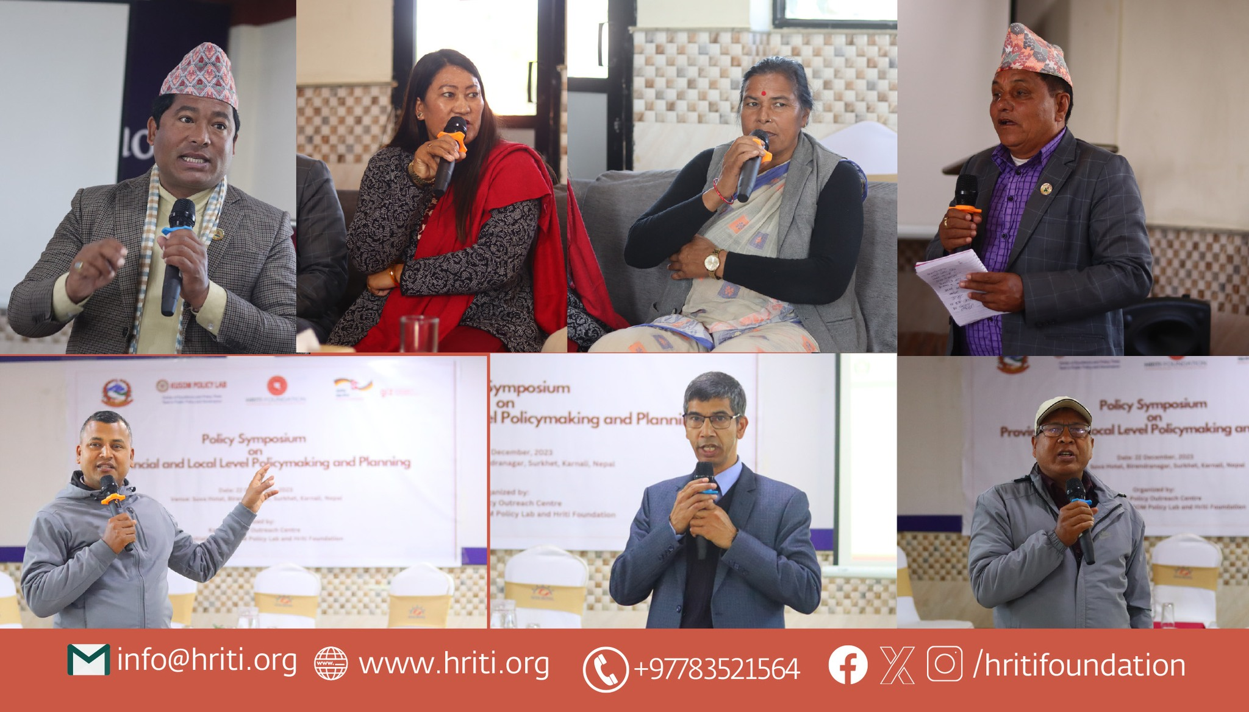
Major Programs
Dialogue and Discussion
- Pre-budget discussion each year ( Public-Private Dialogue)
- Discussion for the activeness of CSO in parliamentary issues
- Discussion on policies, budget, governance, federalism

Slide 6

Research
Research Area
1. Public Policy and Economic Governance
2. Federalism
3. Education
4. Individual and Economic Rights
5. Market Economy
6. Trade and Budget Policy

Slide 7
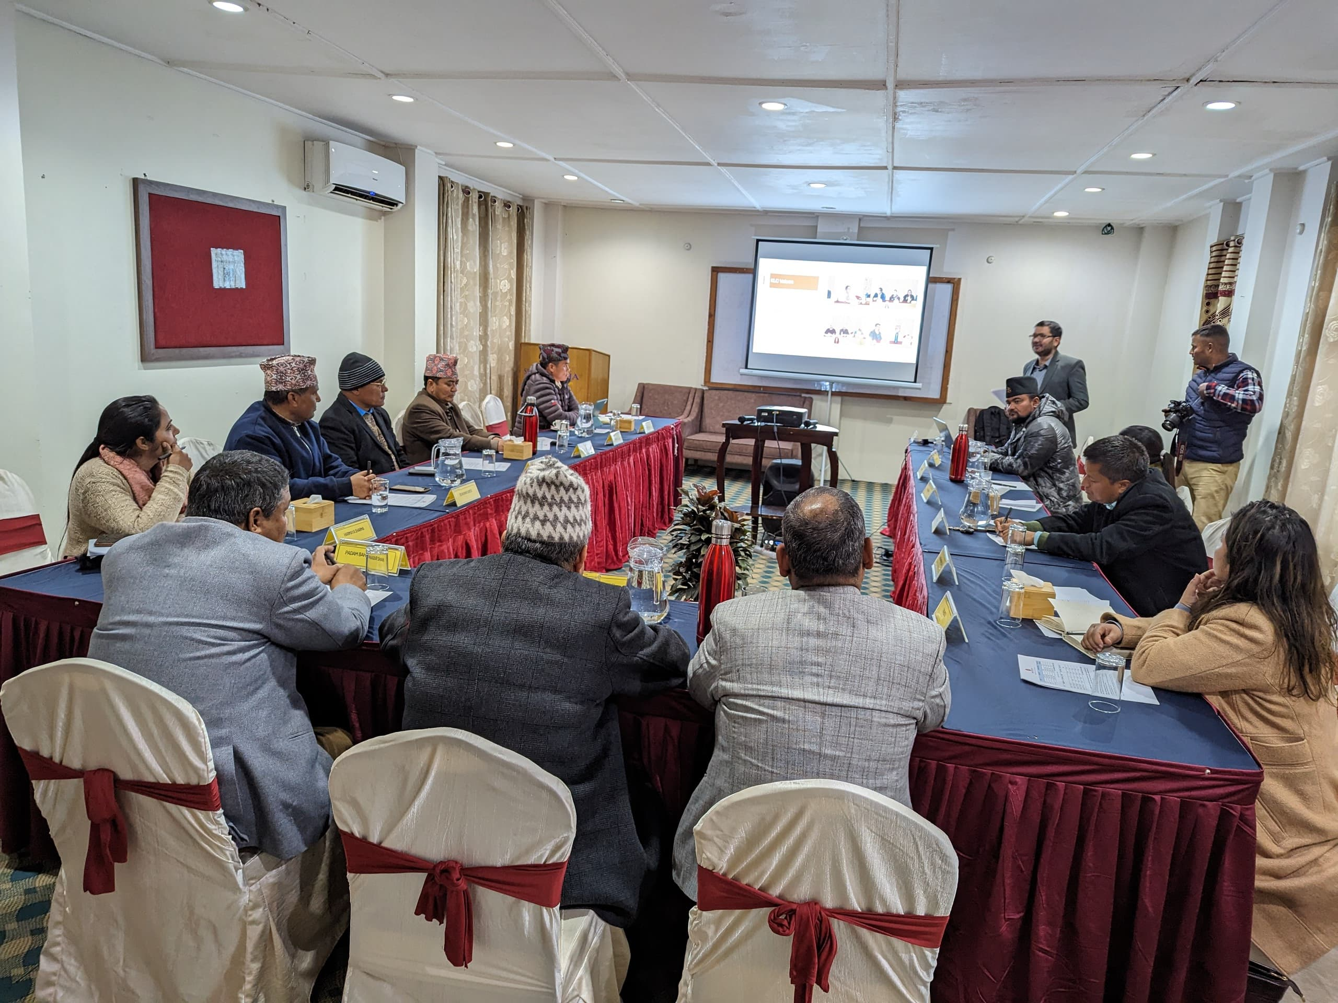
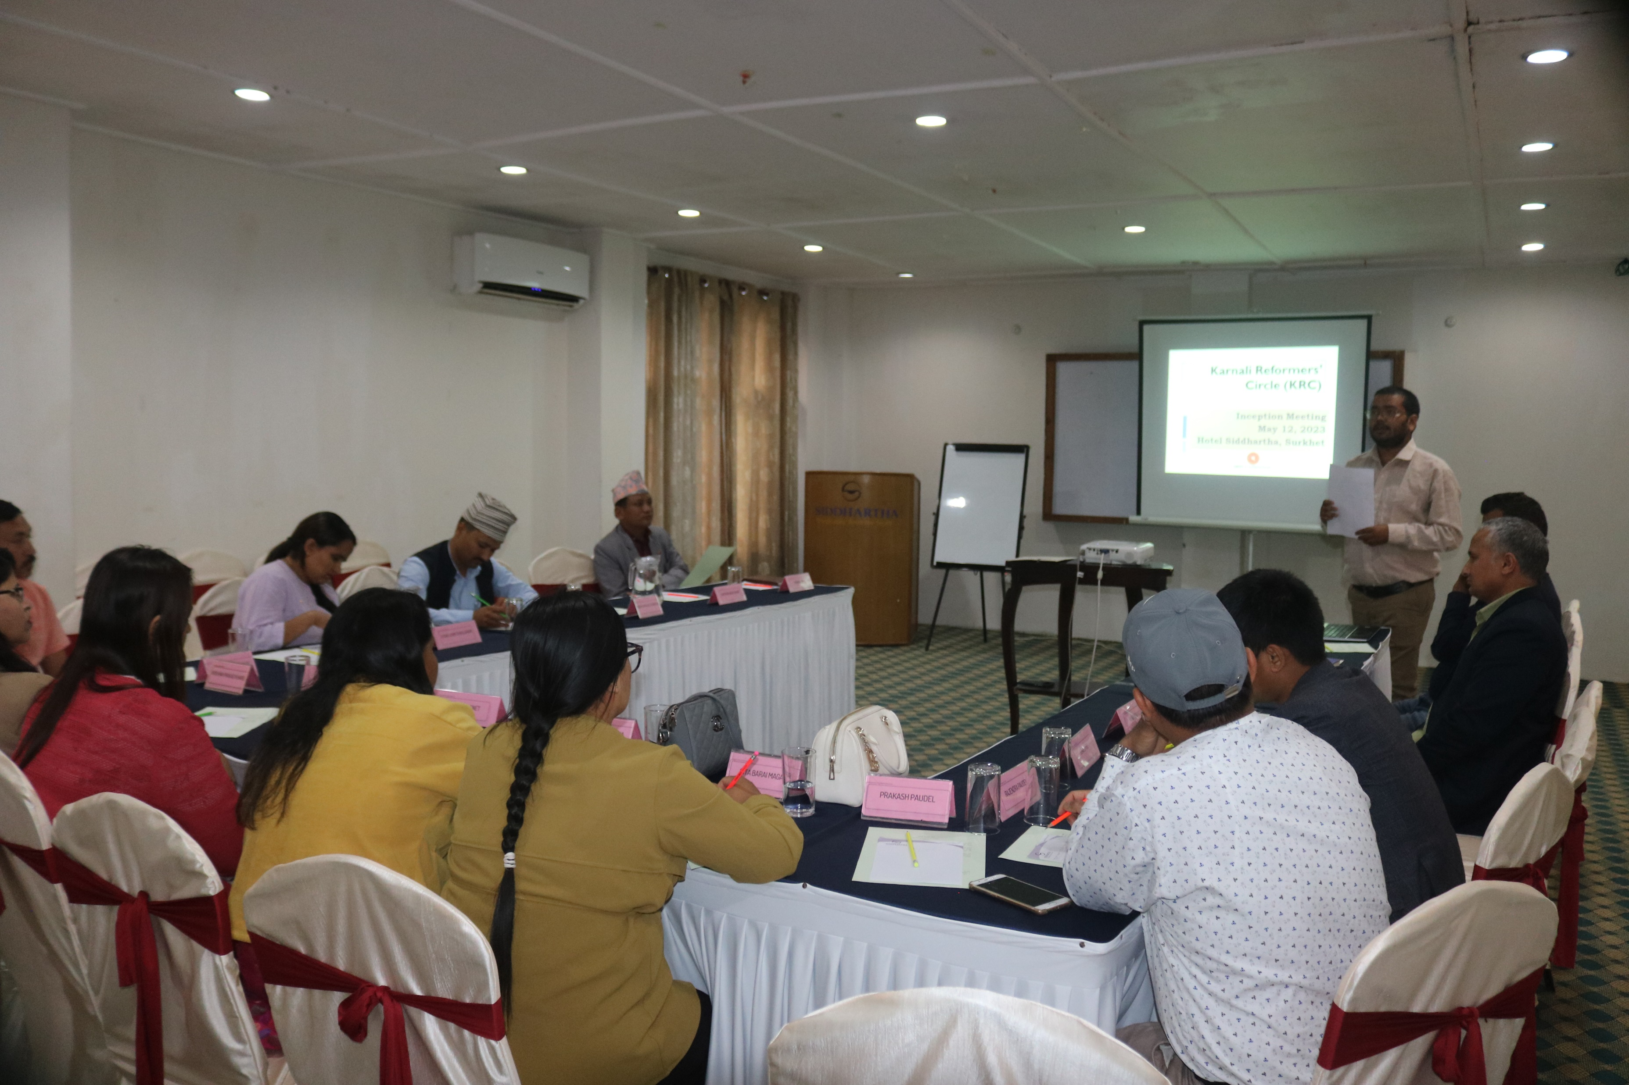
Circle
Karnali Leaders Circle (KLC)
A close forum of policymakers/politicians, private sector leaders, and civil society
Dinner meeting in each 2 months
Discussion based on political economy issues
Members are : former CM, former Speaker Mps, current finance minister, law minister, MPs, Vice-chair of Planning Commission, provincial leader of a political party, Private Sector, and CSO
Karnali Reformers Circle (KRC)
A close forum of the influential bureaucracy of Karnali Province
Dinner meeting in each 2 months
Discussion based on political economy issues
Members: Secretary, joint Secretary, Under Secretary and office-level bureaucracy of Karnali Province Government

Slide 8
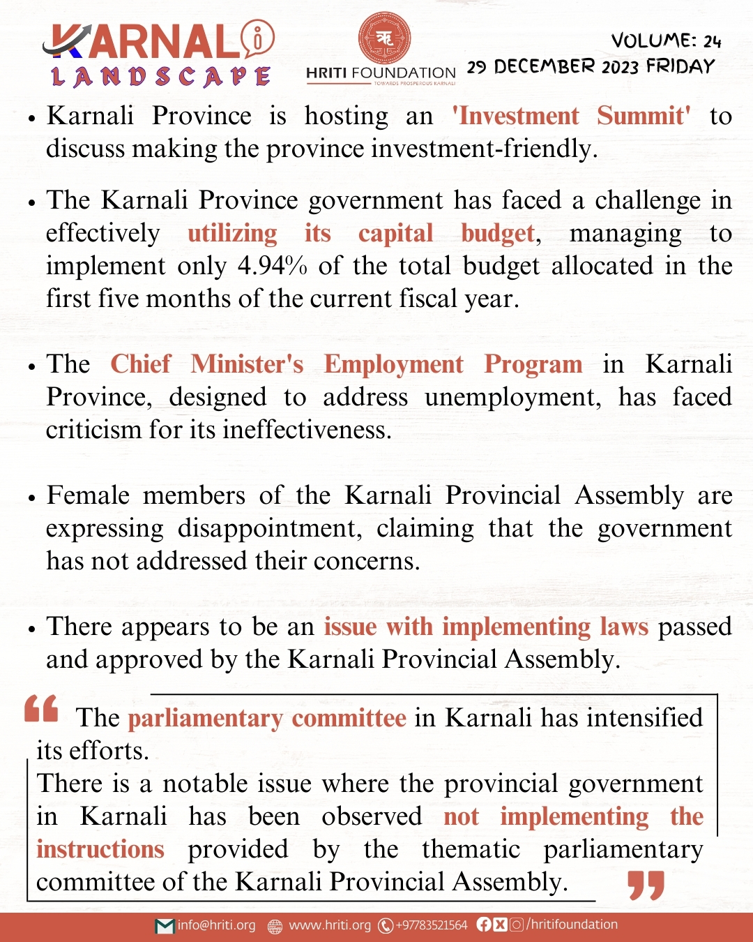
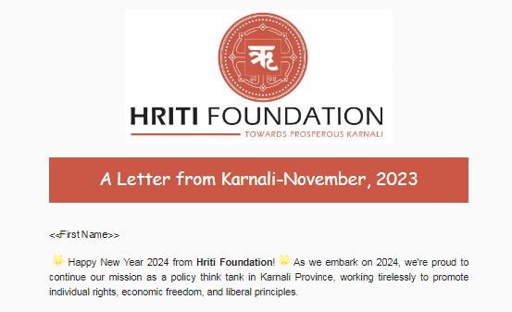
Regular Updates of Political-Economy Issues
Karnali Landscape (Weekly Update Series of economic issues of the Province)
A letter from Karnali ( Monthly update on economic-political issues of the province

Slide 9
Thank You

