Slide 1
Maddy Pattison-Sharp Institutional Advancement Associate
Notes:
Hi everyone, I’m Maddy and I’m an Associate on the Institutional Advancement team at the Center for Global Development (CGD). I’ve been working in fundraising for over 3 years now,

Slide 2
CGD Overview
Work to reduce global poverty and improve lives through innovative economic research that drives better policy and practice by the world's top decision makers.
We focus on the intersection of developing countries and the governments, institutions, and corporations that can help them deliver the greatest progress.
Notes:
CGD is think and do tank and we work to reduce global poverty and improve lives through innovative economic research that drives better policy and practice by the world's top decision makers.
We focus on the intersection of developing countries and the governments, institutions, and corporations that can help them deliver the greatest progress.
We have offices in Washington DC and London. (40 and 80 employees)
We generate new ideas, actionable policy proposals, and independent research, and spark critical global development conversations. Working on Global health, education, sustainable development finance, Migration, Europe and UK development policy.
Our scholars conduct rigorous, impartial analysis, informed by evidence and experts from around the world, to design practical policy solutions and spur intellectual debate.

Slide 3
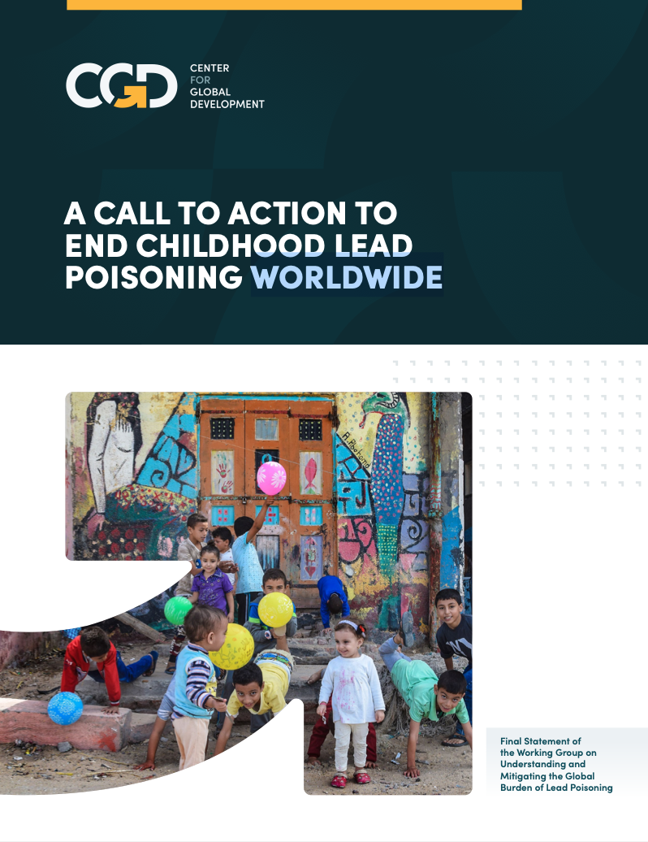
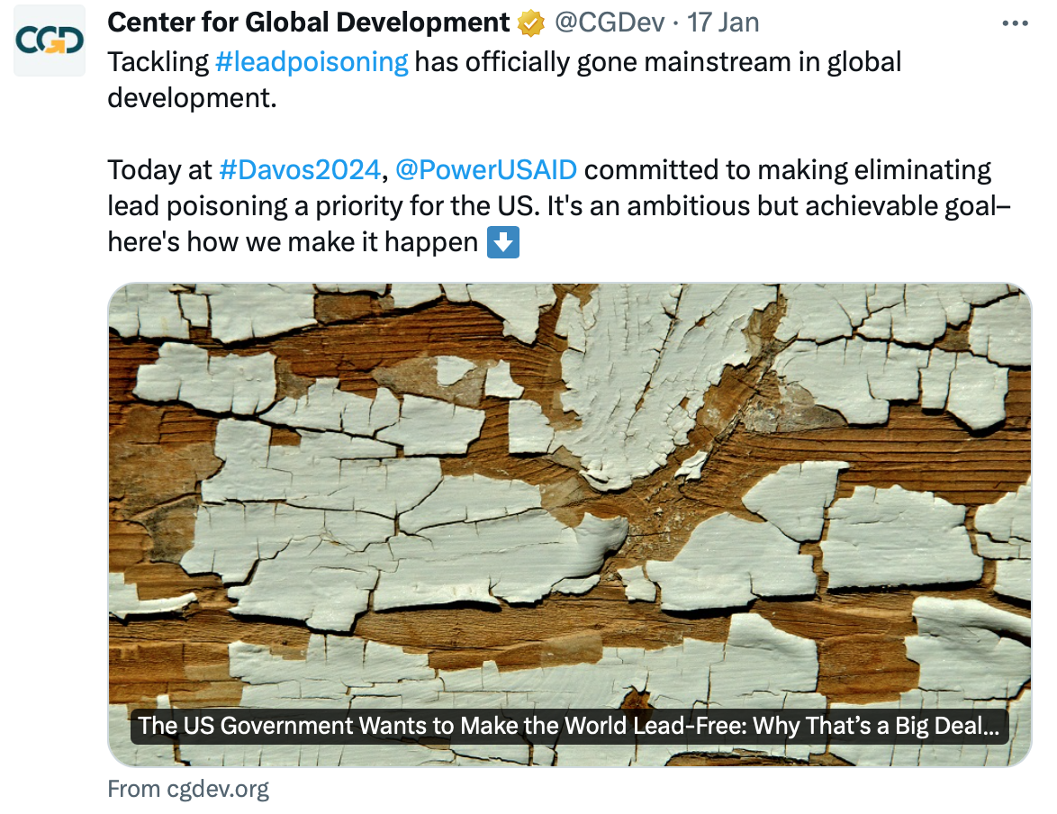
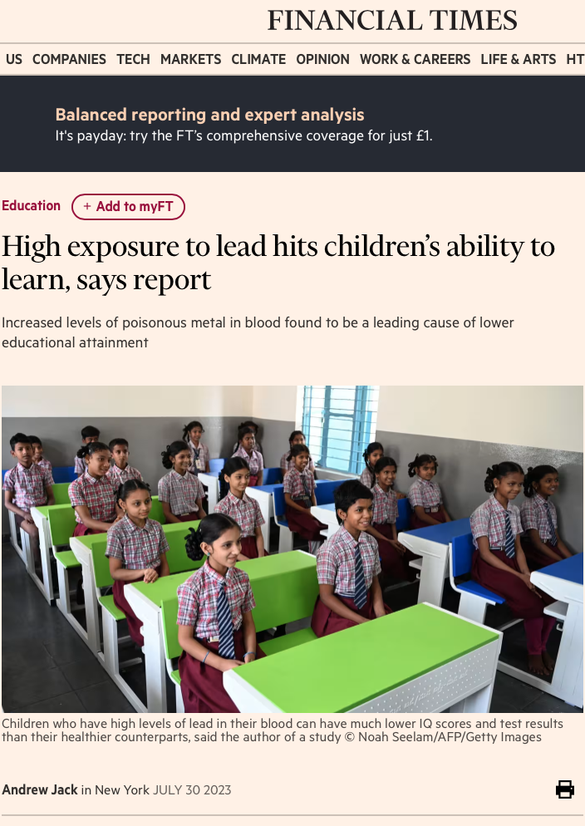
Recent CGD Successes
Understanding and Mitigating the Global Burden of Lead Poisoning.
Notes:
Lead poisoning – ceated working group of experts to raise the profile of this issue and end childhood lead poisoning. highlights the importance of GOS funding in pivoting, incubating, leading with ideas

Slide 4
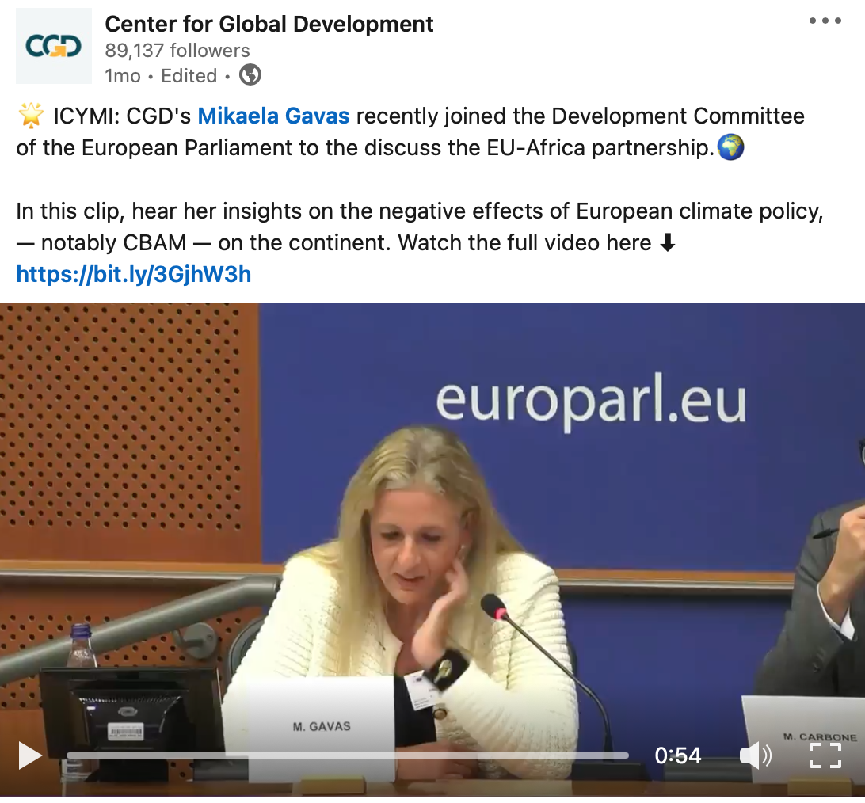
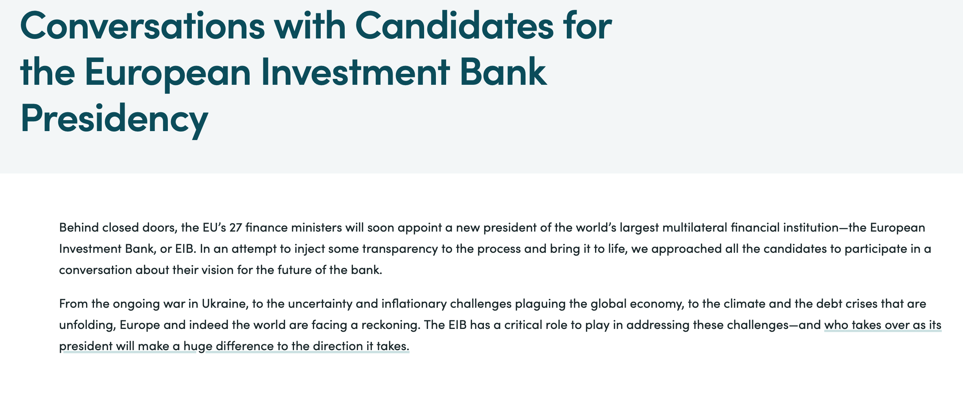
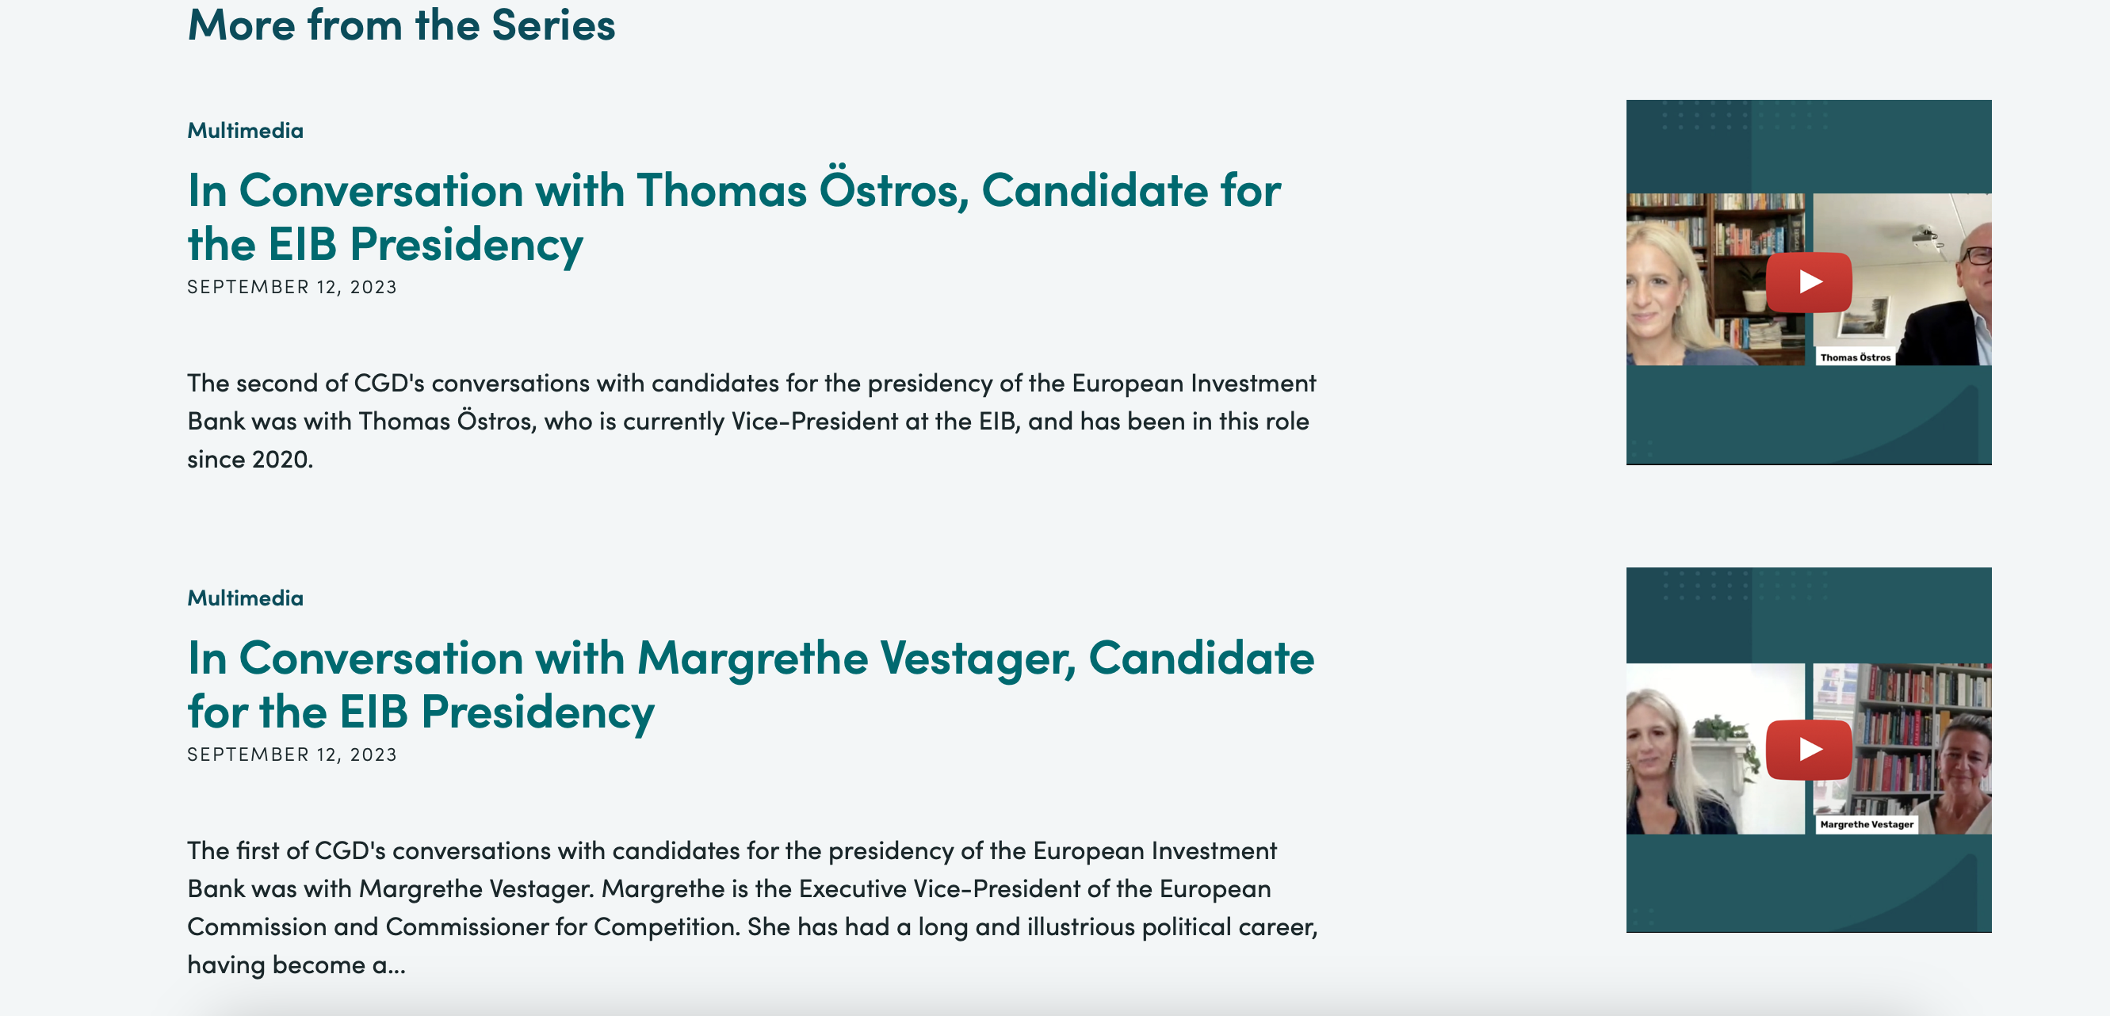
Recent CGD Successes
CGD as a trusted expert on European development topics and demonstrated convening power.
Notes:
Mikaela Gavas, Managing Director of CGD Europe and Senior Policy Fellow has been invited to share her analysis and insights with the Development Committee of the European Parliament. Alongside panel members, Mikaela will explore the relevance of the EU-Africa partnership within the current geopolitical landscape, how to build trust and increase mutually beneficial cooperation.
Interviewed EIB president candidates – convening power
CGD’s work generates practical proposals for Europe and the UK to enhance their effectiveness as global development actors and their collective impact within the international development system.

Slide 5
Challenge
Engaging with European Philanthropies and broadening networks with individual donors in Europe
Notes:
We have a good reputation and visibility in Europe, but haven’t fully managed to translate this to European philanthropies or individuals.
One challenge we face is how to increase our visibility and engagement with European philanthropies (foundations, org) and funders, broadening our networks with individual donors in the UK and Europe.
What has your experience been like of engaging with different funding environments? And also with different types of donors in these spaces? Can you share any advice?

