Slide 2
Introduction to Evidence Use
Emily Hayter (Senior Associate) & Racheal Makokha (Research and Projects Officer)
21 Feb 2024

Slide 3
Programme
Welcome and Introduction
Evidence use overview (Emily & Racheal)
Think tank experiences with evidence use (Frejus, Vaqar & Laura)
Q&A
Breakout sessions: hearing from you about your experiences
Feedback from breakout sessions

Slide 4
Our presentation
What you told us: your expectations
What other think tanks say
From evidence production to evidence use
What is evidence use?
Approaches, tips and practical tools
Key steps you can take
Voices of Evidence Users
OTT’s evidence use work & how we can collaborate

Slide 5
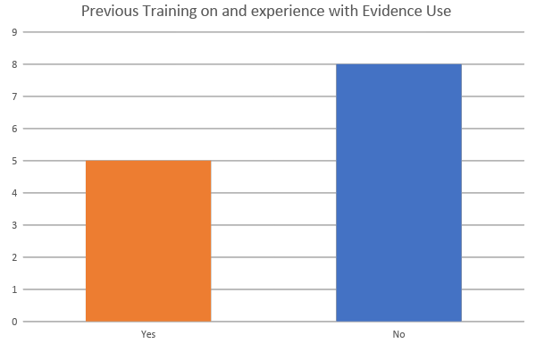
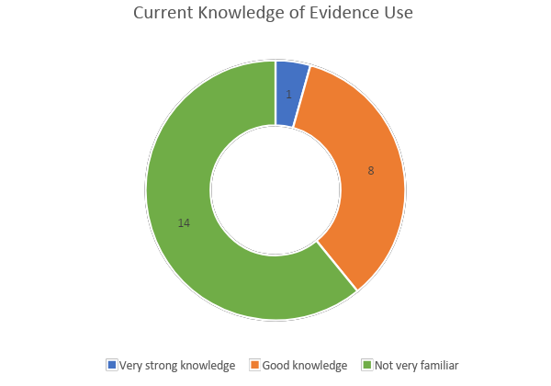
Your familiarity with evidence use

Slide 6
Your Expectations
Understand what evidence use is and why it is important
Understand what other think tanks consider good use of evidence, how they deal with uncertainty and what standards they have
Learn about innovative tools and methods
Share knowledge
Understand how evidence use is reflected in political practice and opportunities to strengthen this
Learn best practices around evidence use
Understand the role of funders in evidence use
Gain a technical understanding of evidence use with practical examples
Understand how new technologies such as ChatGPT impacts evidence use
Understand how evidence from fields like medicine is generated and used
How to analyse data and convert it into meaningful data

Slide 7
Evidence Use: what think tanks told us
12% of global think tanks surveyed in 2023 say evidence use and decision-making processes by government is one of the key challenges they face. (Baertl et al, 2023)
They cited the
  lack of common understanding of the importance of evidence use
  the difficulties of building relationships with policy actors and
  the difficulties in creating a demand for evidence use in policymaking as the main obstacles

Slide 8
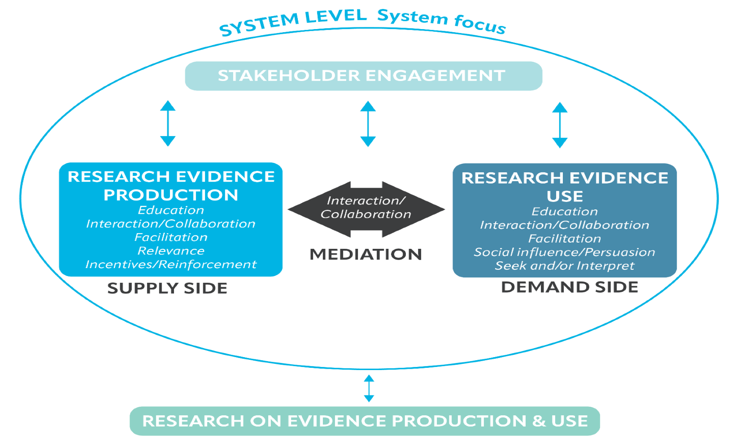
From evidence production to evidence use
Figure adapted from: Gough et al. (2011)

Slide 9
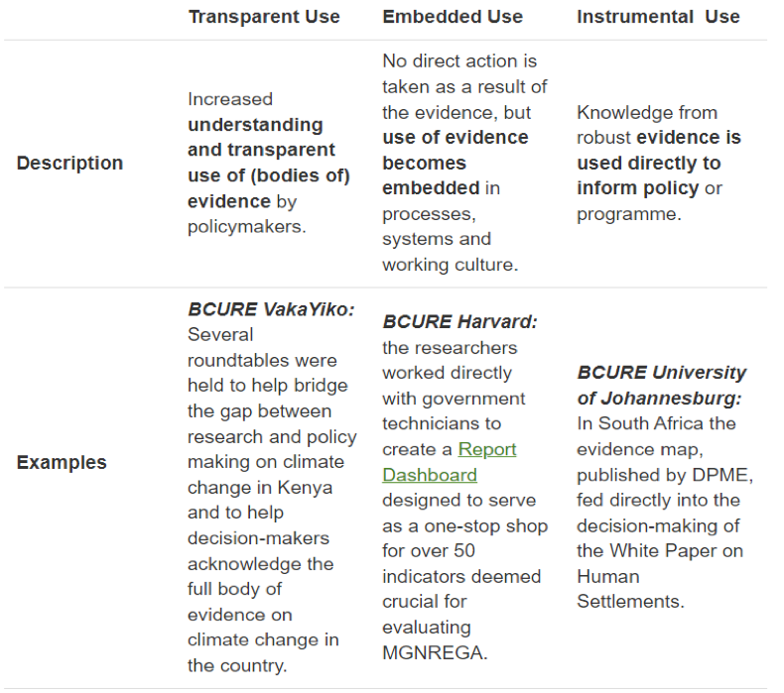
What is evidence use?
“Are there one-off evaluations that others have conducted on behalf of governments that informed large decisions?
Yes.
Did they change any of the underlying causes of underperformance within governments, including the incentives for using evidence in decision-making? No.”
Chris Chibwana (then of IDInsight, now Hewlett Foundation)
Notes:
Chris Chibwana quoted in Hewlett Foundation blog by Lucas and Altschuler, 2021 “How non-governmental organizations can help institutionalize government use of evidence: Four possible paths”

Slide 10






‘Institutionalising’ evidence use
By aiming towards institutionalizing EIPM within countries, evidence is meant to be regularly, systematically and transparently used in decision-making, allowing improvement in policy development for societal progress.”
“To institutionalize a process, approach or intervention is to make it integral to an organization, society or culture, so that it is seen as “normal.”
Supporting the routine use of evidence during the policy-making process: a WHO checklist, 2023
Notes:
Supporting the routine use of evidence during the policy-making process: a WHO Checklist. Geneva: World Health Organization; 2023. Licence: CC BY-NC-SA 3.0 IGO. https://www.who.int/publications/i/item/9789240056145

Slide 11
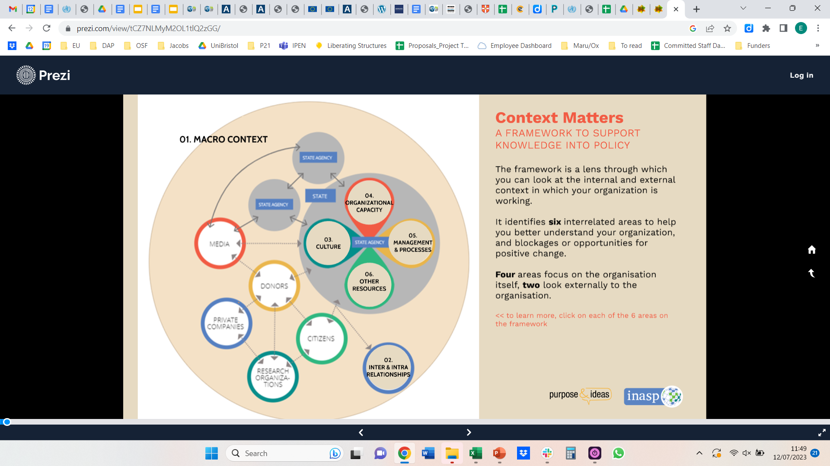
Evidence use is shaped by contextual factors
Political economy context
The evidence ecosystem
Organisational factors within ‘user’ agencies
Individual characteristics of evidence users
“An evidence ecosystem at a country level cannot be fully understood and appreciated without locating it in the context of a political and knowledge economy.”
Stewart, Dayal, Langer et al 2019.
Image: Context Matters Framework (Weyrauch et al, 2016)

Slide 12
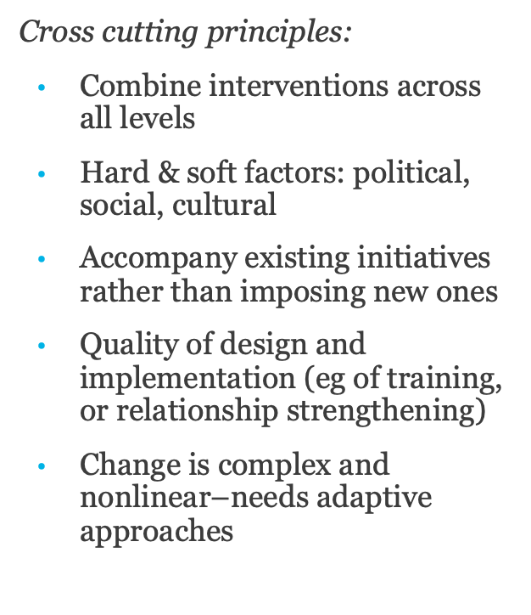
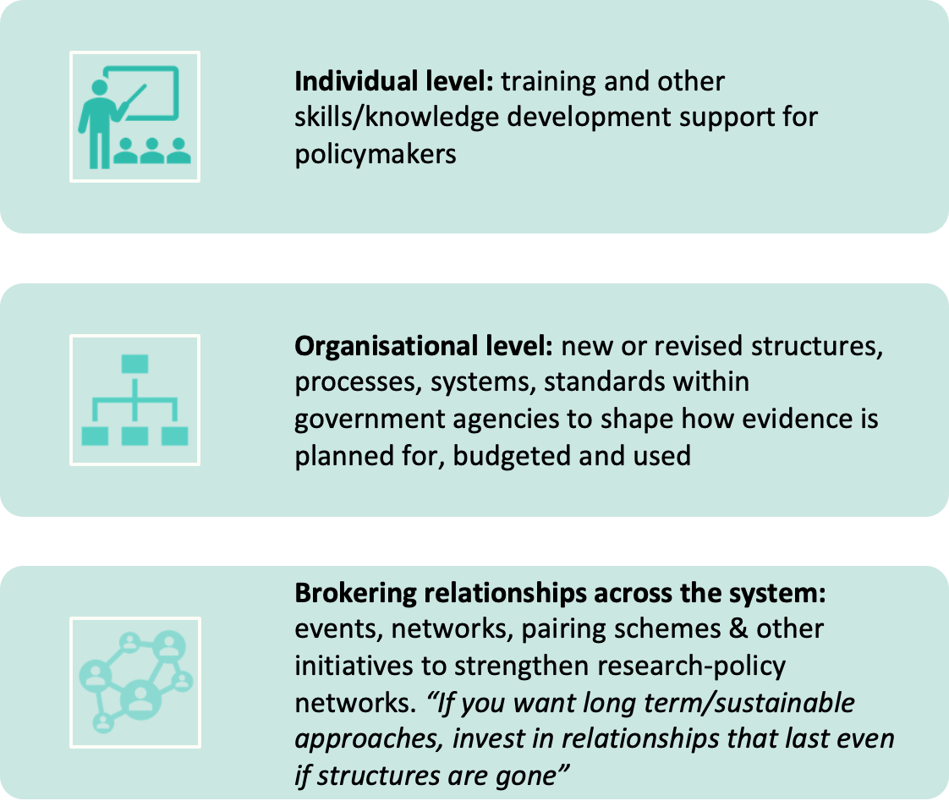
Approaches and ‘best practices’
Notes:
On how to do these things—practical tools listed in this blog https://onthinktanks.org/articles/practical-tools-to-support-evidence-use-in-policy-making/

Slide 13
Three things think tanks can do
Focus on relationships–get to know your evidence users, their realities and needs. Look for opportunities for co-creation.
Consult the evidence on ‘evidence use’--look at what’s been learned so far and what’s missing
Join & contribute to existing regional & global networks focused on evidence use

Slide 14

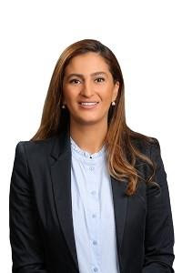
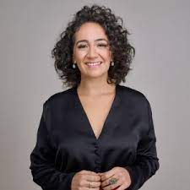
Voices of Evidence Users
We asked evidence users what advice they would have for researchers seeking to influence policy
“...for researchers to inform policy, it is indispensable to speak the language of policymakers. Knowledge translation is a key capacity.” Vinicius Campos, Strategic Projects and Policy Advisor, Parana State Department of Education, Brazil
“I strongly believe in the role of evidence intermediaries. These are key actors that sit between evidence producers and decision-makers. They are able to navigate local politics, and they are truly listened to by decision-makers. In my opinion, they have a key role to strengthen evidence-support systems.” Cristian Mansilla, formerly Ministry of Health, Chile
“ There are topics that the institutions work on which may not be a priority for the representatives, while there are issues for which representatives need specialised research. It is an issue of supply and demand.” HE Dina Al-Bashir, Jordanian Senator
“It is important to emphasise this: the delivery of evidence must be adapted to the target audience, avoiding standardised reports that do not dialogue with those who need to make decisions based on them.”Samara Mariana De Castro, Director of the Department for the Promotion of Freedom of Expression of the Secretariat of Communication of the Presidency of Brazil
Notes:
https://onthinktanks.org/series/evidence-users/

Slide 15
Think tank experiences with evidence use
Laura dos Santos Boeria, Veredas Institute (Brazil)
Frejus Thoto, ACED (Benin)
Vaqar Ahmed, SDPI (Pakistan)

Slide 16
Think tank experiences on evidence use
Why did your organisation decide to start working on evidence use?
What evidence or experience did you draw on in your work on evidence use?
How does politics affect evidence use in your context and how has your organisation navigated that in its work on evidence use?
How do you work to strengthen demand for evidence use?

Slide 17
Breakout Discussions
20 mins

Slide 18
Breakout session
What does demand for evidence look like and how can think tanks know if/where it exists?
What are the challenges and opportunities think tanks experience tackling evidence use in policy making?
What capacities do think tanks need in order to work on evidence use?

Slide 19
OTT’s evidence use work
Examples of current work
Developing a collaborative learning agenda on policy labs for the Jacobs Foundation
Preparing a meeting brief on evidence use for the BE2 education funders working group
Learning partner for the Data for Accountability Project
Research support for the University of Bristol and four African think tanks
What we’d like to do more of
Exploring how politics affects evidence use and how to navigate it
Focusing on evidence use in specific sectors
Strengthening organisational/structural elements of evidence use
Being evidence informed in our evidence use work

Slide 20
How OTT can support you
Advice on designing evidence use initiatives
Facilitate learning on evidence use
Support monitoring, evaluation and learning
Convening: well placed to facilitate dialogue within Southern national contexts, as well as between the North and South
Trusted donor relationships: act as knowledge brokers between donors and grantees
Partnerships and capacity strengthening for evidence users
A critical eye: questioning assumptions and power dynamics
Research and analysis: contribute to evidence use literature
Communications: provide visibility of evidence use work

Slide 21
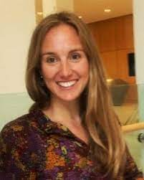
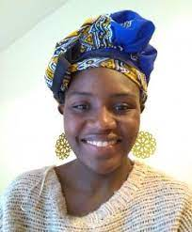


Stay in touch about evidence use
Emily Hayter, Senior Associate
ehayter@onthinktanks.org
Emily Hayter
Racheal Makokha, Research and Projects Officer
rmakokha@onthinktanks.org
Racheal Makokha

Slide 23
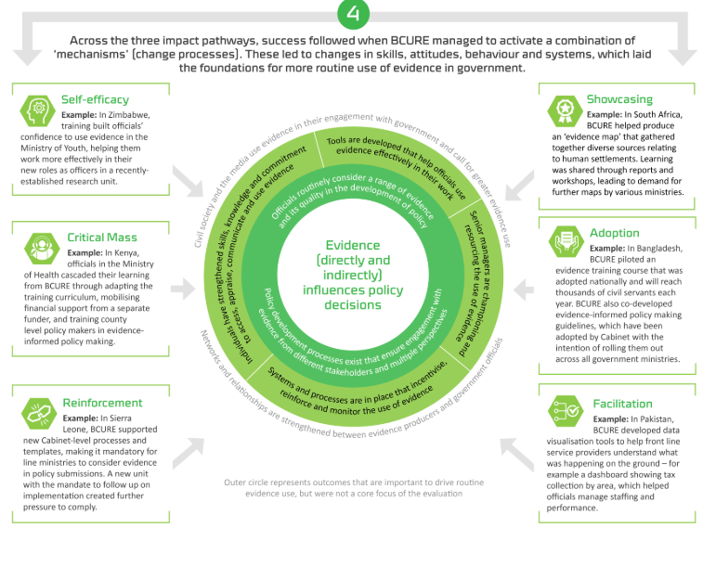
BCURE
“Working with governments to build capacity for evidence use requires a politically informed and multidimensional approach.
Capacity gaps should be viewed as just one element of a tapestry of factors that block or disincentivise evidence-informed policymaking.”
BCURE Evaluation 2018
Notes:
The evaluation of the whole programme was conducted by ITAD. 6 key lessons are summarised here: https://www.itad.com/wp-content/uploads/2020/02/BCURE-Final-Evaluation-Report-Exec-Summary-1-1.pdf

Slide 24
Example tools to support evidence use
Task | Tool
Identifying barriers & opportunities to evidence use in a specific context (esp institutional & organisational) | Evidence diagnostic: consider the Context Matters Framework; WHO Institutionalisation Checklist; Global Commission on Evidence RESSA & others
Developing a Theory of Change on evidence use | Framework in Chapter 3 of ‘Using Evidence in Policy & Practice: lessons from Africa’
Training public servants in accessing, appraising and using evidence | Nesta’s Engaging with Evidence Toolkit VakaYiko EIPM Toolkit European Commission JRC competency framework
Links available from: https://onthinktanks.org/articles/practical-tools-to-support-evidence-use-in-policy-making/ and https://onthinktanks.org/articles/evidence-use-diagnostic-tools-choosing-and-using-them/
Notes:
https://onthinktanks.org/articles/practical-tools-to-support-evidence-use-in-policy-making/

