Slide 1
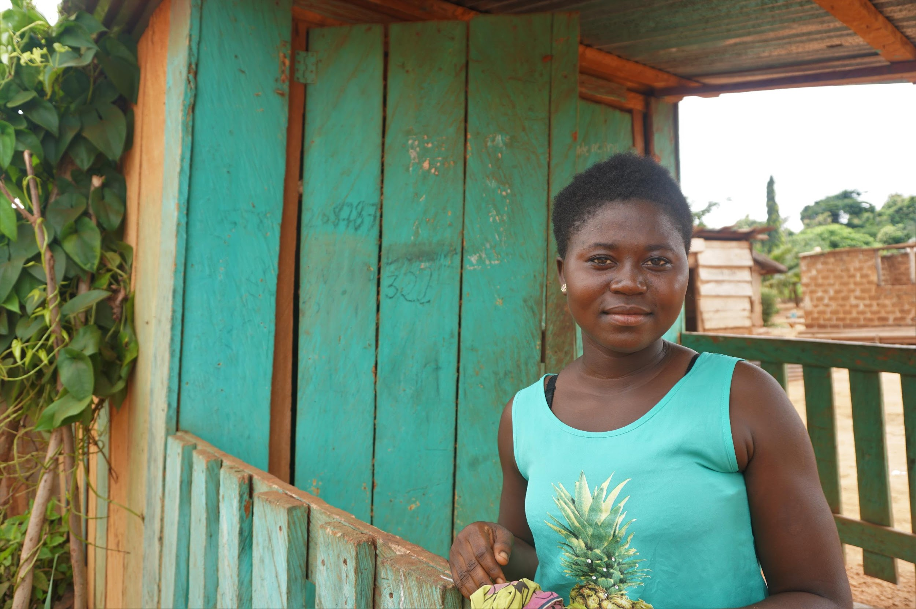

Welcome to IRC

Slide 2
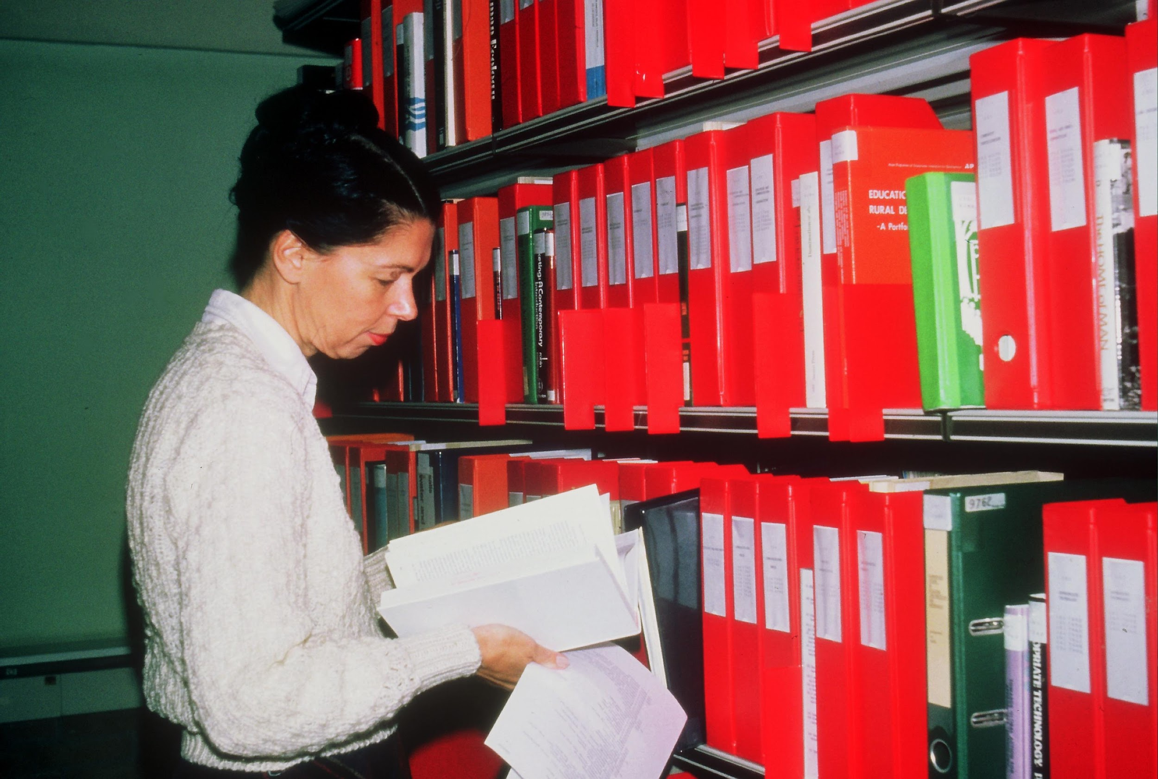
Notes:
Over those years – we changed a lot
We were known to be a knowledge broker. IRC was founded in 1968 under an agreement between the World Health Organization and the Government of the Netherlands as a hub for information dissemination, a 'knowledge broker'. We were the focal point of a world-wide network of collaborating institutions active in water supply research and development.
We turned into the international think-and-do-tank that we are today

Slide 3
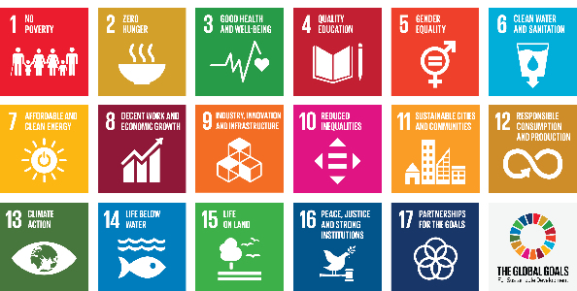
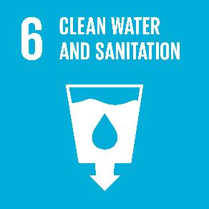
SDG 6
Ensure availability and sustainable management of water and sanitation for all
Notes:
We are IRC An international think-and-do-tank Working with governments, NGOs, entrepreneurs and people around the world. Together we find and implement long-term solutions to make access to safe water and sanitation available for everyone, for good.

Slide 4
The problem
Four billion people — almost two thirds of the world’s population — experience severe water scarcity for at least one month each year.
Over two billion people live in countries where water supply is inadequate. Over 3 billion who don’t have access to adequate sanitation. (infrastructure vs systems focus)
Half of the world’s population could be living in areas facing water scarcity by as early as 2025.
Some 700 million people could be displaced by intense water scarcity by 2030.
By 2040, roughly 1 in 4 children worldwide will be living in areas of extremely high water stress.
Ref: UNICEF

Slide 5
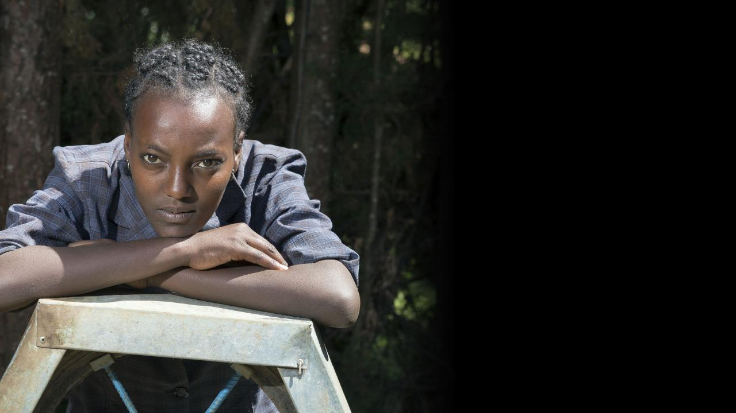
Yesterday’s solutions won’t work
Petterik Wiggers/Panos Pictures UK
Notes:
All of us involved in this know that

Slide 6
Resilient systems: the only way
We know that the only way to achieve this goal is through resilient water, sanitation and hygiene (WASH) systems that transform lives.
We know how to build and strengthen these systems - but we need to do it now.
It will take everyone, in all parts of the system, changing the way they think and work.
Notes:
Collective action and systems

Slide 7
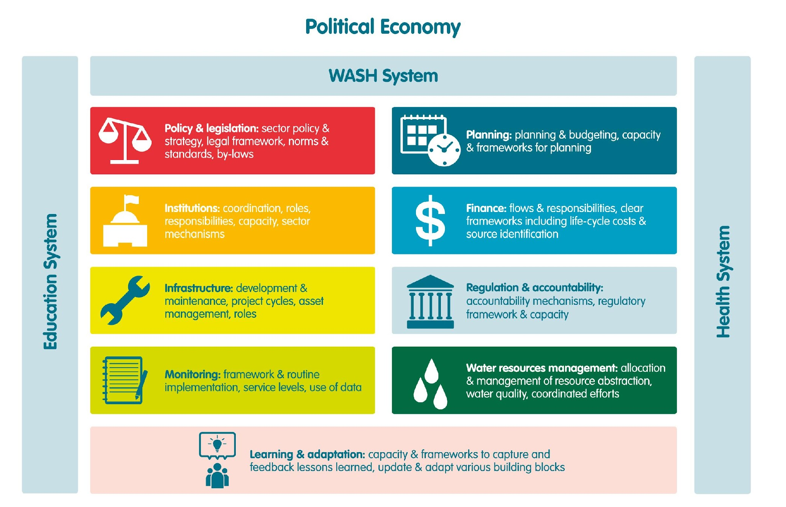
Notes:
By helping break down the complexity of WASH systems

Slide 8
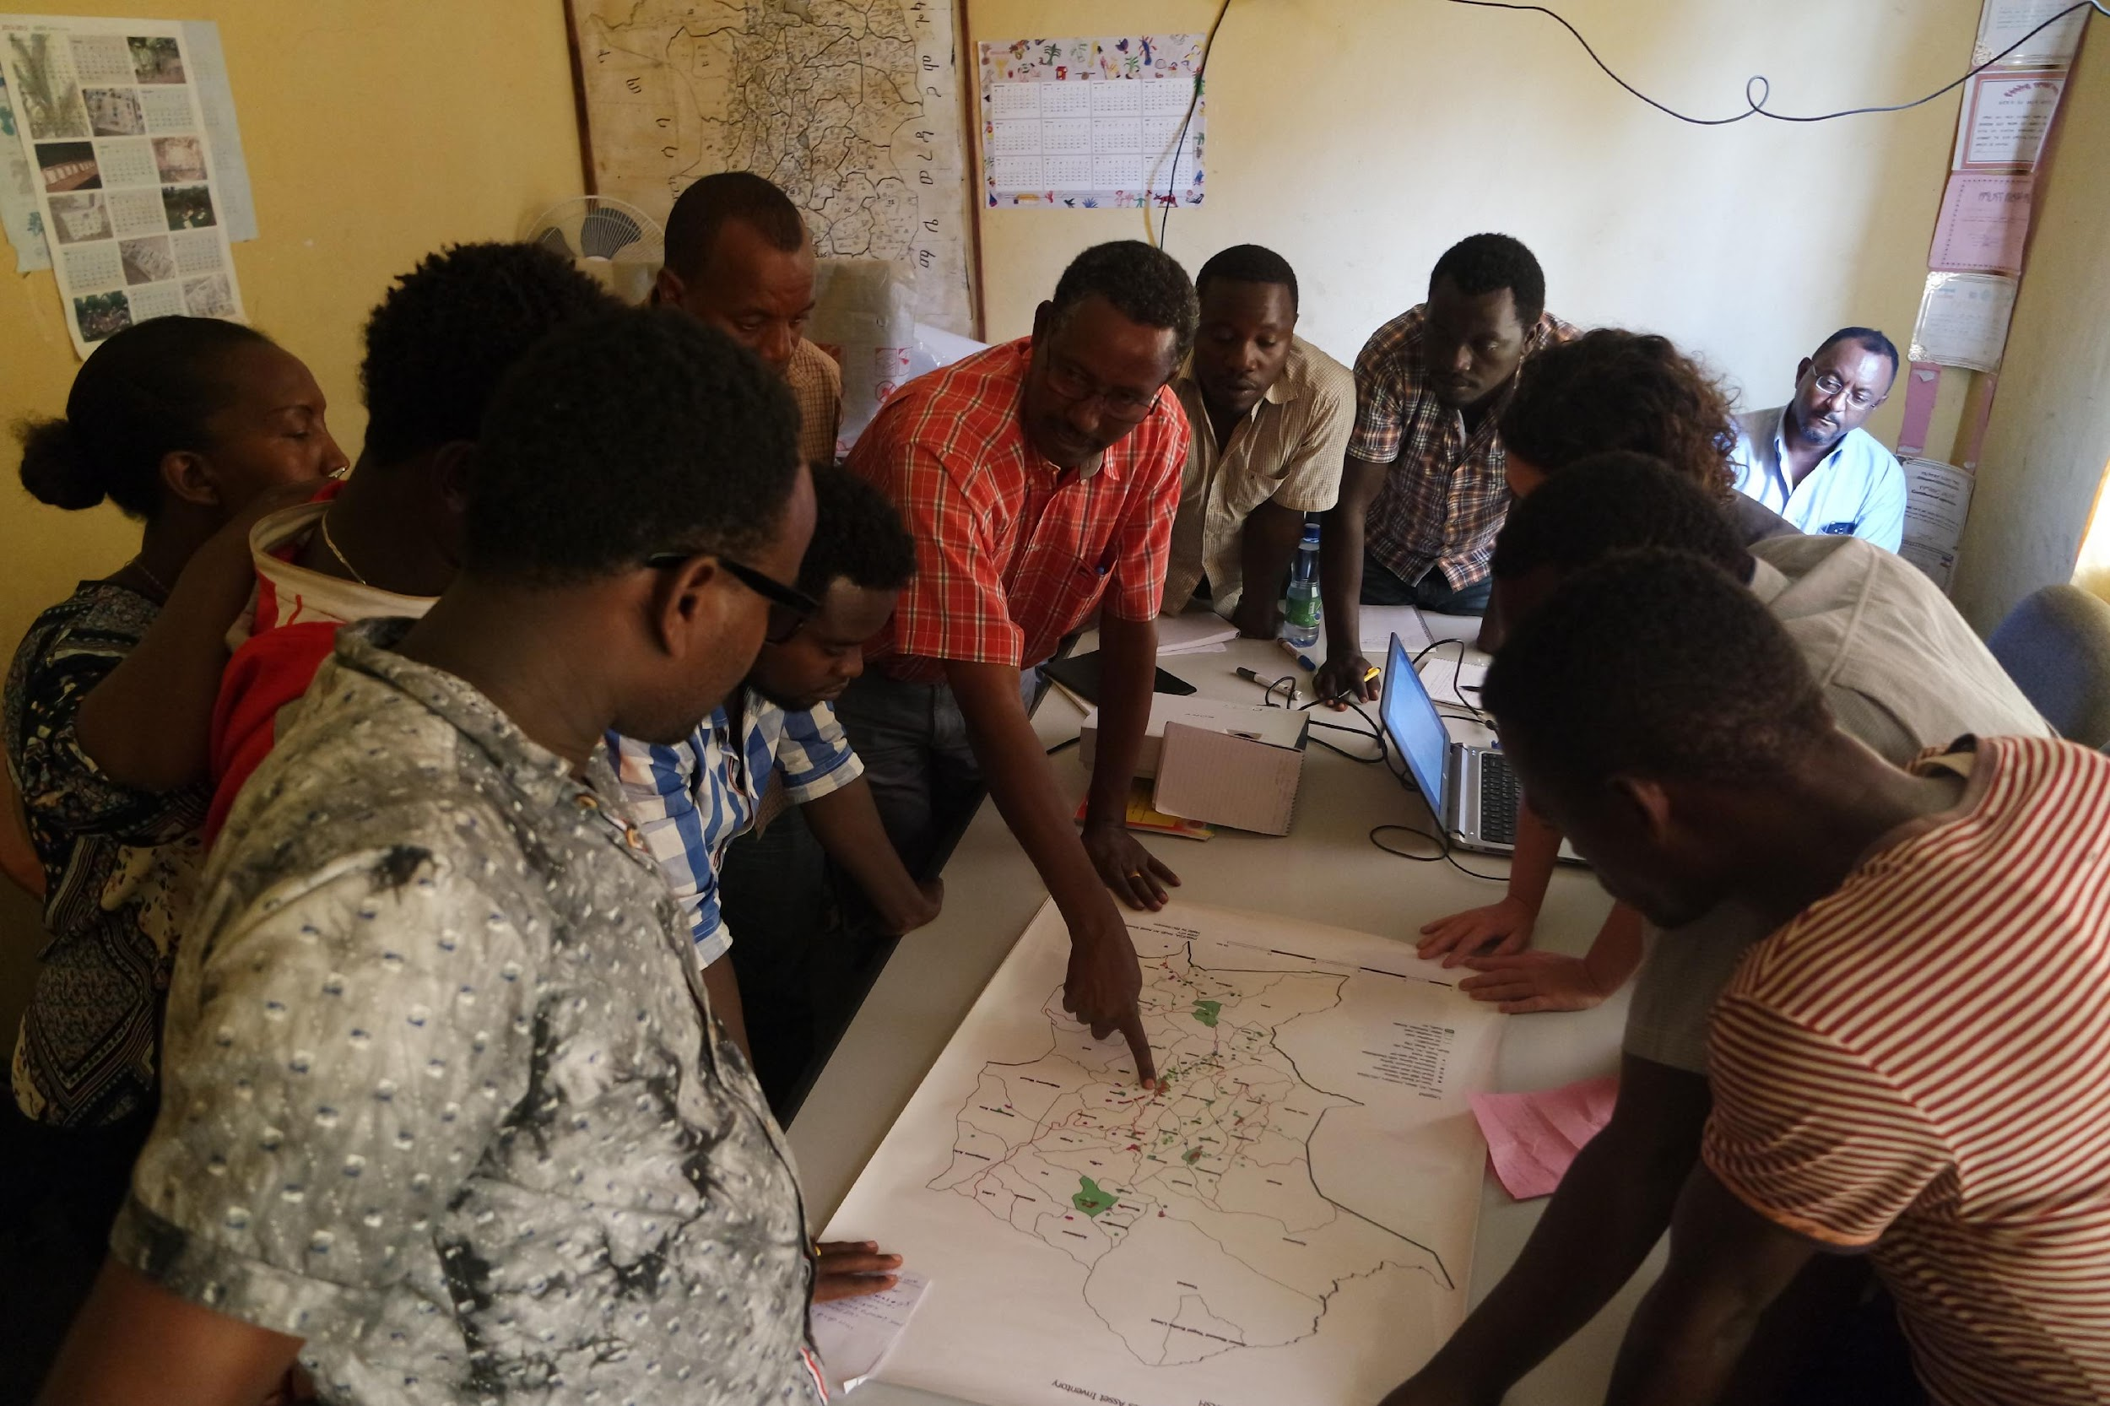
DISTRICT
Notes:
We work at district level

Slide 9
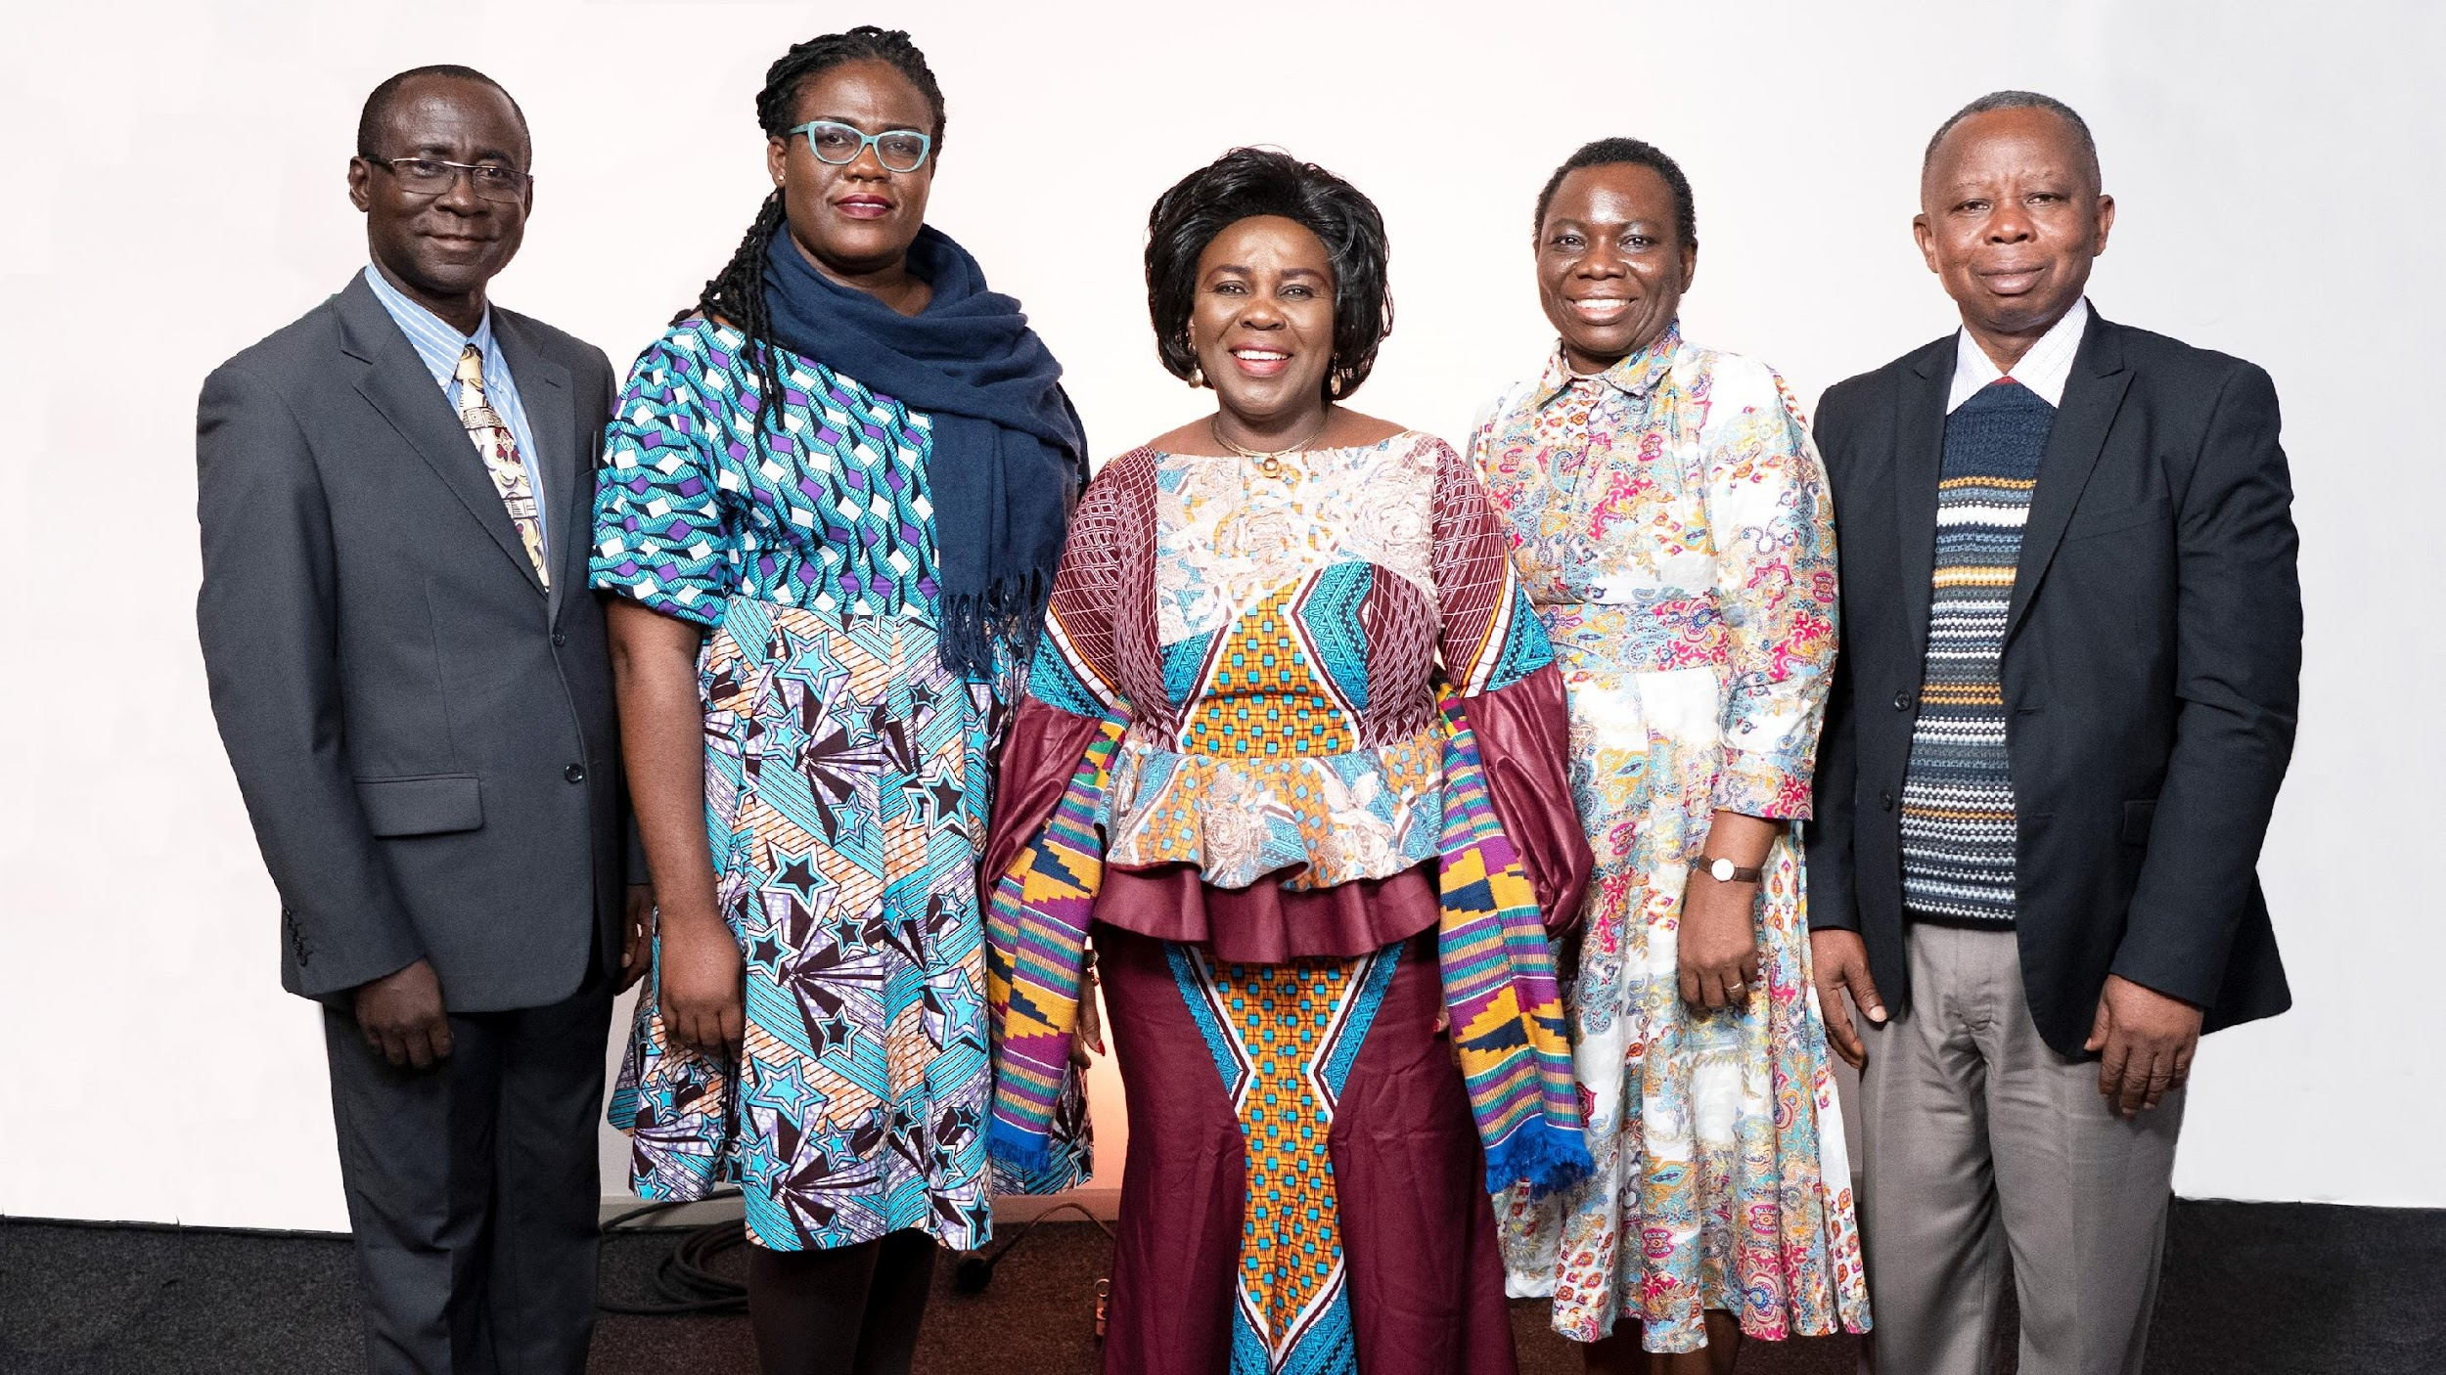
NATIONAL
Notes:
And we use district evidence to bring national change in 8 focus countries and additional 20+ countries we work in through consultancies

Slide 10
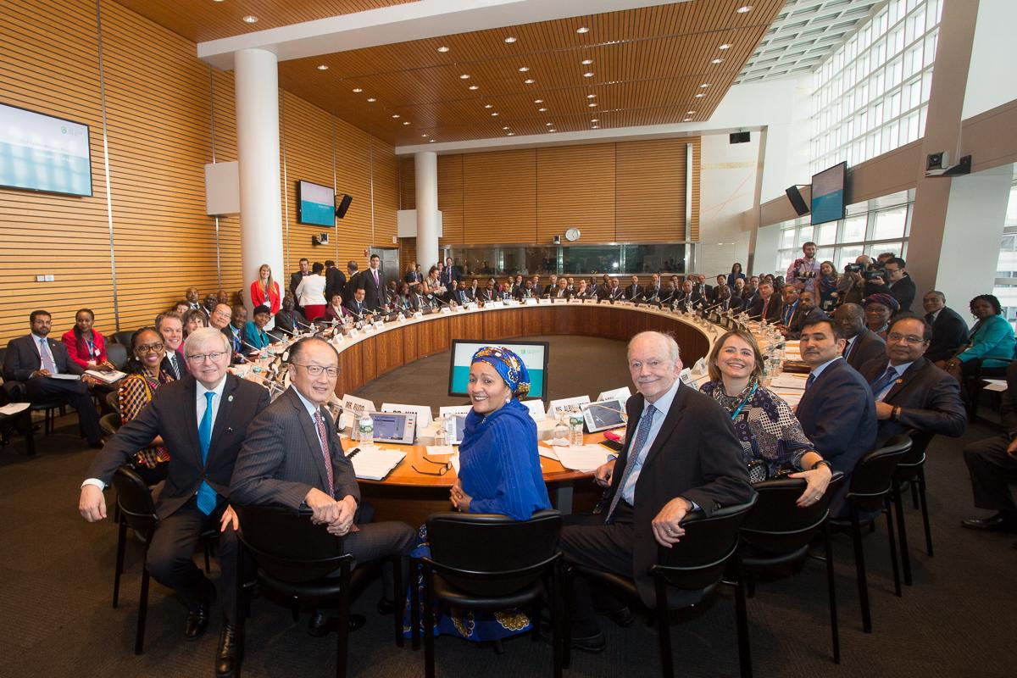
GLOBAL
Photo: SWA, 2017 Global Finance Ministers Meeting
Notes:
And take that to global level

Slide 11
Notes:
At the same time we develop tools for global knowledge sharing like the WASH Systems Academy, our online learning platform.

Slide 12
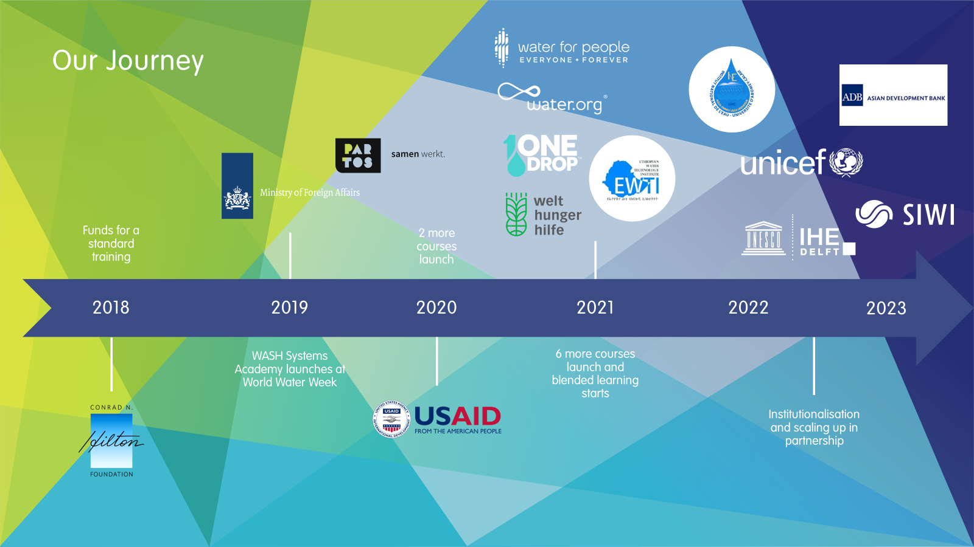
Notes:
At the same time we develop tools for global knowledge sharing like the WASH Systems Academy, our online learning platform.

Slide 13
We call on you for:
Your experience with decentralising think tanks
- Power shift to Global South
- Rethinking think tank identity and functions (e.g. comms)
Building networks, finding programming niche and identifying fundraising opportunities in Europe
Partnerships around
- Connecting out of water with other sectors (e.g. social justice, economic development, finance, climate, health)
-Joint WASH Systems Academy courses

