Slide 2
Introduction & Objectives
22 January 2025
Notes:
Camila

Slide 3
Welcome!
Notes:
Camila

Slide 4
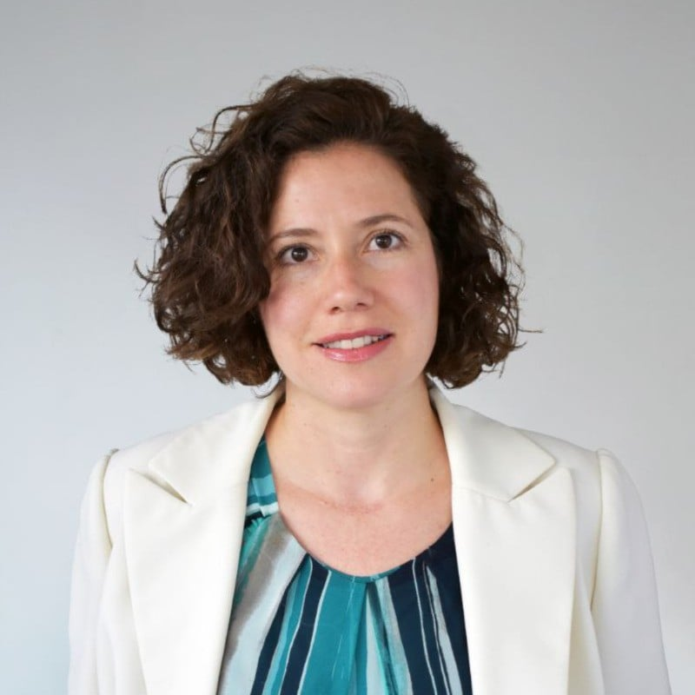
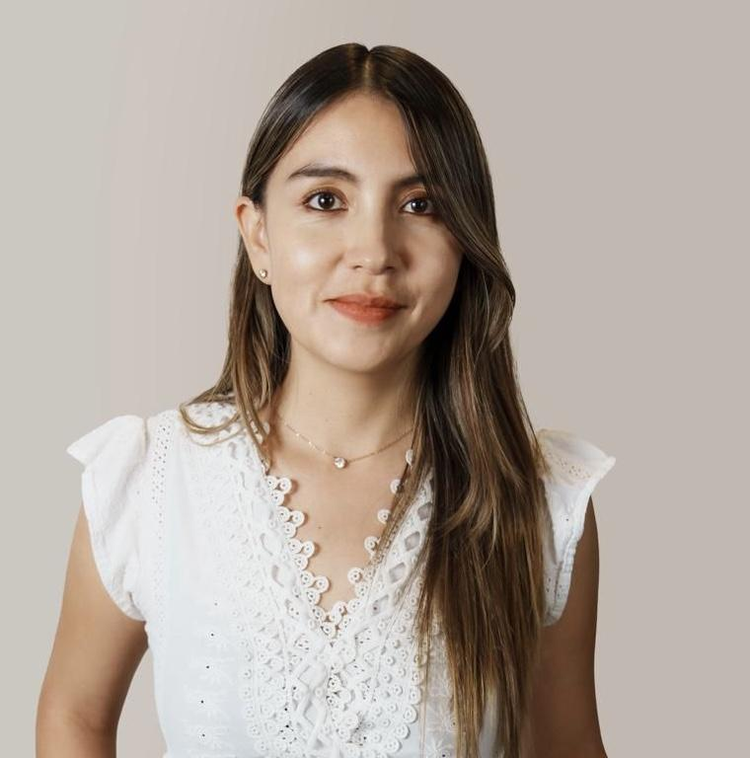
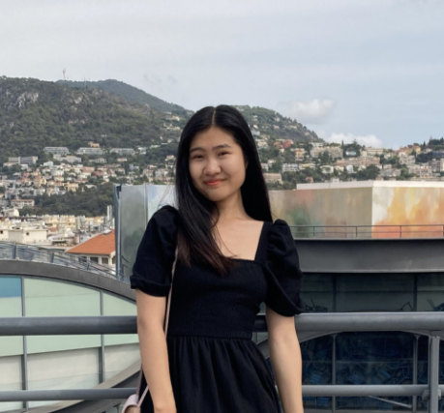
School for Thinktankers team
Estefania Teran Valdez
Camila Ulloa
Selenge Dima
Notes:
Camila

Slide 5
Overview
Refer to the Programme Overview document on the website
Notes:
Camila

Slide 6
What to expect
The School is a five-day onsite intense learning course – a bootcamp for your mind!
Individual and collective learning
Less theory, more emphasis on practice and what works
Networking opportunities
Opportunities to showcase your work
Presentation – 3 mins
Poster (optional) - size 11*14 or 16*20 max
Notes:
Camila

Slide 7
Programme in Barcelona

Slide 8
Date | Monday, 3 Feb | Tuesday, 4 Feb | Wednesday, 5 Feb
Focus of the day | Contextualising think tanks across the policy ecosystem | Good governance & people management | Policy influence and partnerships for change
 | Good governance & people management | Finance and Fundraising
Location | Bofill | Bofill | Bofill / CIDOB
9:00am - 9:30 am | Free time | Institutional visit: Bofill Hub | Tools and tactics for strategic partnerships Lilia Rizk, Policy Center for the New South
9:30am - 10:00 am
10:00am - 10:30 am | Welcome & getting to know each other
10:30am - 11:00 am
 |  | Break
11:00am - 11:30 am | Break | Strategic thinking and innovative leadership Mònica Nadal, Bofill | Break
11:30 am - 12:00 pm | Think tanks across the policy ecosystem Enrique Mendizabal, OTT |  | Policy relevant agendas Áurea Moltó, Elcano Royal Institute
12:00 pm - 12:30 pm
12:30 pm - 1:00 pm
1:00 pm - 1:30 pm | Lunch | Lunch
1:30 – 2:00 pm |  |  | Lunch
2:00 pm - 2:30 pm | Building an effective TT culture Sonja Stojanovic Gajic | Fundraising strategies for uncertain times Goran Buldioski, Hertie School
2:30 pm – 3:00 pm |  |  | Group activity OTT Team
3:00 pm - 3:30 pm
3:30 pm - 4:00 pm
 |  |  | Walt to CIDOB
4:00 pm - 4:30 pm | Break | Break | Institutional visit: CIDOB Measure impact and global influence Pol Morillas and Pol Bargués, CIDOB
4:30 pm - 5:00 pm | Reflections around the identity of a think tank: Bofill case Marc Garriga, Bofill | Group activity OTT Team
4:30 pm - 5:30 pm
Evening | Free time | Group dinner at 7.00 pm | Free time
Notes:
Camila

Slide 9
Date | Thursday, 6 Feb | Friday, 7 Feb
Focus of the day | Communications for impact | Future-proofing think tanks
 |  | Wrap –up and Lessons Learned
Location | La Caixa/ Bofill | Bofill
9:00 am - 9:30 am | Institutional visit/tour: La Caixa | Think Tanks and the future Krizna Gomez, Tala Strategies (Foresight, Systems Change and Impact Strategy)
9:30 am - 10:00 am
10:00 am - 10:30 am
10:30 am - 11:00 am
 | Walk to Bofill
11:00 am - 11:30 am | Communications in complex context David Watson, Chatham House | Break
11:30 am - 12:00 pm |  | Incorporating AI into the think tank’s DNA Ismael Gómez, OEI
12:00 pm - 12:30 pm
12:30 pm - 1:00 pm
1:00 pm - 1:30 pm | Lunch | Farewell Lunch
1:30 – 2:00 pm
2:00 pm - 2:30 pm | Workshop: How to build a think tank website for diverse audience groups John Schwartz and Alice Vulliamy, Soapbox | Reflection on AI integration: Bofill case Lídia Climent, Bofill
2:30 pm – 3:00 pm
3:00 pm - 3:30 pm |  | Group reflection activity and OTT wrap up
3:30 pm - 4:00 pm
4:00 pm - 4:30 pm | Break | Closing ceremony
4:30 pm - 5:00 pm | Workshop: How to build a think tank website for diverse audience groups John Schwartz and Alice Vulliamy, Soapbox
4:30 pm - 5:30 pm
Evening | Cocktail reception
Notes:
Camila

Slide 10
Setting expectations & objectives
Notes:
Camila

Slide 11
1. What would you like to learn during the School (skills/topics)?
Strategic and effective fundraising
How to do comms effectively
Building a strong brand
Attracting and retaining sponsors
Attracting unrestricted funding
Partnership building
Effective fundraising
Improving outreach
Improve interface
How to explain what a think tank is to people who don’t know
Optimise thematic/portfolio teams cross-collaboration
Introduction to policy analysis
How to improve influence of research.
How to develop the Think Tanks identity. Can non-partisan think tanks exist?
Staff time allocation models
Partnership development
Research Agenda Identification abd Setting
How to ensure Independence
-Strategic communication and fundraising
Budgeting and finacial management
What are the most effective “deliverables” to be produced by a Think Tank? Policy brief, video, blog, podcast?
Publishing and circulating think tank reports
How to enable a productive dialogue within the ThinkTank? What are the key needed skills?
Is a Think Tank always a tool to enable science-policy interface?
Models to work with individual experts and SMs
Partnerships with other think tanks and nonprofit organizations
How to teach students to write effective policy briefs and also how to introduce students to Think Tanks and learn about opportunities to engage with Think Tanks, especially via internships.
Notes:
Camila

Slide 12
1. What would you like to learn during the School (skills/topics)? Page 2
How to formulate a policy message for impact
linking local issues with global challenges
Establishing a think tank amidst uncertainty
How to internationalise our think tank
Notes:
Camila

Slide 13
2. Is there a specific issue/problem you would like to improve or resolve?
Consider which sessions that would be useful
New think tanks sometimes find it hard to gain legitimacy? How can we do this?
I want to see if our new website is good for different audiences
How to produce reports in a timely and cost-effective way
New ideas to further stimulate engagement from/keep our members stimulated (who are all student volunteers)
How to articulate added value of think tank work for different stakeholders and broader society
How to mediate different views from the public.
How to remain attractive to sponsors. Who are the groups to target?
- How to collaborate effectively with Think Tanks, creating university -Think Tank partnerships and internships for students.
Website clarity, inclusivity, quality
Presenting added value to potential stakeholders
Identifying policy relevant research agengendas
How can strong collaboration can be established with policy makers/users of the research findings
How to develop Proposal and writing with impact
Notes:
Selenge

Slide 14
2. Is there a specific issue/problem you would like to improve or resolve?
Consider which sessions that would be useful. Page 2
Notes:
Selenge

Slide 15
3. What objectives or concrete results do you want to achieve after the School?
Collaborate with On Think Tanks
Global network of Think Tankers
Create synergies among the think tank community
Gain a better understanding of how our university can work with Think Tanks, creating opportunities for students and faculty to engage.
Notes:
Selenge

Slide 16
3. What objectives or concrete results do you want to achieve after the School? Page 2
Notes:
Selenge

Slide 17
Logistics
Refer to the Programme Overview and the Barcelona City Guide on the website
Notes:
Selenge

Slide 18
Course website & communication
All course materials and details are available on the website www.ott.school in the School for Thinktankers 2025 course page (password: SFTT2025OTT).
We will use Slack for all communication. No emails!
Slack is your community space. Use it to share ideas, comments, questions, and links to relevant articles/podcasts/videos.
Notes:
Selenge

Slide 19
Barcelona
All morning sessions will be held at Bofill. We will walk to La Caixa and CIDOB as a group – prepare to stretch your muscles!
A light lunch will be provided during the School and coffee breaks daily to keep us refreshed and energised.
Group dinner on Tuesday, 4 February at 7.00 pm at El Mercat.
Do bring:
Warm clothes and shoes with thick soles
An umbrella in case it rains
Laptop/notebook/tablet (and adaptors)
Business cards, posters
A little piece of home to share
Check our Barcelona city guide for more information on what to bring, do and see
Notes:
Selenge

Slide 20
Next steps
Notes:
Camila

Slide 21
Participant presentations –
Upload PPT before 30 January
Posters – let Camila know by 29 January
Group dinner – we’ll be in touch
See you in Barcelona!
Notes:
Camila

Slide 22
Questions?

