Slide 1
Beyond Polarisation: A Myanmar Dialogue
Ngu Wah Win
Knowledge Circle Foundation
Centre for Economic and Social Development

Slide 2
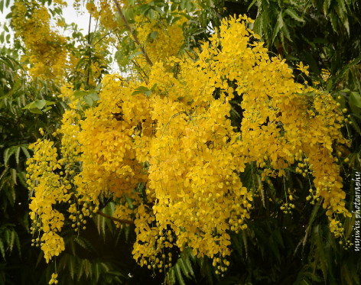
About me and my organization
Ngu Wah
Myanmar-based policy research think tank dedicated to advancing socio-economic equity and sustainable development
Myanmar was accepted as an EITI Candidate in July 2014
First mW setting 2014 – facilitated
Develop and adopt Aquaculture Development Plan

Slide 3
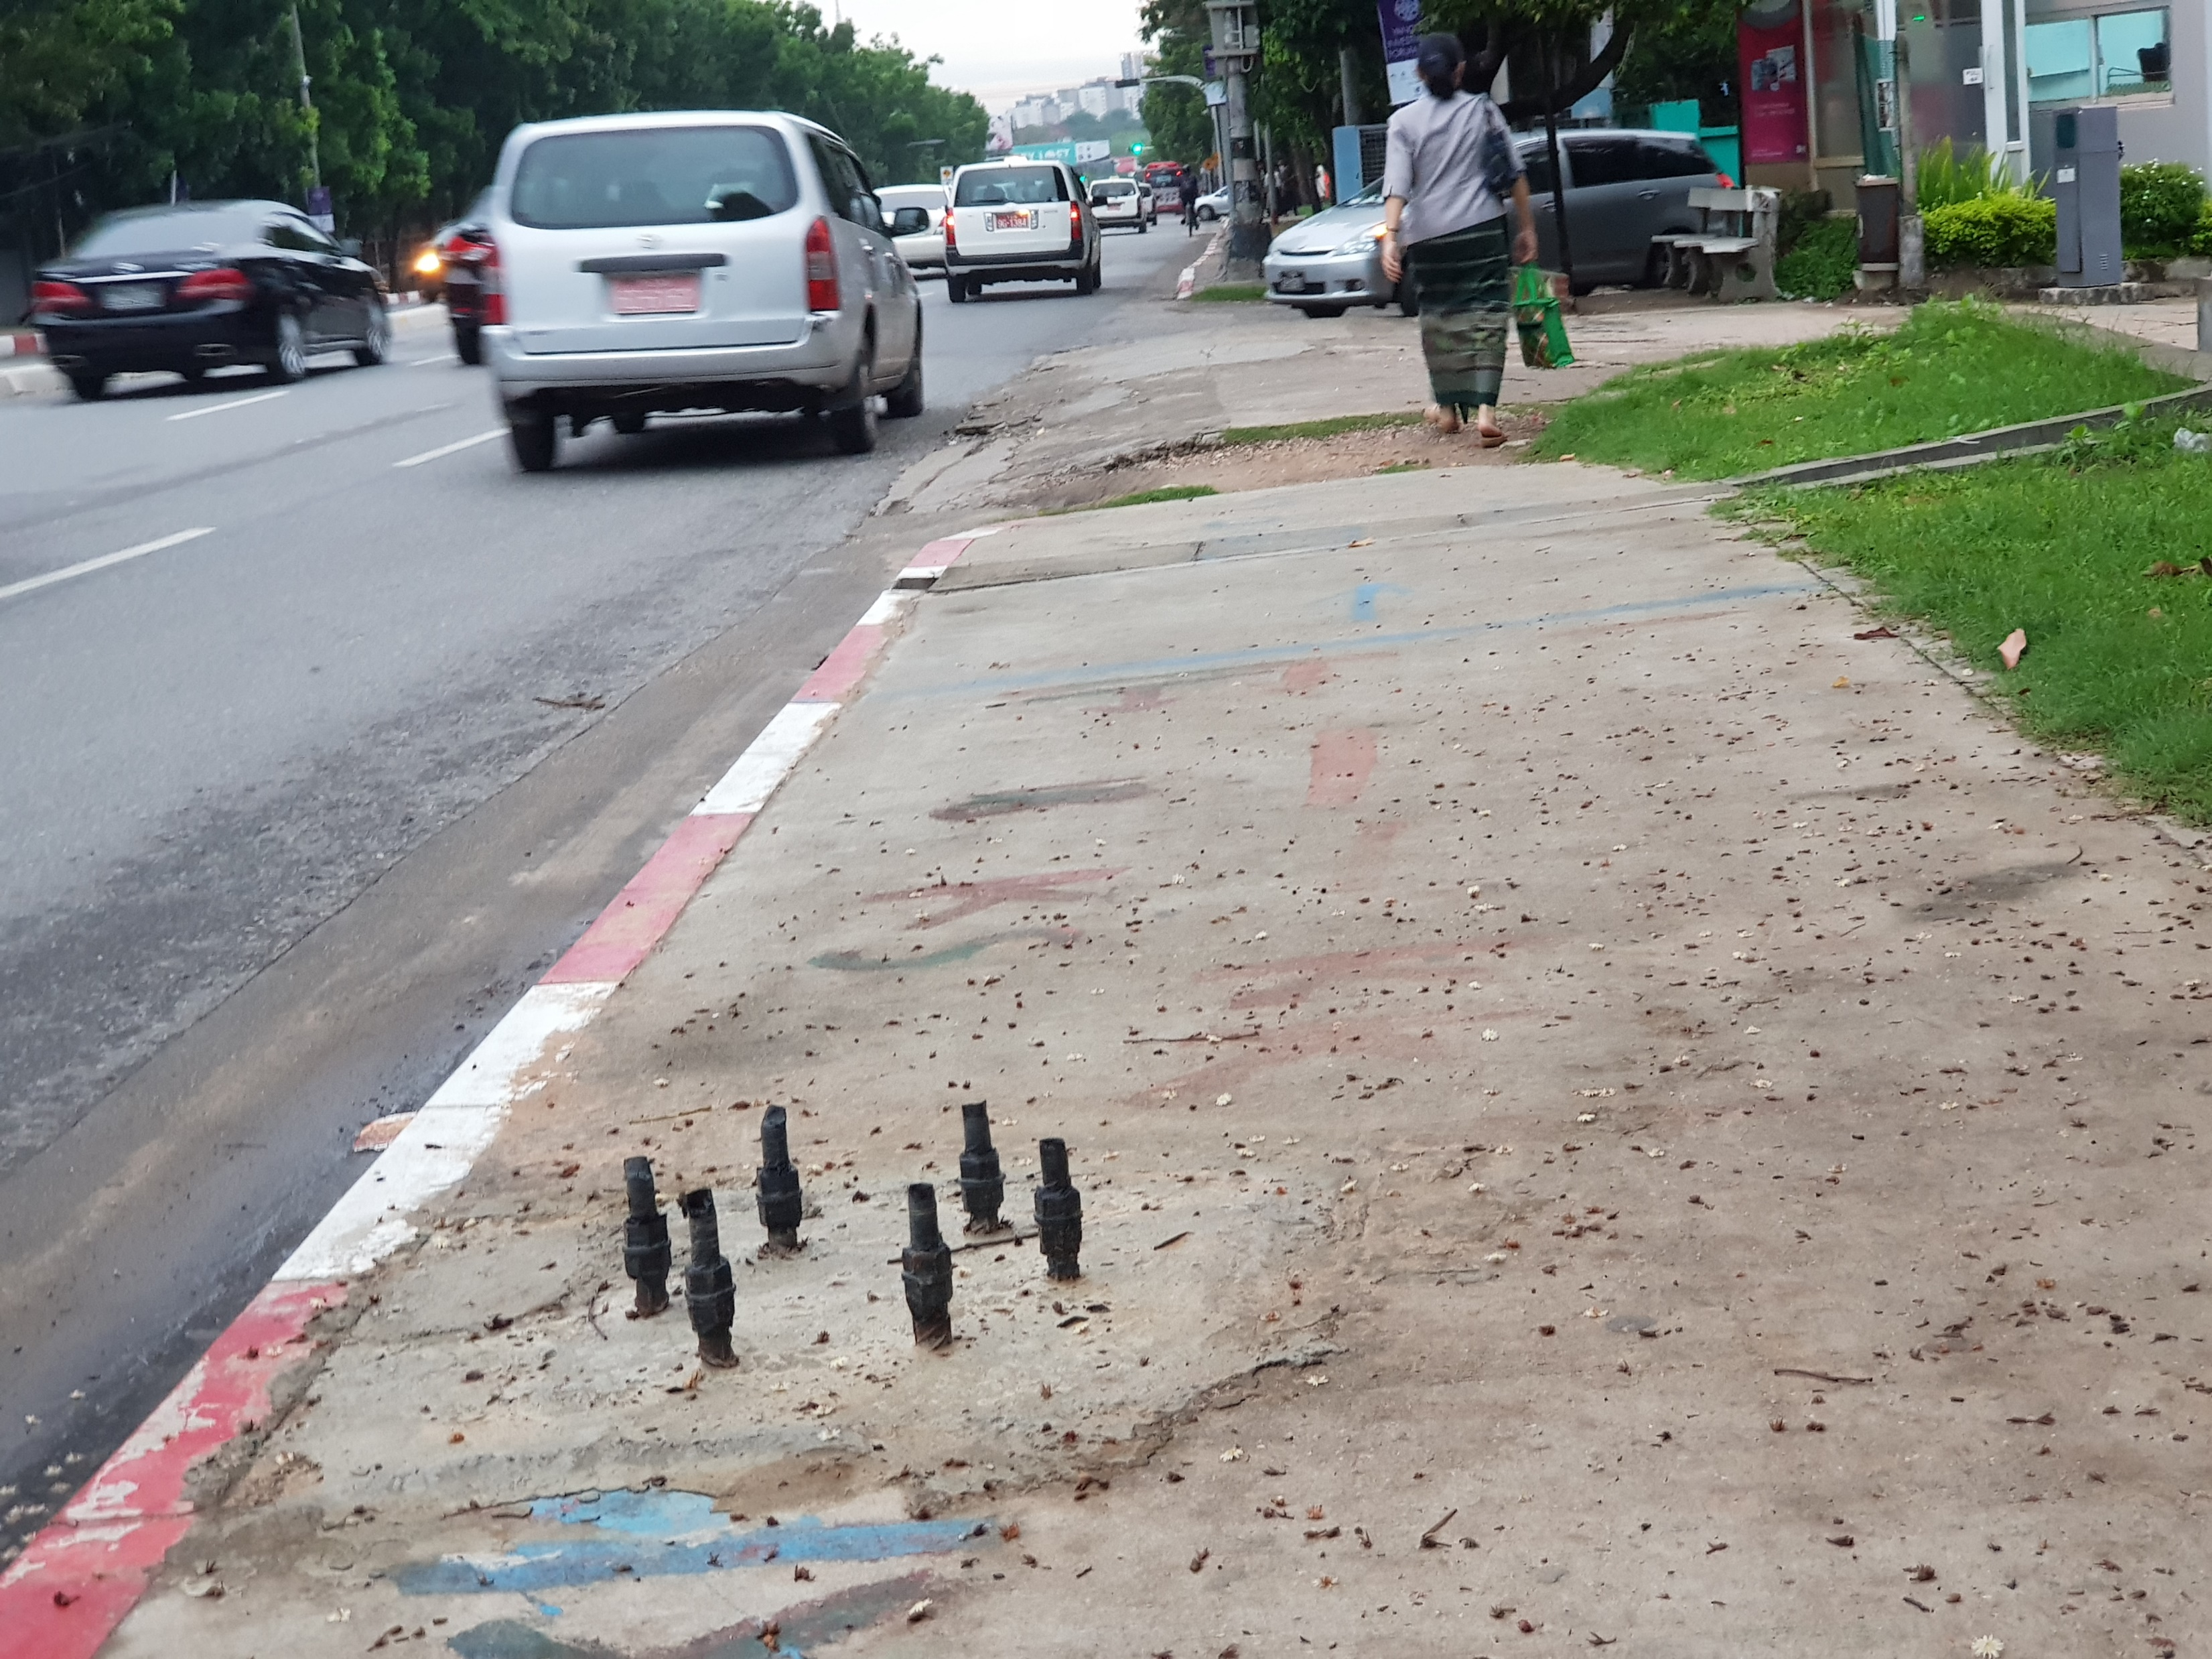
Turning Danger into a Safety Alert
Notes:
local communities adapt and innovate using available resources to address immediate safety concerns

Slide 4
Why we exist
‘Myanmar’s people deserve more than survival—we deserve a future. And that future begins with protecting education, healthcare, and livelihoods today, no matter who governs tomorrow.’
to bridge divides and rebuild Myanmar from the ground up
to empower local communities with evidence-based solutions

Slide 5
A Collaborative Opportunity
One of the key challenges we face is navigating the competing agendas of stakeholders while ensuring that research remains relevant and impactful
Strengthen the capacity of local organizations to lead research initiatives.
Build multi-stakeholder platforms that foster trust and alignment around common goals.

