Slide 1
The Center for Law, Energy, and the Environment
Accelerating the Implementation of Equitable and Effective Policy Solutions

Slide 2
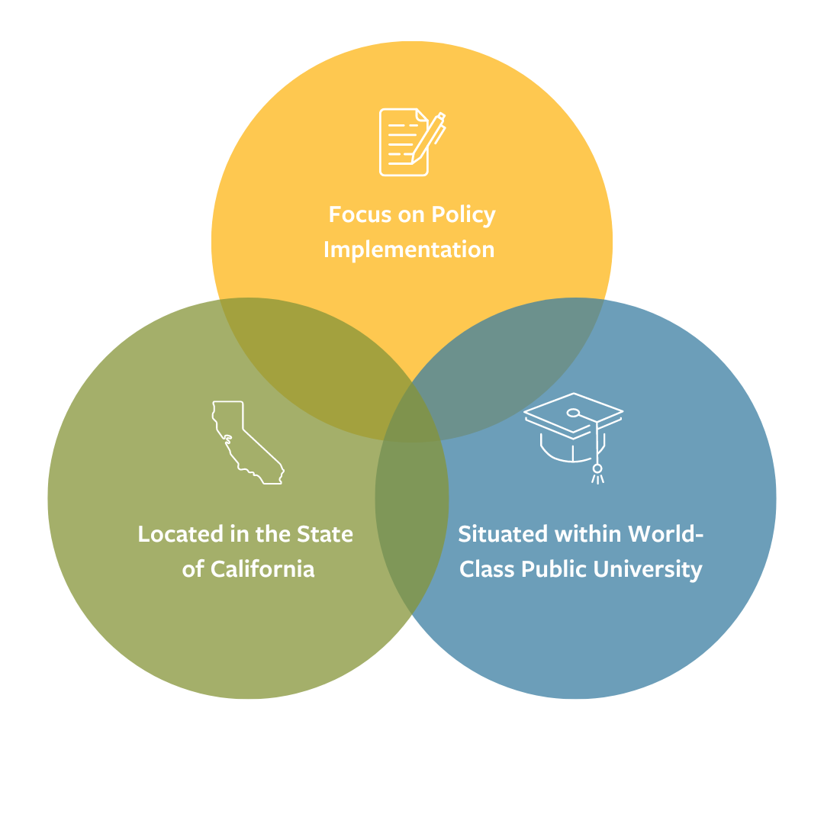

Slide 3
A Few Key Accomplishments
Published over 100 reports & held over 100 stakeholder convenings
Assisted with development of first law advancing carbon capture in California
Conducted research leading to a $30M State investment in the digitization of water rights
Partnered with the State of California to launch the Subnational Methane Action Coalition (SMAC)
Notes:
Key Accomplishments 2018-2023:
Over the past five years, CLEE has achieved several notable accomplishments, such as publishing over 100 reports, assisting in the development of California's first law advancing carbon capture,

Slide 4
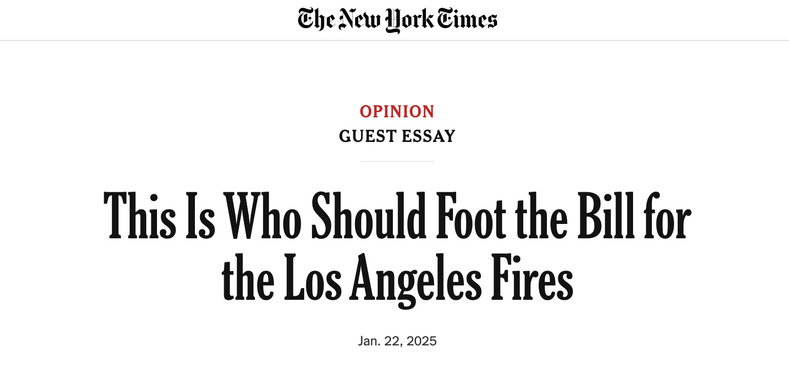
More recently, CLEE’s Climate Risk Initiative Director has been featured in many news articles and media interviews about the recent L.A. fires including the Washington Post, MSNBC, and The New York Times.
CLEE Climate Risk Initiative Director Dave Jones
Notes:
establishing the Tahoe-based Climate & Wildfire Institute, catalyzing the state’s $30M investment in digitizing water rights.

