Slide 1
OTT School of Thinktankers
3 – 7 February 2025, Barcelona, Spain
Bridging the gaps between research, policy, and practice

Slide 2
Ntaliwa Joyce Mbiti
Partnerships and resource mobilisation at the African Institute for Development Policy (AFIDEP)
AFIDEP is a pan-African non-profit research and policy Institute
Ten years at AFIDEP – started out as an EA and transitioned into the role to set up Institute’s first business development unit
Joined AFIDEP from a for-profit and strongly believes that optimising use of data and evidence in public policy formulation, implementation and measurement is critical for African governments to make better policy and programme decisions and investments for better development outcomes
Bridging the gaps between research, policy, and practice

Slide 3
AFIDEP at a Glance
Established in 2010 to bridge the gap between research, policy, and practice across Africa
Generates and translates policy-relevant research, builds capacity for evidence use, and engages in policy dialogue and advocacy for impactful development decision-making, and proactively promotes EIDM - policy dialogues, conferences
Has collaborations with governments, and other stakeholders in over 20 African countries that have resulted in policy reforms, and increased budget allocations
Fosters regional collaborations – for example, partnering with AUDA-NEPAD and Partners in Population and Development Africa Regional Office (PPD-ARO) - supporting AUDA-NEPAD align emerging technologies with Africa’s health priorities, and PPD-ARO co-convenes the Network of African Parliamentary Committees on Health (NEAPACOH) – leveraged to supported ministers of health from 25 African countries champion policies on reproductive health, domestic health financing, tuberculosis among men, and integrated population, health, environment, and climate change
2023 UN Population Award laureate for promoting people-focused development

Slide 4
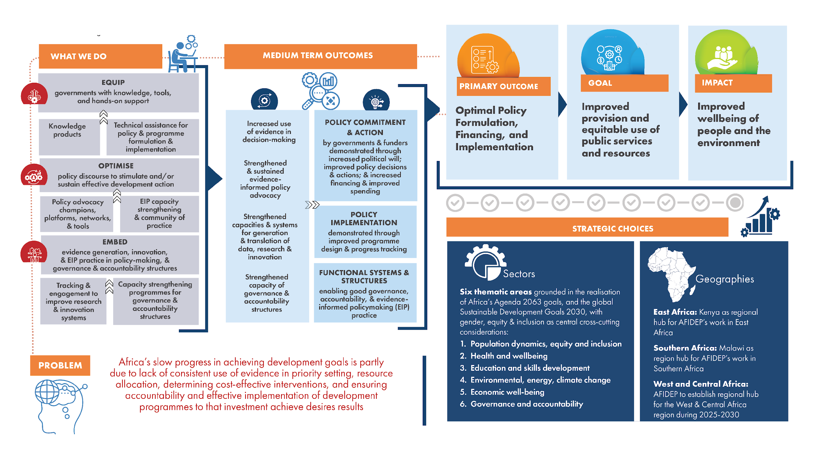
Theory of Change
Bridging the gaps between research, policy, and practice

Slide 5
Support / Interest
Connections for future collaborations – especially for (relatively new) thematic areas - education, economic well-being, climate change/energy and gender and inclusion initiatives; strategic partners in Francophone/West Africa; Asia and Americas and EU/UK
Peer-learning and exchanges – financial sustainability/funding models; affordable and impactful brand visibility strategies; measuring impact as a think tank, a fundraiser and communications lead; tactics for mobilising research scientists to prioritise fundraising; thinktank staffing models to optimise limited and expensive human resources
Bridging the gaps between research, policy, and practice

Slide 6
Gracias. Asante.
Bridging the gaps between research, policy, and practice

