Slide 1
Olivia Darby WONDER Foundation

Slide 2
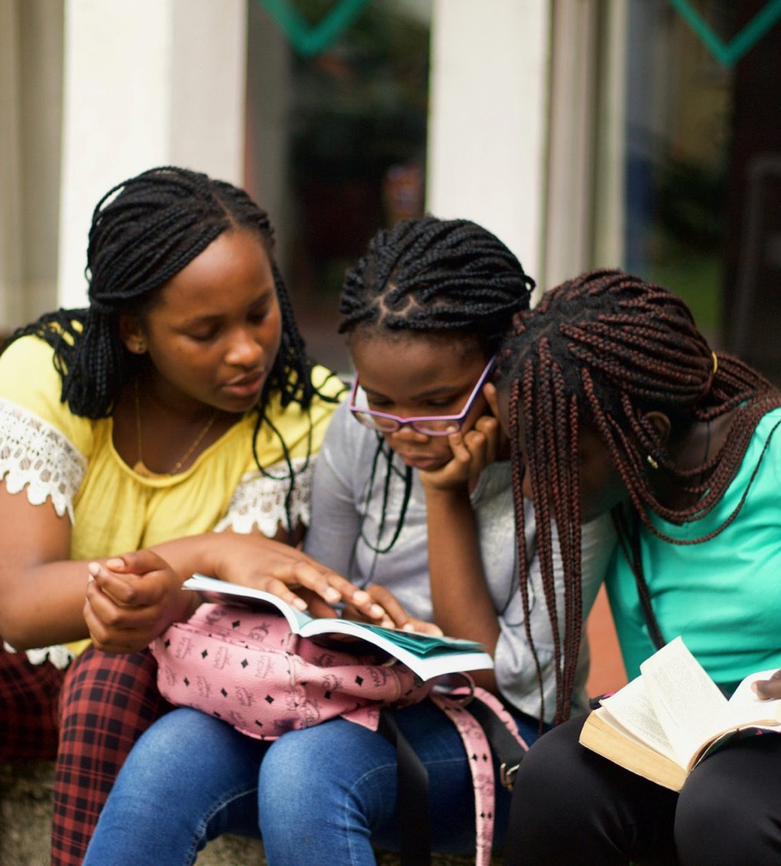
About Me
Olivia Intro
Co-Founder
Experience in programmes, research and policy
Working to amplify experience of rpojet leaders and participants further [which is why I am here!]

Slide 3
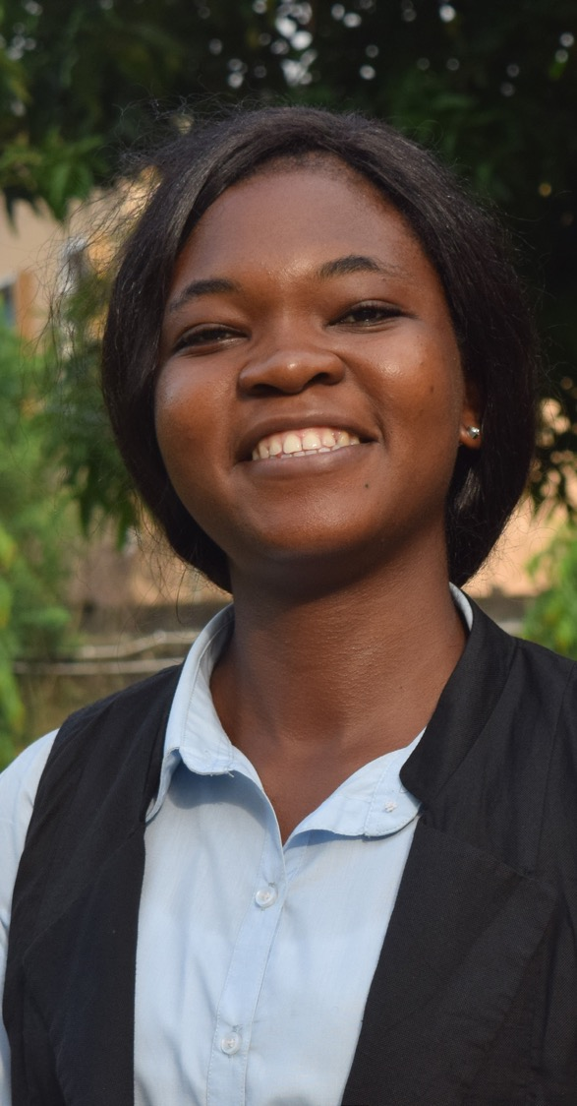
WONDER Foundation at a Glance
Olivia Intro
MISSION
VISION
Our mission is to empower women, girls and their communities through access to quality education so they can transform their lives and exit poverty for good.
We are working towards a world where each woman and girl recognises her significance and reaches her potential.
PILLARS
COUNTRIES AND IMPACT
WONDER’s approach is based on six pillars that guide our work with our partners: 1. quality education 2. accompaniment and mentoring 3. investing in local women-led partners 4. empowering spaces 5. sustainable employment 6. family engagement.
We work with women-led local NGOs in 23 countries across Latin America, Africa, Asia, and Europe. Over the last 11 years, we have empowered almost 125,000 women and girls with 36 local women led partners in 23 different countries around the world.

Slide 4
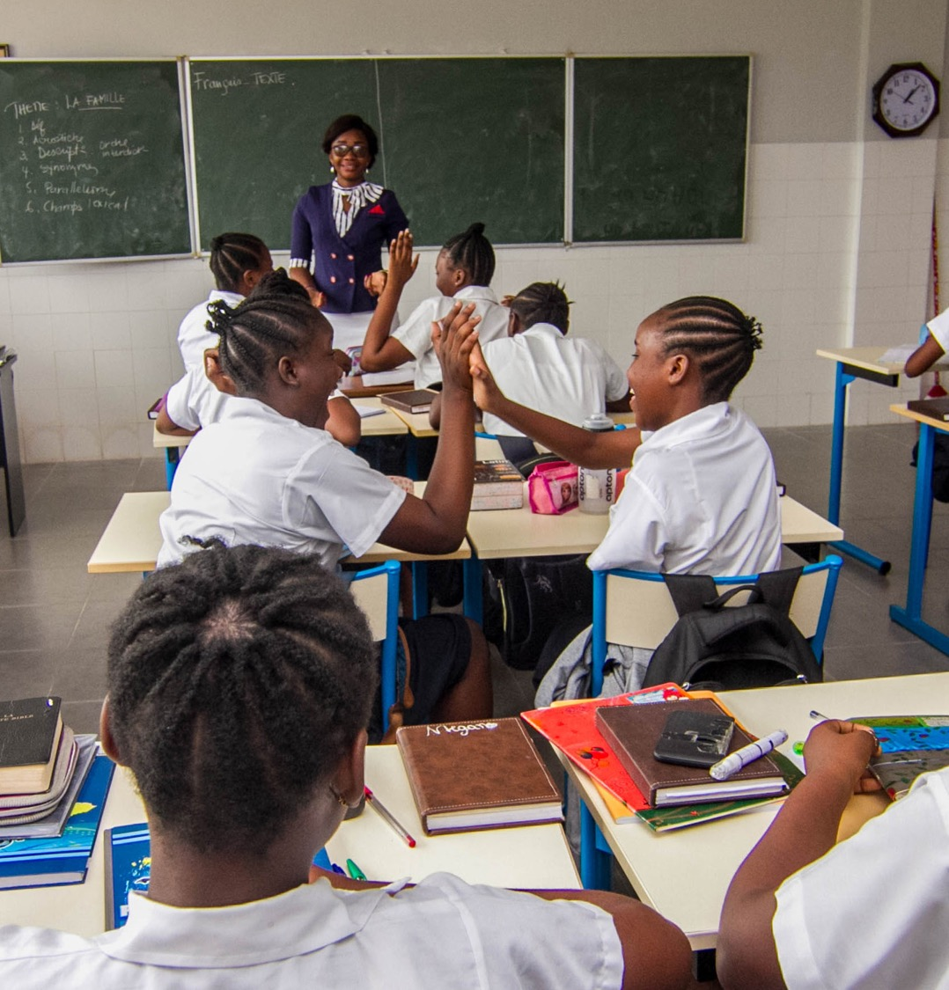
Our Challenge: Amplifying Voices
Olivia Intro
Small, locally-led organisations are often excluded [self-exclude] from spheres of influence
We want to address this and that’s why I am here

Slide 5
olivia@wonderfoundation.org.uk
www.wonderfoundation.org.uk
+44 (0) 20 3488 2008
300 Brixton Road, London, SW9 6AE
Registered Charity No: 1148679

