Slide 2
We live in a vacuum of moral authority due to the widespread distrust in institutions and their loss of influence in society.

Slide 3
A society that perceives companies as the most competent and reliable organizations, over other institutions such as governments and the media.

Slide 4
Initially, interest in business ethics grew at the same pace as most challenges.
CLIMATE CHANGE
ETHICS
SOCIAL MEDIA
AI

Slide 5
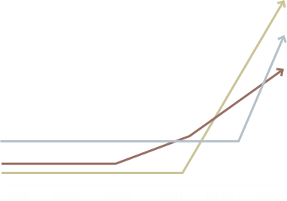
But the ethical risks arising from these challenges have increased exponentially.
SOCIAL MEDIA
AI
CLIMATE CHANGE

Slide 6
Highlighting the need for new ethics applied to corporate governance.
ETHICS

Slide 7
Business leaders are facing the social demand to integrate critical and ethical thinking into their leadership

Slide 8
Do the right think

Slide 9
Ethosfera is an organization specialized in critical thinking and ethics applied to good governance.
We develop new methodologies based on collective intelligence for strategic decision-making in businesses and institutions, with the aim of fostering critical and ethical innovation

Slide 10
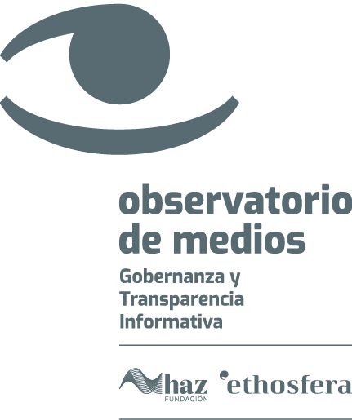
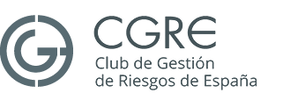
We develop initiatives based on independent research and deliberation, with the aim of promoting ethics and good governance in the public sphere.
Investigación
Aplicada

Slide 11
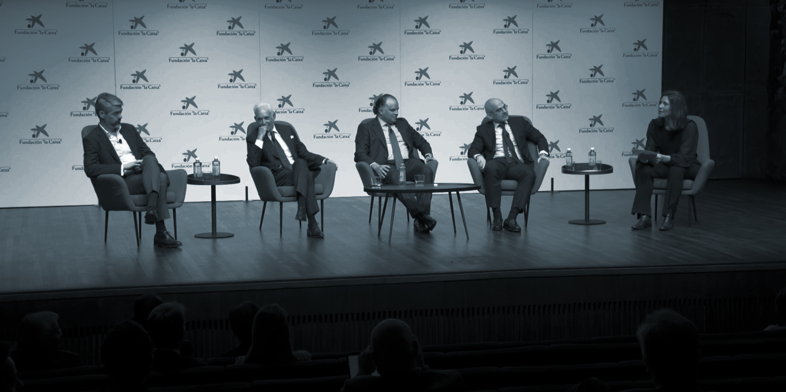
Media Observatory
An initiative that arises with the mission of promoting and strengthening a culture of ethics and governance in the media sector in Spain and Latin America. The objective is to safeguard its credibility and editorial independence. We agree on standards, conduct research, provide training, and carry out communication to raise public awareness about the media's role in a liberal democracy.

Slide 12
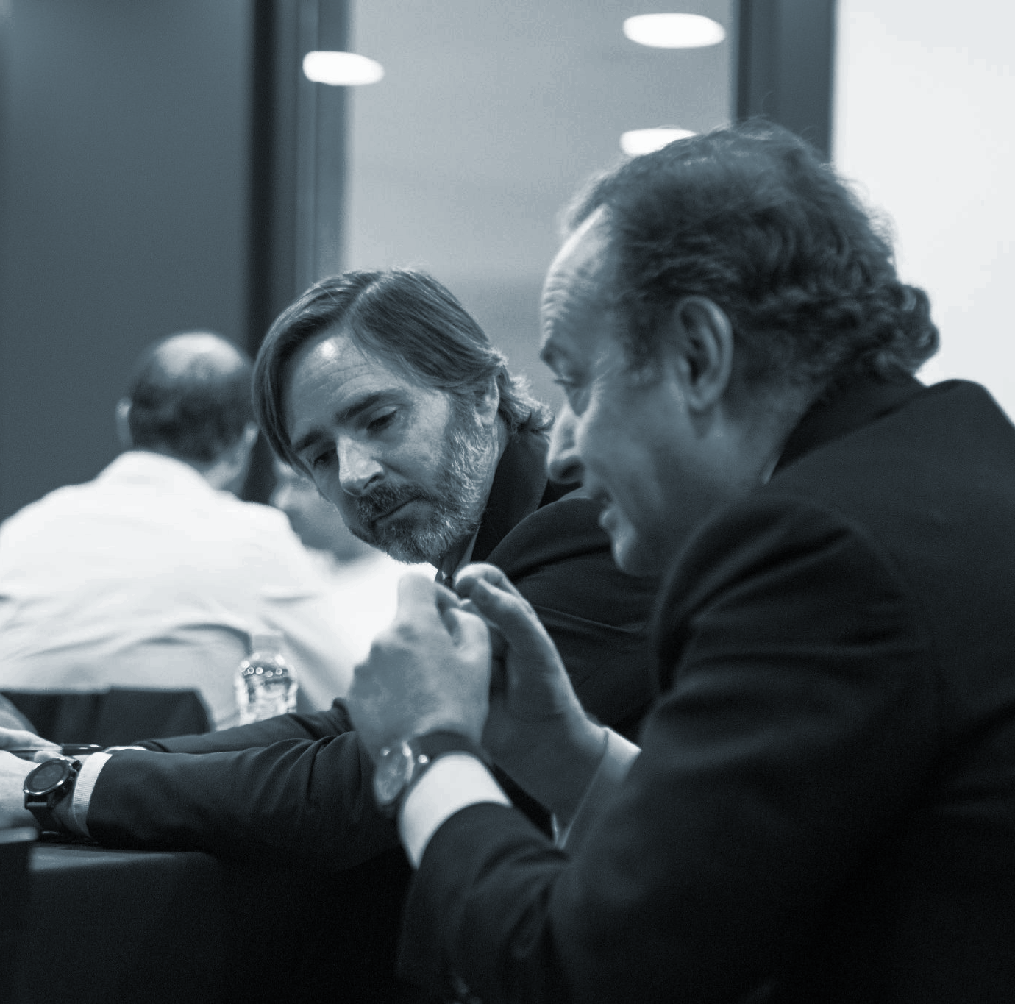
Better businesses, better democracy
A forum for critical thinking and ethical deliberation on the role of businesses in democracy that brings together a community of business leaders, high-ranking public officials, civil society leaders, and experts in business ethics and applications.

Slide 13
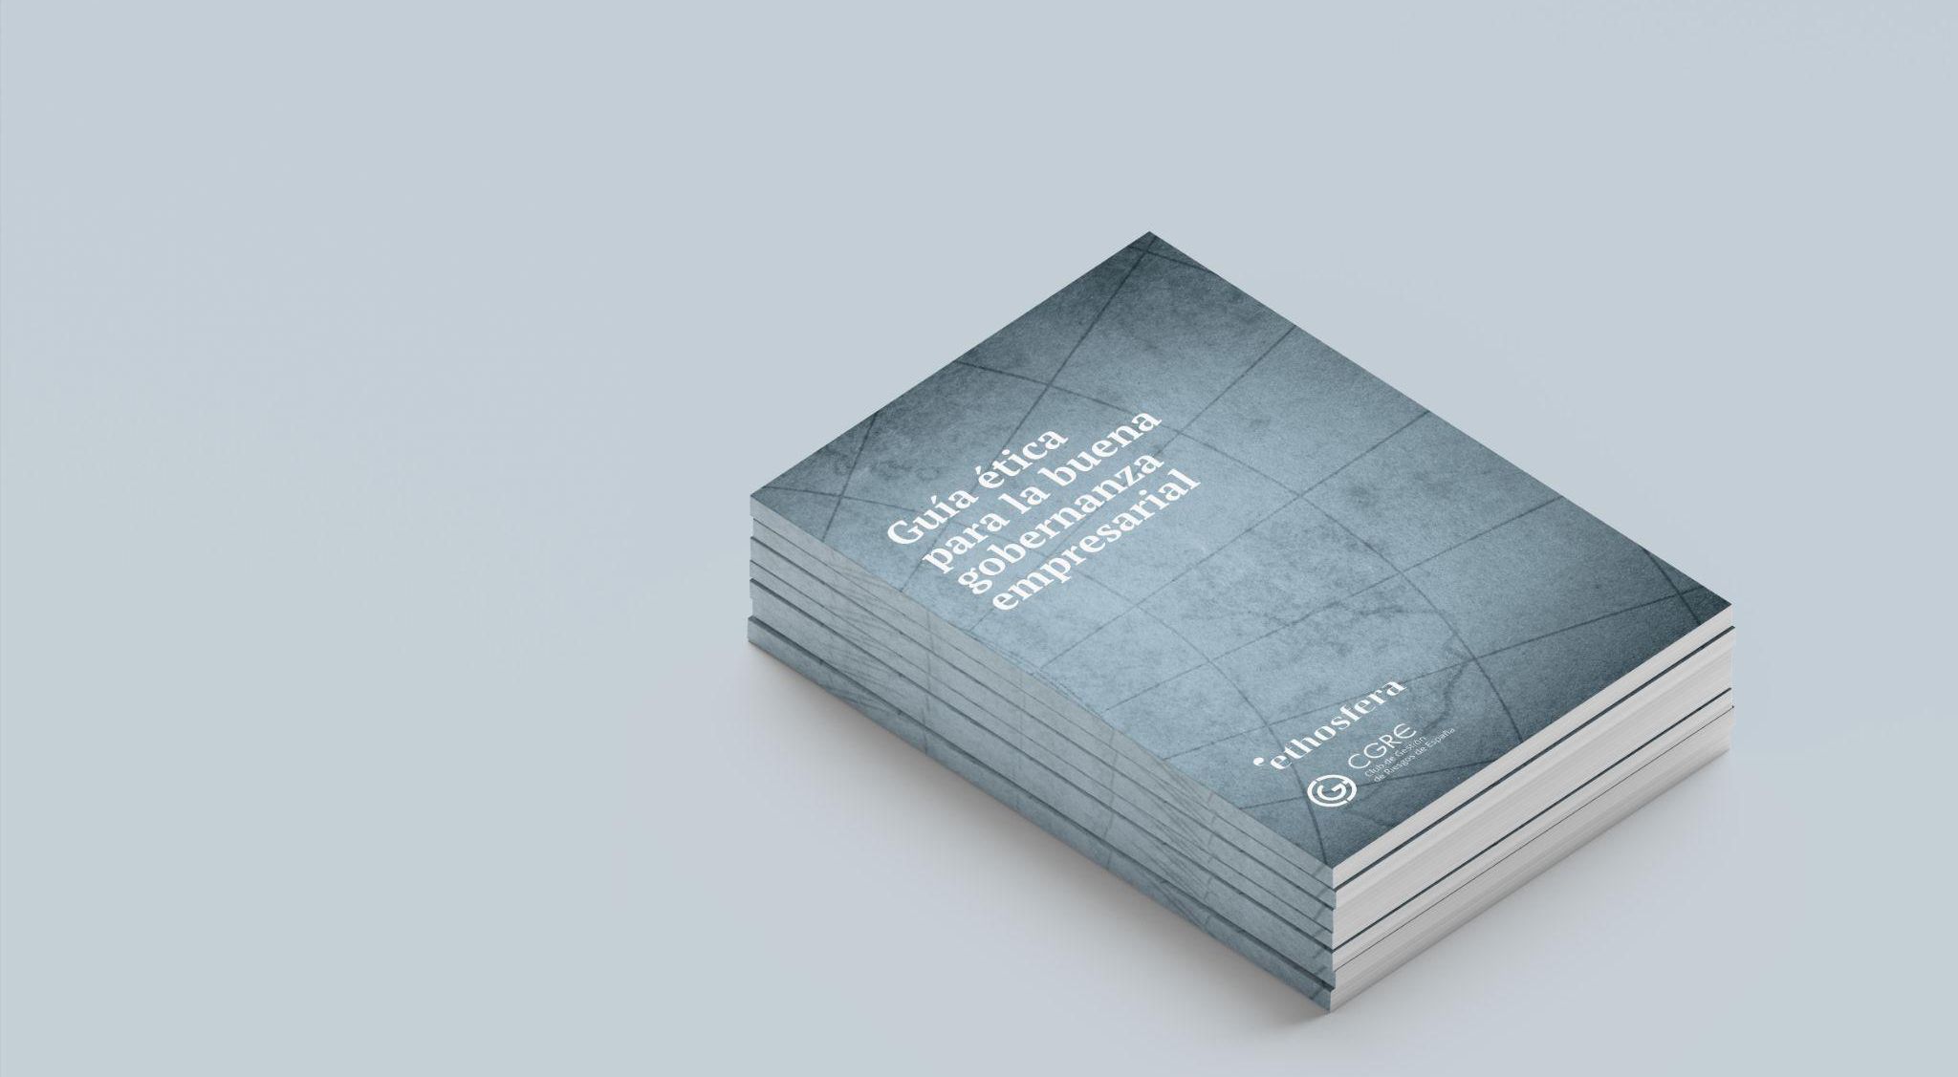
Applied ethics research
We develop open research in collaboration with other institutions regarding emerging ethical risks. The goal is to guide strategic decision-makers, both public and private, on how to integrate the ethical variable into their decision-making processes.
We promote a paradigm shift, moving the focus from ethical compliance to ethics as an organizational culture, driven by the organization's leadership.

Slide 14
Do the right think

Slide 15
ethosfera.org

