Slide 1
OTT School for Think tankers 2025
&
Building for the Future Initiative
STEAR
STUDENT THINK TANK FOR EUROPE ASIA RELATIONS
Sofia Barberis Canonico
2-7th February 2025

Slide 2
About me
From Italy, currently based in Cambridge, UK
Background in International Relations & East Asian Studies
Personal research and interest in South Korean domestic politics
Deputy Editor-in-Chief in STEAR
Previously Editor for 2 years

Slide 3
STEAR’s main goals
Empower young leaders with skills to be analysts and change-makers of Europe-Asian relations
Create opportunities for young researchers to build cross-continental connections
Foster dialogue over European and Asian policy and collaboration initiatives
Provide audiences with context to promote mutual understanding, informing European conceptualisations of Asia and vice versa
Notes:
Creating bridges between communities and regions of Europe and Asia that are distant from each other but growingly interdependent.
Emergence of a new generation of policy leaders, researchers, and organisers, that understand cross-continental relations and strive towards stronger relationships between Europe and Asia.

Slide 4
STEAR’s core activities
Policy and research publications (Editorial Office);
Dialogue and cultural exchange activities, such as speaker events, podcasts, and conferences (Events and Conferences);
Capacity building programmes, such as workshops, mentoring programmes, language exchanges (Internal Affairs);
Communication, fundraising, and networking activities, (Communication and Organizational Development and Growth)
Notes:
STEAR publishes research and policy pieces on its website, sends monthly email newsletters, promotes its events and publications on social media (instagram, X, linkedin), hosts online speaker events open to the public, and publishes the STEAR Journal with longer research pieces on its website.

Slide 5
Publications & Outreach
STEAR publishes on its website weekly articles and policy pieces, and a longer annual Journal publication.
Topics:
foreign policy and political affairs;
society and culture;
trade and sustainability;
technology, AI, and scientific innovations
Outreach:
website publications and calls for papers;
monthly newsletter;
social media promotion of STEAR events and publications (on instagram, X, linkedin)

Slide 6
Stats & milestones
550+ participants to our events, with 80+ participants to the 2024 Conference in Brussels

Slide 7
Stats & milestones
550+ participants to our events, with 80+ participants to the 2024 Conference in Brussels
Our members represent more than 33 countries, including Western and Eastern Europe, the Middle East, Central Asia, South Asia, East Asia & Southeast Asia

Slide 8
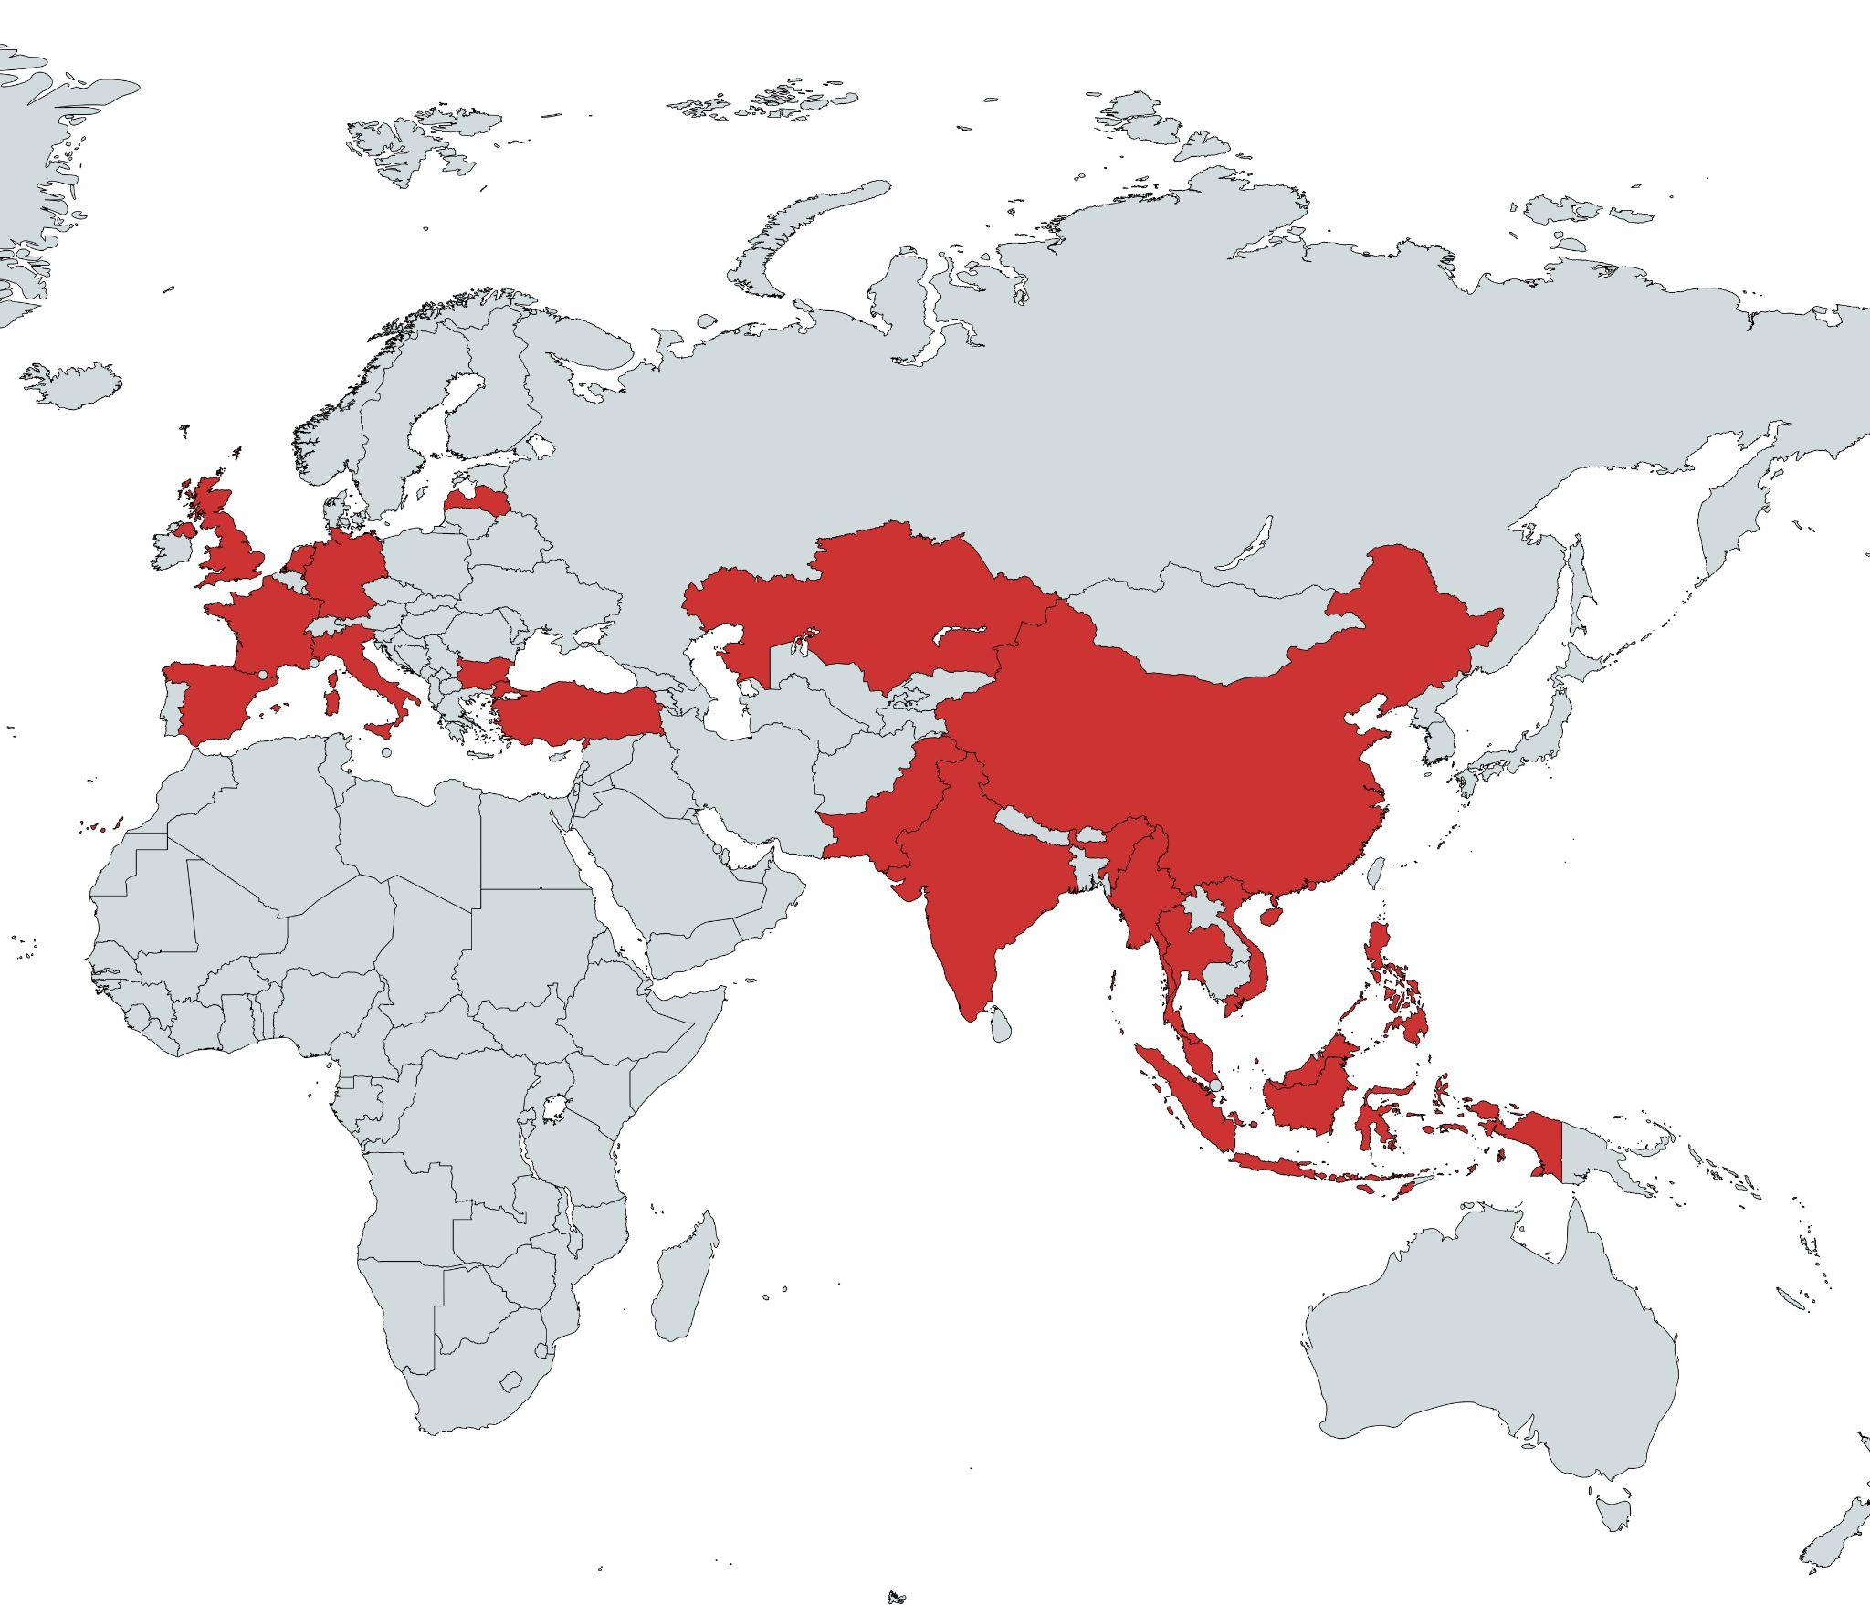

Slide 9
Stats & milestones
550+ participants to our events, with 80+ participants to the 2024 STEAR Conference in Brussels
Our members represent more than 33 countries, including Western and Eastern Europe, the Middle East, Central Asia, South Asia, East Asia & Southeast Asia
170+ article publications
40+ members in the Editorial Office, the largest and most prolific portfolio

Slide 10
Ongoing challenges
Deepening our research impact with policymakers: advocacy or independent research?
Improving a streamlined and structured fundraising model
Registering a Brussels Chapter and eventually one in Southeast Asia

