Slide 1

WARWICK THINK TANK
ABIRRAMI GUNALAN

Slide 2

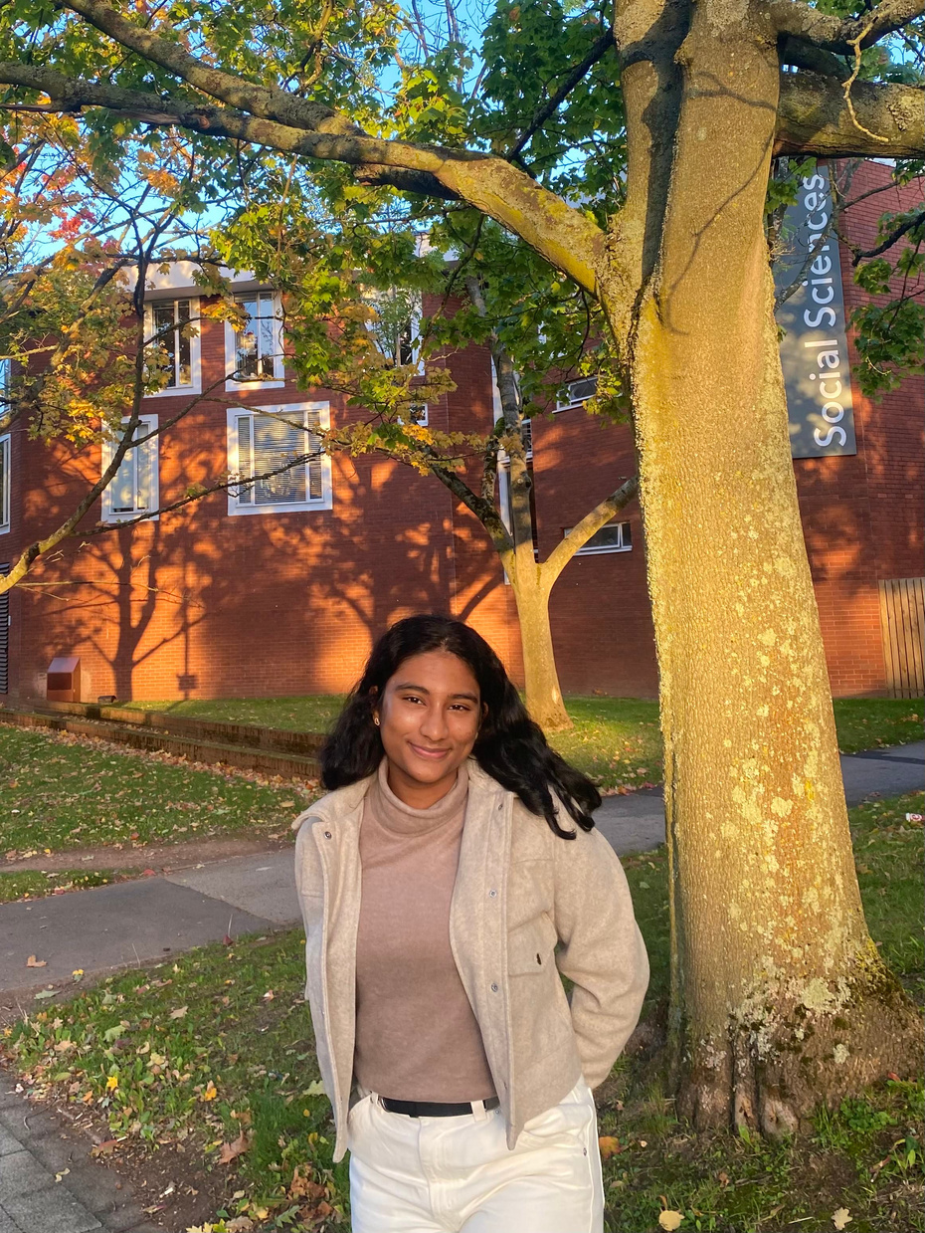

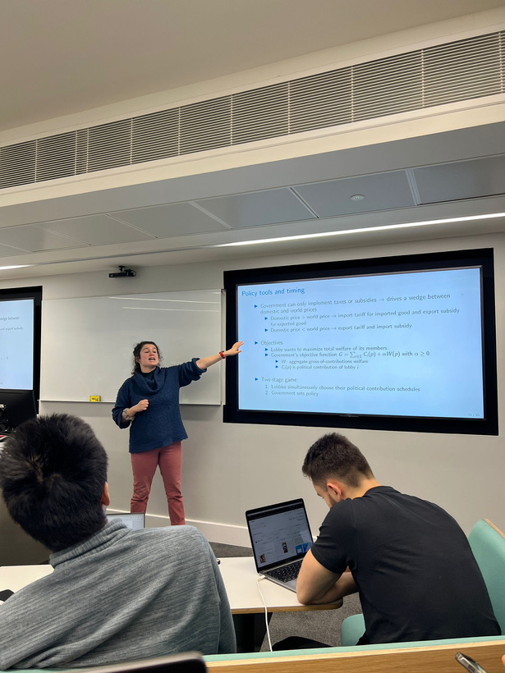
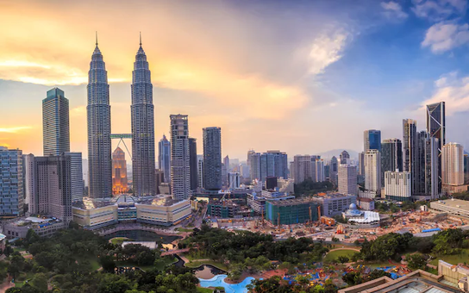


Slide 3
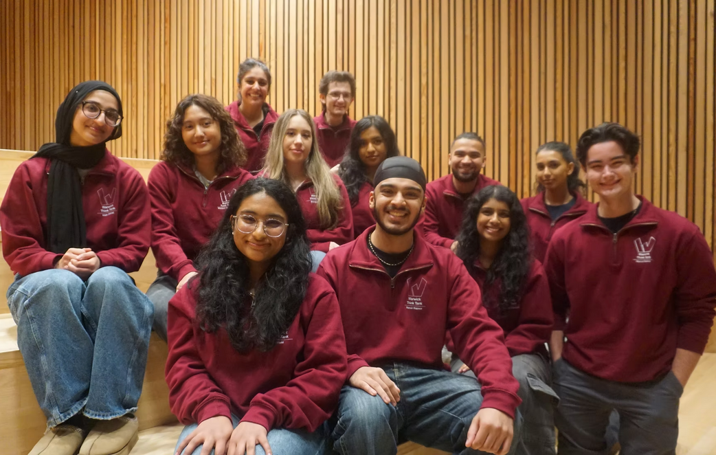
WARWICK THINK TANK
ESTABLISHED IN 2011
WE SERVE AS A DYNAMIC AND POLITICALLY NEUTRAL SPACE, BRINGING TOGETHER A COMMUNITY OF PASSIONATE AND DIVERSE STUDENTS TO ENGAGE IN THE WORLD OF POLICY.

Slide 4

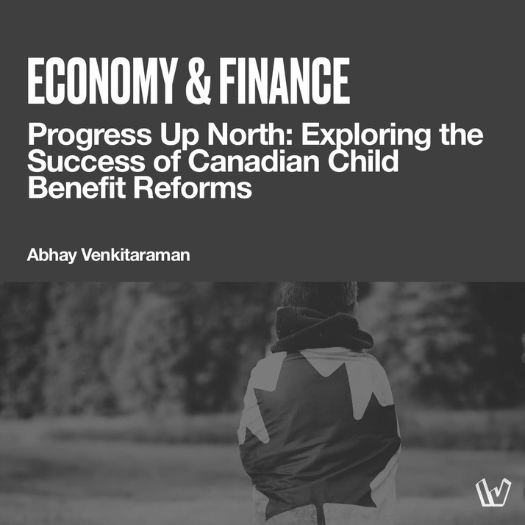
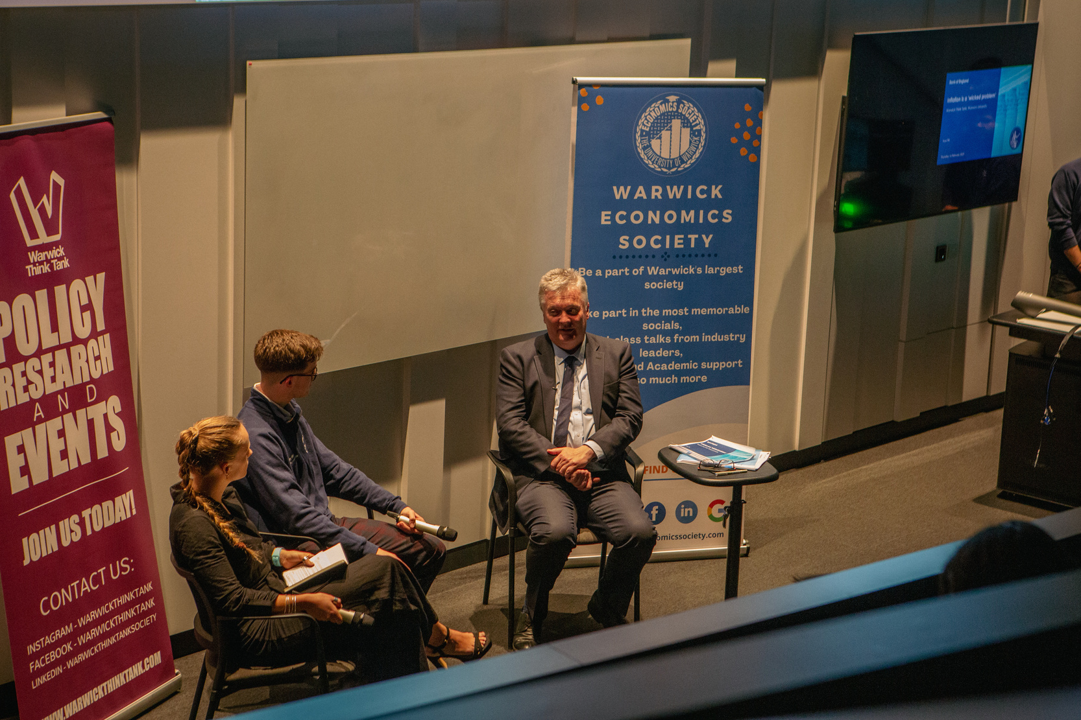
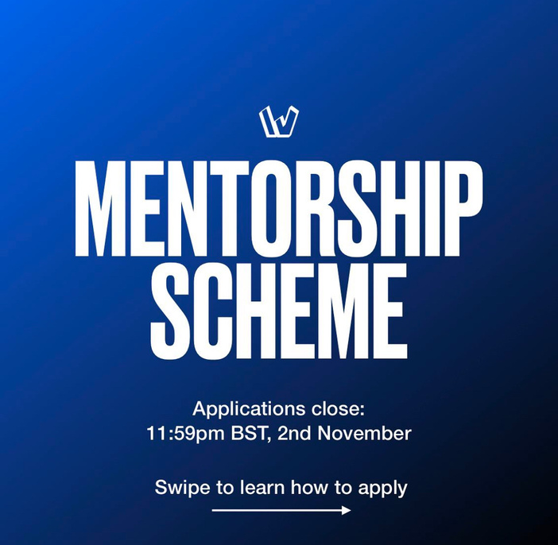

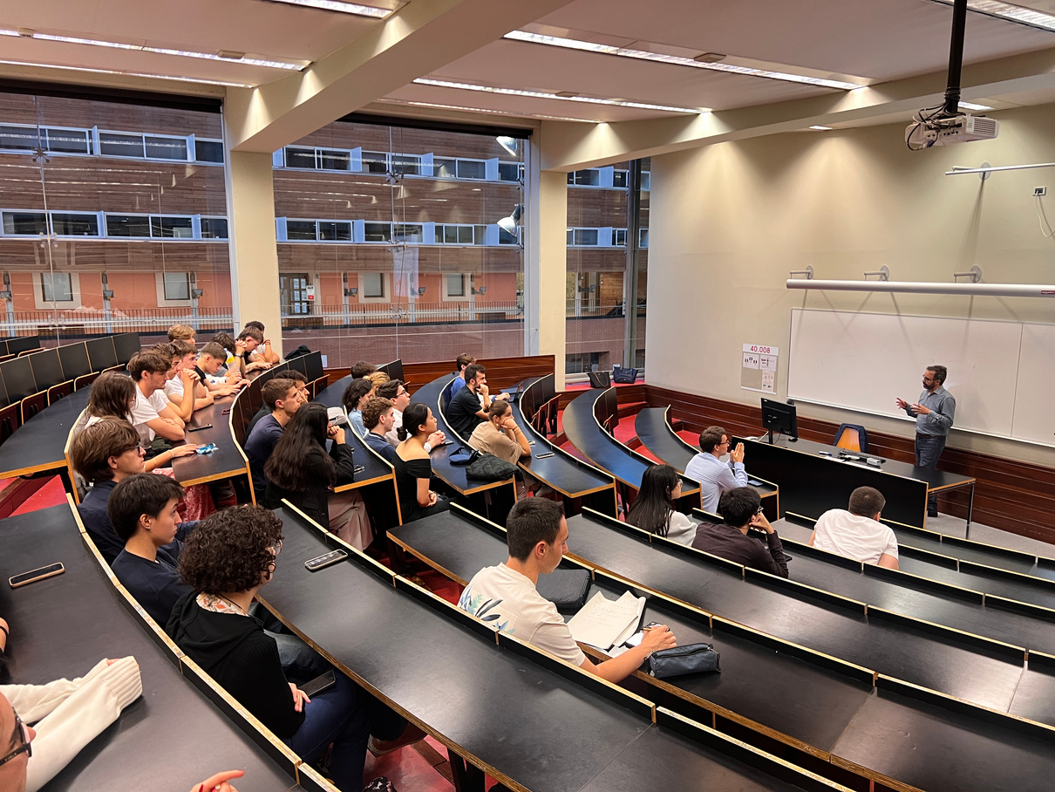
8 SECTORS
FOREIGN AFFAIRS
JUSTICE & HUMAN RIGHTS
ECONOMY & FINANCE
ENVIRONMENT
ARTS & CULTURE
HEALTHCARE
EDUCATION
TECHNOLOGY

Slide 5
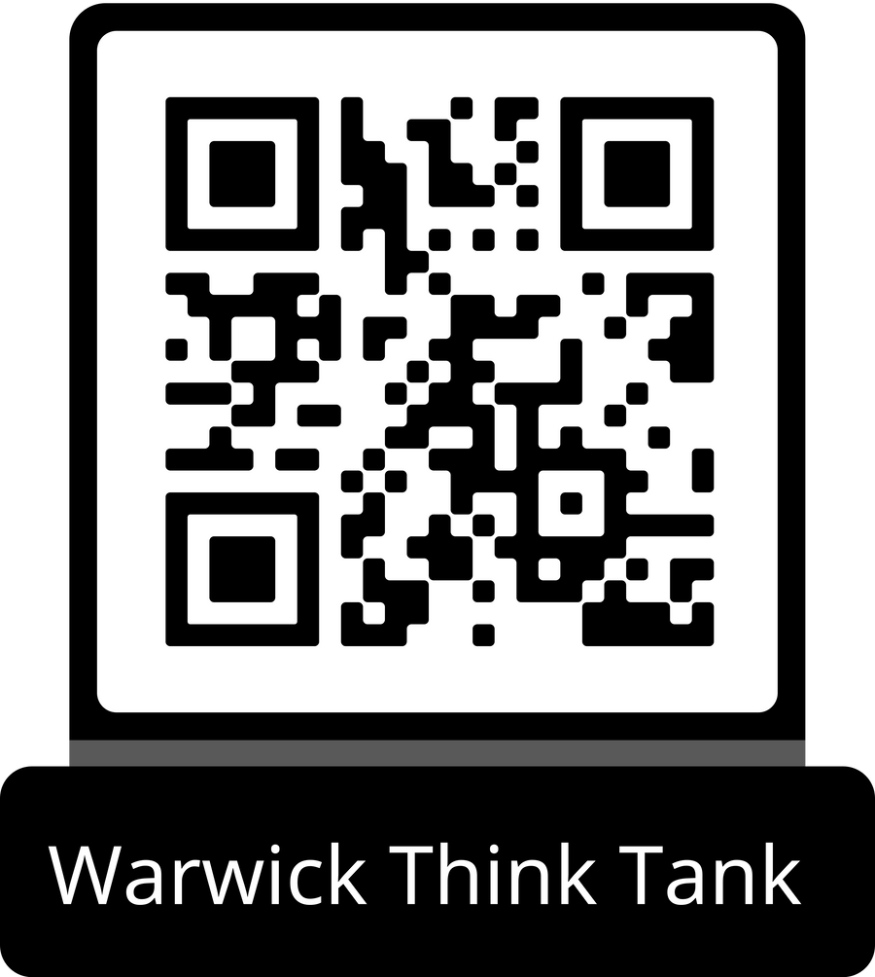
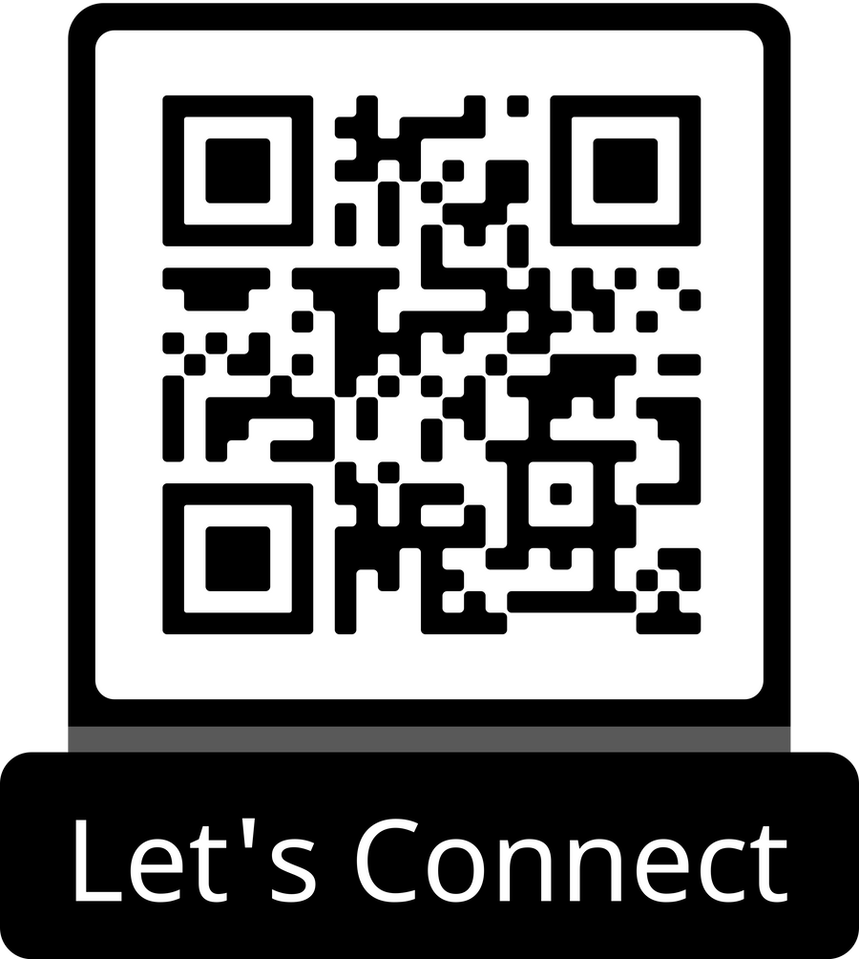
CHALLENGES
  Constructing an identity - lack of a distinct research stance, making it harder to attract a dedicated audience, build a recognizable brand, and establish influence in policy circles.
  Securing Sponsorships- Sponsors often prefer to fund research that aligns with their own agendas
  Policy influence and Impact

