Slide 1
Signals
of Change

Slide 2
Signals of Change
concrete and specific events, stories, innovations, or news
that are at the peripheries/sidelines (*so they are not yet mainstream trends),
which make the observer get a sensation that if the signal is scaled or mainstreamed, it can take us in an entirely different direction in the future.
© 2018 Institute for the Future. All rights reserved. | www.iftf.org

Slide 3
Signals of Change
Learning how to identify signals of change helps build the muscle of being able to see the precursors of significant change well before they become obvious.

Slide 4
Signals of Change
This is a departure from how we are usually wired, where we focus only on predominant trends that we read all the time on the front page of the papers or that we deal with in our daily work.

Slide 5
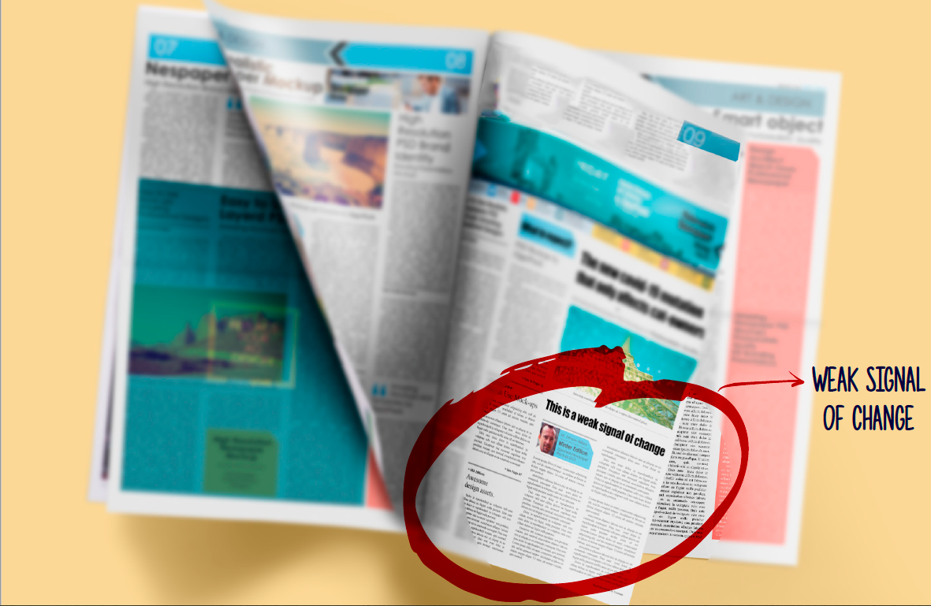
Signals of change are like those small bits of news in easily-missed corners of your newspaper.
Notes:
taken from JustLabs’ Guide to Foresight in the Social Change Field: https://www.openglobalrights.org/userfiles/file/ForesightGuide2021_compressed_.pdf

Slide 6
Signals of Change
Being able to appreciate what is both in the mainstream and in the fringes is the hallmark of a leader who is ahead of the curve, being able to stay one step ahead of everyone else because they have anticipated change before it even becomes anything, or they are able to deliberately scale a signal because it will help deliver the future that they want.

Slide 7
No one can predict the future, especially not in volatile contexts.
What we can do is think about it more systematically—turning uncertainty into inspiration, creativity, and resilience.

Slide 8
© 2018 Institute for the Future. All rights reserved. | www.iftf.org

Slide 9
How to identify a good signal
Signals of change need to meet certain criteria:
SPECIFIC - a product that is newly launched, an anecdote you heard, a specific event you read or heard about, a new data point, a new piece of research finding
CURRENT - within the last 18 months or so
COMPELLING - gives you a quick sense of awe, fear, or constructive confusion. It should make you pause and think.
© 2018 Institute for the Future. All rights reserved. | www.iftf.org

Slide 10
How to identify a good signal
Signals of change should be events or developments that are NOT yet mainstream. They are in the fringes or peripheries, but if they scale or become mainstream, their impact can change reality in such a fundamental manner.
So you cannot cite as a signal something that is already obvious, common or already a trend (such as “closing civic space”; and besides, “closing civic space” is a general trend, not a specific event).
Scan for what is often unseen!

Slide 11
Almost anything can be a signal
Current, real-life examples
You are the judge. They can be:
Product/service/experience
Business/startup
Anecdote/personal observation
Research prototype
Art
Data point
News story or event
© 2018 Institute for the Future. All rights reserved. | www.iftf.org

Slide 12
Almost anything can be a signal
Signals are not trends.
“coming to power of populist leaders” or “wave of authoritarianism” are not signals of change. They are general trends, which are a combination of many specific events. “Independent candidates elected in otherwise party-dominated country X”, which is a specific event, is a signal.
“crushing of media freedom” is not a signal. It’s a trend.
“'Magic' Modi uses hologram to address dozens of rallies at once” is a specific event, and was a perfect example of a signal of change when it happened in 2014, because there was no trend of political leaders using using such technology to reach their constituencies at that time.

Slide 13
© 2018 Institute for the Future. All rights reserved. | www.iftf.org

Slide 14
Almost anything can be a signal
Signals are not forecasts.
– Signals have to actually exist in the world today. They cannot be projections of possibilities in the future.

Slide 15
Examples of signals of change across different fields
See 8 signals of change identified by NESTA for 2025: https://www.nesta.org.uk/feature/future-signals-2025/
For more, see the crowdsourced Signals of Change collection of The Futures Centre or SITRA’s Signals of Change 2022.
For a more detailed guide on spotting signals of change, see SITRA’s Weak Signals from the Future Guide published in January 2025.
© 2018 Institute for the Future. All rights reserved. | www.iftf.org

Slide 16
TASK
Collect at least 1 “signal of change” related to the future of think tanks. Please try to look at signals across the different areas of reality: Social, Technological, Economic, Environmental, and Political (STEEP).

Slide 17
Instructions
Scan your environment via research and observation.
Then write down each signal using the following four components:
TITLE: An evocative summary of the signal.
WHAT: A brief explanation of what the signal actually is.
SO WHAT: Why is it important to think about? What are the potential implications of the signal, as it plays out over the next decade? What challenges or opportunities might it present? Does it suggest new values or norms?
SOURCE: Cite your source.
© 2018 Institute for the Future. All rights reserved. | www.iftf.org

Slide 18
Title:
WHAT:
Image
SO WHAT:
Source:
© 2018 Institute for the Future. All rights reserved. | www.iftf.org

Slide 19
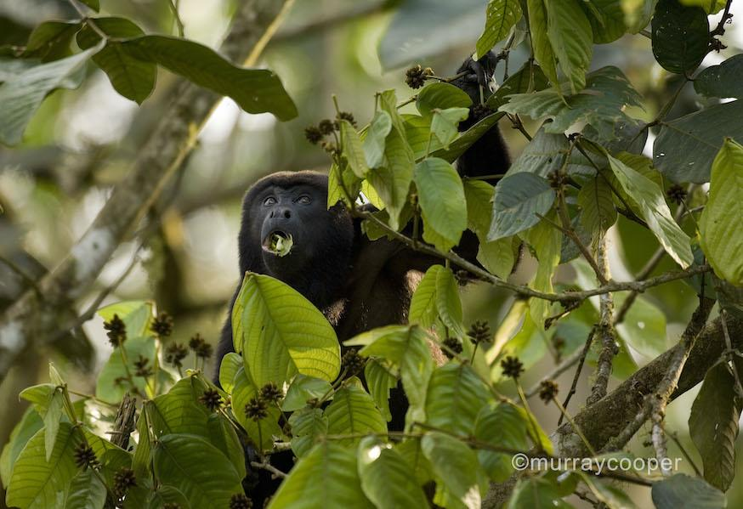
Title:
Ecuadorian forest becomes a song creator
WHAT:
A petition was filed to recognise the Los Cedros cloud forest in Ecuador as the co-creator of the composition Song of the Cedars. The action by the More Than Human Life (Moth) project is the first legal attempt to recognise an ecosystem’s moral authorship of a work of art, based on a prior legal ruling in 2022 recognizing the legal personhood of the Los Cedros biological reserve by Ecuador’s constitutional court, when it determined to cancel mining permits in
the reserve.
SO WHAT:
Forests and the “more-than-human world” often are treated, including in public policy, as objects of actions or charity, but not owners or subjects of rights. If the agency grants moral authorship to the forest, it will be the first in the world. Copyright authorities in other nations would have to acknowledge the same moral authorship. This will expand our traditional human-centric view of the world, and particularly of ownership.
Source: https://www.theguardian.com/world/2024/oct/25/legal-bid-for-ecuador-forest-to-be-recognised-as-song-co-creator

Slide 20
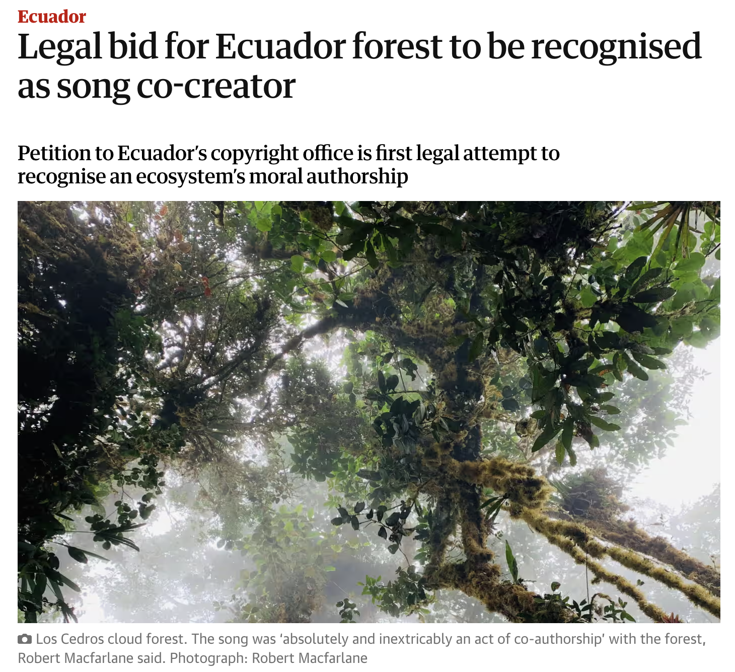

Slide 21
You need not submit in written form your signal of change. Kindly just have it with you when you come to the session.
See you soon! :-)

