Slide 2
BUILDING EFFECTIVE THINK TANK CULTURE
Sonja Stojanović Gajić,
Research Fellow, the University of Rijeka

Slide 3
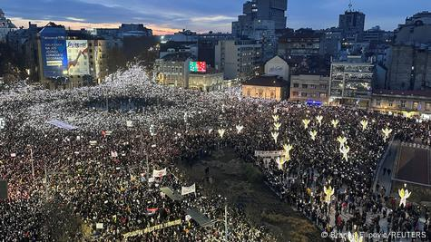
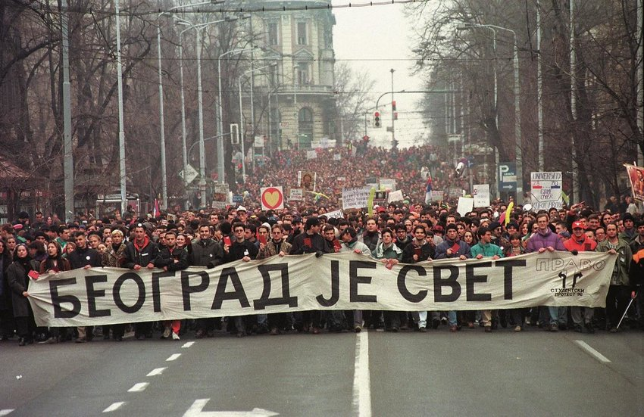
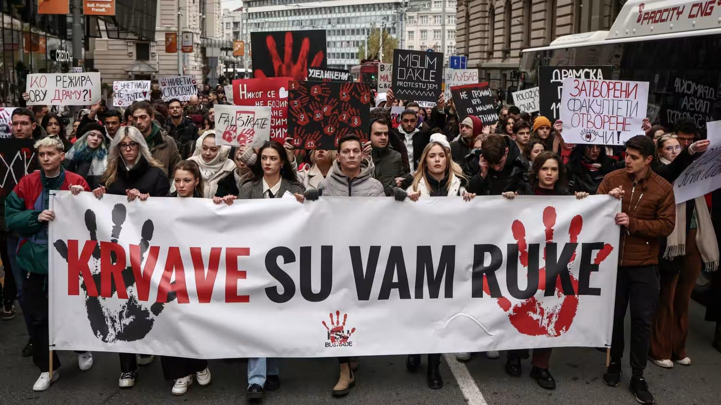
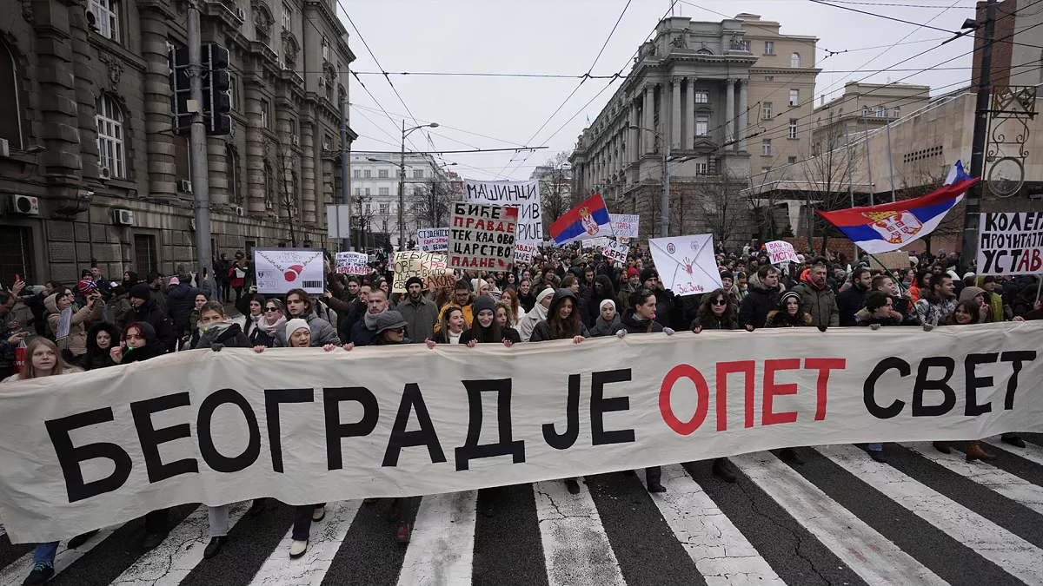

Slide 4
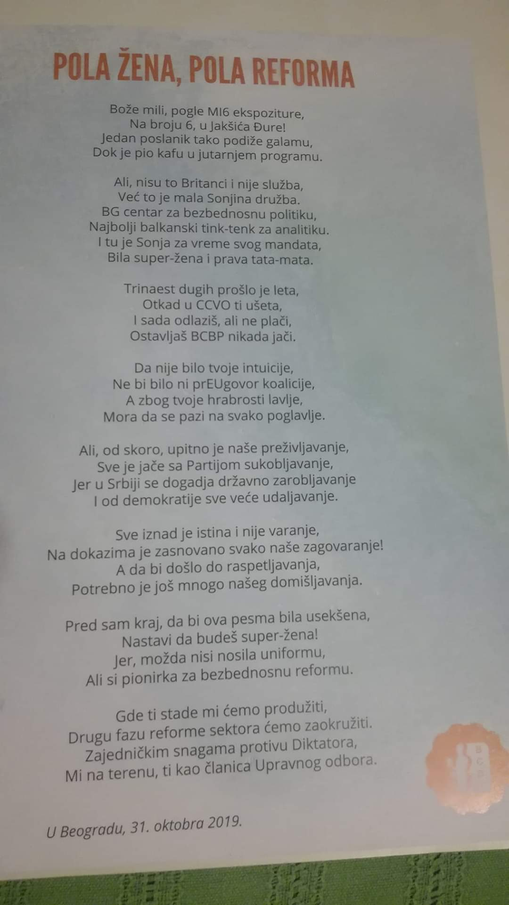
Sonja Stojanovic Gajic
In activism since I was 16. I led a student organization and later worked for big IGO and in academia.
2006-2019 Director of Belgrade Centre for Security Policy (BCSP) Mixed job description: management and programme
Self-educated manager - learned by doing it and leading an organisation through change process
Set up networks and communities of practice to resolve cross-national issues
Consultant to CSOs and IGOs in East Europe, Middle East and Latin America
Certified Analytic-Network Coach and completed multi-year Training in Systems-Psychodynamic Consulting
Research Fellow, Centre for Advanced Studies, UniRI, Croatia

Slide 5
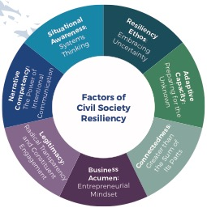
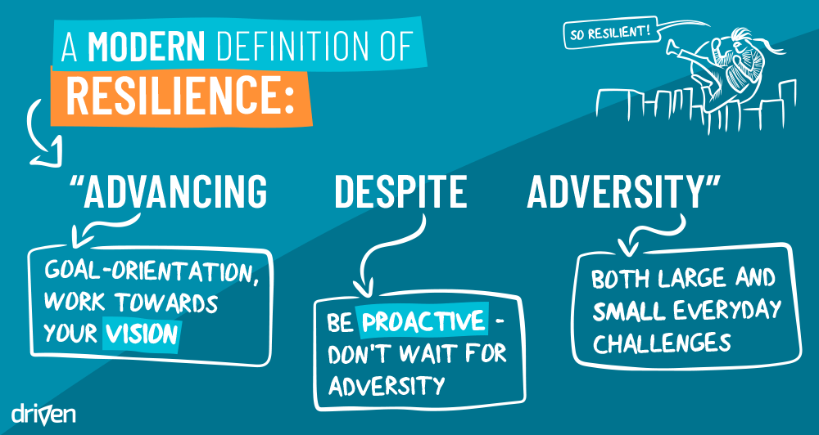
Organizational Resilience
The greater the extent of internal vulnerabilities, an organization is the more at risk in increasingly hostile external environments.

Slide 6
Draw a typical situation/activity/ place/object of your organisation
Use visuals, not words
It is not about drawing, but your experience of organisational culture.

Slide 7
CULTURE is a learned system of shared understanding This is the way we do things here How should people behave? How are decisions made? How work activities should be carried out?
Notes:
8 responses – 18 trainers

Slide 8
Where would you start from to study organizational culture of think tanks?

Slide 9
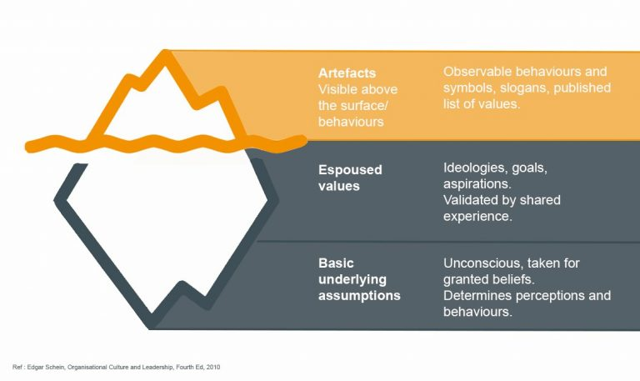
Culture
Schein, E. H. (1990). Organizational culture. American Psychologist, 45(2), 109 -119. https://doi.org/10.1037/0003-066X.45.2.109

Slide 10
Task: list the atributes and examples
Ineffective
THINK TANK CULTURE
Effective
Disables…
Enables…

Slide 11
CULTURE
EATS STRATEGY
FOR BREAKFAST

Slide 12
Example of supported values - GOVERNANCE
What are we making decisions about?
What kinds of relationships are these structures supporting?
Whose voices/engagement are included?
A board or governing body responsible for overarching decisions and the long- term vision (independent from management).
Executive direction: a competent manager at the centre of the organisation.
Senior managers/decision makers with oversight over three main aspects of the
think tank’s work: research, communications and management.
Institutional structures that bring people, teams and roles together

Slide 13
Decisions | Board | Management with the Board | Management
STRATEGY
Mission | X
Strategic planning | X
Annual plan | X
Implementation of annual plan |  |  | X
Evaluation of strategic plan | X
Plans for major cooperation, partnerships | X
PROGRAMS
Introduction of new programmes and services | X
Policy for grant-making |  | X
Donations |  | X
Programmes evaluation |  | X
MANAGEMENT
Structure and size of Board | X
Selection of Board members | X
Selection of external audit | X
Appointment of internal audit/control |  | X
HUMAN RESOURCES
Management structure | X
HR policies | X
Recruitment and employment |  |  | X
Compensation policy |  | X
Career development plans |  | X
FUNDRAISING
Approval of fundraising plan | X
Setting annual targets |  | X
Gift/donation policy | X
Decisions on receiving grants |  | X
Capital gift/investment | X
OUTREACH
Logo/change of image | X
Communications for specific initiatives |  |  | X
Contracting advertising agencies |  |  | X
LAW - LEGAL MATTERS
Statute | X
Initiating legal procedure | X
Evaluation of legal service |  |  | X
Contracting procedure | X
FINANCE
Financial targets |  | X
Approval of operating budget | X
Capital spending | X
Costs over 1000€ outside of budget |  | X
Investment policy and targets | X
Credits | X
Reporting on financial work |  | X
Report on spending |  | X
Financial control |  | X
Financial audit |  | X
Selling property or transferring | X

Slide 14
The structure can be established in flat organisations vs. ‘we are family’ myth
Agreements and clarity and transparency
clarity of roles and division of responsibilities and the right to change
lines of responsibility (who is responsible for what...), and where is the autonomy
ways of coordination way of decision-making - democracy within the organization
Western, S., 2017. Where's Daddy? Integrating the Paternal and Maternal Stance to Deliver Non-authoritarian Leadership Dynamics, 17(2) .

Slide 15
Not ideal, but good enough leader
I always say that think-tank Directors are doomed to fail, because the job description is so wide. How can you be the world’s best researcher, best communicator, best fund-raiser, best leader of change, and best manager, all at once? Of course, you can’t.
Simon Maxwell, former director of the Overseas Development Institute.

Slide 16
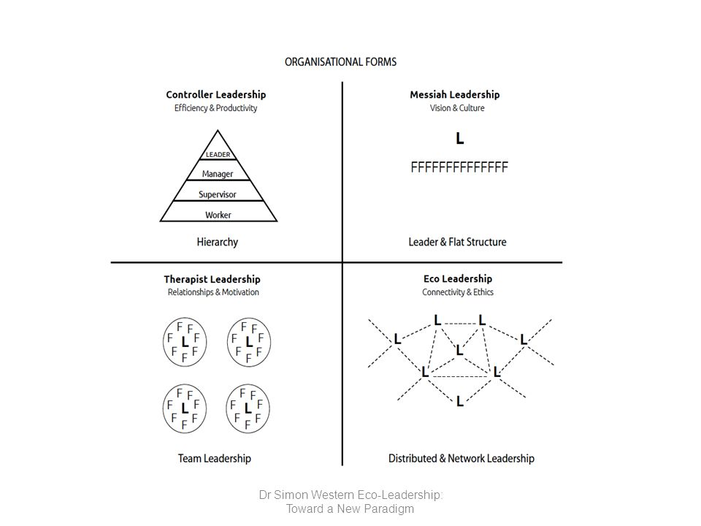
Networked Leadership
(especially in the context of hybrid work)
https://www.ecoleadershipinstitute.org/what-is-eco-leadership

Slide 17
What keeps directors awake at night?

Slide 18
Internal relations
HR relationships within (the team – research role)
HR – profile of the think tankers (young graduates vs. established individuals)
Career opportunities (professional development) – what is career progress? Compensation and employment policy. Where do people go afterwards?
Management of non-permanent or volunteer staff
Development of team leaders and middle management: How to transition from technical ‘expert’ position to the management role?
In unstable context - how to protect staff from external threats and burn out

Slide 19
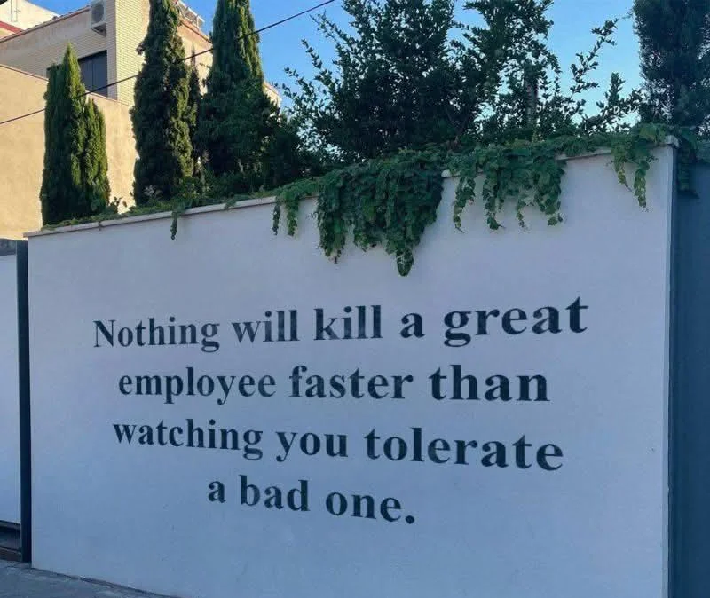
The nightmare

Slide 20
Team Relationships
Status and purpose - recognition of value, pride and awareness of power and privilege in the team
Certainty - predictability through routines, boundaries and thinking about the future
Autonomy - possibility of choice, voice and control
Connection - social connections give us a sense of security
Fair relations - fairness within the organization
Leading by example - 75%
Space for conflicts
Room for mistakes
Pride and purpose
Connection

Slide 21
Practices and the participation in the communities of practice (CoPs) change more than other instruments. But the consistent use of mix of approached is necessary!

Slide 22
Fuck-up Nights
What? a global movement where people share stories of professional failure. https://en.fuckupnights.com
Why? To create a culture shift around failure and enable a mindset of well-being and innovation. Fuck-Up Nights are a safe space for sharing vulnerabilities and laughs and learning within the community.
How?
Few introductory speakers kick off the event with sharing their stories of failure/challenges during their career.
Everyone present can ask follow-up questions to the presenters.
The Open Mic for volunteers after initial stories.

Slide 23
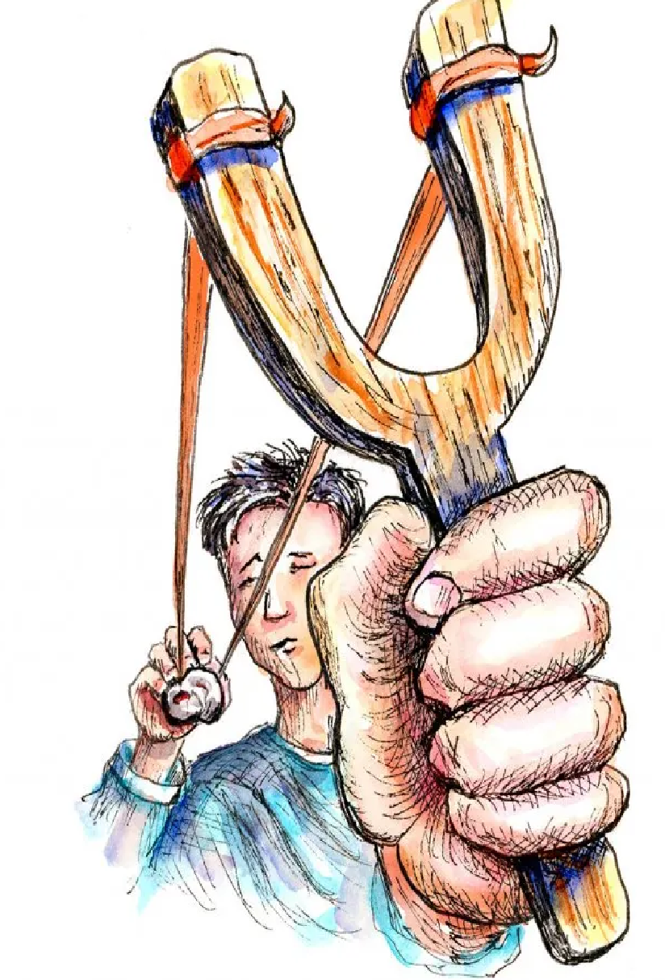
How to manage external risks?
let's reduce external uncertainty through joint reflection
why we do what we do and
what we won't do during marathon stride
Foresight - Anticipating future scenarios instead of constantly reacting
linking with important partners
Plan B – getting ready to respond to risks and how to respond
trauma prevention and recovery support - support groups

Slide 24
How would you introduce change into organizational culture?

Slide 25
Practical Work
Group 1: How would you onboard – introduce interns or newly hired staff to the organisational culture?
Group 2: How to create and maintain organisational culture in remote work?
Change Management: How to change the practice of too many long meetings in the organisation?

Slide 26
Challenge 1: Onboarding for new staff - scaling up
The think tank X was founded by a tight-knit group of seasoned researchers, all of whom have worked together for years. Their bond is rooted in shared activist experiences, intellectual passion, and a collective vision for advancing knowledge. As a small organization, the team is close-knit and informal, often blurring the lines between professional roles and personal friendships. The culture is highly collaborative, but also fast-paced.
Despite its impressive reputation for producing high-quality research, tt faces a significant problem: difficulty in retaining new, younger staff members. The founding team’s frustration with the new hires’ lack of commitment leads to even less effort in mentoring and guiding them. At the same time, the new hires’ confusion and discomfort with the unstructured environment leads to dissatisfaction and eventual departure.

Slide 27
Challenge 2: Remote Work
Context: A youth think tank with members from various countries is operating remotely, and its staff consists of students based on different continents. The challenge lies in creating a shared sense of organizational culture and coherence among a diverse, geographically dispersed group with no consistent in-person interactions.
Problem: The virtual environment makes it difficult to establish common values, expectations, and a unified approach to work. Members come from varied educational backgrounds, cultures, and time zones, leading to miscommunications, feelings of isolation, and inconsistent levels of engagement. Despite the shared goal of policy advocacy, there’s a lack of shared organizational identity.

Slide 28
Challenge 3: Too many meetings
The think tank’s senior leadership has noticed that staff, particularly research and advocacy teams, are overburdened with internal and external meetings, leading to burnout and a decline in overall productivity.
The organization’s culture values face-to-face interaction (even if virtual), and there's an unspoken expectation that attending meetings is essential to being seen as a ‘dedicated’ employee.
Some senior staff members are reluctant to reduce the number of meetings, fearing loss of control or communication breakdown.
Different teams or departments often hold simultaneous meetings, which leads to scheduling conflicts and further reduces available working hours.
The constant pressure to attend meetings—some outside of working hours due to time zone differences—has led to an unsustainable work-life balance. Staff members feel overwhelmed and are finding it increasingly difficult to balance work with personal life.

Slide 29
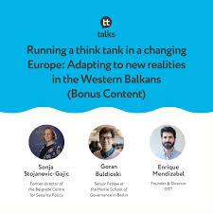
Running a think tank in a changing Europe https://open.spotify.com/episode/5TSeB3eRTC4Ap98AjGwDU5?si=smIB5NvAQWiFZANabcxi_A

Slide 30
Useful resources on leaderhsip
Think Tank Leadership: Functions and Challenges of Executive Directors https://onthinktanks.org/wp-content/uploads/2021/06/OTT_WP9_Think-Tank-LeadershipFINAL.pdf
Ajoy Data on networked leadership
https://onthinktanks.org/articles/what-shapes-the-authority-and-power-of-leaders-and-their-followers/
https://onthinktanks.org/articles/in-charge-but-not-in-control-lessons-from-leading-teams-in-a-networked-world/
Enrique Mendizabal https://onthinktanks.org/articles/what-keeps-think-tank-directors-up-at-night-reflections-on-funding-staffing-governance-communications-and-me/
Think Tank Director Profiles and how to replace them https://onthinktanks.org/articles/directors-profiles-and-how-to-replace-them/
Why pay attention to management
https://onthinktanks.org/articles/why-pay-attention-to-management-the-managing-think-tanks-series/

Slide 31
Stay in touch
Sonja Stojanović Gajić
Twitter: @StojanovicSonja
BlueSky:@SonjaSG.bsky.social
WhatsUp: +381646479091 (Serbia) and
+38595 3724170 (Croatia)
LinkedIn: @SonjaStojanovicGajic
Academia: https://ucl.academia.edu/SonjaStojanovicGajic
E-mail: sonja.stojanovic.gajic@outlook.com

