Slide 2
Strategic thinking and innovative leadership
FUNDACIÓ BOFILL
Mònica Nadal, Director of Research
Lídia Climent, Deputy Director

Slide 3
Organizing to promote strategic capacities

Slide 4
HOW DO WE WORK?
Specific challenge for everyone
→ Regardless of placement in the organizational structure
No technical support roles
→ Inverted pyramid structure

Slide 5
EVOLUTION OVER TIME
Initially focused on policy makers
Questioning all the “what ifs”
Opening focus towards:
Ecosystems
Proof-of-concept projects
Advocacy
Theory of change

Slide 6
Promoting strategic thinking

Slide 7
WHY
To maximize potential impact
To give autonomy to each team (and individuals) and promote conversations focused on strategy.
To empower teams to solve strategic dilemmas and be effective leaders.
Notes:
teams come to supervisors with strategic dilemmas, not previously. Therefore convos start at a high level.

Slide 8
RISKS
Empowering the team doesn’t mean directors deflect responsibility
Be careful not to promote uncertainty

Slide 9
HOW
5 years strategic plan + annual planning
Promoting strategic conversations with a shared narrative:
At different levels (directors, department heads, etc.)
With different formats (thursday sessions, informal spaces, etc.)
Using different tools (annual planning, Asana, BSC)
Notes:
We plan our strategy with a 5 year framework but review it yearly to adjust:
we know where we're going in the long run but allow ourselves to have flexibility to adjust buy reviewing it often (every 6 months) to allow for changes of direction to happen when we detect the need and not too late.
We need to be able to imagine what do we want to achieve in 5 years, it’s our vision, our lighthouse. Especially important in our VUCA (volatile, uncertain, complexity, ambiguity) context. Without it you’re lost. But we’re not enslaved by it.
We base it all in the quality of the conversations we promote
Strategic convos happen at all levels within the organization: led by directors but expected by everyone
With different formats: in structured team-wide meetings, informal spaces, every possible moment
Using an array of different tools
Let’s see the detail

Slide 10
BALANCED SCORECARD (BSC)
To measure impact at the organizational level
Related to the 5-year strategic plan
To track hard KPIs
AI tool in process

Slide 11
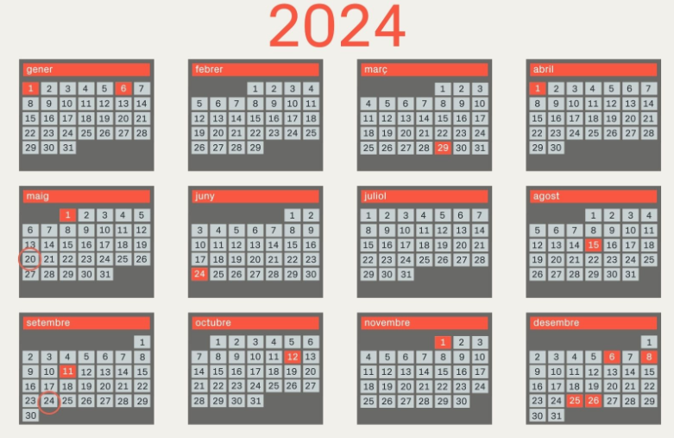
ANNUAL PLANNING
Strategy trumps planning
Conversations:
Based on goals, KPIs and actions, not tasks
Calendar-binded
Current year actions start
Current year achievements
+
Next year orientations
Next year first draft
+
Action day
Current year closing
+
Next year final
Notes:
Linked with our Board of directors meetings to approve next year’s plan and review current year’s closing data

Slide 12
TOOLS FOR ANNUAL PLANNING
Asana
Avoid using it for accountability purposes
Tool to follow up and guide conversation but not a requirement to update
Constant redefinition
Goals, KPIs and actions can be redefined at each conversation (sooner if needed)

Slide 13
THURSDAY SESSIONS
Not informative, but strategic
Sharing narrative and strategy
Mandatory for everyone (not just directors):
Refresher on how each role impacts strategy
Team members share with a strategic perspective:
Learning points
Dilemmas
Innovations introduced
Failures
Risks and mitigations
Next steps and alternative scenarios
major takeaways for the rest of the team

Slide 14
INFORMAL SPACES
Google Chat
It exists to avoid strategic spaces to turn into informative ones
Documents, articles, papers to enhance everyone’s knowledge around our issues
Successes and impact achieved
Conversation is not promoted to avoid distraction
All team-wide spaces
Notes:
all organizations need to share information but to prevent strategic spaces being hijacked by informational news we have created this space.

Slide 15
Challenges, risks and mitigations

Slide 16
Balance strategy and accountability
Middle management guidance
Directors-led shared narrative
Accountability reports limited to in-context conversations

Slide 17
Balance empowerment and changing context
Empowering within changing context
Sustaining motivation when there’s no certainty: No sure shots!
Incorporating context analysis to conversations and linking it to changing strategies.

Slide 18
Advancing strategy based on individual leadership
We ask teams to take their challenge as far as possible.
Focus and recognition not based on doing what we said but on taking challenges as far as possible.
To do that, we promote autonomy in risk taking BUT with shared responsibility.

Slide 19
Ongoing dilemmas

Slide 20
Prescription
vs.
implementation

Slide 21
Scaling up
vs.
establishing standards of quality

