Slide 1
Hello & welcome!
On Think Tanks School
The UX Session
with John & Alice

Slide 2
Soapbox is a creative studio for ideas that matter.
We combine strategy, technology and design to help forward-thinking organisations turn knowledge and ideas into social progress.
Notes:
Soapbox is a creative studio for ideas that matter.
Another way of saying that, is that we are a design agency for think tanks.
In fact, when we started in 2008, we were the first communications agency of any kind to specialise in think tanks.
I used to work in a think tank – the Institute for Public Policy Research in London – working on designing and editing publications and on their website.
I must have been OK at it, because lots of other think tanks asked me to do similar things for them in my evenings and weekends.
Eventually, that turned into a business – Soapbox.
There are 35 of us now. Most of us are in the UK – but we work globally, with a lot of clients in the USA and in Europe as well, plus some in Africa and Asia.

Slide 3
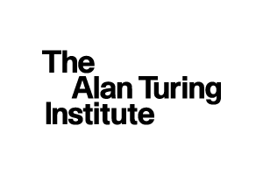
We help some of the world’s leading mission-driven policy, research and advocacy organisations to communicate in more imaginative ways.
We work with organisations that generate and share knowledge and ideas – as well as organisations who support, champion, and put them into practice.
We work alongside established institutions who have already changed our world for the better and emerging initiatives who are just about to. Our clients range from independent research institutes and think tanks to grantmakers, membership organisations and educational institutions.
Notes:
Here are some of the clients.
You’ll see there are some big names in there like Chatham House, Bruegel and the World Resources Institute.
And also a lot of think tanks within universities – which is why you see the LSE and Stanford University in there.
And we work for multilateral organisations as well – when they are doing think tanky things. So you’ll see United Nations University there and the Intergovernmental Panel of Climate Change.

Slide 4
Brand
Web
Publishing
Creative
We have experts across all four of our focus areas.
This means we bring the right people together for each project as well as having access to a wider pool of expertise from across the agency.
We work in a joined up and integrated way, minimising messy hand-offs and saving time and duplication of efforts.
Notes:
We work across these areas.
And it’s worth emphasising that we see ourselves as a creative studio not a PR, marketing or events agency.
Of course we’re really interested in those things, we do intersect with a lot of them in our work and I'm really happy to answer questions about them.
But mostly our work involves making things – visual identities, websites, detailed research reports and creative campaign materials – and, as you will see today, that work is always best when it is informed by good strategy and insights from working with the people who use and consume your research.

Slide 5
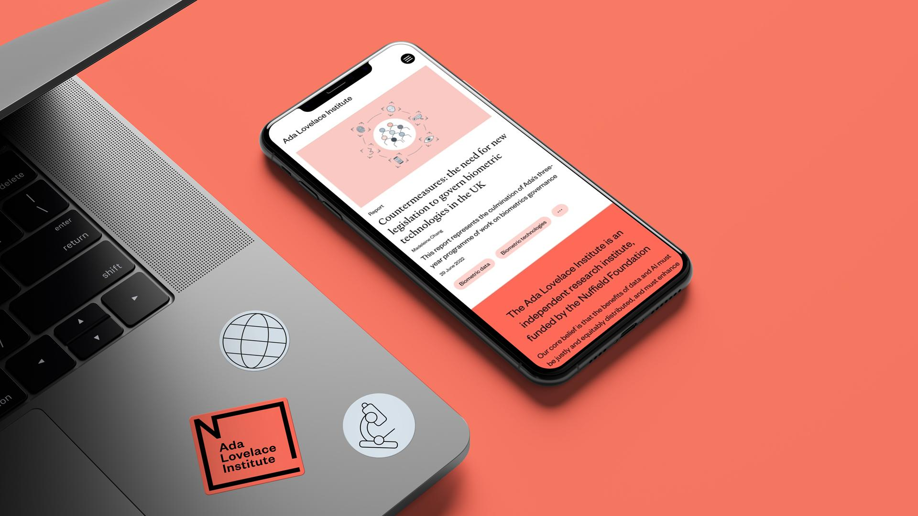
Our services
Brand
We crafted a vibrant look and feel for Ada Lovelace Institute, the leading voice on data and AI
We developed a tactile brand identity for ICCROM that draws from their rich history
We help progress-driven organisations express who they are, what they do and why it matters, amplifying their impact and sparking positive social change. Whether through a light-touch brand refresh or complete overhaul, we help our clients to bring their brand stories to life.
Brand strategy
Messaging and tone of voice
Project, campaign, event and organisational identities
Brand collateral
We embodied NRGI’s energy for change with a brand identity focussed on the future
We worked with the National Centre for Social Research to recharge their brand and digital presence
Notes:
Often, the work we do for clients like you begins with understanding your brand – what you do, why you do it, who you do it for.
The set of expectations audiences have about you and how we might shape those expectations.
We work out all of that stuff – which we call brand strategy – and we use our skills as creatives to work out what that means visually and verbally.

Slide 6
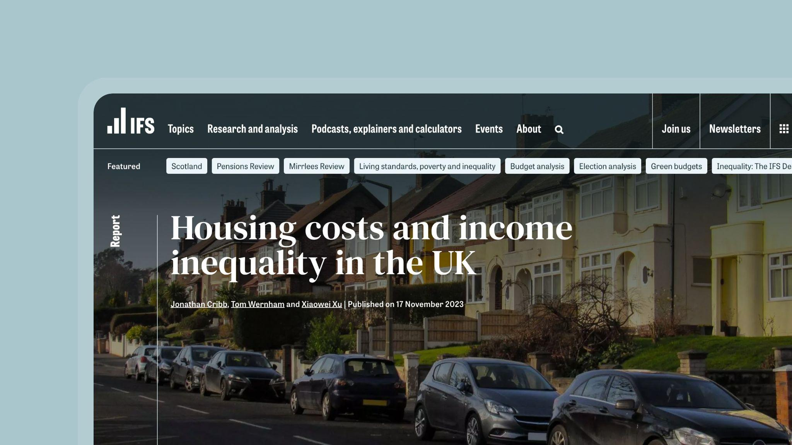
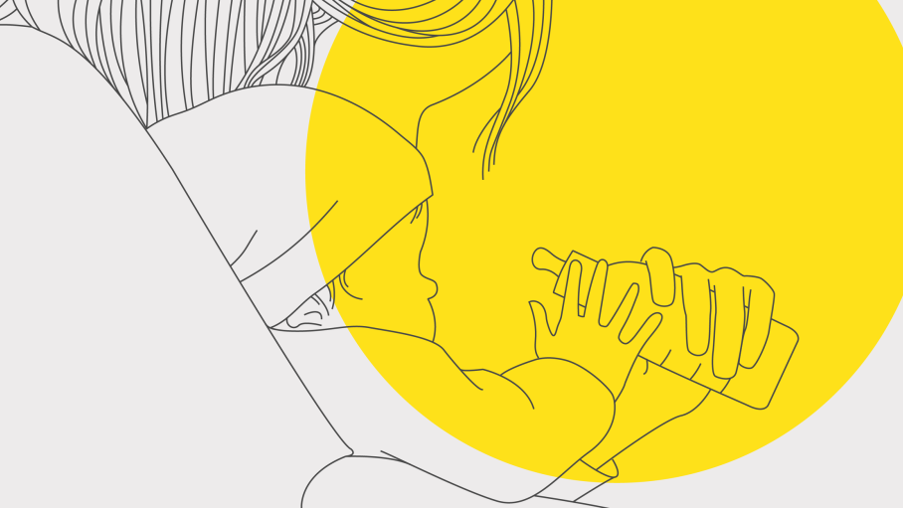
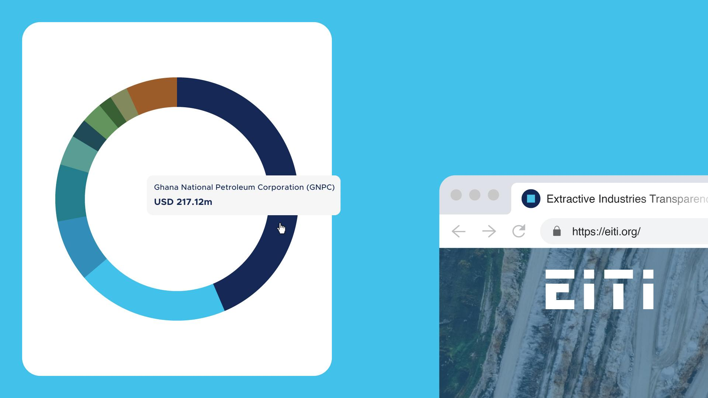
Our services
Web
We crafted a website to help IFS share their outstanding work with diverse audiences
We worked with Stanford Center on Early Childhood on numerous digital experiences for their RAPID initiative
We specialise in creating structured digital platforms for organisations that publish detailed original content, often at scale. We design, build and maintain everything from campaign microsites to interactive tools, data dashboards to large-scale digital platforms for global institutions.
Research and strategy
User experience and interface (UX/UI) design
Web development (Drupal and Wordpress)
Maintenance, hosting and support
Continuous improvement
SEO and analytics
We created a seamless user experience that puts data and discovery first for EITI
We helped Murray Edwards College to express their values and the unique studying experience they offer
Notes:
But no brand can succeed if it doesn’t add value for its users. For most think tanks users these days will primarily encounter you online, much more so than in person. For these users, your website is not something that your think tank does or something which is about your think tank.
For these people your website literally IS your think tank.
That bears repeating

Slide 7
for most people
Notes:
For most people

Slide 8
your website IS your think tank
Notes:
Your website IS your think tank

Slide 9
Our services
Web
We crafted a website to help IFS share their outstanding work with diverse audiences
We worked with Stanford Center on Early Childhood on numerous digital experiences for their RAPID initiative
We specialise in creating structured digital platforms for organisations that publish detailed original content, often at scale. We design, build and maintain everything from campaign microsites to interactive tools, data dashboards to large-scale digital platforms for global institutions.
Research and strategy
User experience and interface (UX/UI) design
Web development (Drupal and Wordpress)
Maintenance, hosting and support
Continuous improvement
SEO and analytics
We created a seamless user experience that puts data and discovery first for EITI
We helped Murray Edwards College to express their values and the unique studying experience they offer
Notes:
That’s why user experience strategy is important. And what we’ll be learning about today.
And we, at Soapbox, are at the pointy end of that everyday, building, maintaining, improving big websites for some of the world's best think tanks.
And also trying to innovate in that digital space and set standards for the think tank sector as a whole.

Slide 10
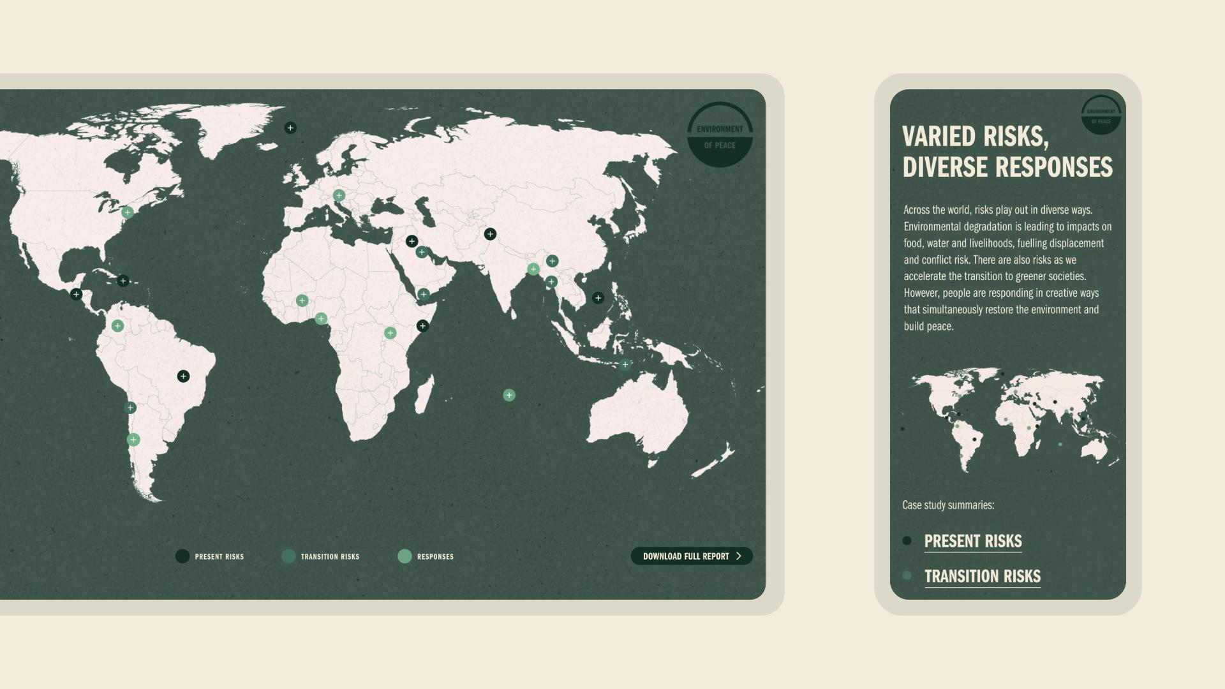
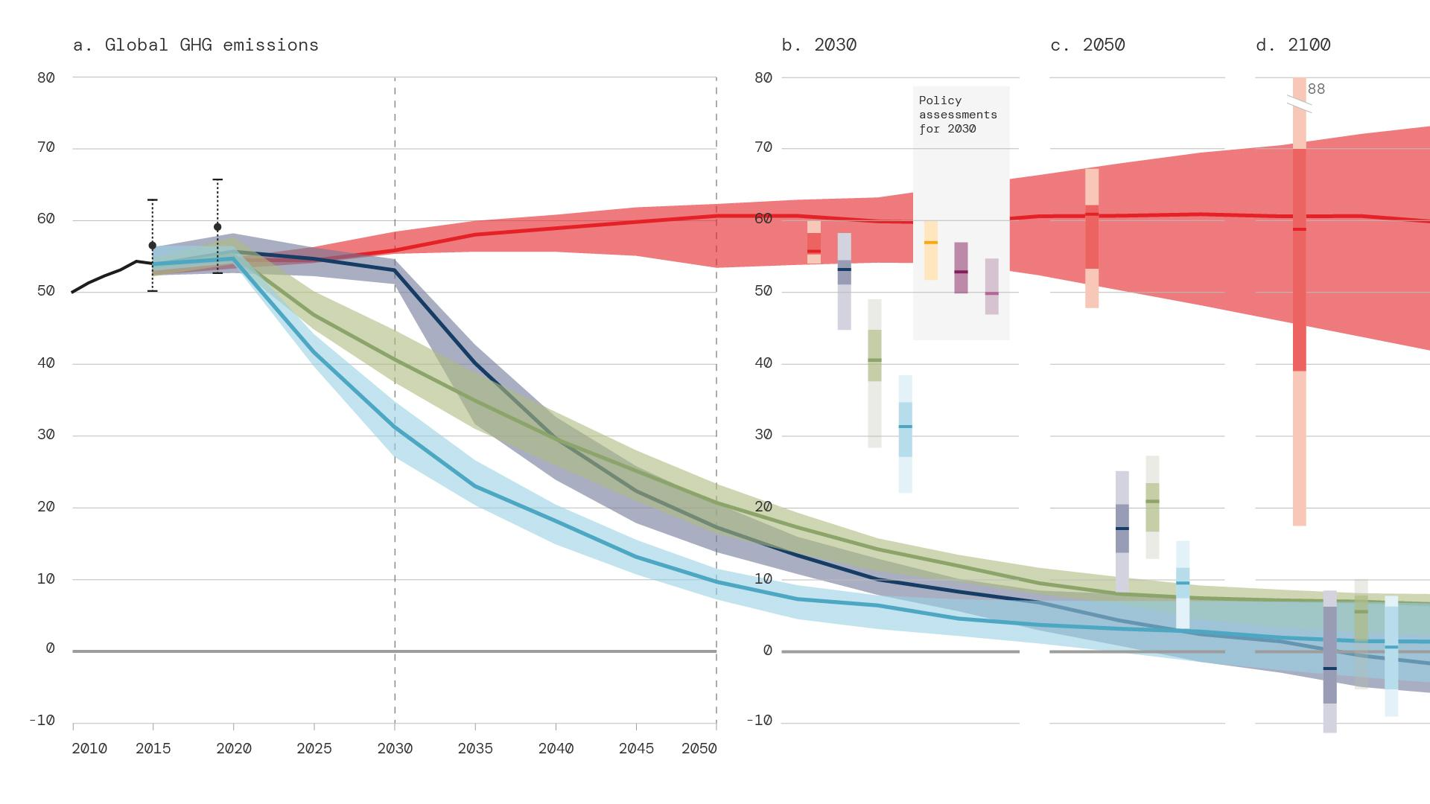
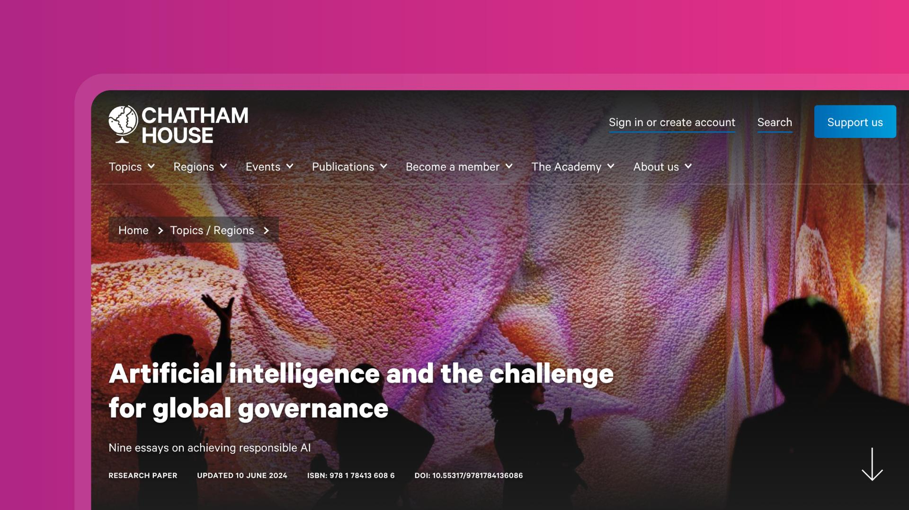
Our services
Publishing
services
We developed a visual language, publication design and online home for Centre for London’s new series
We created an immersive digital report with SIPRI for their Environment of Peace project
For the clients we work with, deep thinking is their currency. For this thinking to take hold, it needs to be expressed in ways that are understandable, findable and shareable. And in ways that generate trust and deliver impact.
Copywriting and editorial
Proofreading
Typesetting, templates and layout
Chart and map design
Online reports and page-to-PDF
Publications strategy
We visualised data for the IPCC that tells the crucial story of climate change
We worked with Chatham House to implemented our online Reader product and workflow
Notes:
And also helping users to navigate complex written content.
We started out working on reports.
We still design all of Chatham House’s reports.
We were responsible for editorial and layout of the IPCC’s sixth assessment report
But of course, these days, it’s not enough to have those detailed reports in PDF form. You really ought to have them online in HTML in machine readable ways – which makes them more searchable, shareable, accessible and easier for AI to use.
We’ve developed innovative ways to do that for lots of clients – including Chatham House and the Stockholm Environment Institute. I would especially recommend that you check out how Chatham House reports are presented online in full.

Slide 11
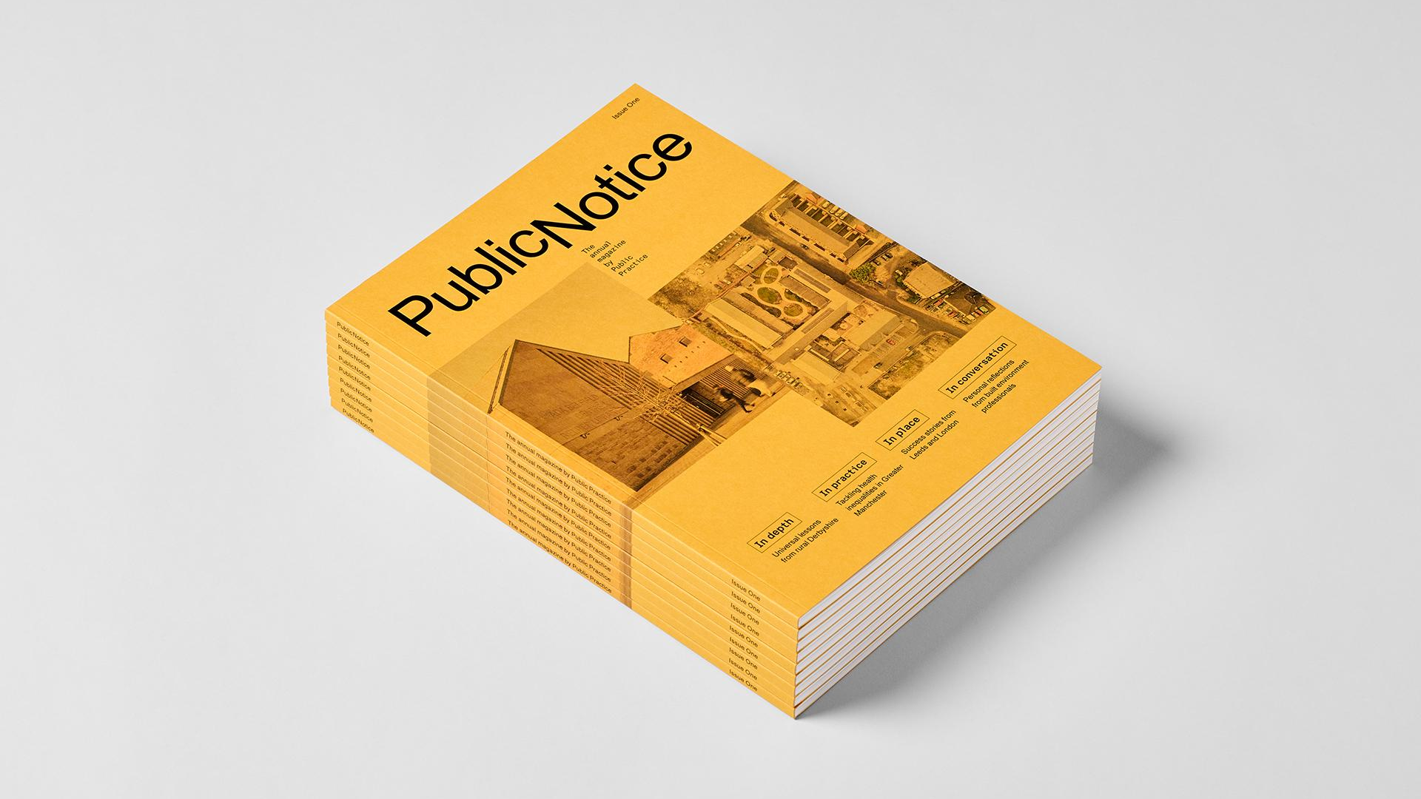
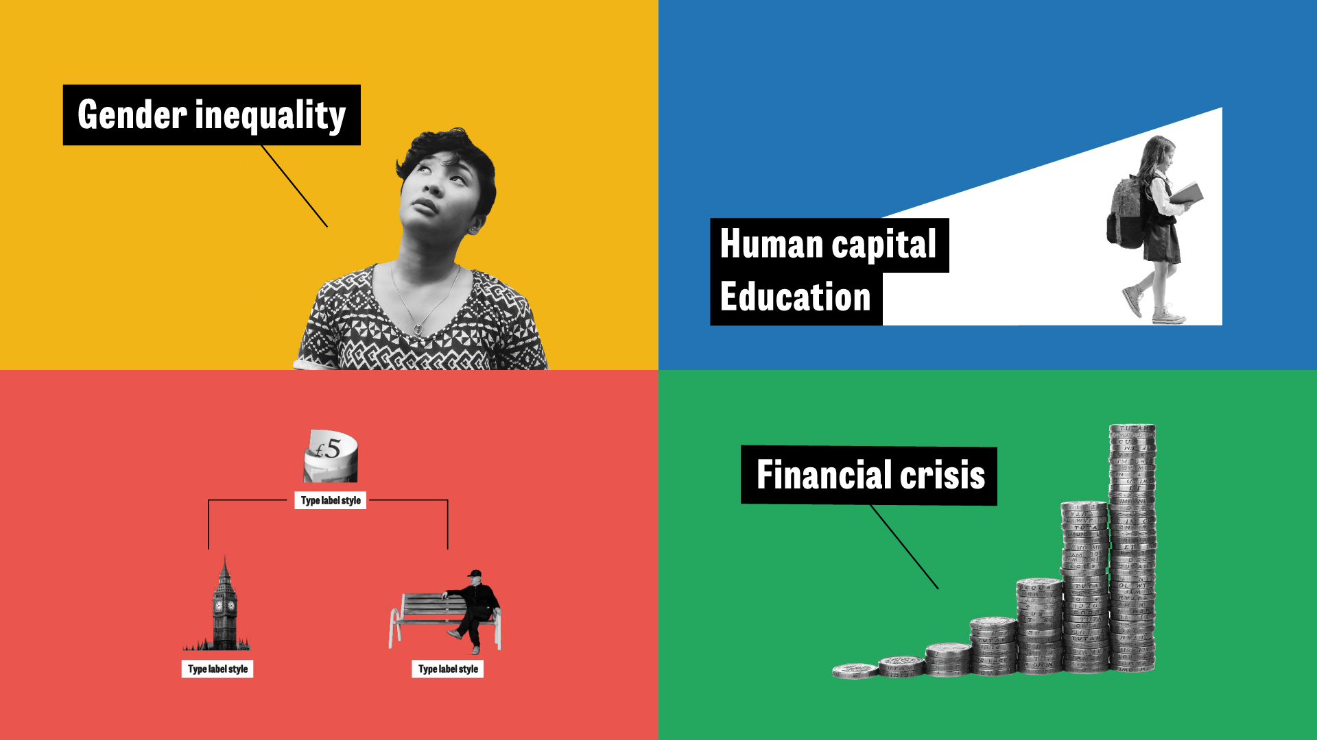
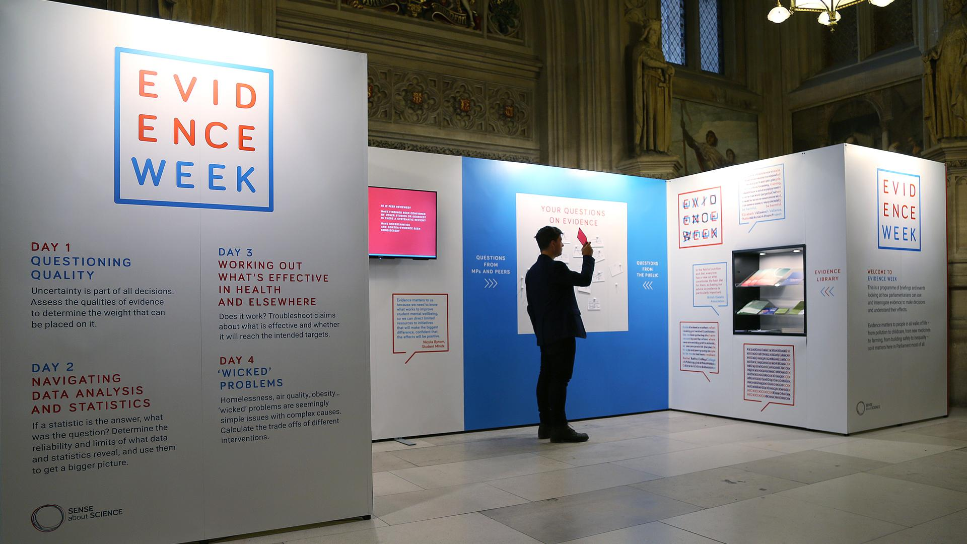
Our services
Creative
content
We worked with Public Practice on their annual publication that celebrates good practice
We brought the IFS’s five-year study on equality to life with a project identity and launch campaign
We bring sophisticated and world-changing ideas to life in imaginative and innovative ways, helping organisations to shape the conversation and change what’s possible.
Bespoke publications and flagship reports
Film and animation
Data visualisation
Event and exhibition design
Creative strategy
Communications and marketing materials
We produced illustrations and animations to amplify the work of the Nuffield Family Justice Observatory
We worked with Sense about Science to design an eye-catching installation in the heart of Parliament
Notes:
But lots of audiences will never read a full research report.
So you need to get your messages across in other ways – in creative formats that they will respond to and on the channels where they already are – or where you can attract them.
So that is why we also work on infographics, animations, films, exhibitions, magazines, social media campaigns and lots and lots more creative content.

Slide 12
How we do it
Deep expertise
We have over 15 years experience working with clients just like you. We have an unrivalled understanding of the work you do, the people you want to talk to and what they need. We bring that deep experience to bear on every project. And it continues to get deeper, as we push our practice and develop new tools.
Notes:
Like I said, we were the first agency in the world to do this with that niche focus on think tanks – recognising that think tanks have a unique set of communications products and a unique set of audiences. Different to government, academia, charities, NGOs or consultancies.
We’re still by far the biggest niche agency for think tanks and – I would say this – the best.
All of which is to say that we think an awful lot about the best way for think tanks to communicate evidence and ideas – and we’ve been pushing our clients to do more and do better for over 17 years now.

Slide 13
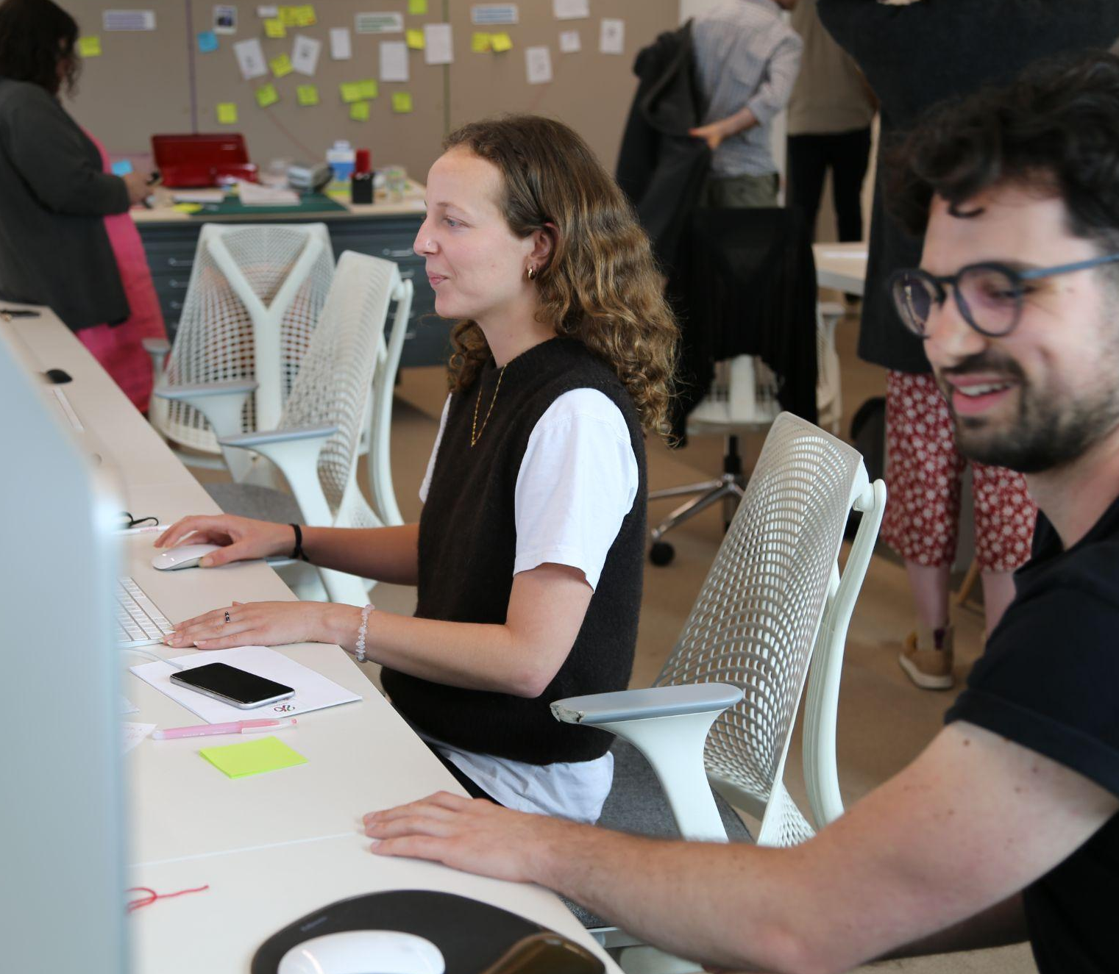
How we do it
True partners
We pride ourselves on building long-term relationships with our clients, turning initial projects into long-term partnerships.
We create durable products that are built to last and to evolve as you do. We work closely with teams to make sure you have everything you need to support and improve outputs in the long-haul.
Notes:
A lot of them have been the same clients for many of those years.
That includes Chatham House who have been our client since we started. Our very first client and still one of our biggest clients. And there are many others who we’ve collaborated with in true partnerships for over a decade

Slide 14
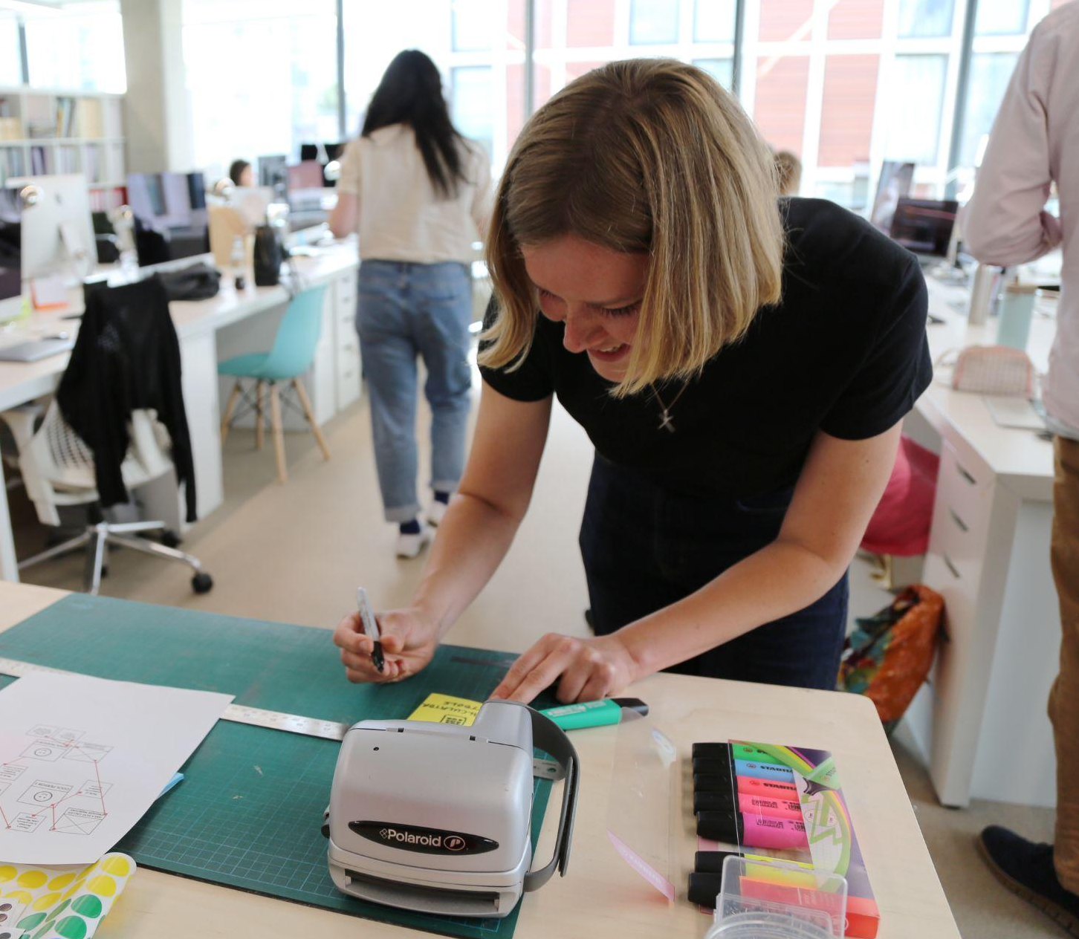
How we do it
Work that makes a difference
Since day one, we’ve only worked with clients who share our vision of a more sustainable, equitable and peaceful world. We think carefully about who we work with and what we work on. And we actively pursue projects aligned with causes we believe in – like tackling climate change and advancing social justice.
Notes:
We only work with clients who use knowledge, ideas, evidence to make the world a better place. A more peaceful, sustainable, equitable place.

Slide 15
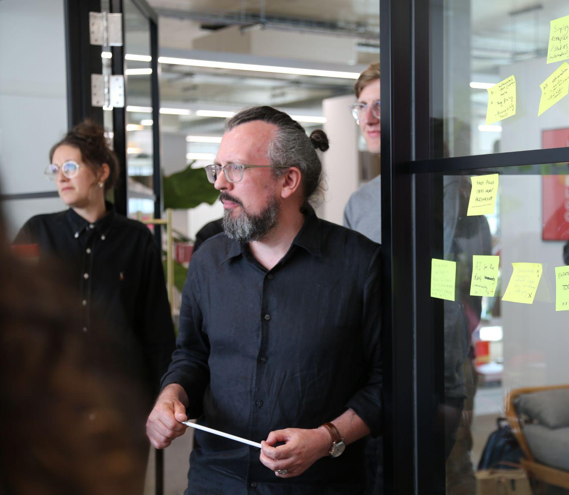
How we do it
Turning complexity into clarity
We believe that understanding leads to impact, and we know how to handle complex, wicked problems to simplify things while retaining their substance.
Soapbox started life as a publications studio. This experience informs our unique perspective when it comes to communicating knowledge and ideas. We know how to work with large volumes of detailed content and bring an editorial mindset to every project we do.
Notes:
And all of our work is helping our clients to take complex ideas, complex evidence, complex issues and bring clarity.
To inspire action. To inspire good policy.
Our job is the same job as our clients.
And it’s the same job all of you here have.
We take ideas and evidence and turn them into social progress.
Always striving to do better and to make the think tank sector better. With creativity, with passion, with intelligence, with enthusiasm – and with sheer bloody hard work.
So, with that, let’s get to work …

Slide 16
What we’re doing today
Notes:
Let's have a look at what we're up to today.

Slide 17
How do we build a think tank website for diverse audience groups?
Notes:
Our aim is to explore and hopefully answer this question.
How do we build a think tank website for diverse audience groups?

Slide 18
How do we build a think tank website for diverse audience groups?
Notes:
When we’re talking about diverse audience groups, we’re talking about your donors, the media, policymakers, researchers, activists, civil society, the corporate world…
We’re talking about the users of your website.

Slide 19
user experience
Notes:
It’s all about their experience

Slide 20
(“UX”)

Slide 21
your website IS your think tank
Notes:
If they like your website, then they like you

Slide 22
How do we build a think tank website for diverse audience groups?
Notes:
Our focus today is on the how — how do we meet the needs of your users so that they can get what they want?

Slide 23
How do we build a think tank website for diverse audience groups?

Slide 24
Discover
Test
Define
Design
Notes:
To do that we are going to deep dive into this. This is the design process.
Discover, Define, Design, Test — and repeat — until your website is a joy to use, embodying YOU and communicating your important ideas in a compelling and intuitive way.

Slide 25
Notes:
This session will be split into two parts.

Slide 26
Part 1
Introducing user experience design
Notes:
In part 1 we're going to explore user experience
— what it is, what good looks like,
— who your users are and how we meet their needs.

Slide 27
Part 1
Part 2
Introducing user experience design
Website design workshop
Notes:
In part 2, it’s over to you.
This is an opportunity for you to get stuck into creating your own think tank website — don’t worry we’re not going to be writing any code.
We’ll have an activity for each step of the design process.

Slide 28
Today’s agenda
15 mins
Welcome
Part 1 Introducing user experience
30 mins
Key concepts, examples & approach Your brief
15 mins
10 mins
Quick break
Part 2 Website design workshop
10 mins
Discover Define Design User Testing
40 mins
40 mins
40 mins
10 mins
Questions & Wrap up
Notes:
A quick look at today’s agenda, we’re running a tight ship, this is how things are going to look for the next few hours — of course they'll be opportunities for questions and to grab a quick snack with a couple of breaks.
So does anyone have any questions before we get started?

Slide 29
What is user experience?
Notes:
What is user experience?

Slide 30
It’s how a user interacts with and experiences a product, system or service.
Jakob Nielsen
Notes:
It’s how a user interacts with and experiences a product, system or service..
Jakob Nielsen — one of the gurus of UX thinking — cofounded NN Group alongside the true god father Don Norman
This could be physical or digital
It’s anything at all that has been designed in a human-centred or user-centred way
in other words, a way that makes life as easy and enjoyable as possible for the human using the product.

Slide 31
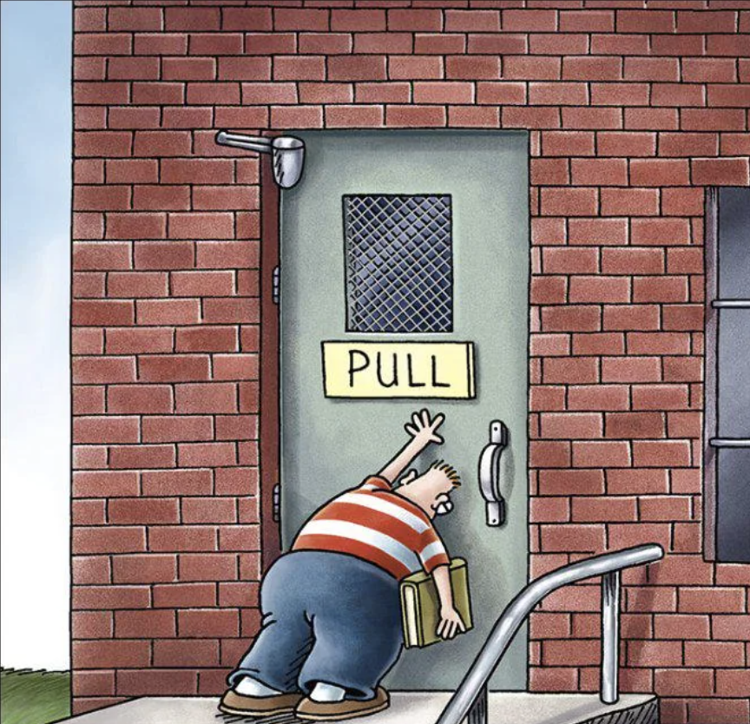
Push?
Pull?
Slide?
Notes:
Door
Think about how you use a door.
How do you know whether to push, pull or slide it open?
There needs to be a door handle that makes it clear, based on its shape and placement.
A flat plate on a door suggests "push”
while a handle suggests "pull."
This is a signal to us as users of the door.

Slide 32
How is your supermarket experience?
Notes:
Supermarket
How is your supermarket experience?

Slide 33
Shop Entrance
Aisle
A section in the aisle
Coffee
You preferred brand of coffee
Notes:
You start by entering the shop, you grab your basket
You then locate the aisle
Then within that you find the appropriate section in the aisle where all of the coffees are
Then you scan that shelf and select your preferred aisle
That’s the ideal journey of course,

Slide 34
50% off chocolate
Shop Entrance
Aisle
2 for 1 on wine
Notes:
in practice, a few obstacles in the way that may make you go a bit off-list…

Slide 35
Shop Entrance
Aisle
A section in the aisle
Coffee
You preferred brand of coffee
Homepage
Landing page
Subsection
Your content
Annual report 2025
Notes:
We’re going to explore this later, but this supermarket analogy we find really helpful to map out journeys through a think tank website.
Shop window/entrance = Homepage — The experience of when someone discovers you — when they see your name, maybe in a Google search, maybe they hear it at a networking event. The experience of when they first land on your website
Aisle = Landing pages — When they try to find that report that their colleague had mentioned.
Section within an aisle = Sub landing pages
Product = Your content types — Where they register for your upcoming event

Slide 36
What is a good user experience?
Notes:
What is a good user experience?

Slide 37
Awareness
Exploration
Engagement
Commitment
Notes:
Awareness, Exploration, Engagement, Commitment.
By optimizing each of these stages, think tanks can create a smooth and engaging user experience.

Slide 38
Awareness
Users discover who you are via search engines, social media, news, email newsletters etc.
Notes:
Awareness
Users discover who you are via search engines, social media, news, email newsletters etc. They want to learn about who you are and what you do. But our clients sometimes struggle to get the word out there — they’re not known to the very people they are trying to reach.

Slide 39
Awareness
Exploration
Users find it easy to browse your website and find interesting things
Notes:
Exploration
Users explore your content, see if it aligns with their interests, browse research topics, read policy briefs, explore latest events. Think tank websites are content rich, so they need to be organised in a clear way that makes sense to the end user. One of the main frustrations we hear about the existing websites of our clients is that the navigation is confusing.

Slide 40
Awareness
Exploration
Users can actively interact with you and participate in your activities
Engagement
Notes:
Engagement
Users interact with you via the site, signing up for newsletters, joining discussions, attending events. They want to engage with experts and fellow users.

Slide 41
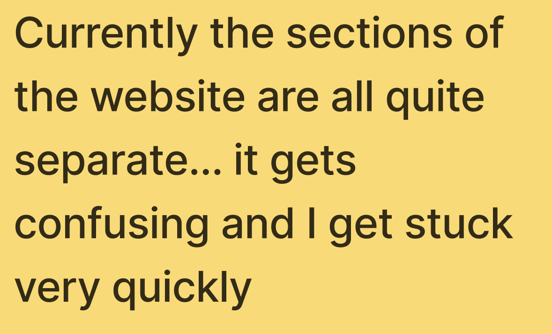
Awareness
Exploration
Engagement
Users stay on your website. They keep coming back. They tell their peers.
Commitment
Commitment
Notes:
Commitment
Users stay on your website. They keep coming back. They tell their peers. They become a part of your network, they want to support you, collaborate with you — by donating, partnering, subscribing to exclusive content, sharing content.

Slide 42
Awareness
Search relevant terms in headings
Targeted use of paid social
Answer common questions
Relevant, timely content
Restated across channels
Notes:
Awareness is all about helping people find your content.
Here’s a great SEO friendly title that answers a question that users might have.
It’s really hard to underestimate the power of using search relevant terms in headings and subheadings in your content to drive organic traffic. It’s one thing our clients consistently get wrong, but it is really simple. And really, there is not much we can do when we build your website to subsequently stop you from putting dumb, complex, uninformative titles onto your content. Stop doing that.
This is the Peterson Institute for International Economics. They got 135,000 pageviews on this page during the 2024 election cycle – and that was driven by organic search. It’s because it is great content, that uses their expertise, in a timely way to answer a real question that lots of people have, when they have it, and it does so in plain language – especially in the headings.
Peterson adapted this same content for Linkedin articles, threads on X and had their researchers ready to go on news shows and podcasts to explain the same points.
It’s expertise as a public service
That’s how you drive awareness. Be useful and clear and relevant in the places where people already are.
Searching on Google, scrolling on social media, watching TV and listening to podcasts.

Slide 43
Exploration
Intuitive content structure
Plain language
Boring can be good
On page navigation items
Notes:
[show CEGA]
[points to hit:
Intuitive content structure
Plain language
Boring can be good
On page navigation items]

Slide 44
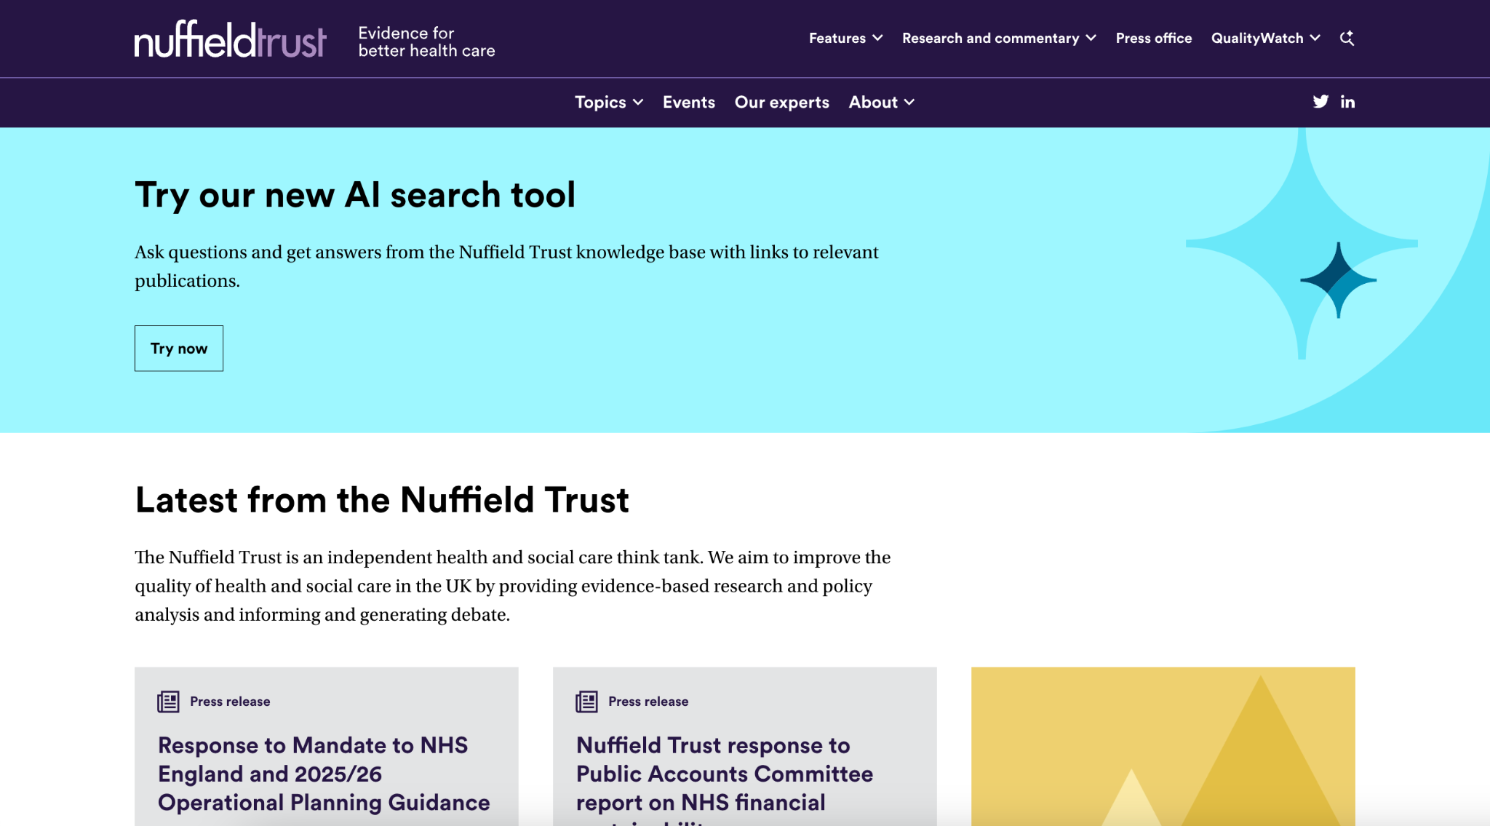
Exploration
Search relevance and vector databases
AI overviews
Editorial structure of content
Accessibility and the use of images
Notes:
[show Nuffiled live site]
[show search logs, show structure of answer (sourcing) - real question real people ask]
This is real people asking real questions of a think tank in real time. Analytics used to be able to give you some of this, but not in natural language. So you were always one or two steps removed. There was less immediacy and so less impetus to answer the questions directly.
Of course AI can answer the questions directly here. But it would give an even better answer if an expert wrote some content that directly addressed the question.
Good content leads to good answers.
[show real question and briefly explain how it works]:

Slide 45
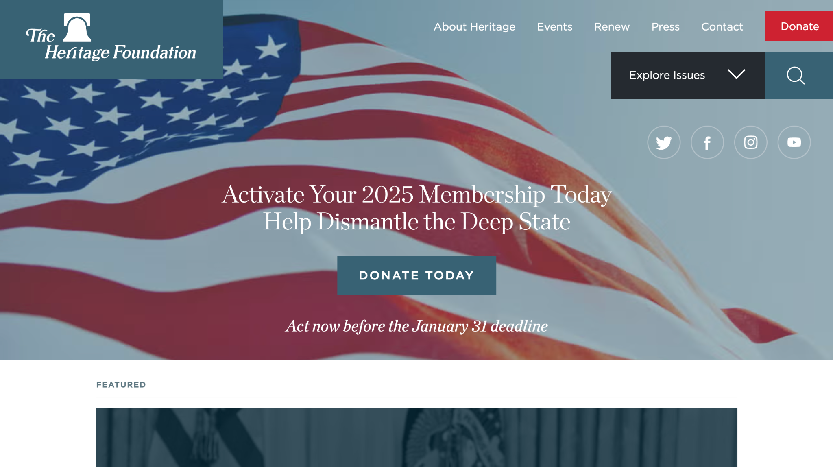
Engagement
Building a community
Participating in or leveraging a cause
Campaign focus
Notes:
[show Heritage]
Here’s a think tank that engages and wants to make you part of a community.
There’s always a lot to learn from the Heritage Foundation about communications and engagement whatever we might think of them.
There is a marketing focus as well as a content focus.
They understand their brand and they understand how to create a community around it and how that in turn gives them power. It’s explicit here that you are participating in a movement and therefore it is appropriate that you are asked to donate. How many think tanks can actually drive individual donations on their websites. Should they seek to do that? Is that think tanky behaviour? I’ll let you decide.
As a bit of an aside
[ go to ABOUT: scroll down, 3 priorities]
Look at these three priorities – this is about the how of policy not just the what. So yes they have policy answers, but they also create a movement behind those ideas and they create the people who are able to put them into action.
Project 2025 (which despite CAP’s best efforts we now see going into effect) is explicit about the same sort of structure - it’s a playbook and a rolodex of people and a training offer as well as a set of policies.

Slide 46
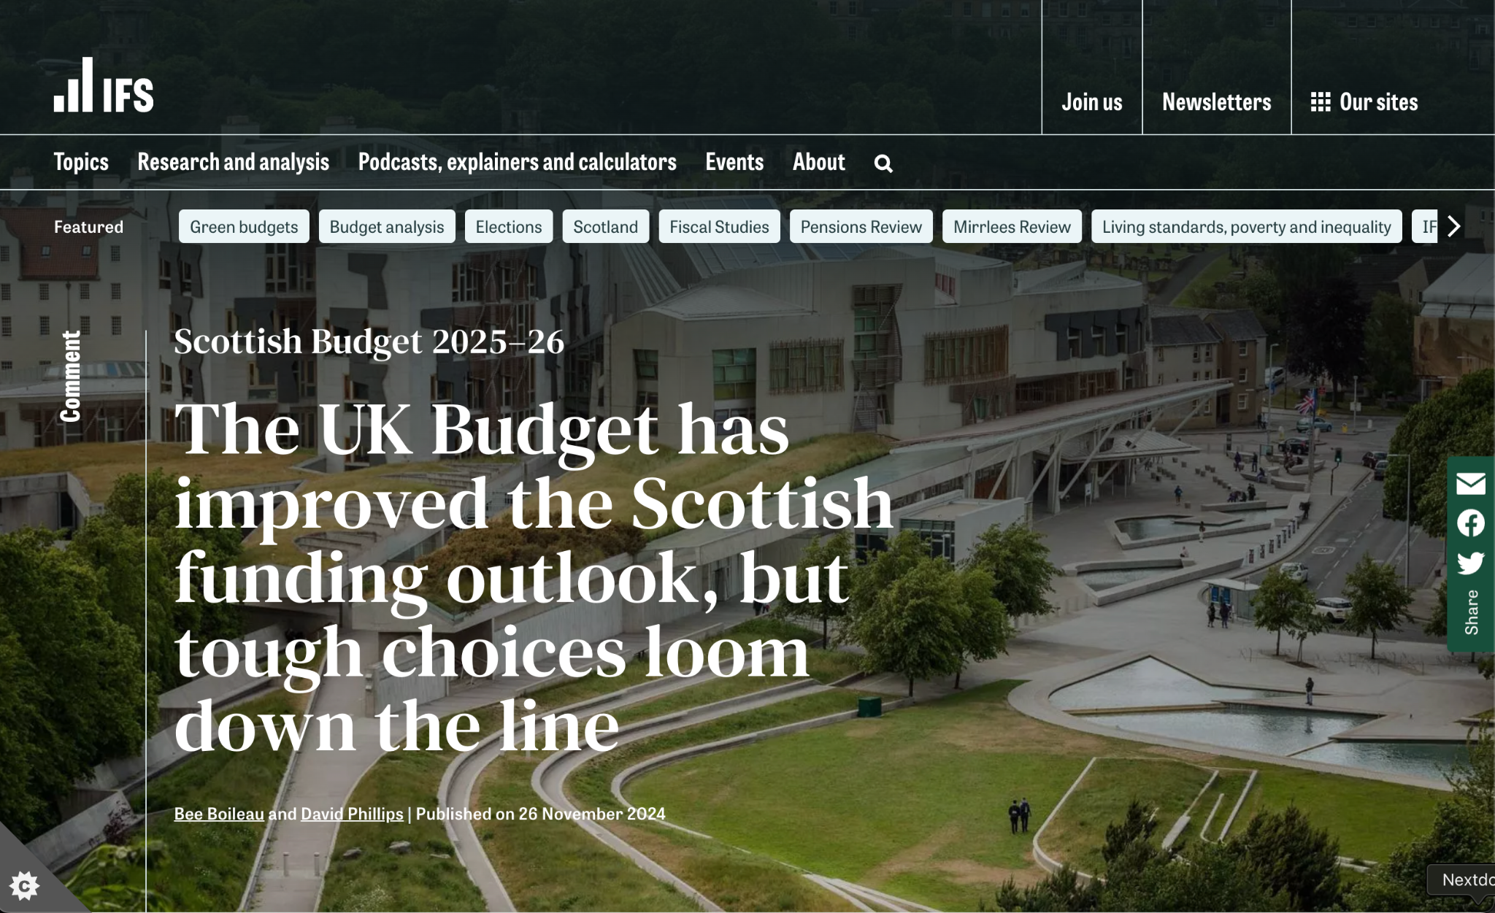
Commitment
Onward journeys via related content
Regular drumbeat of quality, user-focussed content
Notes:
[show IFS]
Again here in IFS we see think tank content as a public service.
[explain IFS - budget cycle, election cycle]
Timely relevant content that responds to the current issues
[explain related content - segmenting users - academic, policy, public]
[explain user who had 20 tabs open]
Its all about usefulness and relevance in users' lives. That’s what builds commitment and return visits. That’s what encourages people to become champions of you and engaged with your work

Slide 47
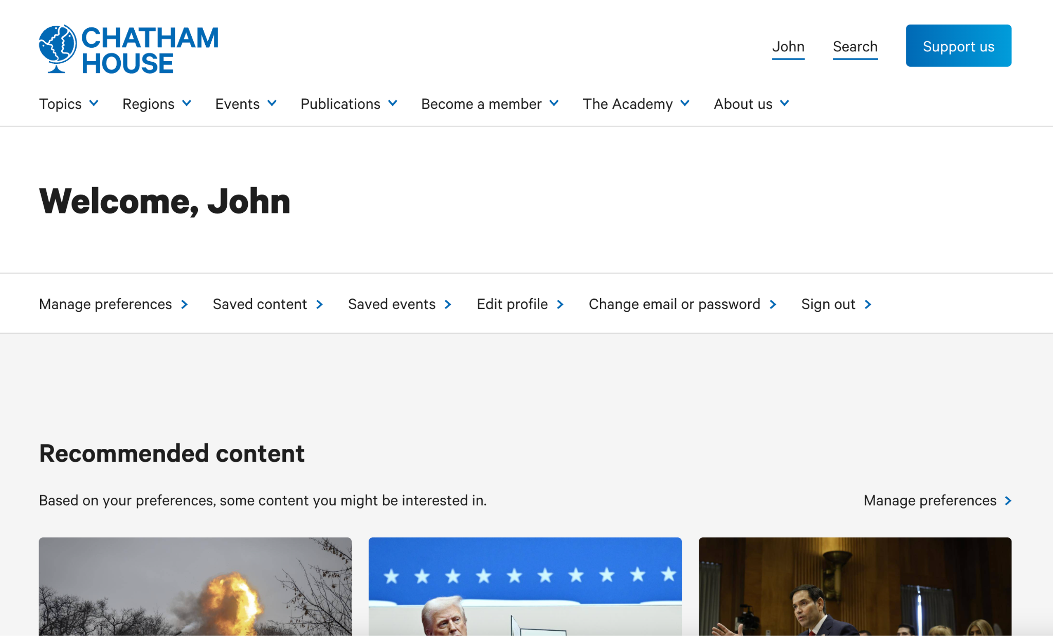
Ongoing commitment
Personalized dashboards for returning users
Notes:
[show CH logged in]
We can take that a step further if we have a membership model and membership functions like Chatham House. Here you can see how I can personalise my feed to the issues I’m interested in.
Personalisation gives me what I want – but it also tells Chatham House what different types of members are interested in and they can respond to that.
Because I am a member they can engage with me directly and ask me about my preferences if they want and, hopefully, I’m motivated to respond. But also, because I am logged in, they can observe what I do directly, personalise the experience and, hopefully, deepen my commitment and engagement still further.
Building community, building personal engagement, making me a champion of their work, making their content more relevant and more useful to me.
All of that accumulates energy and relevance to their brand and makes them more influential and impactful.

Slide 48
What do your users want?
Notes:
What do your users want?

Slide 49
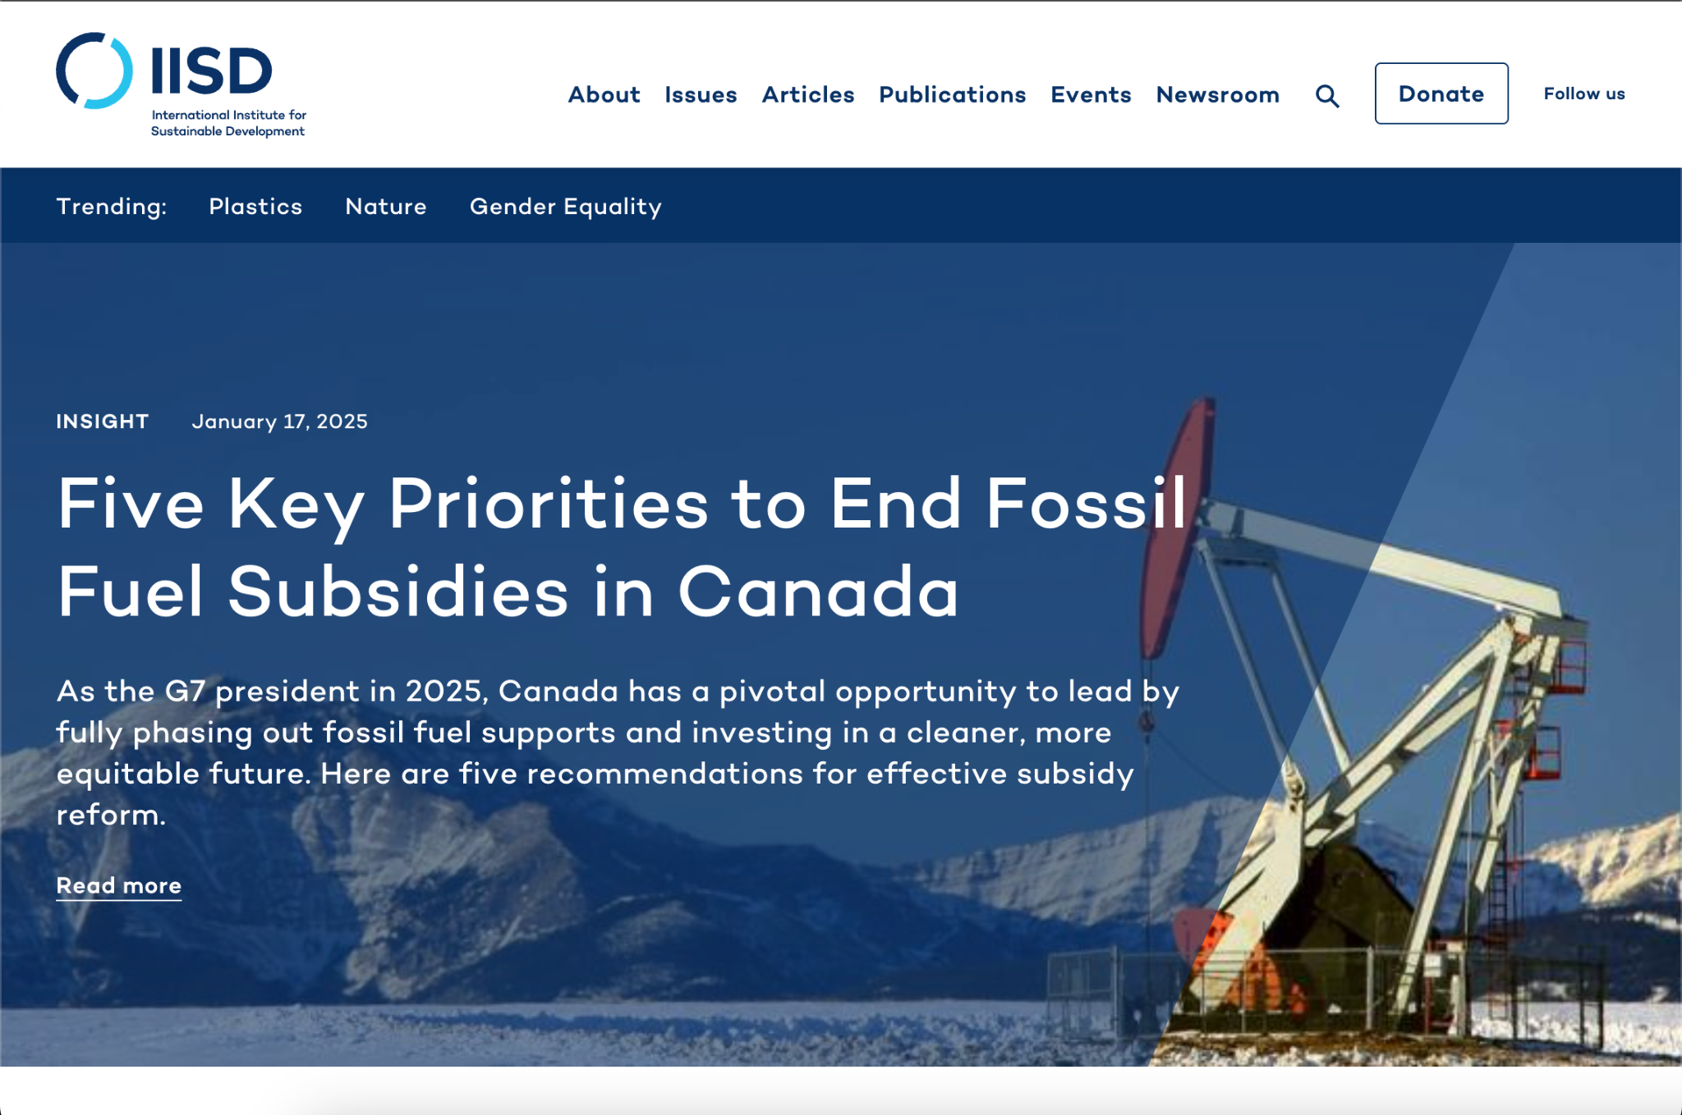
Notes:
So each of the examples I’m going to show you come from user interviews which informed us when we built the website for the International Institute for Sustainable Development which is a big Canadian think tank.

Slide 50
Policymakers

Slide 51
“The international stuff is not that relevant to us most days but the local stuff can be useful. If it is very local to me then we will nearly always use it.”
As a policymaker I want to stay informed about issues that affect my constituency so that I can take action to address them.
“We’ve worked with think tanks before on panels and things like that. It can be a way to get noticed on a particular issue.”
As a policymaker, I want to organize and schedule
speeches and events so that I am seen as an effective legislator
Notes:
Here we see a couple of quotes from an interview with someone working for a Canadian legislator.
We would be looking to carry out two or three interviews with representatives of each audience segment – and we use what we learn to inform what we call user stories
User stories take the form: “As an XXXXX I want to XXXXXXX so that I can XXXXXXX”.
So here we have [read out]
The thing about a user story is that it is something we can test. We can ask “was this type of person actually able to do this thing on the website”
And this cycle of: discovering something about the organisation and its users; defining what we think the desired action is; designing something that we think delivers that; and then testing whether users can indeed complete the action, is something we’re going to learn a lot more about in a moment.
But back to policymakers. Of course that is a very broad term and often we would actually break it down into officials, legislators, ministerial aides etc.
But broadly speaking, when we’re talking about political policy makers at least, they want two things
Concise information that informs policy positions, or, very often, reinforces or offers a new angle to existing policy positions
Opportunities to build profile or network or otherwise accumulate political capital.

Slide 52
Policymakers
Researchers

Slide 53
“I’m a data scientist, so I like to have the raw datasets to look at. To be honest, that is often more useful to me than a report or article.”
As a researcher, I want to access relevant datasets so that I can use the data to inform my own work.
“If a question is research focused, I’d start with Google Scholar to gather the relevant literature as a starting point”
As a researcher, I want to search Google Scholar for relevant reports so that I can incorporate their findings into my own research.
Notes:
Here we have two quotes and two user stories from researchers.
Researchers generally do want to get in depth information and they are able to get into the weeds of the data.
You need to accommodate the tools researchers use, many of which are outside of your own site such as Google Scholar – so working with citations databases of various kinds is actually really useful and important but often overlooked.
Reports and datasets get a bit of a bad press in think tank comms circles. But I’ve maintained for years that comms and publishing are actually different but equally useful things.
Doing research and creating research products like reports and datasets is how you build expertise. And expertise is the thing you are trading in as a think tank. Expertise is the thing you leverage when you do comms, but you get to that by conducting and publishing research and evidence.
So one of the main things we are trying to do when we think about UX for a think tank website. In fact one of the main things we are doing as think tanks – is straddling that line between publishing work as part of the research community and advocating for that work as part of the political community.

Slide 54
Policymakers
Researchers
Journalists

Slide 55
“I need quotes from experts and I sometimes need the details of issues explaining. It’s really useful if I know who to contact. ”
As a journalist, I want to connect with experts so that I can better understand
unfamiliar topics.
“If I pitch a story to my editors today, it has to be filed today. Lots of pressure to get it out.”
As a journalist, I want to quickly find relevant research so that I can complete my story
before my 7pm filing deadline.
Notes:
Journalists need things quickly, but they also want to be able to verify things.
So they want to know who to talk to (and by the way you need to be ready, willing and able to respond when they call. Plus ideally they are calling you because you have proactively cultivated a relationship with them – remember expertise is a service).
And, as I said, they want to verify things, so making your research findable, searchable and clear will get you a very long way with them. Features like allowing them to search within a particular publication are really good. So is having really well thought out related content in case they need to go deeper
And be really clear about what the story is. Again, back to clear headlines, clear explanatory titles for figures and a hierarchy of information.

Slide 56
Policymakers
Researchers
Journalists
Donors

Slide 57
“MEL is important here so and I need to do a report for each board meeting. Finding materials so I can do that quickly is good.”
As a current donor, I want to read outputs from projects I have funded so that I can
prepare evaluation reports for board meetings.
“Hard to get a feel for the organization. I read their strategic goals. They were low down, and felt more internal focused. Very buried.”
As a potential funder, I want to read your organization’s mission so that I can tell
whether your organization works in areas that meet our funding criteria.
Notes:
These are the important ones. The ones with the money.
This is where understanding your brand really comes into play.
They are looking for proof of impact, reassurance that their money will be well spent and clarity about what they are spending it on.
So you need to be very clear on your homepage and in your about us section:
“This is what we do, where we have expertise and where we add value”
“Here are the people you will work with and the funders and partners we work with. So you know we are serious and can be trusted with your money”
“Here is our track record so you can be sure we can deliver”
Now, that last one, about impact, is very tricky but I’m not going to get into it here. Instead you should all come to the OTT conference in June where we will definitely settle that debate once and for all…

Slide 58
Your brief

Slide 59
Introduction
We want you to play the role of user experience designers and design the website of a fictional think tank that focuses on the needs of these audiences.
The workshop has four parts to it, one for each stage of the design process…
Notes:
So it’s almost over to you. After the break, we are going to ask you to design the website of a fictional think tank that focuses on the needs of these audiences that John’s been talking about.

Slide 60
Discover
10 mins
Test
40 mins
Define
40 mins
Design
40 mins
Notes:
The workshop has 4 parts to it, 1 for each stage of the design process.
We’ll give you more information at the beginning of each part.
For now we are just going to divide you up into 6 groups (roughly 4 or 5 pg) and give you a workshop kit.
[LET EVERYONE SETTLE INTO THEIR GROUPS]
Inside the brown envelope you’ll find your brief.
Feel free to take a look right now or we’ll be diving in after the break

Slide 61
Break

Slide 62
Discover
10 mins
Step 1
Test
Define
Design
Notes:
Discovery is about exploring the problem or opportunity — its about taking the time to read key documentation, explore the landscape, talk to the right people…
In practice we use many activities such from interviews, surveys and focus groups, to analytics review and content audits.

Slide 63
Step 1
Discover
Understanding what your organisational goals are, who you are trying to reach and what those audiences need from your website, is essential before diving into design.
Notes:
All with the aim of understanding…
what your organisational goals are
who you are trying to reach
what those audiences need from your website

Slide 64
Step 1
How to do it
Spend 10 minutes reading over your brief as a group.
Think about and discuss the following:
Who is your primary user and what do they need?
How could the site meet their needs?
Are there organisations whose website you admire that could be a source of inspiration?
Notes:
Today we are making your lives a bit simpler, your focus is just on desk research. Inside your brown envelopes you will find your brief.
We want to you to spend 10 mins now reading over it and discussing it as a group. Up on screen here are a few questions to kick start your discussion.
You’ve also got some users in the room (John, Enrique and Alice), if you need to gather any further insights to set you up.

Slide 65
Discover
Step 2
Test
Define
40 mins
Design
Notes:
Next up, the Define phase. This is all about mapping out your website — the different pages and types of content.

Slide 66
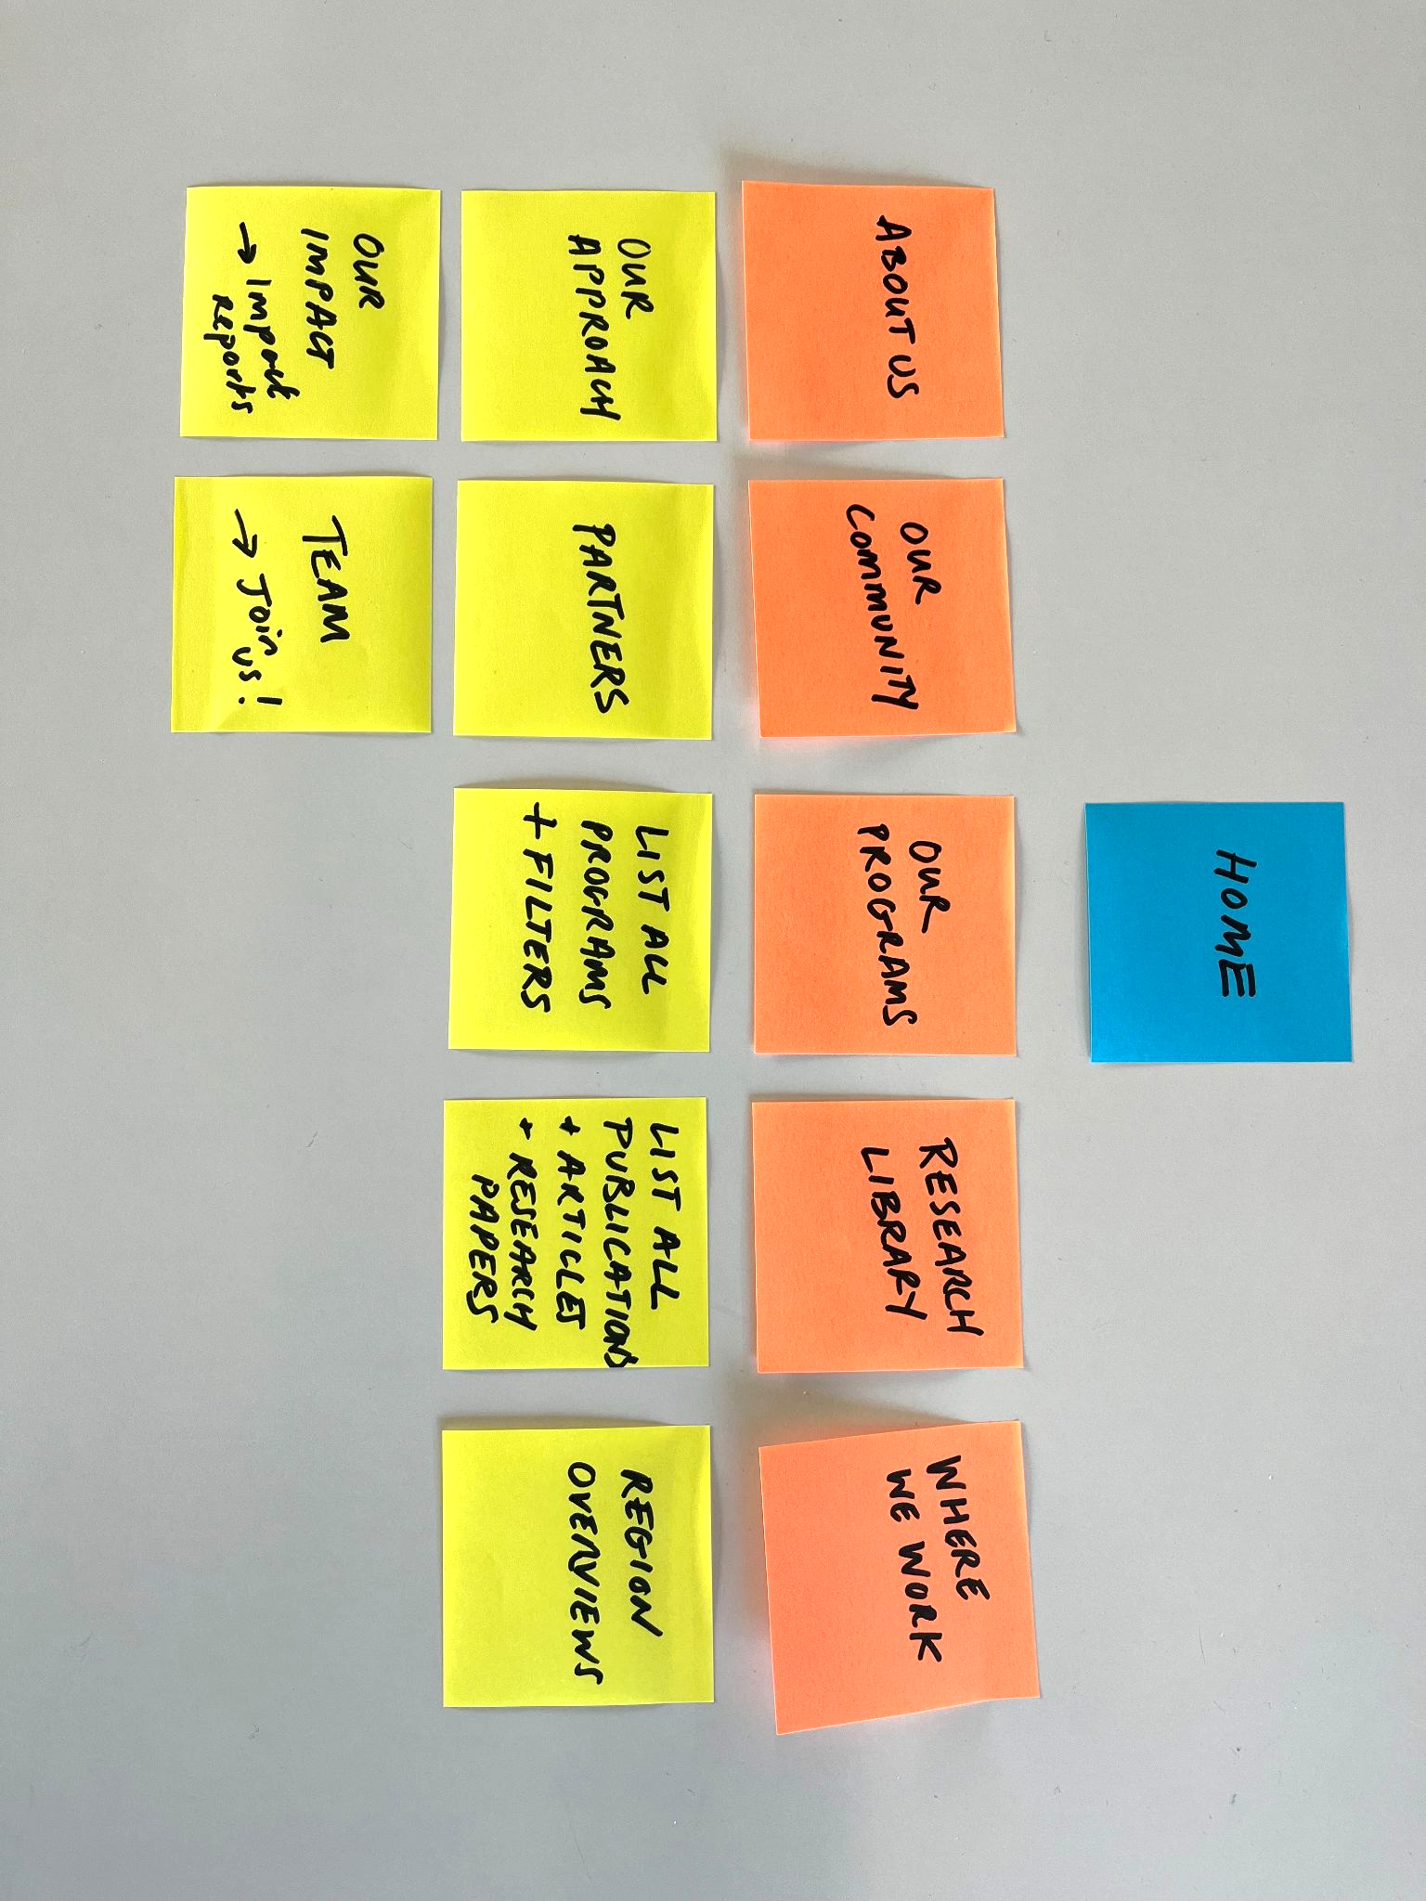
Step 2
Define your site map
Deciding on your site map is a great starting point to define what the pages of a website are and how they link together to meet your users’ needs.
Notes:
Deciding on your site map is a great starting point to define what the pages of a website are and how they link together to meet your users’ needs. You can think of it like a blue print of a building, or a tree, with branches and leaves…

Slide 67
Step 2
Define your page templates
It’s also helpful to define the page templates that make up your site map at this stage. We recommend that you use these 3 main types:
Homepage: the main entrance, your shop window
Landing page: the section pages, your aisles, that group particular things together
Content pages: the content, your actual product (e.g. events, blog post, etc.)
Notes:
It’s also helpful to define the page templates at this stage, for things that follow the same layout and structure as each other. That means you don’t need to create the same thing twice. We recommend that you use these 3:
Homepage: the main entrance, your shop window
Landing page: the section pages, your aisles that group particular things together
Content pages: the content, your actual product (e.g. events, blog post, etc.)

Slide 68
Shop Entrance
Aisle
A section in the aisle
Coffee
Your preferred brand of coffee
Homepage
Landing page
Another landing page
A type of content
A piece of content e.g. Annual report 2025
Notes:
It might be useful to think back to our shopping journey for this.

Slide 69
Step 2
How to do it
Start with your homepage.
Home
Notes:
So start with your homepage.

Slide 70
Step 2
How to do it
Then think about your core landing pages…
Home
Who we are
Where we work
Topics
Our Work
Notes:
Then think about your main sections of the website — these will most likely be landing pages.

Slide 71
Step 2
How to do it
Then think about your other landing pages…
Home
Who we are
Where we work
Topics
Our Work
Our Values
Our History
Our Impact
Team
Partners
Regions
Notes:
Do they have subsections?

Slide 72
Step 2
How to do it
Finally think about which content pages you need
Home
Who we are
Where we work
Topics
Our Work
Our Values
Our History
Our Impact
Team
Partners
Regions
Topic
Info
Publications
Articles
Person
Bio
Partner
Bio
Country
Bio
Notes:
Where do the content pages (or leaves) go?

Slide 73
Step 2
How to do it
Publications
Articles
Events
Biographies of staff
Check that the user can reach their goal using your site map
Home
Who we are
Where we work
Topics
Our Work
Our Values
Our History
Our Impact
Team
Partners
Regions
Topic
Info
Publications
Articles
Person
Bio
Partner
Bio
Country
Bio
Contact
Notes:
When creating your site map, it’s really important to think about and check that your user will be able to reach their goal with it.

Slide 74
Discover
Step 3
Test
Define
Design
40 mins

Slide 75
Step 3
Design your pages
Now that you have defined the site map, you are ready to think about the content and layout of your pages. It’s time to get creative!
Creating wireframes is a great way to quickly explore and iterate on what needs to go on each page, and importantly, what the information hierarchy should be.
Create 1 wireframe per page on your users’ journey. Prioritise information that they need, but include other things too to create a well rounded site design.
We have provided a number of reusable components to get you going, but feel free to draw your own if none of these feel quite right.
Notes:
Define Task
Now that you have defined the site map, you are ready to think about the content and layout of your pages. It’s time to get creative!
Creating wireframes is a great way to quickly explore and iterate on what needs to go on each page, and importantly, what the information hierarchy should be.
Create 1 wireframe per page on your users’ journey. Prioritise information that they need, but include other things too to create a well rounded site design.
We have provided a number of reusable components to get you going, but feel free to draw your own if none of these feel quite right.

Slide 76
Step 3
How to do it
Spend 5 mins exploring the different components available and discussing how you might use them to meet your users’ needs. Are there any new ones that you need to make?
Create your wireframes by cutting out and arranging your desired components on the paper screens provided. Write any text needed directly onto, or around, each component.
Explore different arrangements and assess which one works best to meet your audiences’ needs.
When you’re happy, stick the components down on your paper screens.
Notes:
How to do it
Spend 5 mins exploring the different components available and discussing how you might use them to meet your users’ needs. Are there any new ones that you need to make?
Create your wireframes by cutting out and arranging your desired components on the paper screens provided. Write any text needed directly onto, or around, each component.
Explore different arrangements and assess which one works best to meet your audiences’ needs.
When you’re happy, stick the components down on your paper screens.

Slide 77
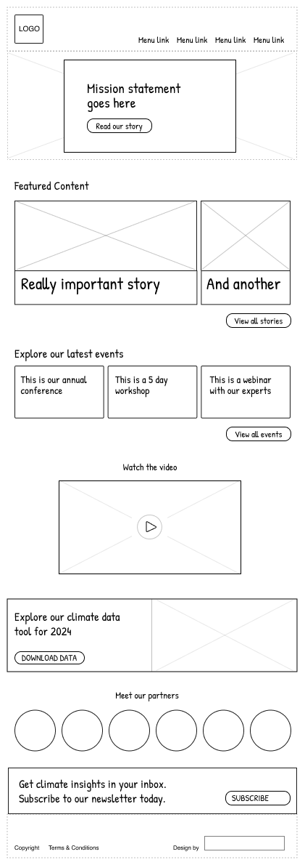
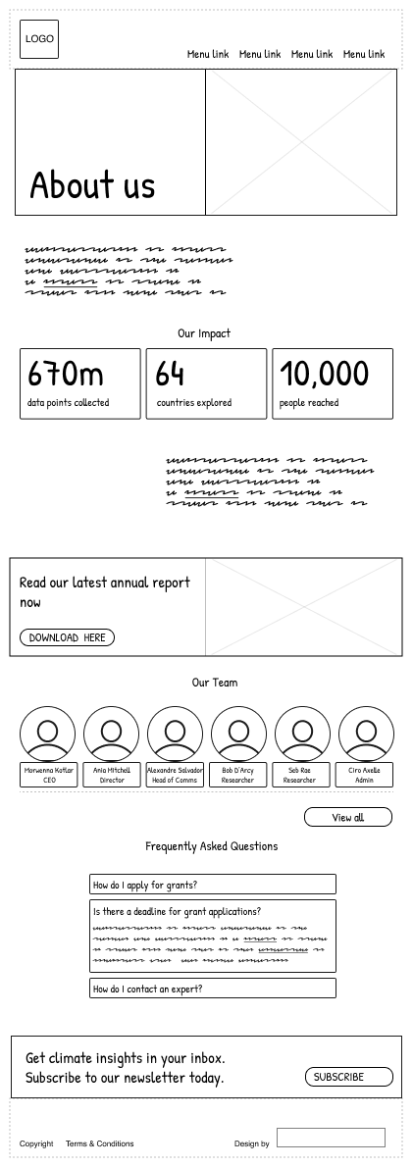
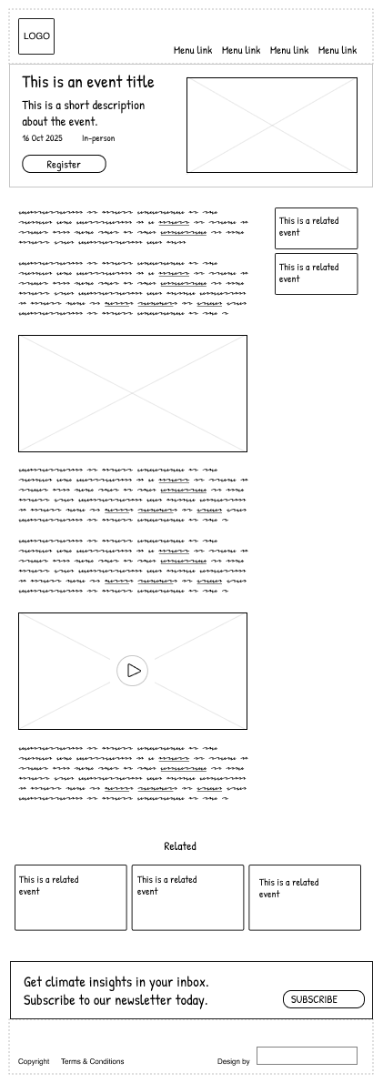
Notes:
Here’s some we made earlier…

Slide 78
Discover
Step 4
Test
40 mins
Define
Design

Slide 79
Step 4
User Testing
We have users in the room who will be asked to test your wireframes to see if they can find what they’re looking for. Their tasks are those written at the bottom of your brief. Decide amongst yourselves who will deliver the user testing. There are 2 main roles:
The Facilitator will guide the testing session
The Computer will simulate the system’s responses to a users’ request, e.g. scrolling, changing wireframes when they click etc.
Others in your group can observe and make notes about the users’ responses.
Notes:
Testing Task
We have users in the room who will be asked to test your wireframes to see if they can find what they’re looking for. Their tasks are those written at the bottom of your brief. Decide amongst yourselves who will deliver the user testing.
There are 2 main roles:
The Facilitator will guide the testing session
The Computer will simulate the system’s responses to a users’ request, e.g. scrolling, changing wireframes when they click etc.
Others in your group can observe and make notes about the users’ responses.

Slide 80
Questions and wrapping up
Wrapping up

Slide 82
Your brief
You are The Institute for Climate Action, a think tank with a mission to make environmental policies fair for everyone worldwide.
Currently you produce 4 main types of content:
Publications
Articles
Events
Biographies of staff.
You also have 3 core topics:
Energy transition
Climate science
Climate finance.

Slide 83
Groups 1 and 4
Your primary audience is potential donors.
Their goals are:
to read about your organization’s vision for the energy transition, so that they can tell whether your organization meet their funding criteria.
to donate directly through the website (if they like what they see!)

Slide 84
Groups 2 and 5
Your primary audience is journalists.
Their goals are:
to connect with an expert on climate finance, so that they can better understand and report on the business case for green initiatives.
to quickly find relevant and easy-to-understand articles on climate finance, so that they can complete their story before a 7pm deadline!

Slide 85
Groups 3 and 6
Your primary audience is researchers.
Their goals are:
to download the raw data from your latest climate science publication, so that they can use it to inform their own work.
to see if you have any open research positions, and if so, to find out more about the application process to assess if they would be a good fit.

Slide 86
Why you need a good user experience strategy
Introducing UX

Slide 87
Ingredients of UX Strategy
1 | 2 | 3
Vision | Goals | Plan
Improved future state of where the user experience is going and why | How we’ll now if we’re making progress | The path we take to get there

Slide 88
Stages of UX Maturity
1
User-driven
UX is beloved, reproducible, habitual
1
Integrated
UX ie comprehensive, pervasive, universal
1
Structured
UX is partly systematic, sometimes effective
1
Emergent
UX is promising, inconsistent, inefficient
1
Limited
UX is uneven, haphazard, aspirational
1
Absent
UX is ignored, nonexistent, undiscovered

