Slide 2
INCORPORATING AI INTO THE THINK TANK’S DNA
Ismael Gómez (OEI)

Slide 3
“My kid is never gonna grow up being smarter than AI”. Sam Altman

Slide 4
Smarter organizations make technologies smarter Not the other way around
Structure
Strategy
AI has advanced rapidly, especially with the development of large language models (LLMs).
These models, with enhanced intelligence and reasoning capabilities, can process vast amounts of unstructured data and perform multiple tasks.
People
Technology

Slide 5
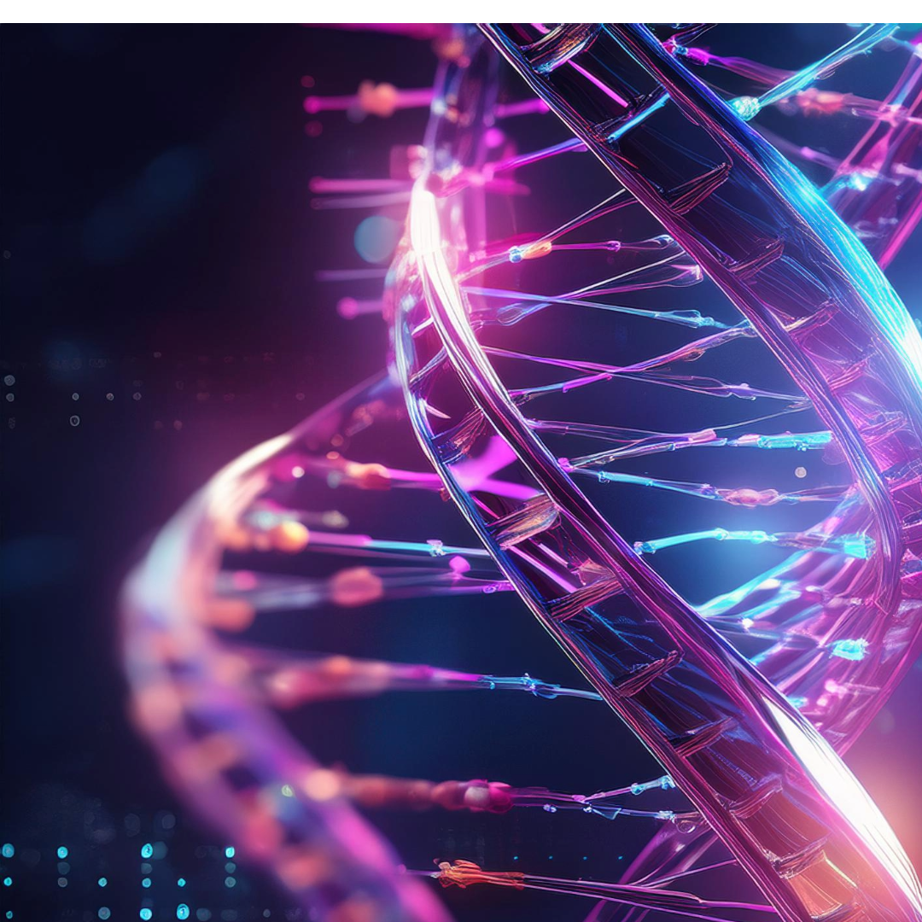
Stop Me If You’ve Heard This One Before:
think tanks’ DNA
Data collection and processing.
Analysis and report generation.
Stakeholder engagement.
Innovation and scenario simulation.
Influence and action.

Slide 6
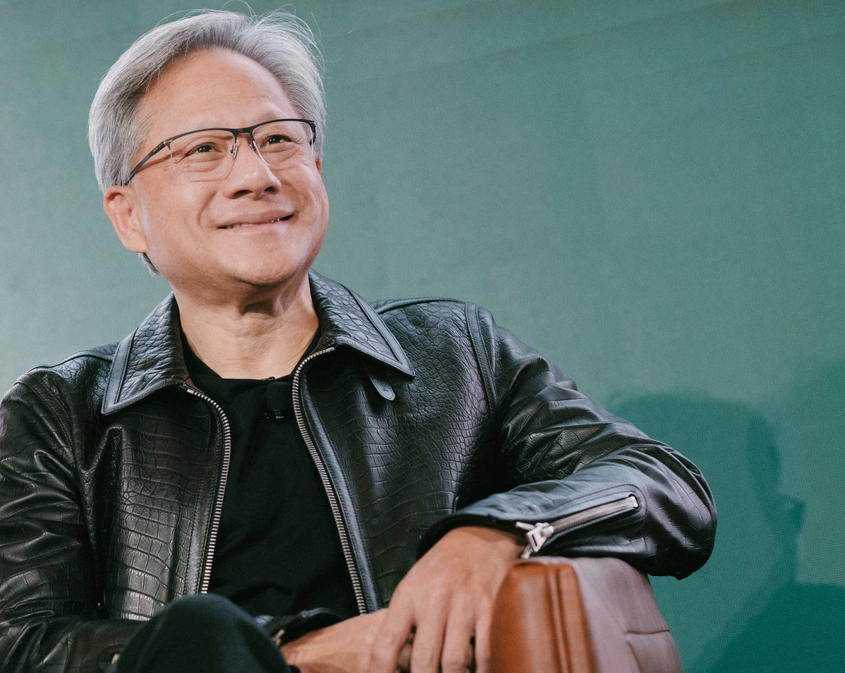
A Rush and a Pull and the Land Is Ours
AI has advanced rapidly, especially with the development of large language models (LLMs).
These models, with enhanced intelligence and reasoning capabilities, can process vast amounts of unstructured data and perform multiple tasks.
“Don’t learn to code”
Jensen Huang, Nvidia’s CEO.

Slide 7
Are we going nowhere fast?
Digital skills.
Scientific knowledge gaps.
Sustainability of investments.
Support networks.
Data sets availability.

Slide 8
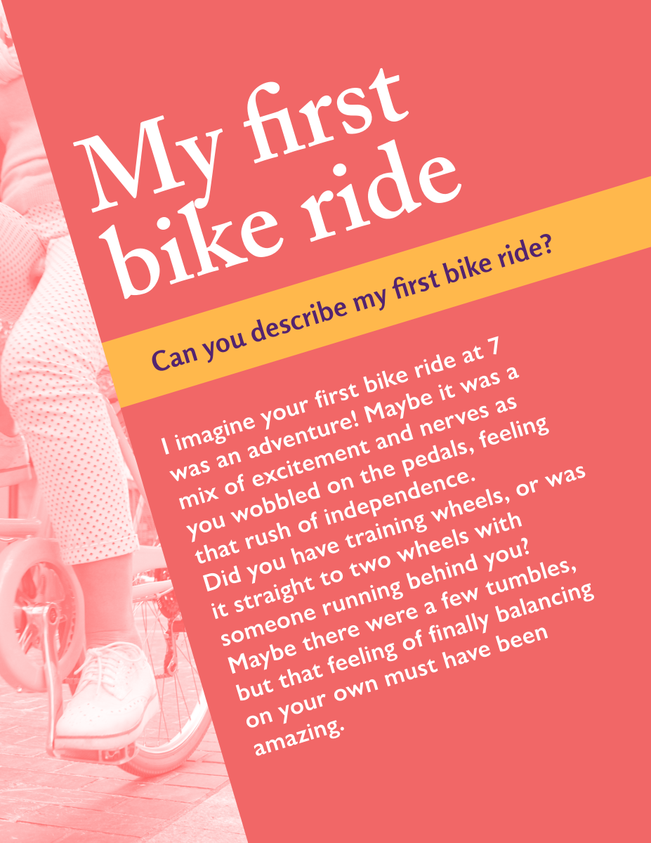
Enhanced intelligence Actual experience
What does it mean to have “enhanced intelligence” through AI?

Slide 9
Services Vs. Transformative change

Slide 10
Services Vs. Transformative change

Slide 11
Some services you can use

Slide 12
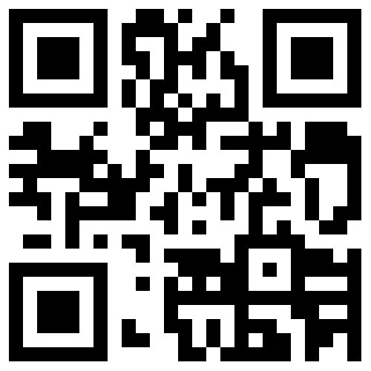
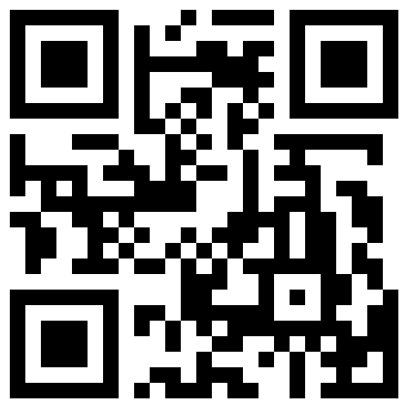
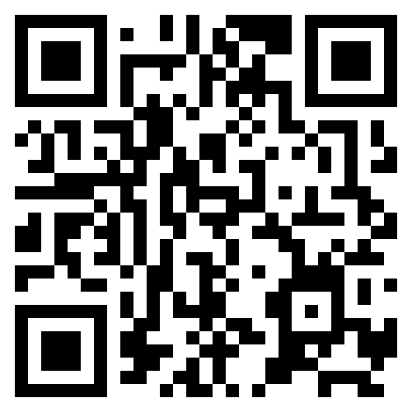
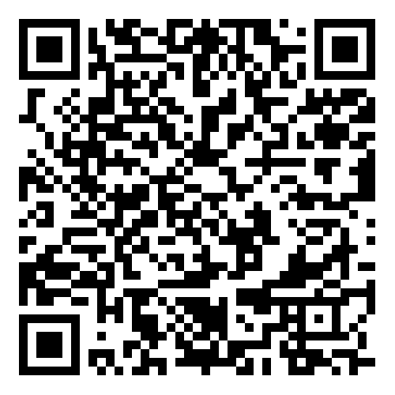
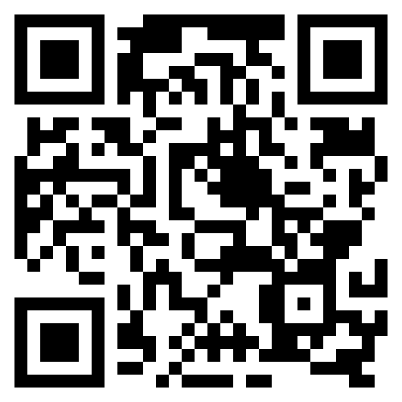
Data analysis
Julius
Vizly
Obviously
Assistive technologies
Dyslexic AI Assistant
Notebook LM

Slide 13
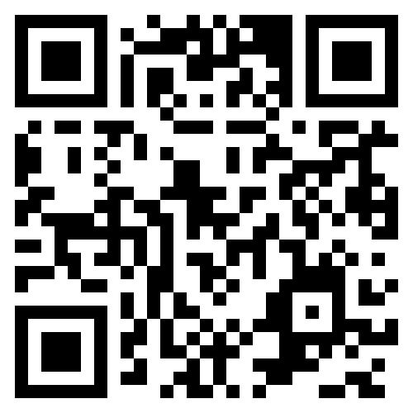
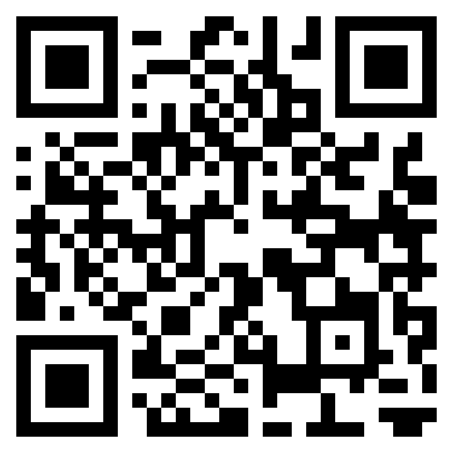
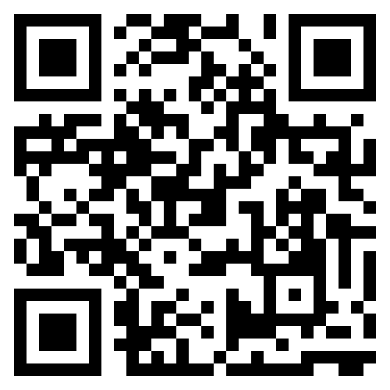
Productivity
Presentations.
Data summaries.
Mindmaps.
Automated tasks.
Note taking and information analysis.
AdutorAI
Notebook LM
MyMap
SlidesAI

Slide 14
How soon is now?

