Slide 1



Slide 2









Social RESEARCH
Generation of science-based knowledge on social issues through:
COMMUNICATION
Dissemination of rigorous content on today’s social issues
Community
Promotion of learning and knowledge exchange
COMPETITIVE
CALLS
publications
events
activities
GATHERINGS OF EXPERTS
COLLABORATIVE STUDIES
audiovisuals
TRAINING ON SOCIAL RESEARCH

Slide 3



Social RESEARCH
Calls for social science research
Social
Research

Slide 4


Social RESEARCH
Social
Research
4

Slide 5





Social RESEARCH
Social Research
Two-year projects generating quantitative data on social interest phenomena in Spain and Portugal.
Examples of funded projects:
Entrepreneurship as a social mobility and inclusion strategy
Digital technology and the gender gap
Subsidised school meals and child well-being
Depopulation and climate change
Gender-based violence and schools
Disinformation and governance
Job flexibility and gender inequality
One annual edition in Spain since 2019
One annual edition in Portugal since 2020
  Match-fund with Portugal’s Fundação para a Ciência e a Tecnologia
  Up to 115,000 euros of funding per project
  Evaluators from academia and the social sector

Slide 6

Social RESEARCH
Flash
6

Slide 7


Social RESEARCH
Flash
One-year projects generating quantitative data on social interest phenomena in Spain and Portugal.
Topics:
February 2019
Social research with surveys
June 2019
Social science outreach
July 2019
Experimental research
September 2019
Immigration
October 2019
Multi-annual survey
Vocational training, early school leaving and job insecurity
November 2019
Talent drain
June 2020
Social impact of COVID-19
Surveys on the social impact of COVID-19
September 2020
Social inequality
September 2021
Technology and society
April 2022
Social reality of young people
July 2022
Education and society
March 2023
Vulnerability in childhood
September 2023
Social impact of climate change
February 2024
Social impact of longer lifespans
July 2024
research projects based on quantitative surveys
17 calls since 2019 in Spain
9 calls since 2020 in Portugal
  Open topic
  Up to 35,000 euros of funding per project
  National and international academic evaluators

Slide 8

Social RESEARCH
Connect
8

Slide 9

Social RESEARCH
Connect
Two years joint research between a research centre and
a third sector organisation or the public administration.
Examples of funded projects:
Emotional well-being and mental health of children with learning disabilities and their families: a holistic approach
Impact of a mentoring programme on the well-being and mental health of migrants and refugees
How does working in a company affect the emotional well-being of people with intellectual disabilities?
Justice system experiences of gender-based violence victims and the professionals accompanying them
Four editions
  Open topics
  Up to 90,000 euros funding per project
  Evaluators from academia and the social sector

Slide 10
Social RESEARCH
Collaborative studies
Own studies developed together with other organisations in collaboration with different areas of the ”la Caixa ” Foundation.
Research on:
The working and living conditions of artists and cultural professionals
University of Barcelona and University of the Basque Country
Keys to the success of maximum, high complexity centres
ESADE and Save The Children
Private tutoring and social inequalities
ESADE and UNED

Slide 11
Social RESEARCH
Generation of science-based knowledge on social issues through:
COMMUNICATION
Dissemination of rigorous content on today’s social issues
Community
Promotion of learning and knowledge exchange
COMPETITIVE
CALLS
publications
events
activities
GATHERINGS OF EXPERTS
COLLABORATIVE STUDIES
audiovisuals
TRAINING ON SOCIAL RESEARCH

Slide 12



KNOWLEDGE OUTREACH
Contents
Publications
Activities
The Social Observatory Café
Rigorous content in various formats:
Conference series for debating and reflecting on social issues:
Audiovisual content with collaboration of social science experts:
· Issue specific dossiers
· In-depth articles
· Reports
110 sessions at CaixaForum centres
Since 2022
14 interviews and
7 podcasts

Slide 13
Social RESEARCH
Generation of science-based knowledge on social issues through:
COMMUNICATION
Dissemination of rigorous content on today’s social issues
Community
Promotion of learning and knowledge exchange
Competitive
Calls
publications
events
activities
GATHERINGS OF EXPERTS
COLLABORATIVE STUDIES
audiovisuals
TRAINING ON SOCIAL RESEARCH

Slide 14
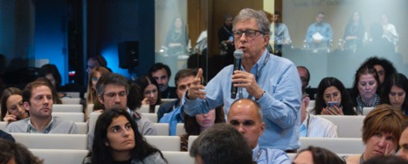
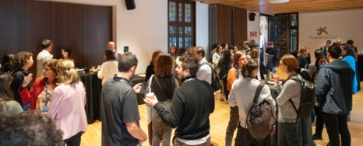
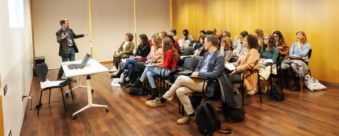

community
Promotion of learning and knowledge exchange
  Events
  Gatherings
  Training
Exchange and debate between experts:
Networking to connect experts from academic and social fields
Training on social research:
Forum 360 offers a global view of the current state of social sciences in Spain.
This annual conference uses various discussion panels to reflect on what we have learned in the last year in social sciences.
4 training sessions for third sector organisations
1 training day for researchers and third sector organisations with ongoing grants
6 online meetings
Cap Roig: seminar on longevity
Presentation of dossier on youth
Presentation of results of research from calls

Slide 15

How it is tied together
Social RESEARCH
KNOWLEDGE OUTREACH
Monitoring and training
Publications
Calls
Final results
Collaborative studies
Final results
Activities
Research from other sources
Audiovisuals

Slide 16
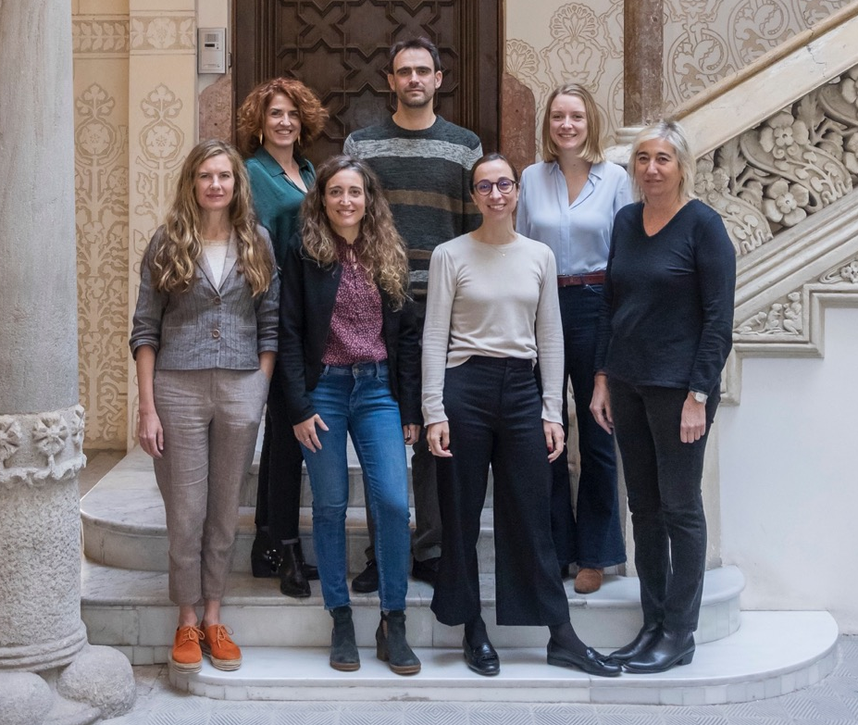
The team

Slide 17

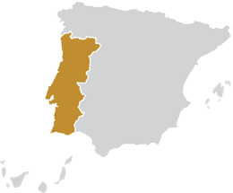
Social RESEARCH
Summary of calls
Spain
 | Total 2019-2024 | 2024
Calls | 26 | 4
Projects funded | 199 | 36
Total LCF funding | € 11,019,334 | € 2,558,302
Applications evaluated | 4,773 | 727
Portugal
 | Total 2020-2024 | 2024
Calls | 14 | 3
Projects funded | 60 | 17
Total LCF funding | € 2,960,810 | € 1,122,488
FCT projects | 8 | 1
FCT funding | € 801,783 | € 114,947
Applications evaluated | 936 | 180
*Calculated according to month and year of the call’s resolution.

Slide 18

Social RESEARCH
Summary of calls
Spain + Portugal
 | Total 2019-2024 | 2024
Calls | 40 | 7
Projects funded | 259 | 53
Total LCF funding | € 13,980,144 | € 3,680,790
Applications evaluated | 5,709 | 907
*Calculated according to month and year of the call’s resolution.

Slide 19
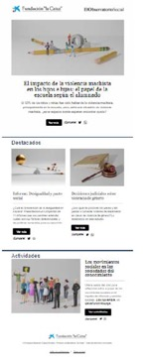
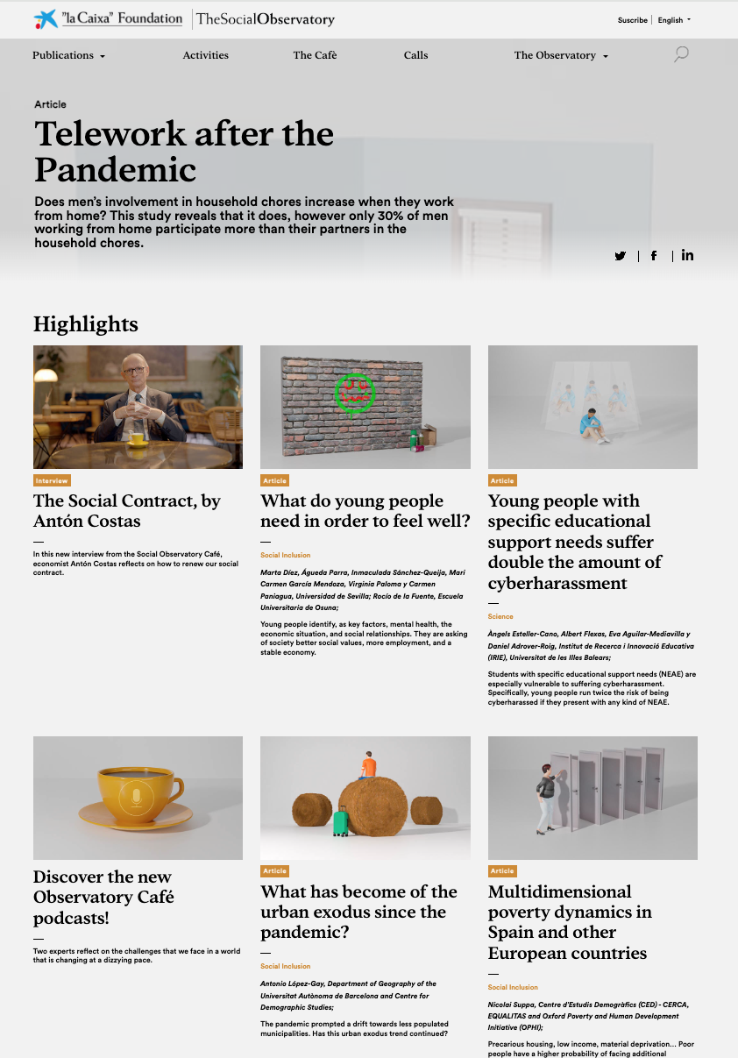


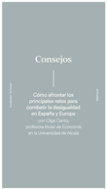
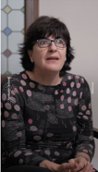

Dissemination channels
Web:
Newsletter:
Other:
Two distinctive websites for Spain and Portugal
Monthly mailings to general public and social science researchers
”la Caixa” Foundation channels
CaixaForum+
8 CaixaForum centres
In 2024:
243,375 visits to websites
Own subscribers: 12,305
Researchers: 28,091
Total monthly mailings: 90,000
Media coverage:
10,361
impacts:
Press: 2,708
Radio: 414
TV: 135
Online: 7,104
Since 2017

Slide 20


