Slide 2
WHAT IS A THINK TANK?
History, roles and models
Enrique Mendizabal, On Think Tanks

Slide 3
THINK WHAT?

Slide 4
DOES THIS SOUND FAMILIAR?
“ I do a lot of work with policymakers, but how much effect am I having? It’s like they’re coming in and saying to you, ‘I’m going to drive my car off a cliff. Should I or should I not wear a seatbelt?’
And you say, ‘I don’t think you should drive your car off the cliff.’
And they say, ‘No, no, that bit’s already been decided—the question is whether to wear a seatbelt.’
And you say, ‘Well, you might as well wear a seatbelt.’ And then they say, ‘We’ve consulted with policy expert Rory Stewart and he says . .’ "
Extracted from: Washington’s Think Tanks: Factories to Call Our Own

Slide 5
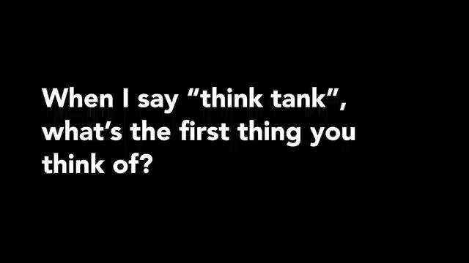
WHAT IS A THINK TANK?
The public’s answer (Cast from Clay)

Slide 6
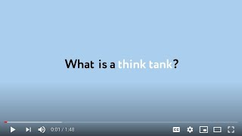
Thinktanker’s answer

Slide 7
THINK TANK – WHAT IS IN THE LABEL?
Think Tank Research Centre Public Policy Research Institute Idea Factory University Research Centre Investigation Centre Laboratory of Ideas
Policymaking supporting centres
…

Slide 8
"We are not a think tank, Quique"*
*/ 2 Think tank director in Peru, months before the Think Tank Initiative was launched – and to which they applied

Slide 9
WHAT IS YOUR LABEL OF CHOICE?
What are think tanks called in your country?
Would the average voter know what a think tank is?

Slide 10
FROM NORMATIVE DEFINITIONS
At one extreme, the definition is written into law:
United States’ legal code says: 501 (c)(3) organisations are non-for-profit, non-partisan, and organised for educational, religious, charitable and scientific purposes (Harvard Law Review, 2002).
More common, however:
Non-profit, independent of the state and dedicated to communicating research findings to policymakers. (Some now accept the presence of state-funded think tanks or state-own think tanks).

Slide 11
TOWARDS MORE FUNCTIONAL DESCRIPTIONS
“Viewed collectively, think tanks […] are organizations that generate policy-oriented research, analysis, and advice on domestic and international issues in an effort to enable policymakers and the public to make informed decisions about public policy issues” (McGann 2006)
“Independent (and usually private) policy research institutes containing people involved in studying a particular policy area or a broad range of policy issues, actively seeking to educate or advise policy makers and the public through a number of channels.” (Buldioski 2012)

Slide 12
DIFFICULT TO PIN-POINT
The common definition describes [‘think tanks’] as a distinctive class of organisations – different and separate from universities, markets, and the state.
However, these think tanks only exist in the imaginary of those who idealised the Brookings and Chatham Houses of this world.
Most think tanks exist on the boundaries with others.

Slide 13
SELF-LABELLING EXERCISE
Tom Medvetz argues that the act of labelling is a political act – this is the art of forging an identity – John Schwartz calls it an intellectual territory.
The label is adopted and rejected with equal passion by organisations wishing to join or set themselves apart from the think tank community.
Calls attention to the boundaries of the definition.

Slide 14
It might be more useful to ask what do they do

Slide 15
FUNCTIONS INCLUDE
They generate evidence and knowledge.
They can advance and promote policy ideas and solutions.
They can provide legitimacy to policies and politicians (whether it is ex-ante or ex-post).
They are advisors on policy design, but also on implementation.
They can act as spaces for debate and deliberation –even as a sounding board for policymakers and opinion leaders. In some contexts they provide a safe house for intellectuals and their ideas.
They can provide a financing channel for political parties and other policy interest groups.
They attempt to influence the way the policy process works.
They are providers of cadres of experts and policymakers for political parties and governments.
They act as auditor or social monitors
Etcetera

Slide 16
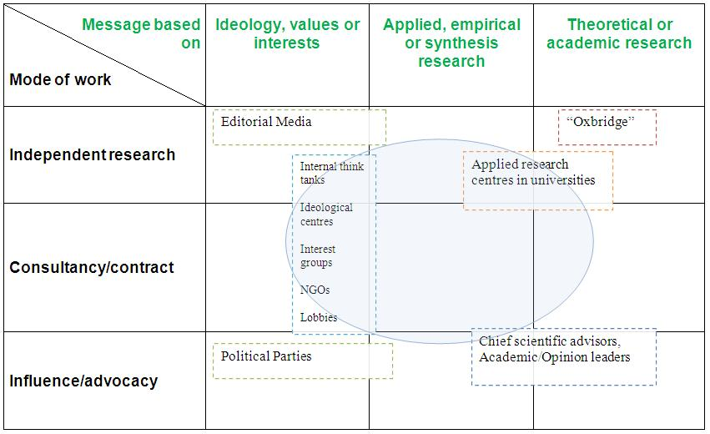
THEY SHARE MUCH WITH OTHERS
Source: Stephen Yeo

Slide 17
WHEN DOES AN ORGANISATION STOP BEING …
a think tank that generates some of its income through consultancy and become just a consultancy?
an academic think tank, based in a university, and focused on a range of fairly broad and theoretical issues, and become just an academic research centre?
an advocacy think tank with strong ideological arguments to become just an activist organisation?
a think tank with a strong covering power to become simply a commission or network?
a think tank with a strong media presence to become a not-for-profit (or for profit even) media outfit?
a publicly funded and managed think tank based in a ministry or another public body to become a policymaking body itself?

Slide 18
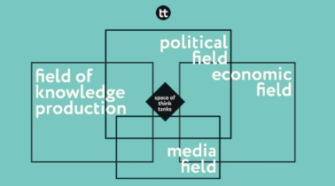
THE SPACE OF THINK TANKS
Source: Thomas Medvetz

Slide 19
THIS HAS AN IMPACT ON THE ORGANISATION ITSELF
Depending on which boundary they are on, we could argue that they need to have people and teams with skills to:
Appreciate and undertake research (boundary with academia);
Communicate effectively to broader audiences and the public (boundary with the media);
Undertake analysis and deliver solutions (boundary with consultancy);
Analyse policy and provide actionable recommendations (boundary with policy and politics); and
Work with citizens to develop new ideas and solutions (boundary with NGOs).

Slide 20
THINK TANKS “GOTTA SERVE SOMEBODY”
The State.
Political parties.
The private sector and private advocates.
International development agencies.
“Well, it may be the devil or it may be the Lord But you're gonna have to serve somebody” ( Bob Dylan)

Slide 21
CONTEXT MATTERS
This is further complicated by the effects that the context can have on the formation and development of think tanks:
Political context –can be a driver and a constraint for their formation. SOS Reports from 2023, 2024 and 2025 consistently highlight the impact of political polarisation!
Economic context –can define who are the main funders, the funding available and how funding is provided.
Legal context –can determine the business models chosen, think tanks freedom of operations, etc.
Education policy/state of higher education – can affect the skills that think tanks can count on … (which has a direct effect on their bottom line).

Slide 22
THE CONSEQUENCE IS AN INCREASINGLY MESSY SPACE
There are regional and national traditions – but also waves of formation.
National - but also sectoral - particularities.
New and ever-changing business models that challenge the idealised models.
Coupled by:
Greater competition from old and new knowledge sector players - consulting firms, interest groups, more policy oriented university research centres, government centers, “new public intellectuals”.
A deficit of trust in experts and expertise.
A politically motivated strategic rejection of the label.

Slide 23
HISTORY MATTERS

Slide 24
A BRIEF HISTORY OF U.S. THINK TANKS
Provides a case study to consider the evolution of think tanks in our own countries
Draws attention to the power of narratives in the formation and development of think tanks
And the changing nature of the label, think tanks and the community

Slide 25
A CHANGING NARRATIVE: FROM MEDICINE TO MARKETING
The history of think tanks in the US is marked by a series of waves of development which explain the great heterogeneity in the current landscape.
They are partly driven by the changing role that science, the state, the private sector and civil society are assumed to play in society.
Also: To keep important matters of the State out of the hands of the public. (This is the explicit intention of some of the early foreign policy think tanks!)

Slide 26
SOCIETY AS THE PATIENT
American Association of Economics (1885)
Bureau of Economic Research (1899)
National Civil Federation (1900)
American Bureau of Industrial Research (1904)
Chicago Civil Federation (1894)
Experts, funders, citizens, and policymakers came together
Treated the symptoms and (later) the causes of social “maladies”
Russell Sage Foundation (1907)
Marks the beginning of a new ”professional cadre” of policy researchers

Slide 27
EFFICIENCY AND VALUE FOR MONEY
Twentieth Century Fund
National Bureau of Economic Research
New York Bureau of Municipal Research (1907)
Institute for Government Research (1916 – then Brookings)
Sought to influence policy from the outside
Focused on improvements in government processes
Flourished thanks to professional philanthropy

Slide 28
CRISIS AND PLANNING FOR THE FUTURE
The Great Depression and the First World War changed the focus towards reflecting upon and explaining what had happened.
Twentieth Century Fund (1922)
Committee for Economic Development (1942)
RAND Corporation (1948)
Recommendations
Plans for long term results
Plans including implementation
Is this where the label was coined?

Slide 29
SALOMON’S HOUSE AND THE REVOLVING DOOR
After the Second World War, Brookings, Russell Sage Foundation and NBER offer advice and moved to DC to serve agencies under pressure to deliver the complex New Deal
Council of Economic Advisers (1946)
Thinktankers take on “boundary roles”
Such was the extent of the “revolving door” that The Economist described Brookings’ researchers as [President] Kennedy’s experts on tap. And RAND was the main recruiting ground for the Department of Defence.

Slide 30
THE IDEOLOGICAL MARKETPLACE
The Hudson Institute (1961)
The Heritage Foundation (1973)
The Cato Institute (1977)
Explicitly ideological
Funding increasingly partisan and private (foundations reduced their role)
Set up by people already in politics
Think tanks adopt new corporate practices and marketing approaches

Slide 31
THE IDEOLOGICAL BATTLEGROUND
Heritage has founded Heritage Action for America and Project 2025.
Think tanks in Washington DC, London and Brussels have to worry about being hacked.
Think tanks in the Western Balkans are subject to State surveillance.
The biggest think tank in Europe is endowed by the Hungarian government.
Think tanks across the world are subject to defamation laws.
Think tanks (and thinktankers) are increasingly and explicitly siding with parties and political leaders.

Slide 32
SIMILAR WAVES ELSEWHERE
In Chile, China, Russia, etc.
These are defined by the growth of certain ideas, political or economic shocks, institutional reforms, etc.

Slide 33
Can you recognise any “waves” in your country?

Slide 34
Today

Slide 35
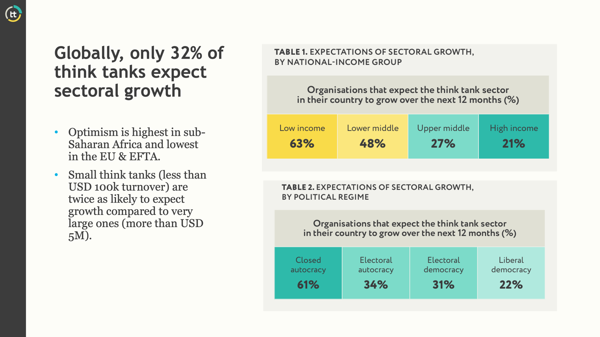

Slide 36
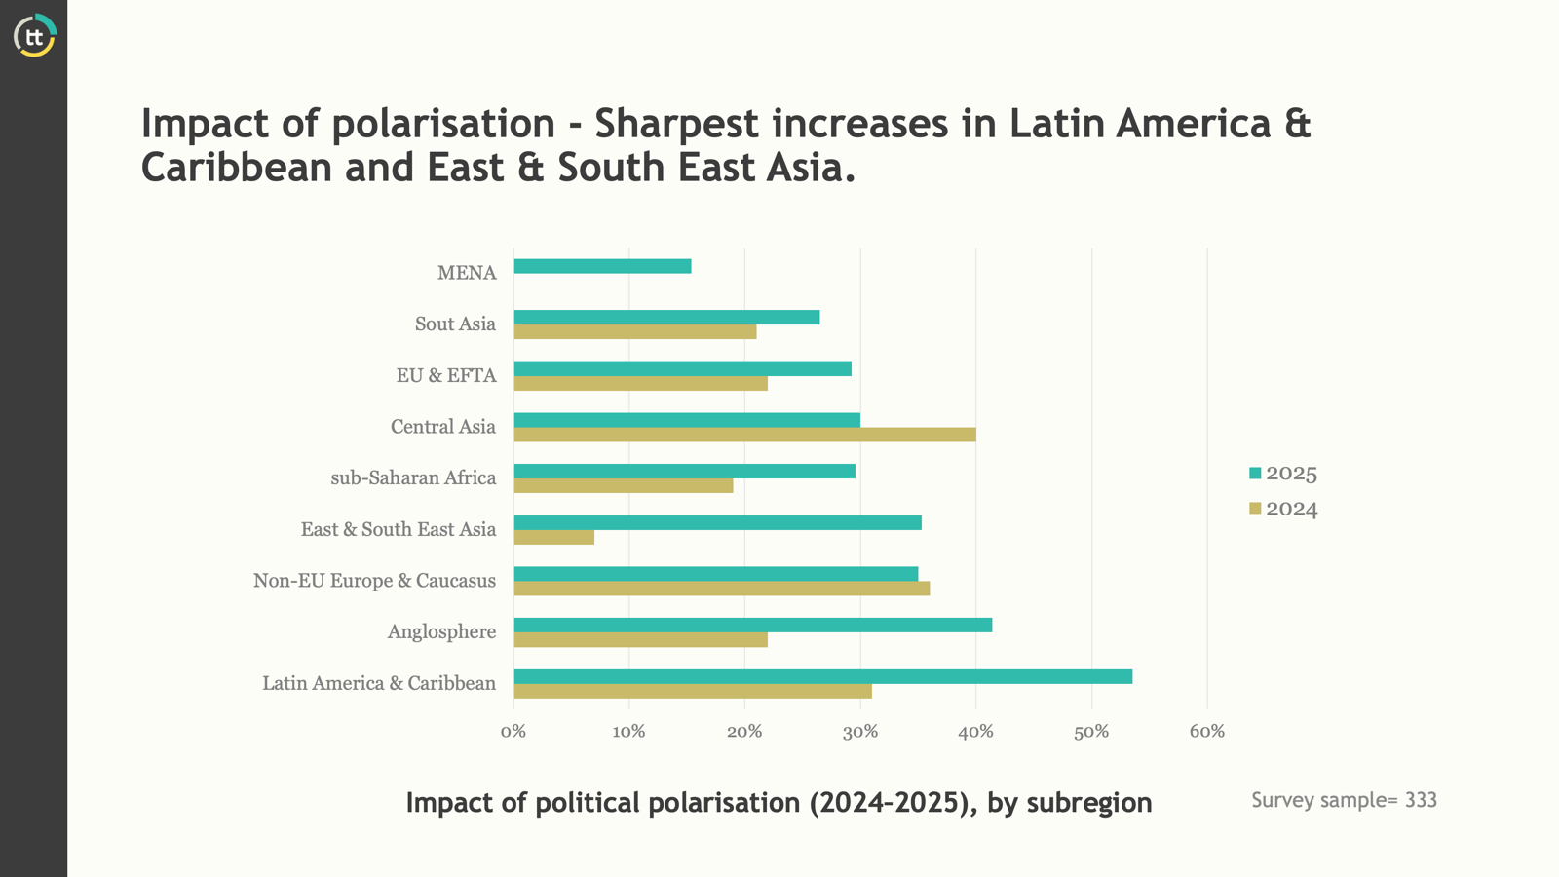

Slide 37
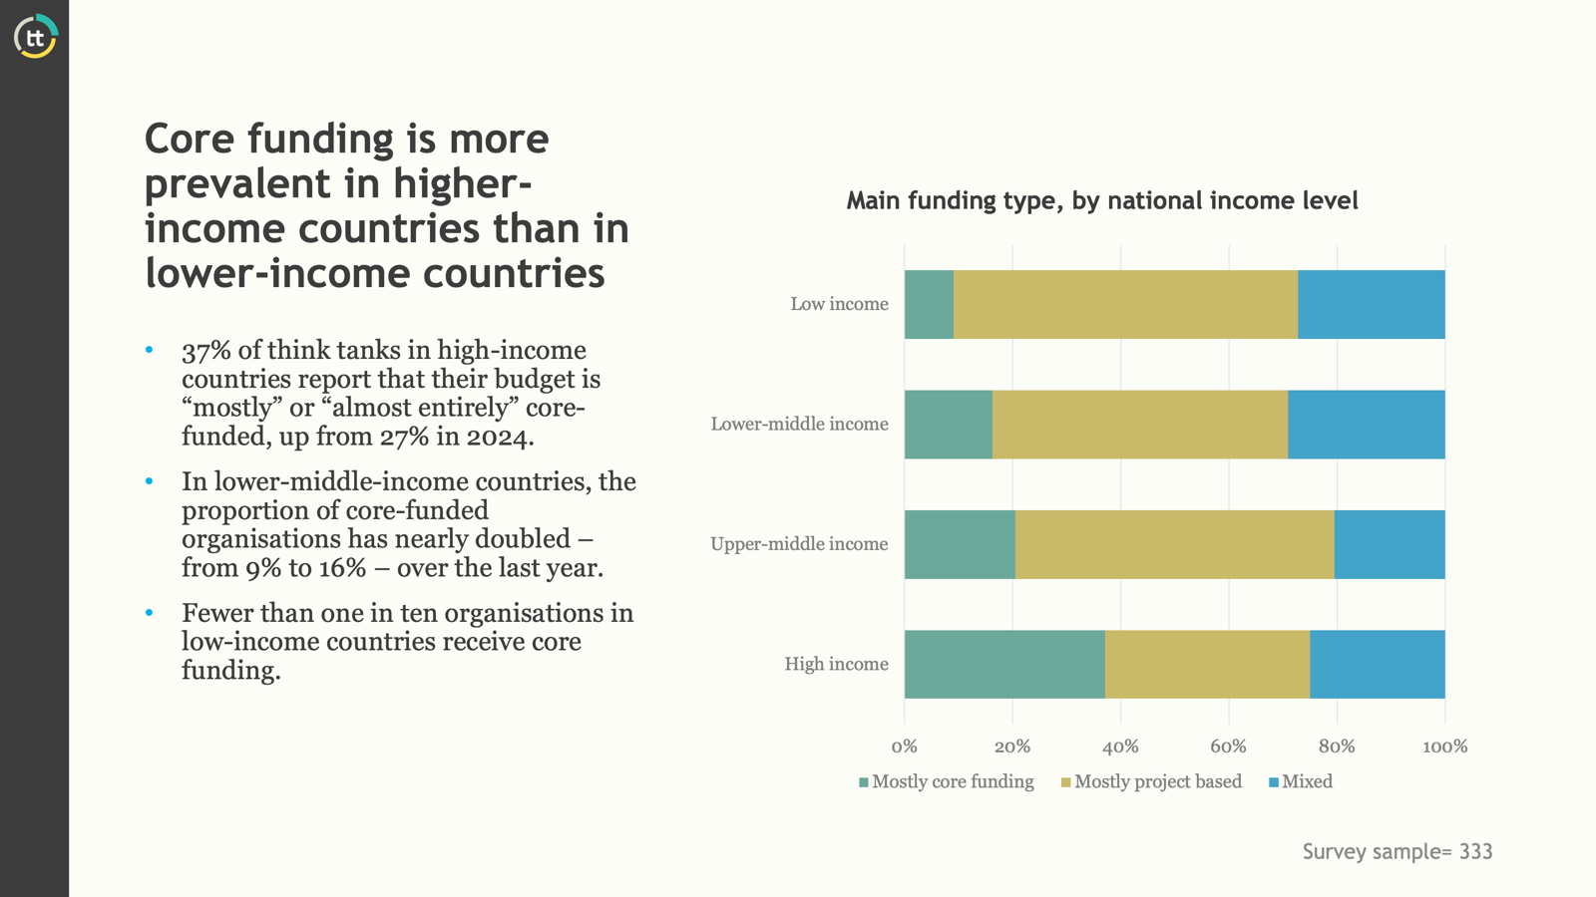

Slide 38
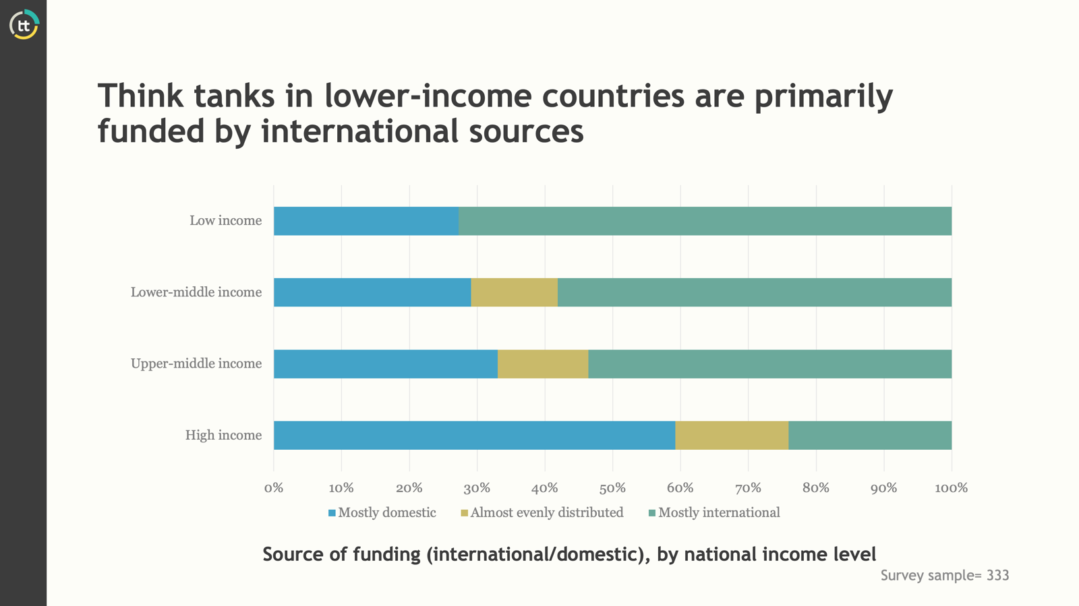

Slide 39
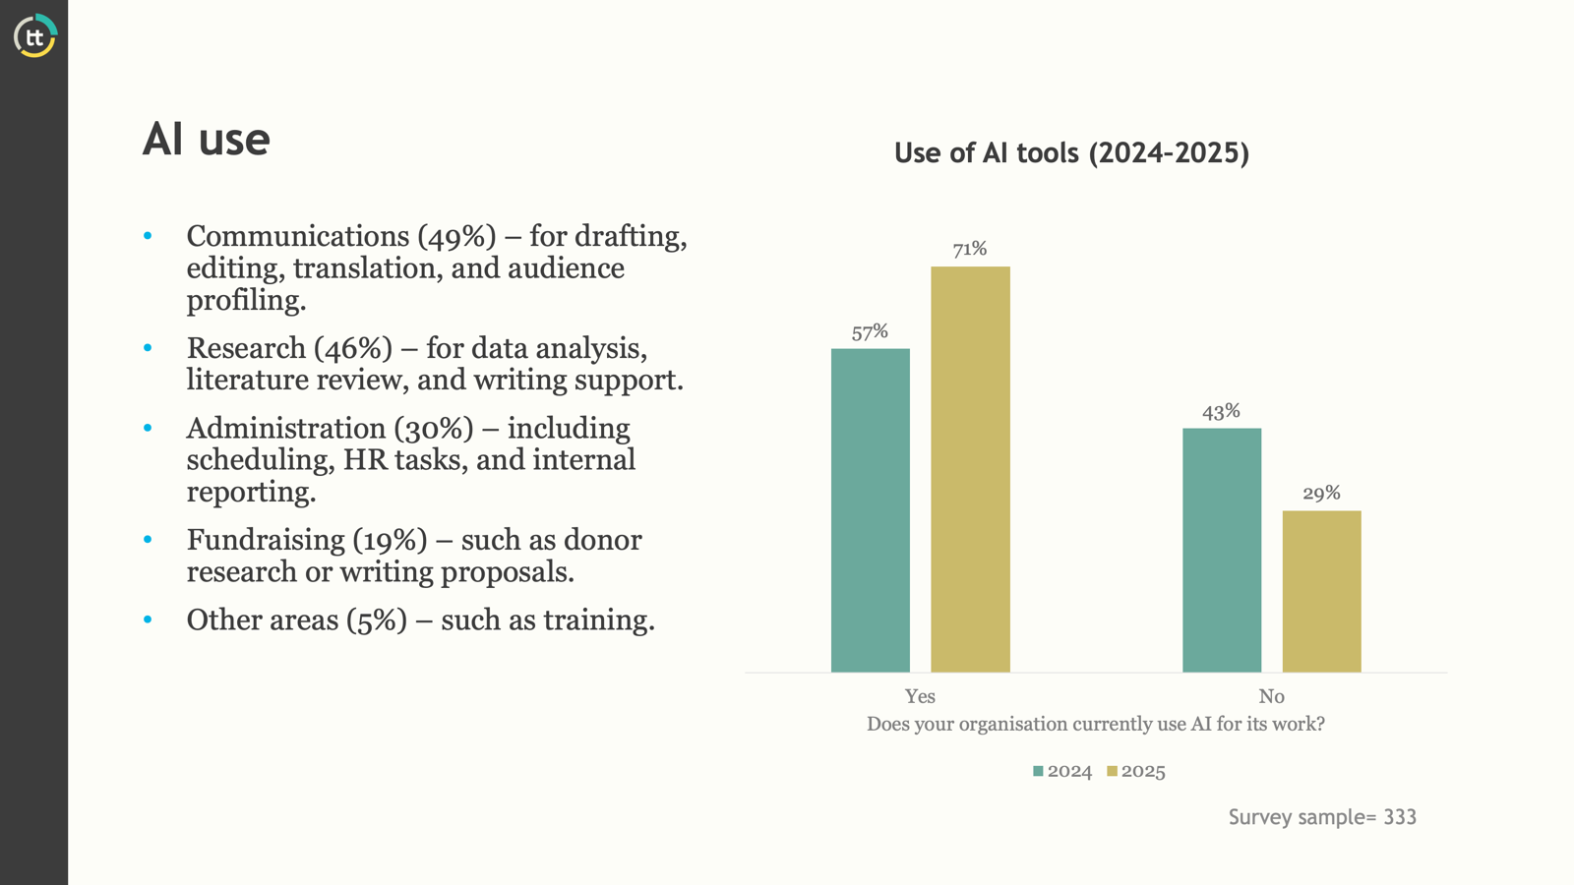

Slide 40
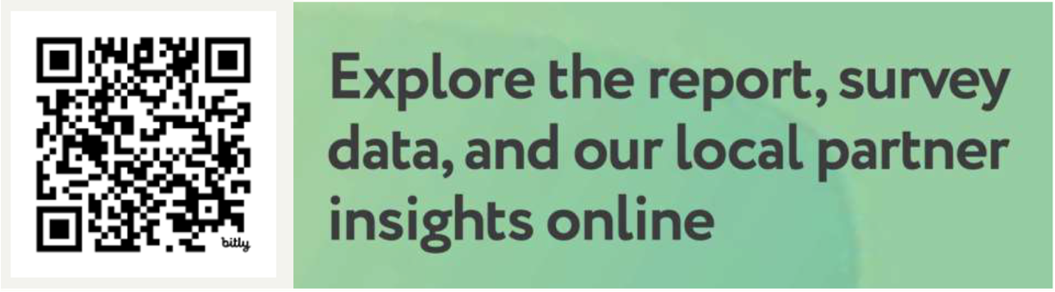
onthinktanks.org/sos2025

Slide 41
WHAT NEXT?

Slide 42
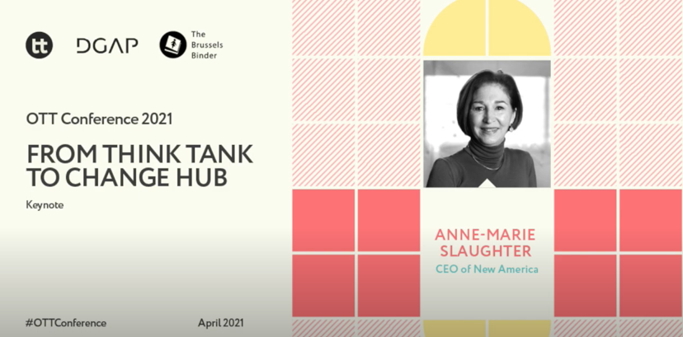
FROM THINK TANK TO CHANGE HUB
https://www.youtube.com/watch?v=Ia1qBgliBHM

Slide 43
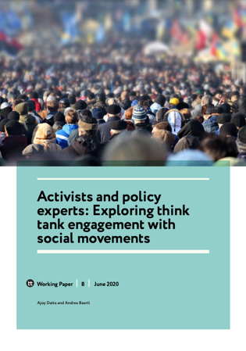
THINK TANKS AND SOCIAL MOVEMENTS
https://onthinktanks.org/articles/understanding-think-tank-social-movement-engagement/

Slide 44
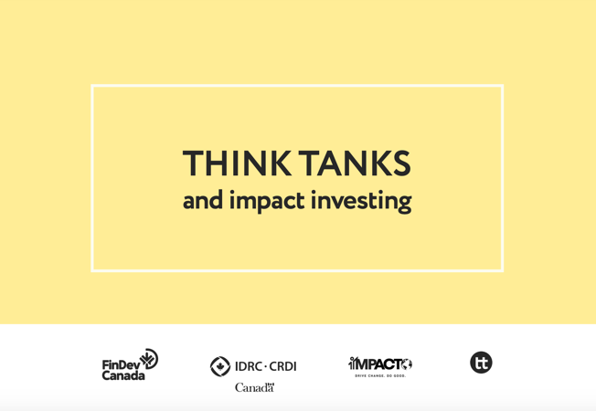
THINK TANKS AND IMPACT INVESTING
https://onthinktanks.org/initiatives/think-tanks-and-impact-investing/

Slide 45
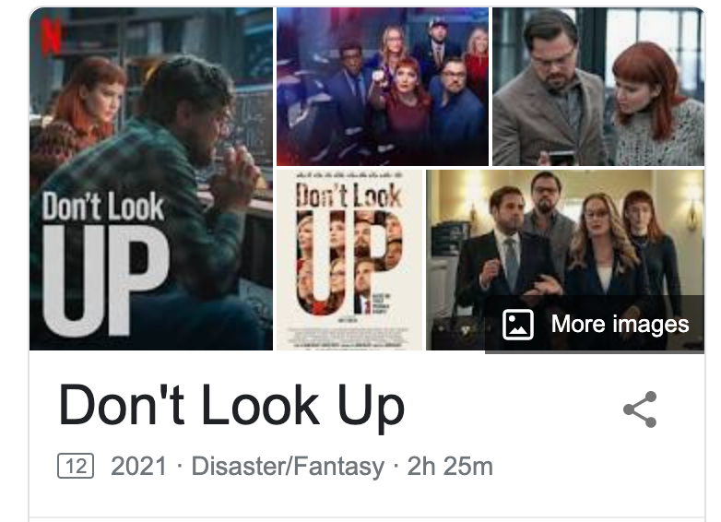
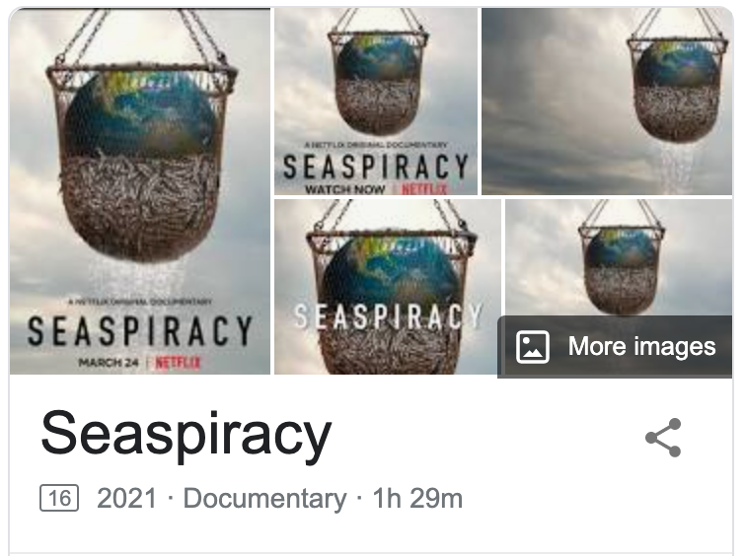

COMPETITION
Films
Documentaries
Reports by foundations

Slide 46
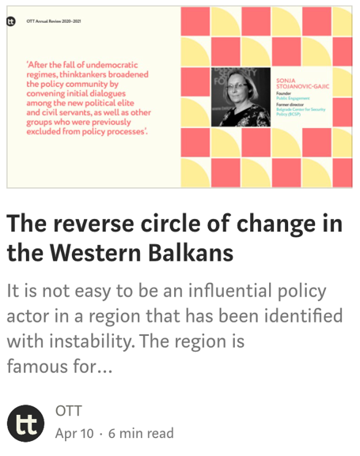
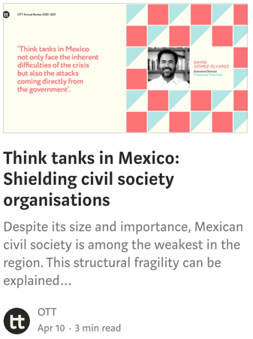
STATE CAPTURE BACK TO ORIGINS
https://medium.com/ott-annual-review-2020-2021

Slide 47

Ongoing innovation
At the individual level, think tanks are constantly innovating, adopting new strategies and tactics.
onthinktanks.org/100towatch

Slide 48
NEW MODELS, NEW THINK TANKS
So in response to changes in the context in which think tanks operate: unexpected competition, state capture, wealth concentration, polarisation.
We will explore new models for thinktanking: student-led think tanks, AI thinktanking, change hubs, business think tanks, trans-national spaces.
We will also consider new functions - or old functions.
And innovations that are constantly being brought about by members of the community!

Slide 49
Thank you!
enrique@onthinktanks.org

