Slide 2
Reflections around the identity of a think tank: Bofill case
Marc Garriga
Fundació Bofill - Communications director
mgarriga@fundaciobofill.org

Slide 3
Reflections around the identity of a think tank
How many of you have gone through a rebrand or a major brand update in the last 3–5 years?
Is there anyone here who feels their organization is trying to be two things at once: a research center and an agent of change?
Has anyone here experienced political or ideological attacks that affected how your organization communicates or positions itself?
Reflections around the identity of a think tank

Slide 4
First, some Bofill context…
Notes:
8 responses – 18 trainers

Slide 5
Populism and tension in the education debate:
Possible reasons:
A general post-pandemic decline in educational outcomes, higher than in other territories of the Spanish state and Europe.
Sustained underfunding of the education system and increased complexity in schools.
Growing challenges in schools and institutes (social, climate, health, etc.) mainly due to external accelerations to the system: digitalization, AI, immigration...
We are an atypical organization:
  A think and do tank: not a regular think tank, not an NGO… A mix of them.
  The conception of a lot of influence in the debate and educational policies.
  And we have never invested in explaining who we are.
Ultra-right populism agenda:
  Constructing "others" (creating fear)
  Generating a perception of collapse (widespread)
  Methodological nostalgia and suspicion of innovations
  Sum of negatives: Different agents from ideological spectrums and opposing interests.
  Decline of important traditional values (effort, authority, etc.). A dangerous world for the current generation, preparing to be tough and competitive. A "woke" agenda that has distracted governments from what is truly important, etc...
Reflections around the identity of a think tank

Slide 6
And some global context:
Notes:
8 responses – 18 trainers

Slide 7
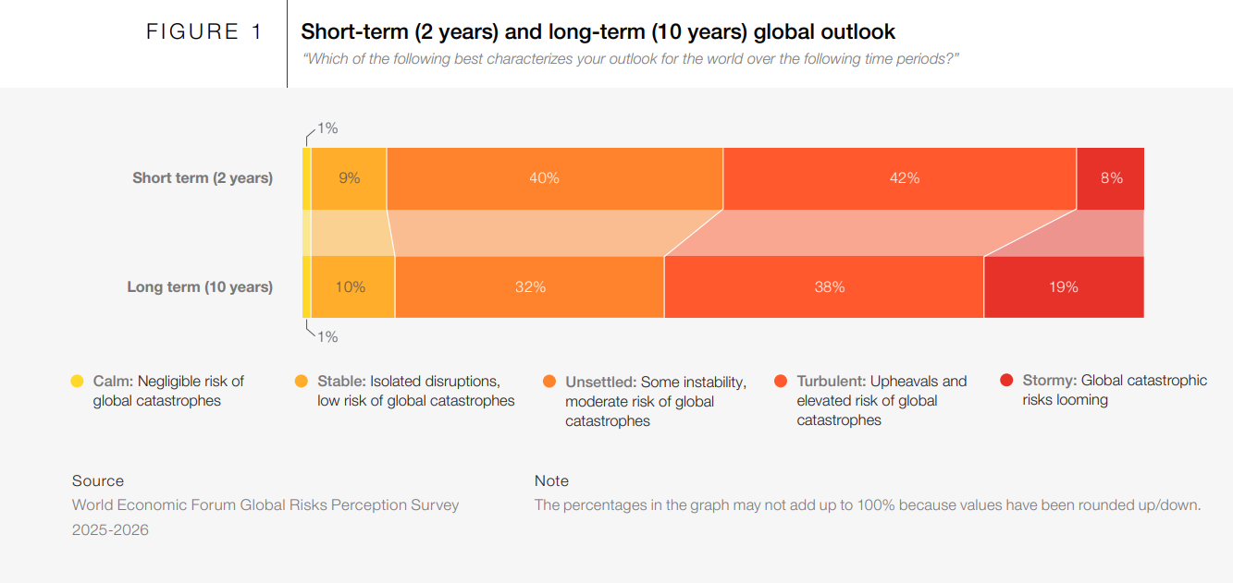
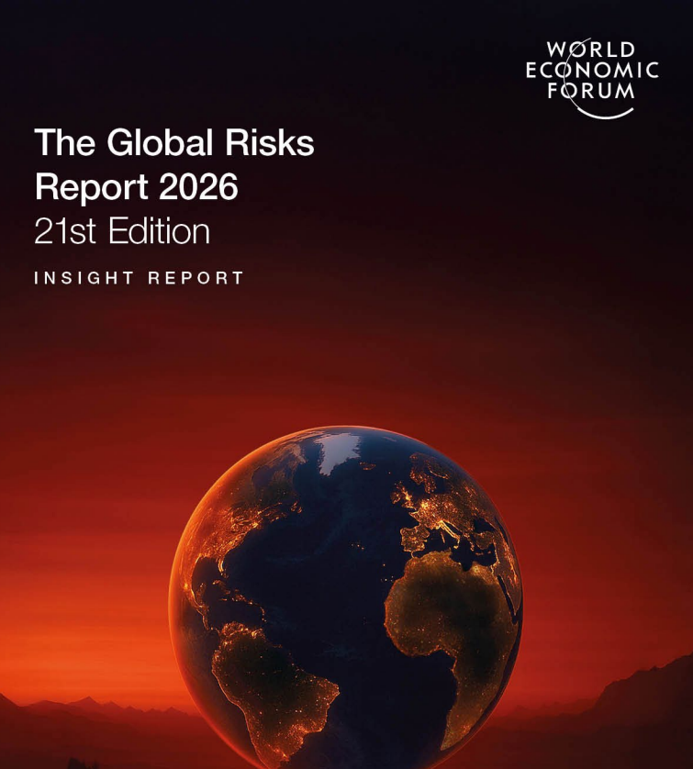
Declining optimism, turbulence, polarization and societal fragmentation
The Global Risks Report 2026
Reflections around the identity of a think tank

Slide 8
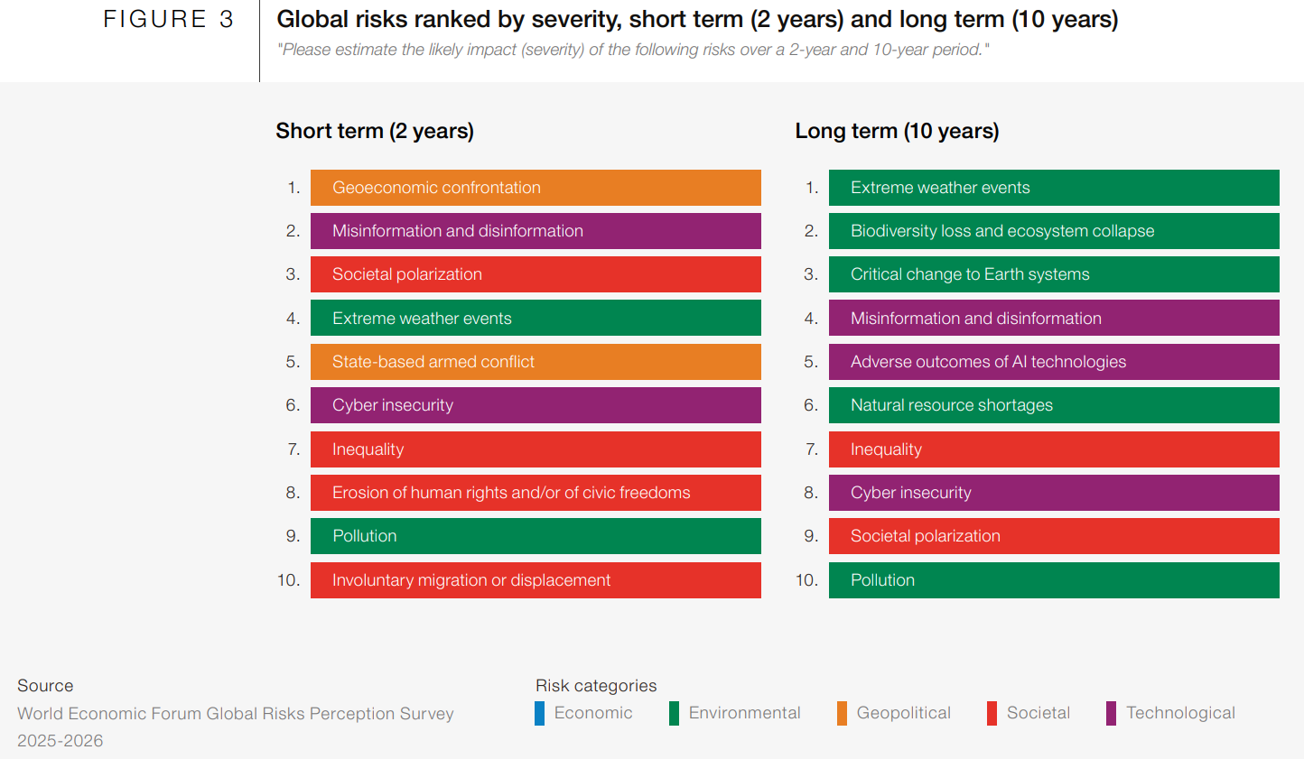
Declining optimism, turbulence, polarization and societal fragmentation
This will be our context for years to come; it is not a short-term temporary situation.
The Global Risks Report 2026
Reflections around the identity of a think tank

Slide 9
What do we want a brand for?
(don’t forget the WHY!)
Notes:
8 responses – 18 trainers

Slide 10
(Re)definition of the Bofill brand
We still don't speak to a global audience: we are little known outside of our specific field.
We are very well known sectorially and with a lot of impact: the Foundation's main communication challenge lies in how we go beyond the audiences that already know us and gain in public relevance and social impact.
We receive reputational attacks, but very focused.
The reputational problem is quantitatively not very serious and very focused but it must be managed due to its potential influence in specific sectors of teachers and opinion leaders and government.
Critics make themselves heard a lot, but the groups of enthusiasts and supporters are more numerous.
We are asked to listen more: this indicates a potential community.
We have audiences that ask us and want to be “more Bofill”. That they want to get involved and be part of the educational debate. They want us to listen to them more, to be more involved, and this is good news and shows potential for community and involvement.
From passive followers to active members.
Convert followers into an involved and prescribing community to strengthen the legitimacy of the Foundation, contain the echo of critical sectors and gain in social presence and impact on challenges.
Lack of knowledge and confusion about the purpose and activity of the Foundation.
The Foundation's brand generates confusion and it is necessary to invest in renewing the Foundation's brand and narrative to clarify for all audiences who we are, what we do and what purpose drives us.
Reflections around the identity of a think tank

Slide 11
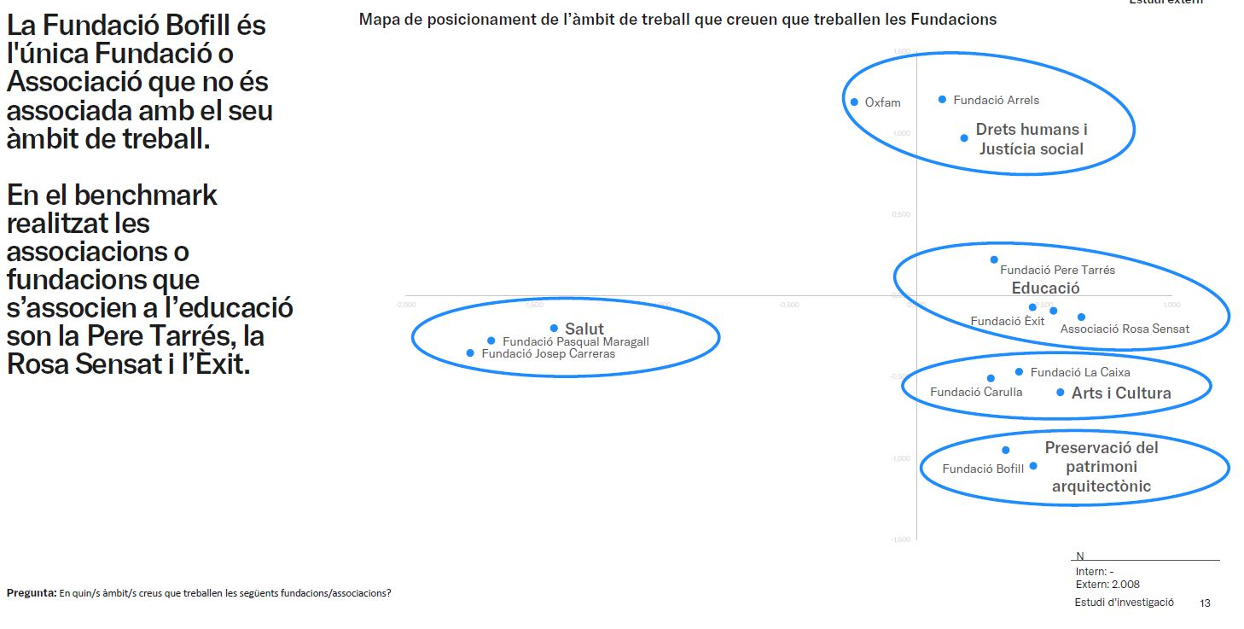
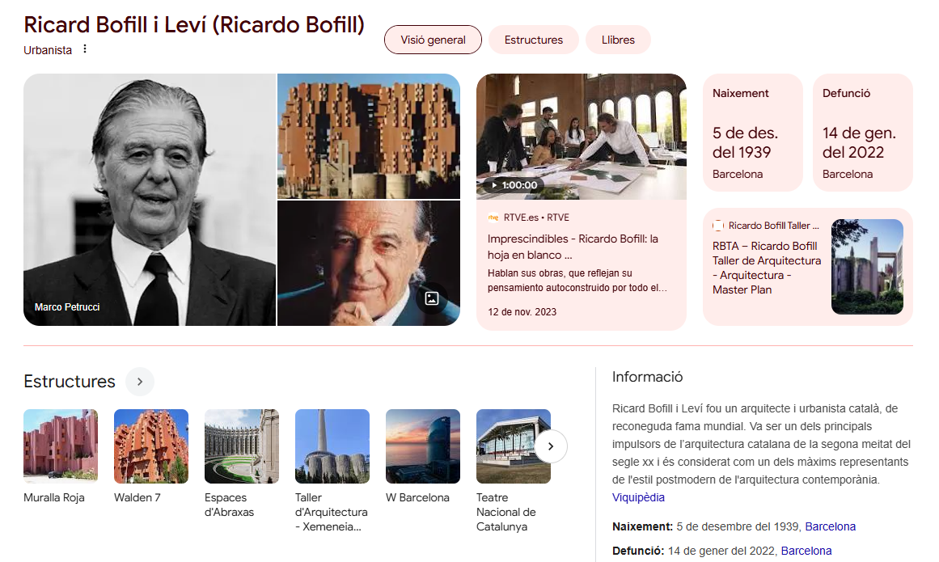
The Bofill Foundation is not associated with its field of work. And it is clearly associated with another sector.
Reflections around the identity of a think tank

Slide 12
(Re)definition of the Bofill brand
A process to boost the Foundation's visibility, grow involvement and legitimacy, and increase social impact. Not a defensive move: an opportunity!
With the current brand, we will face the Foundation's new challenges with greater difficulty.
The Foundation needs to broaden the social base and involve and be relevant to more people, and the narrative, brand and sector positioning does not work to reach new audiences.
The purpose is not understood: the Foundation needs to connect the brand with the purpose. The narrative of rigor and high-level approaches alienate the general population from the Foundation.
The current brand has several obstacles that make it difficult to increase brand awareness, recognition and value:
  We do not capitalize on the Bofill name: Jaume Bofill is unknown and does not link to the purpose.
  The Bofill surname is currently associated much more strongly with the architect and the firm.
The current brand is a critical element of confusion, because it deviates from the mission and counter-communicates.
We must make some movement. And that it must be strategic, not aesthetic and superficial.
We are facing the opportunity of a relaunch of the organization to drive the strategy and purpose: it is not a matter of making a defensive brand change or just a new logo and brand identity.
Reflections around the identity of a think tank

Slide 13
WHY: we want a brand that is useful to society
What factors make us rethink the brand?
We have a more hostile social and political context for equity, diversity, and inclusion policies (cultural war)
We have changed our headquarters, we have grown...
We have adjusted our purpose to be clearer.
We have defined new challenges within the framework of inequality: school early drop-out, community and digital opportunities, and vulnerable schools…
We want more social presence and more territorial scope.
We want to increase our impact around equity.
We want to achieve more political impact.
We want to increase our activity and capacity for influence.
We will invest more in communication and campaigns to achieve more social impact.
We want to increase potential audiences, their involvement and our financing channels (membership)
Reflections around the identity of a think tank

Slide 14
From:
To:
From the small org.
From being local
From information
From impact
From studies
From reactivity
From the focus on data
From the sectoral scope
From working internally
From the expert worker
Social influencer
Being glocal
Communication
Influence
Campaigns
Proactivity
Focus on impact
Segmented community
Collaborating openly
The motivated collaborator
Reflections around the identity of a think tank

Slide 15
More impact?
Promote more social pressure and impact
Media and public impact
Political impact: proposals and initiatives for changemakers
Awareness
Notoriety
Involvement
Legitimacy
Knowledge and proposals
More social impact
BUILD TRUST
BUILD BRAND VALUE
What cause are we concerned about?
Let’s build our brand from here!

Slide 16
Brand Value Associated with the Acquisition Funnel
– Brand value
+ Brand value
8%
23%
Confused
Ambassador
Lowalty
Adherence
69%
Consider
Interest
Unaware
Awareness
Individu
Know the brand
Show interest
Evaluate the brand
Connected to the brand
Actively participates
Speaks well of the brand

Slide 17
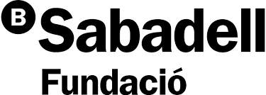

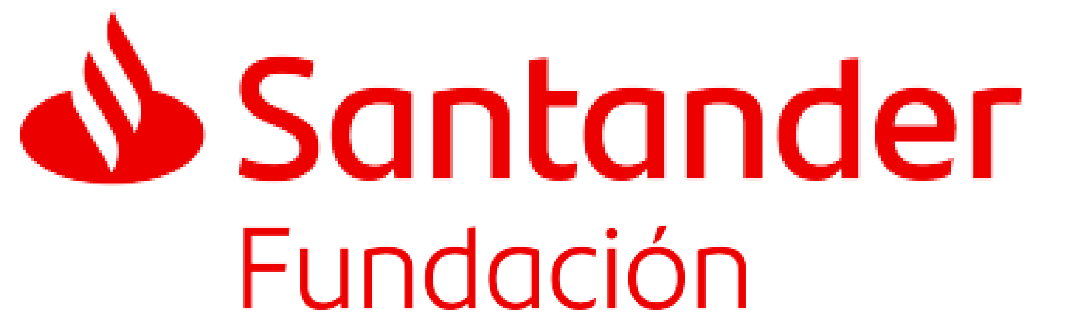
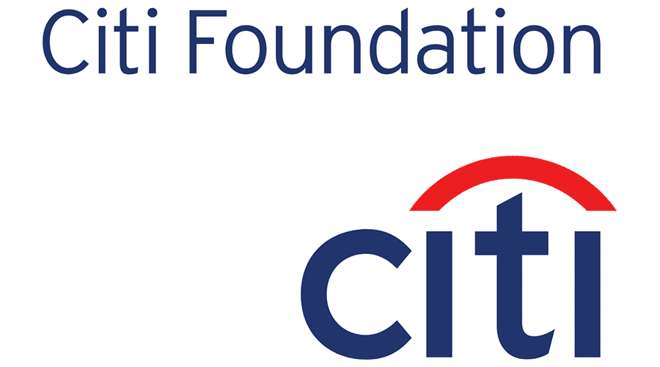






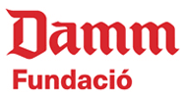
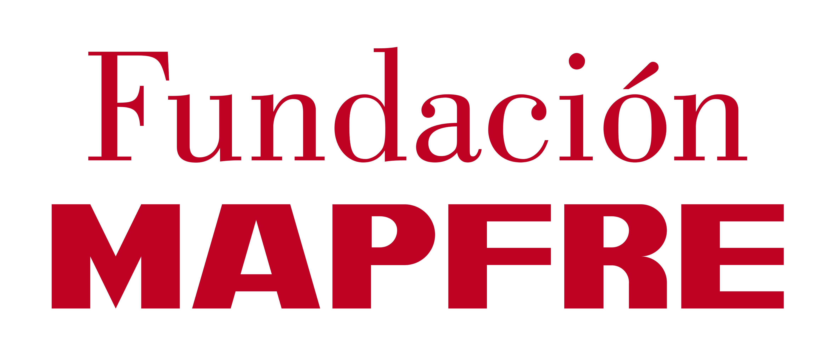
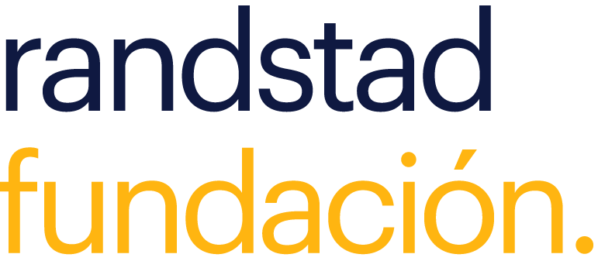
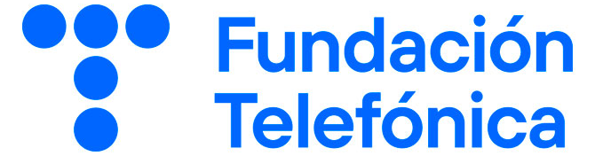
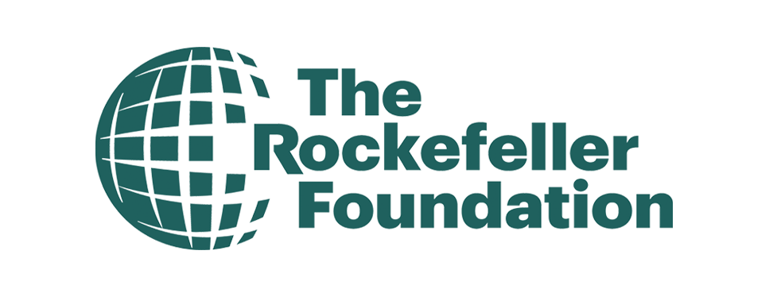








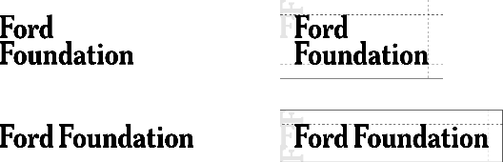

















































CORPORATIONS
FOUNDER
CAUSE
LEGACY / FAMILY

Slide 18
Key Findings on Identity and Naming
If we look at the visual identity, within the social organizations and NGO we find four main groups: those associated with the founder, those associated with the cause/purpose, the corporate ones and the "Organizations" associated with cultural, health and solidarity institutions (Assistance).
Those associated with an emblematic founder, retain the name or naming of the person and usually have an austere graphic treatment (initials).
Corporations take advantage of the name of the parent brand by adding the term "Foundation". The term Foundation, therefore, has connotations associated with the corporate world.
Small organizations use various strategies, acronyms, names, concepts, depending on the sector, but they are always associated with the theme or the social cause.
Organizations that have specific social causes, make their purpose or commitment a call to build their identity.
Reflections around the identity of a think tank

Slide 19
Questions for discussion:
In a moment of pessimism, social tension, and growing complexity in the social and educational ecosystem, what should a brand primarily transmit? Hope, solutions, and optimism? Or highlighting problems to avoid appearing disconnected from reality?
Should a think tank’s brand be built mainly around research—expertise, evidence, and rigor? Or around purpose—values, mission, and social commitment? Can it credibly do both without losing trust?
Is it strategically safer for a think tank to position itself primarily as a research center to avoid political attacks? Or is embracing an NGO or activist identity sometimes more honest and effective and necessary today?
When a think tank is attacked by opposing political movements or interest groups, does this weaken its credibility—or can it reinforce its positioning?
In the next decade, will think tanks be judged more by the quality of their evidence—or by their ability to connect knowledge with social change?
Reflections around the identity of a think tank

Slide 20
Reflections around the identity of a think tank: Bofill case
Marc Garriga
Fundació Bofill - Communications director
mgarriga@fundaciobofill.org

