Slide 1
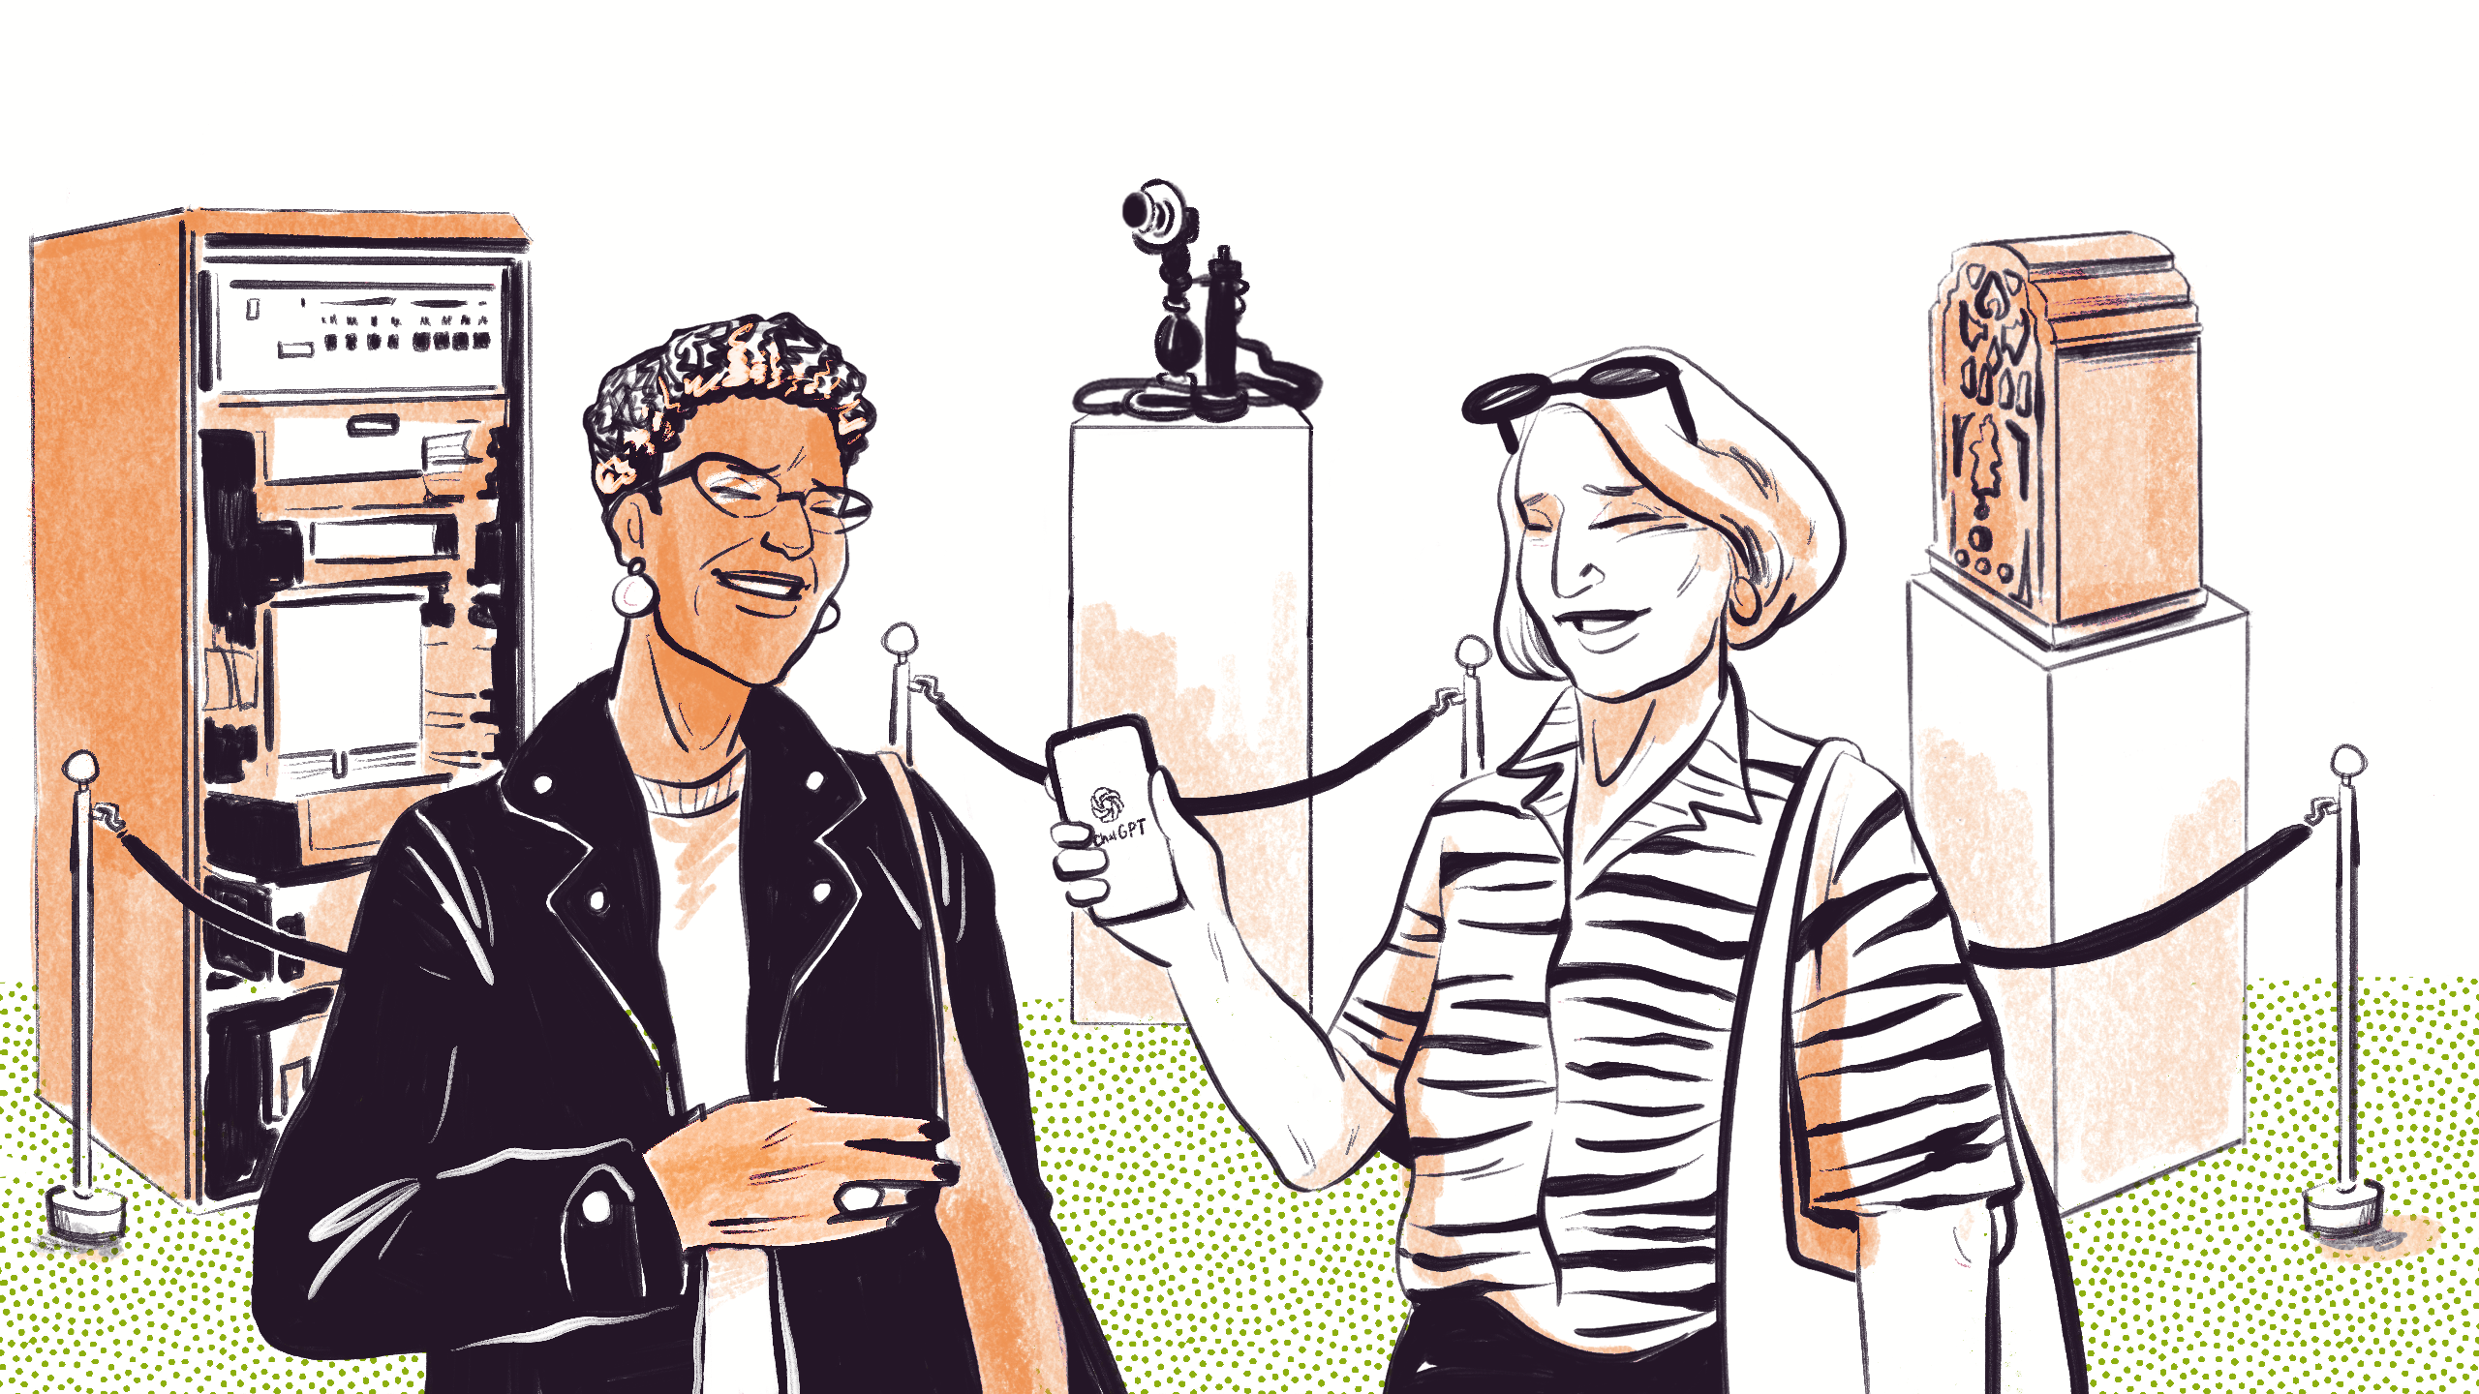
Managing AI in your think tank
Nick Scott @ School for Thinktankers 2026
Image: Ada Jušić & Eleonora Lima (KCL) / https://betterimagesofai.org / https://creativecommons.org/licenses/by/4.0/

Slide 2

About me
Have always been focused on how technology drives change in the ways organisations have an impact.
Previously worked as Head of Digital for non-profits (Médecins Sans Frontières), trade unions (UNISON the public service union) and think tanks (ODI Global).
Since 2021 have been a freelance digital and AI strategy consultant and trainer for third sector organisations.
Run Cast From Clay’s Generative AI for Policy Communications course.
Director of the Centre for Responsible Union AI.
A victim of Brexit. Have lived since 2017 in Barcelona and now two years away from regaining EU citizenship.

Slide 3
Session structure
The AI moment for think tanks
We look outwards and forwards to understand what AI’s impact might be – and how it is already affecting us
Managing AI in your think tank
Understanding the complex opportunities and challenges of AI for strategy, tech choice, people and processes.
Turning crisis to opportunity
Discussing what AI might make possible for us that was previously impossible
Notes:
We'll start by looking outwards and forwards, at what the impact of AI might be in the future –and how it is already affecting us.
I'll give you a framework for thinking about the complex challenges of AI transformation.
We'll end with three more questions about the future of think tanks that will try to help us think about how to run potential crisis into opportunity.

Slide 4
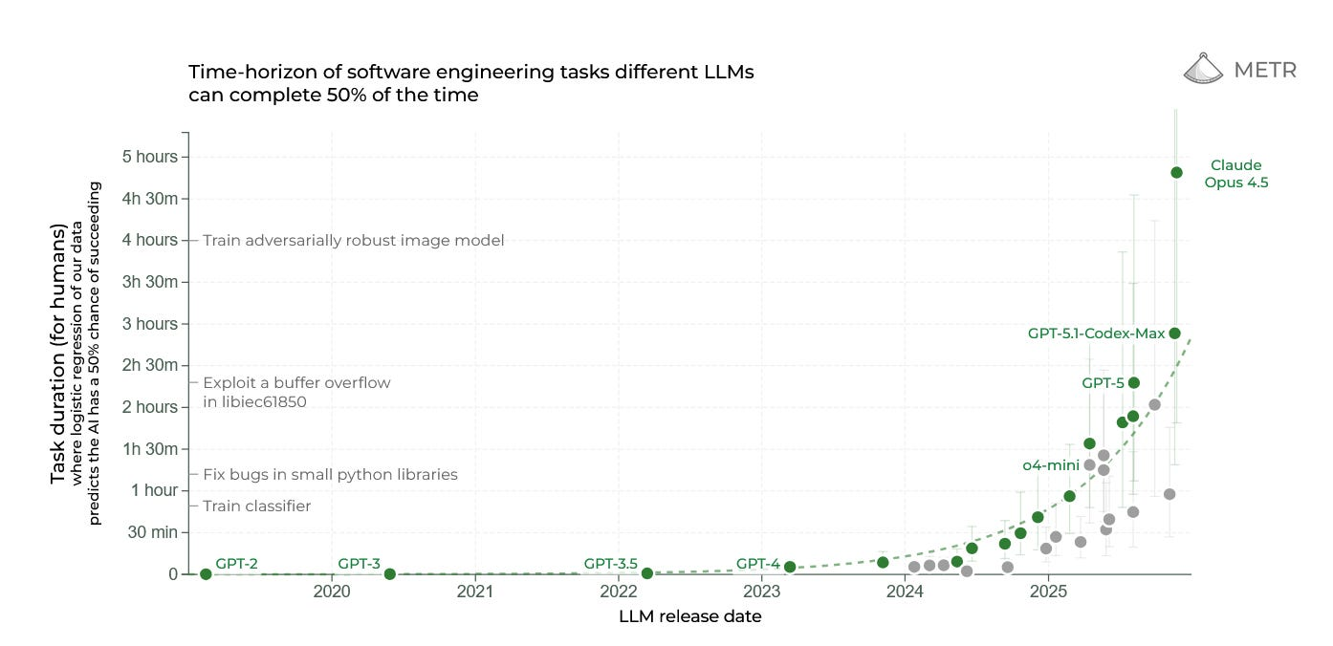
The complexity of tasks AI supports is increasing rapidly
AI is handling increasingly complex work that would take humans longer time to complete… and this trend is accelerating.
Source: METR
Notes:
Let’s start by being realistic.
AI is powerful
And, for many of the tasks that think tanks do, AI is getting better, fast.
This chart shows we're on an exponential curve.
Every seven months, the length of a task AI can reliably complete doubles.
The model I use, Claude Opus 4.5, can apparently complete tasks that would take a human almost 5 hours with 50% reliability.
It’s not perfect. Nor is it yet that long, many tasks I have on my plate take longer than 5 hours.
But the trajectory is clear.
The AI you use next year will be significantly more capable than the one you used today.

Slide 5
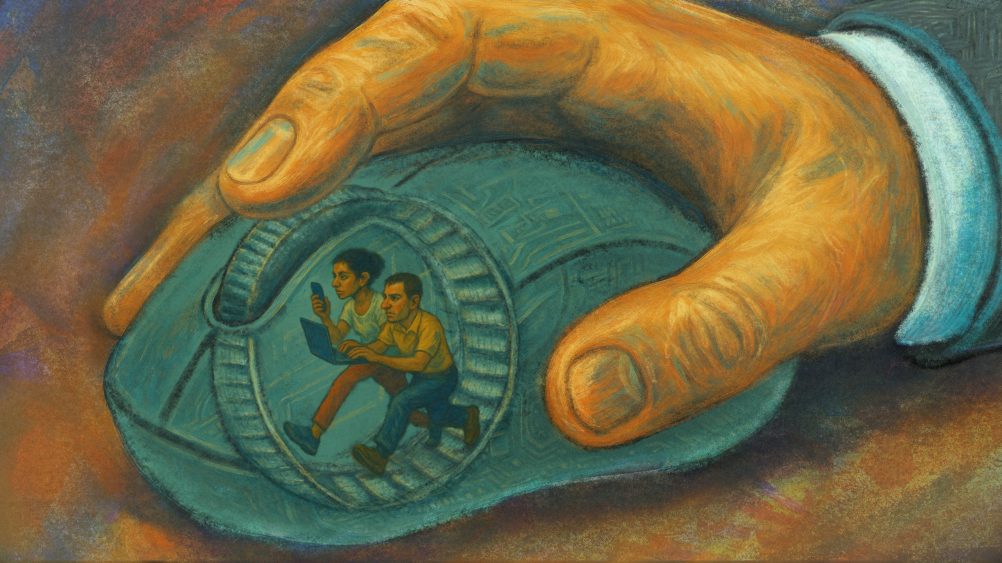
What useful thing does your think tank do that is no longer valuable in a world of AI?
Image: Leo Lau & Digit / https://betterimagesofai.org / https://creativecommons.org/licenses/by/4.0/
Notes:
Which leads me to start with a hard question: What useful thing does your think tank do that was is no longer valuable?
AI doesn't do everything well—but it does some things very well.
For many organisations, AI is now fully capable of automating a task that used to be an important part of your identity or strategy.
AI can synthesise literature faster than your research assistants.
It can analyse consultation responses overnight. It can draft policy briefs that are... fine.
It can provide the kind of rapid analysis that used to take weeks.
So: what useful thing you do might no longer be valuable? What's being commoditised?
To the room (8-10 min): "What are you already seeing? How is AI showing up in your work—your research, your audiences, your funders, your teams?"
Harvest 4-5 responses, noting the variety. Acknowledge both the threats and the opportunities as they emerge. Some will share anxieties; others will share experiments. Both are valid.
Bridge (2-3 min): "What you're describing is hitting think tanks across multiple dimensions—and it's messy. Let me give you two scenarios that sharpen these tensions..."

Slide 6
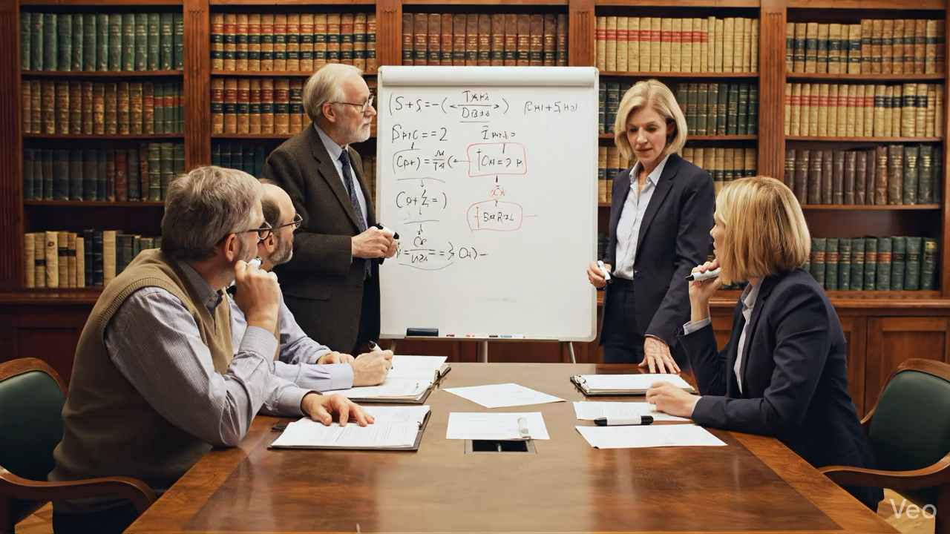
Activity: read a fictional scenario to find risks and opportunities of AI
Notes:
The scenarios together surface:
Strategy questions (value proposition, stakeholder changes, peer competition)
Technology questions (tool fragmentation, data security, who decides)
People questions (anxiety, identity, skills, generational divides)
Process questions (governance gaps, quality control, learning together)

Slide 7
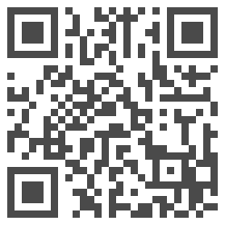
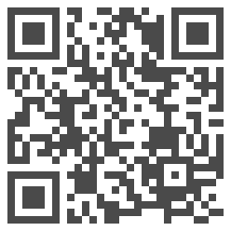
Activity: read a fictional scenario to find risks and opportunities of AI
Read the scenario (5-6 min)
Then discuss with people near you: What stands out? What would you do?
We’ll finish with a group discussion.
Scenario A:
The eager research team
Scenario B:
The leadership dilemma
Notes:
Format:
Assign one scenario assign one per half of the room
Ask them to scan QR for their scenario.
5-6 min reading and initial table discussion: "What stands out? What would you do?"
8-10 min harvesting: capture tensions on a flip chart or verbally, noting how issues connect
2-3 min bridge: "These tensions map to four dimensions we need to think about..."

Slide 8
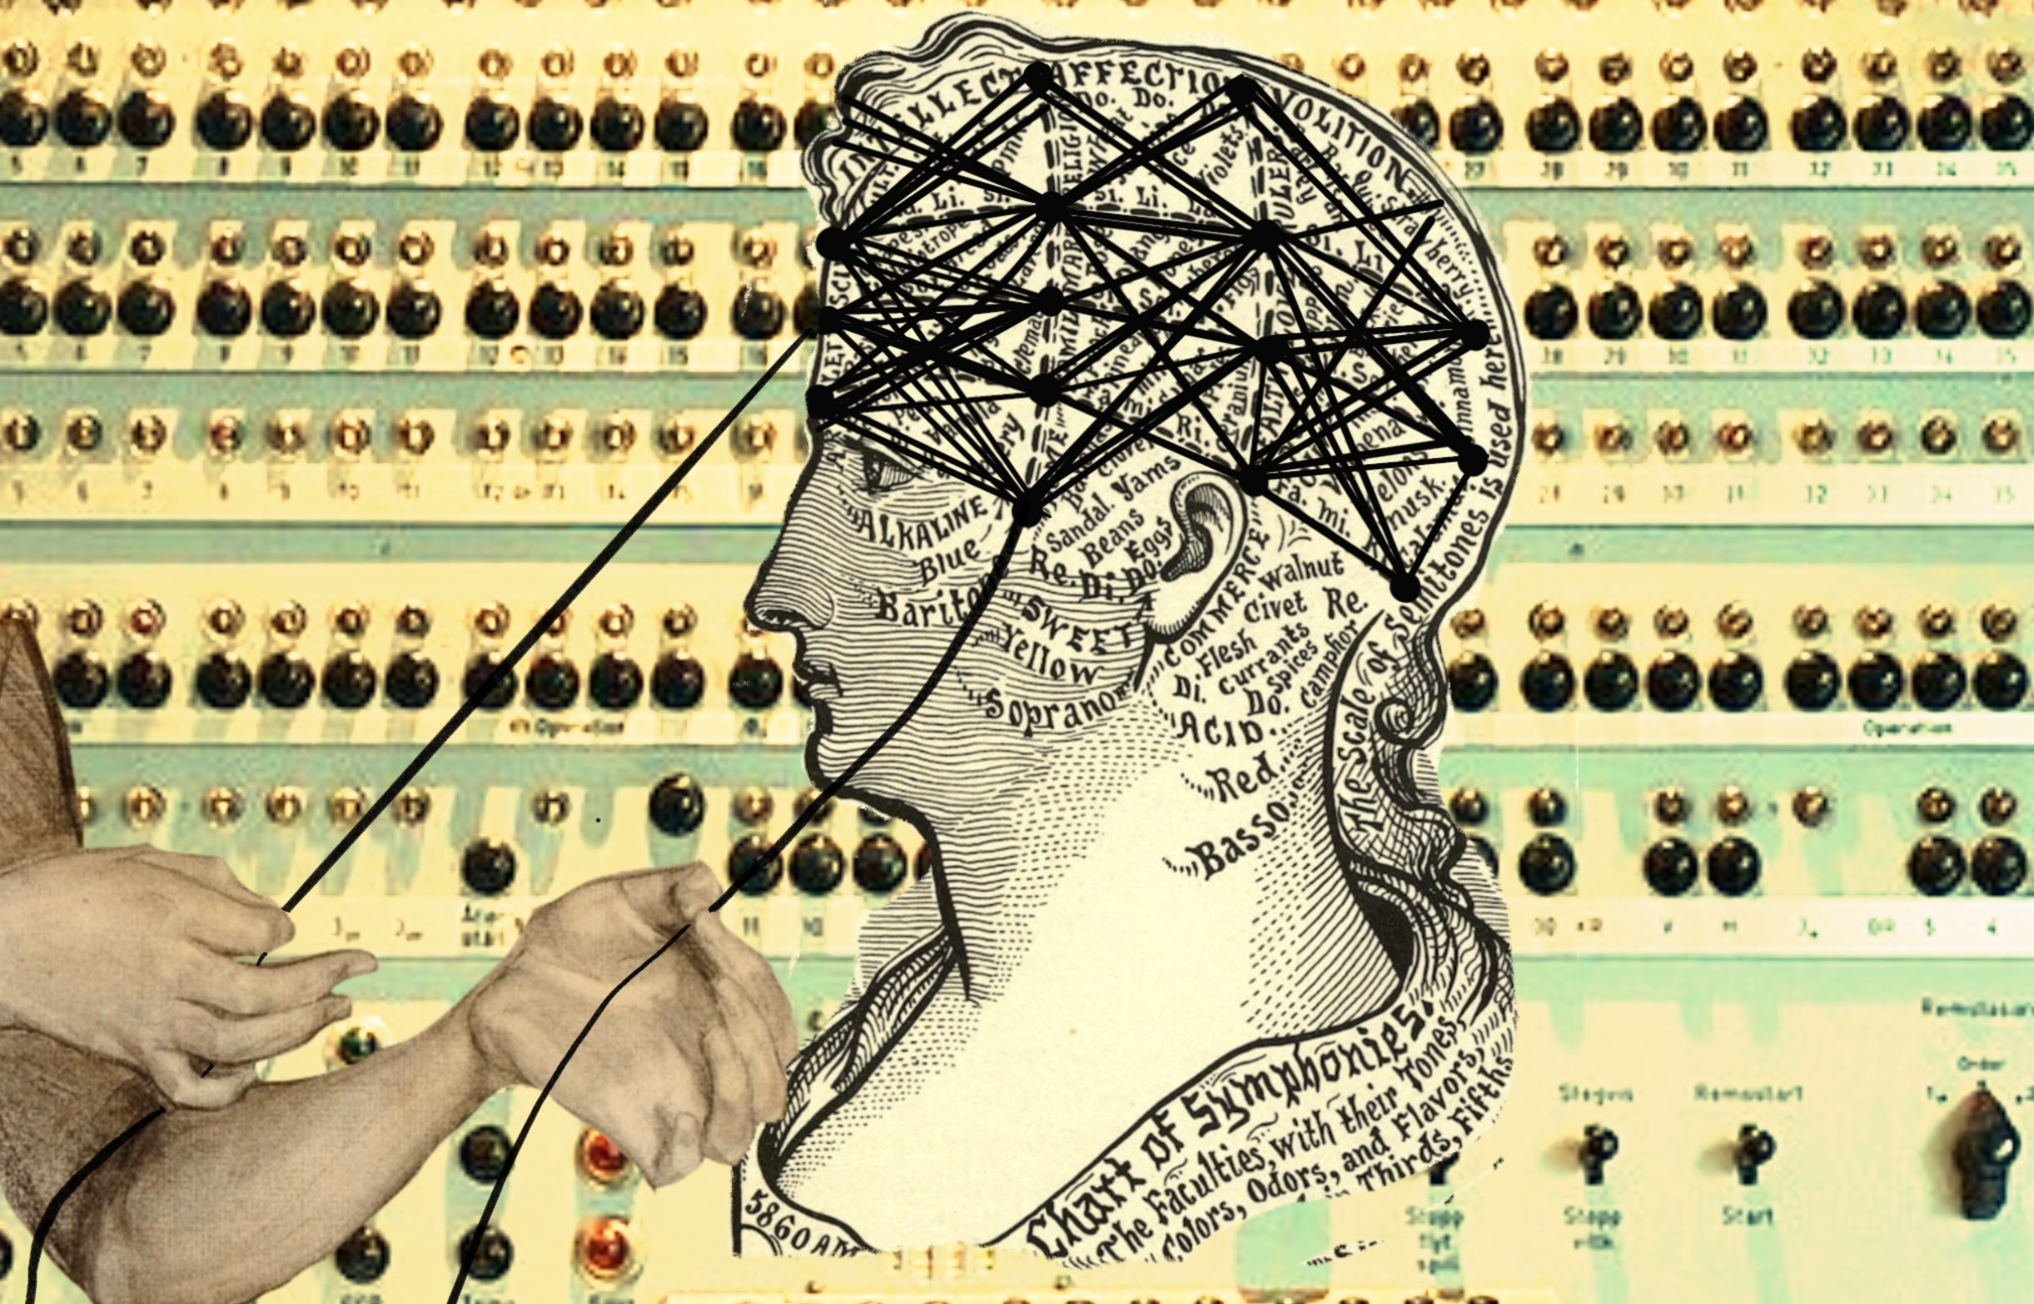
Four dimensions for managing AI transformation in a think tank
Image: Hanna Barakat & Archival Images of AI + AIxDESIGN / https://betterimagesofai.org / https://creativecommons.org/licenses/by/4.0/

Slide 9
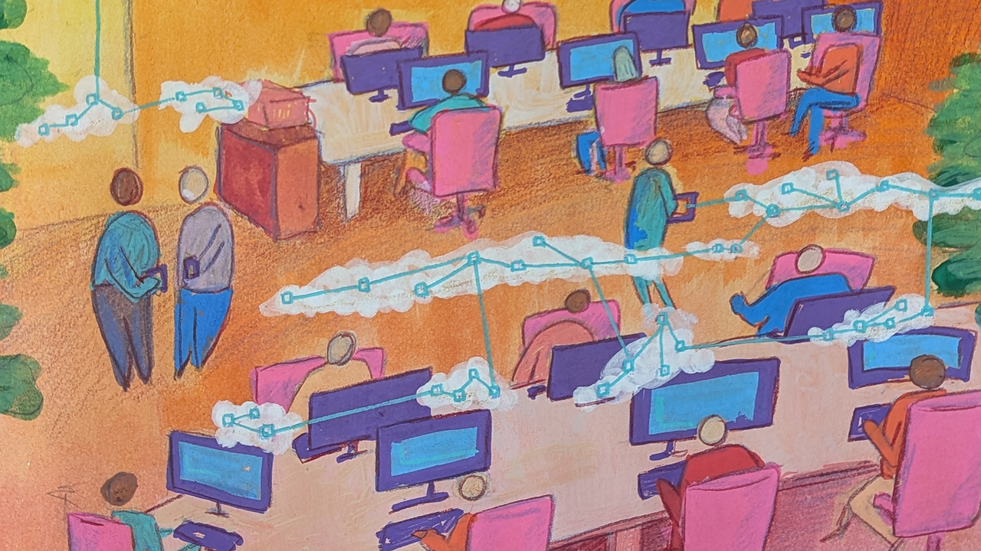
Dimension 1: PEOPLE
Image: Jamillah Knowles & Digit / https://betterimagesofai.org / https://creativecommons.org/licenses/by/4.0/
Notes:
The scenarios surfaced tensions across multiple dimensions. Let's start with the most fundamental: people.

Slide 10
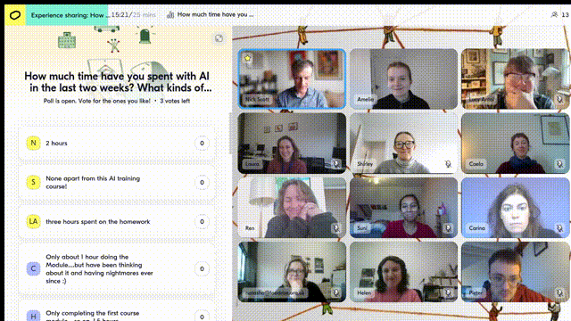
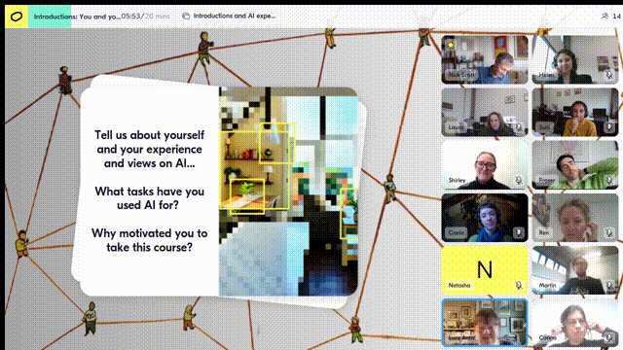
AI’s potential for individual staff at a think tank
Staff could use AI to work faster and do better work.
They could generate work, with AI drafting content or analysing data.
They could improve their work, with AI refining writing, improving clarity, critiquing or extending work, or strategising and planning with them.
Their processes could be automated: AI transcribes their meetings or manages their calendar to create slots for focused work.
Notes:
I’ve met hundreds of staff from think tanks during my courses
In terms of what AI could do for them, there’s a lot of ideas and examples that come up.
I think of this in three categories:
Generate things from scratch
Improve work as a partner in ideas, critiques, analysis, or design
Automate routine tasks, like meeting note taking or calendar organisation.
The potential is real.
People are drafting policy briefs faster, analysing consultations overnight, testing how audiences might respond.
But four challenges get in the way...

Slide 11
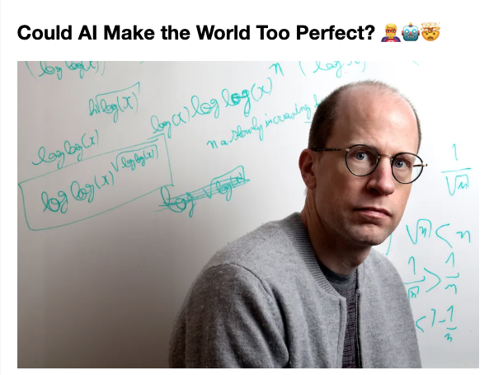
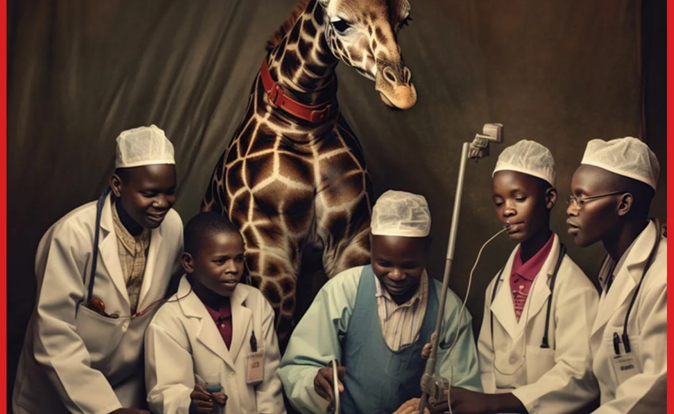
The world of AI is a world of extremist views
Notes:
But AI isn’t easy for everyone to get into… why?
Because they hear of things like this:
In a study some researchers asked MidJourney, an AI image creation tool, to create white patients and black doctors in Africa.
150 attempts. It never did it. Always white saviour imagery.
This is a real problem. AI reflects biases in its training data.
Bias is one of many problems AI has.
But here's what happens because of this: some people use examples like this to say AI is fundamentally dangerous.
And then others dismiss concerns entirely.
They talk only about some wonderful AI that is going to make our lives better.
Among staff you find extremism about AI.
Extreme positivity. Extreme pessimism.
Neither extreme helps staff in thinking about AI’s potential.
AI is an imperfect tool.
A challenge is helping people find the pragmatic middle.

Slide 12
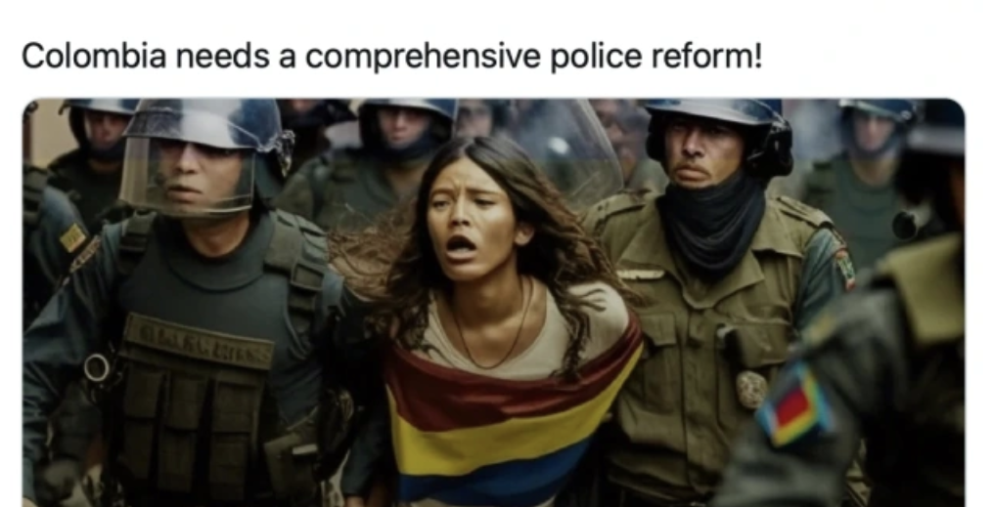
The fear of making mistakes stops people engaging at all
Notes:
Even if they don’t reject AI as dangerous because of its ethical challenges, many people fear using AI because of the risk of mistakes.
A staff member at Amnesty Norway once published AI-generated images of real protests in Colombia.
This is an incredible mistake. Amnesty lives and dies by the credibility of its content.
And it caused massive reputational damage.
When people see others make mistakes using AI (and the news is full of them) they don't just avoid that specific mistake.
They avoid all experimentation.
Fear spreads.
People either don't engage... or experiment in secret where no one can learn from them.

Slide 13
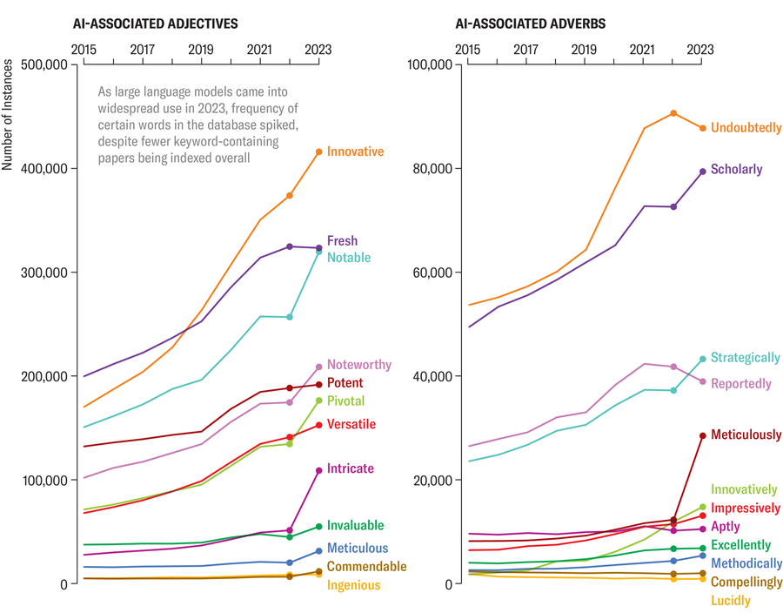
People see AI increasingly encroaching on work that was theirs and it scares them
Notes:
And secret experimentation is happening. At a massive scale.
Research in 2023 found 60,000 scientific papers published likely used AI.
17% of peer review text at major conferences was AI-generated.
Whether that's good or bad isn't the point right now.
Researchers are watching AI do things that used to be their domain.
Knowledge may eventually not be something we specialise in.
If AI can draft a policy brief in minutes, even if it isn’t perfect, it has an impact on people’s sense of professional identity
People worry that AI will replace them
Particularly if their identity is based on their knowledge, as is the case for many researchers.
The answer isn't reassurance; it's reframing.
Focus on what AI can’t replace.
Judgment and relationships.

Slide 14
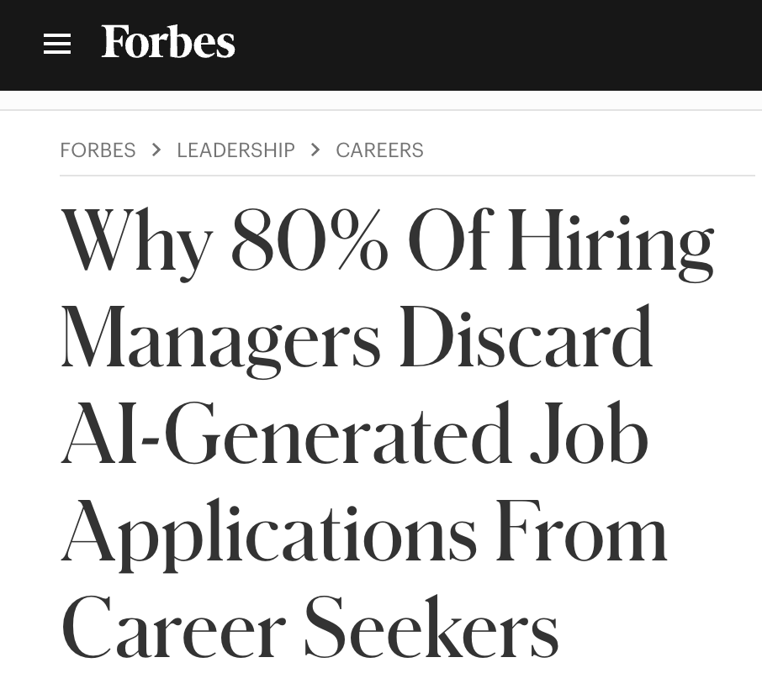
People don’t have time to develop AI skills … and they don’t try to hire them either
Notes:
So some staff reject AI, others use it secretly.
What’s the way to overcome this?
Well, training is one.
Building AI skills among all staff.
But what’s the biggest barrier there?
Time.
I don’t know how many times I’ve heard people say
“I know AI should save me time, but I don’t have time to learn AI”.
This matters because growing AI skills is not about one-off training. (Though that is important)
Because AI keeps evolving.
It is about continuous learning.
You need learning embedded in how teams work.
Not an event. A rhythm.
And that requires time.
Another route to growing AI skills is hiring them in.
But most organisations are more focused on rejecting AI than finding AI.
A research team found 80% of hiring managers hate AI-generated applications.
I understand why we’d reject anyone who applies for a job and you can see their entire application was written by ChatGPT.
Usually because it is exactly the same as many other applications you received.
But how do you hire the person who used AI really well in their job application?
This shows why training matters.
To avoid these kinds of mistakes, that come from ignorance.

Slide 15
The PEOPLE dimension: four things to get right
Support people to move from extremism to negotiation on AI: it isn’t existential threat nor magical solution; it is a tool we decide when to use.
Support people to reframe their professional identity: their knowledge may be less unique; their judgement is more valuable than ever.
Support people keep up with the speed of AI evolution: one-off training programmes won’t work; hiring and continuous learning is needed.
Support people in overcoming their fear of experimentation: to learn, people need active permission to try AI – without fearing failure.
Notes:
Four keys - and they map to those four challenges:
Extremism → pragmatism.
AI as salvation or existential threat.
Reality is brilliant at some things, weak at others.
Your people need to learn where the boundaries are, and those boundaries keep moving.
That means people learning to negotiate the human/AI split continuously, not settling it once.
Fear → safe experimentation. Explicit permission to try, fail, learn.
Without permission and psychological safety, you get paralysis or people using AI secretly.
With permission people try, fail, learn
"When AI can draft a policy brief in minutes, what defines my expertise?”
This is real and it's uncomfortable.
The answer isn't reassurance—it's reframing.
Help people shifts from what you know to what you can judge.
That's harder to articulate but more durable.
You need to help people keep up.
One-off training doesn't work. By the time you've trained everyone, the tools have changed.
This isn't a moment to adapt to—it's a new condition.
Adaptation becomes perpetual, not periodic.
These work together. You can't do just one.
[TRANSITION]
Now let's look at how this plays out at the process level...

Slide 16
Dimension 1: PROCESSES
Image: Ada Jušić & Eleonora Lima (KCL) / https://betterimagesofai.org / https://creativecommons.org/licenses/by/4.0/
Notes:
Now let's move from individuals to how your organisation works together.

Slide 17
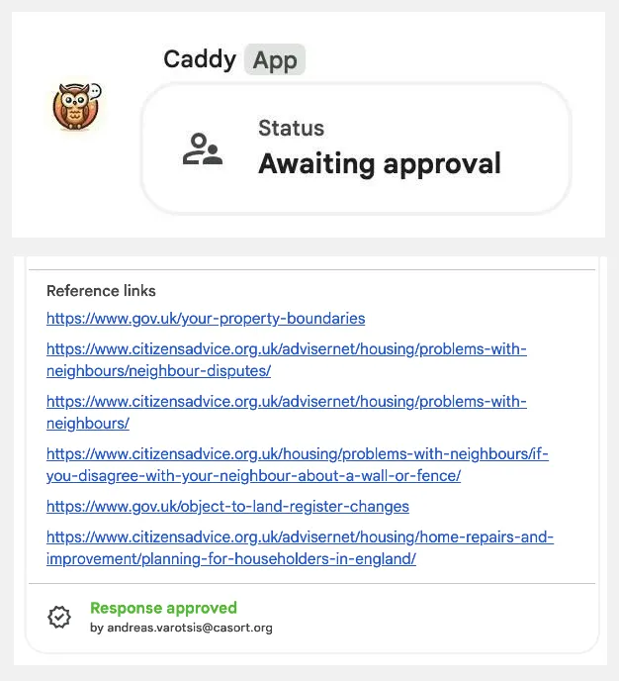
The process hope: AI supports teams to connect and collaborate better
Teams could use AI to make internal collaboration and processes more powerful.
Teams can generate work jointly, with AI creating content or analysis that uses organisational data or knowledge and templates.
Teams can improve collaborative work, with AI simulating audience personas; or giving access to organisational knowledge bases and libraries.
Team processes can be automated, with AI doing media monitoring; updating databases; organising files; or translating internal documents.
Notes:
At the team level, the same three categories: generate, improve, automate.
Generate together - content drawing on organisational knowledge, drafts that follow house style automatically.
Improve collaboration - AI simulating audience perspectives, testing ideas before they go public.
Automate team processes - media monitoring, database updates, file organisation.
Citizens Advice built "Caddy" - helping supervisors review adviser conversations across 270 organisations. A
I ensuring quality while reducing bottlenecks.
→ But making this work requires getting four things right...

Slide 18
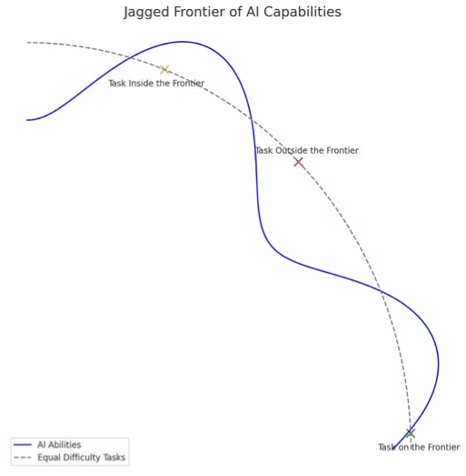
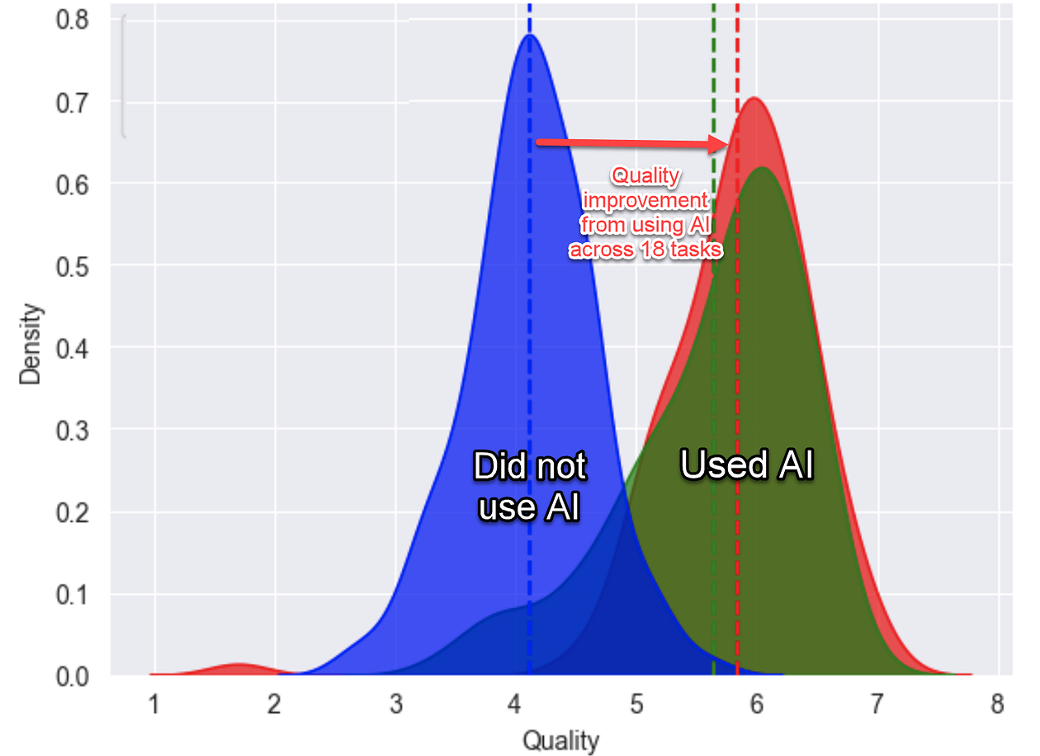
Generative AI technology is weird and unpredictable. How do teams discover where it will help – or not?
Source: Harvard Business School
Notes:
A Harvard Business School study looked at consultants using basic ChatGPT.
12% more tasks completed
25% faster work
40% higher quality results
Great results.
But the same research coined the term "jagged frontier” to describe AI’s unpredictability.
Sometimes it pushes the frontier of what you think is possible.
AI might write a complex research abstract brilliantly.
But fail at summarising a short meeting.
It might excel at large datasets.
But it makes elementary fact-checking errors.
[KEY POINT]
The problem is you can't know in advance where AI works for your specific tasks. You have to experiment to find out.
And that experimentation can't happen in isolation.
If one team discovers AI is brilliant at X but terrible at Y, everyone needs to know.
Otherwise you're running the same experiments thirty times.
Shared experimentation.
Connected learning.
That's how you map the frontier for your organisation.

Slide 19
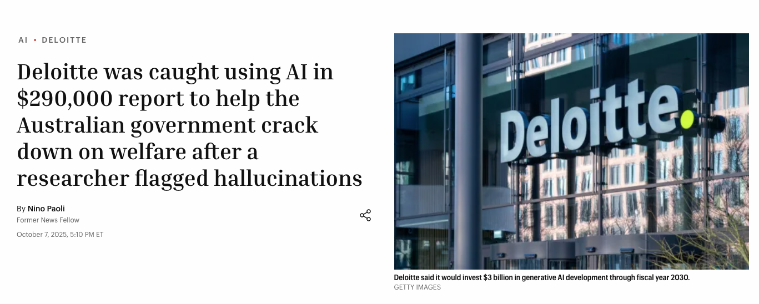
If teams don’t ensure there’s a human in the loop, they’ll face the consequences
Notes:
Australian government. Deloitte. $440,000 for an "independent review"
237 pages. Looked like normal Big Four output.
Then someone checked the references.
Academic papers that didn't exist
Books never written
A fabricated quote from a judge... name misspelled
[PAUSE]
This is what happens when no one checks the output
They used GPT-4o
Nobody validated what came out
→ The question isn't whether to use AI... it's where are the human checkpoints?

Slide 20
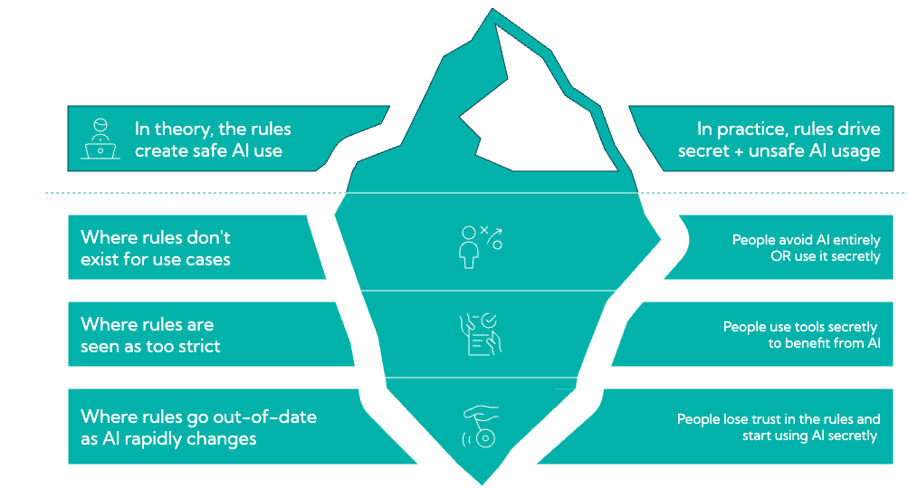
Strict organisational policies can create hidden risks
Notes:
Because of all the risks, many organisations focus on policies and rules.
Legitimate concerns here
Data protection matters
Confidentiality matters
Quality standards matter
But overly restrictive policies backfire.
Drive staff to personal ChatGPT accounts
If something is not explicitly allowed, people don’t know what to do.
Creating exactly the security risks you were trying to avoid
[PAUSE]
Good governance isn't blanket rules
It's use-case specific:
What's appropriate for this type of work?
What's the human role?
What are the data boundaries?
→ Clear enough to follow. Flexible enough to enable.

Slide 21
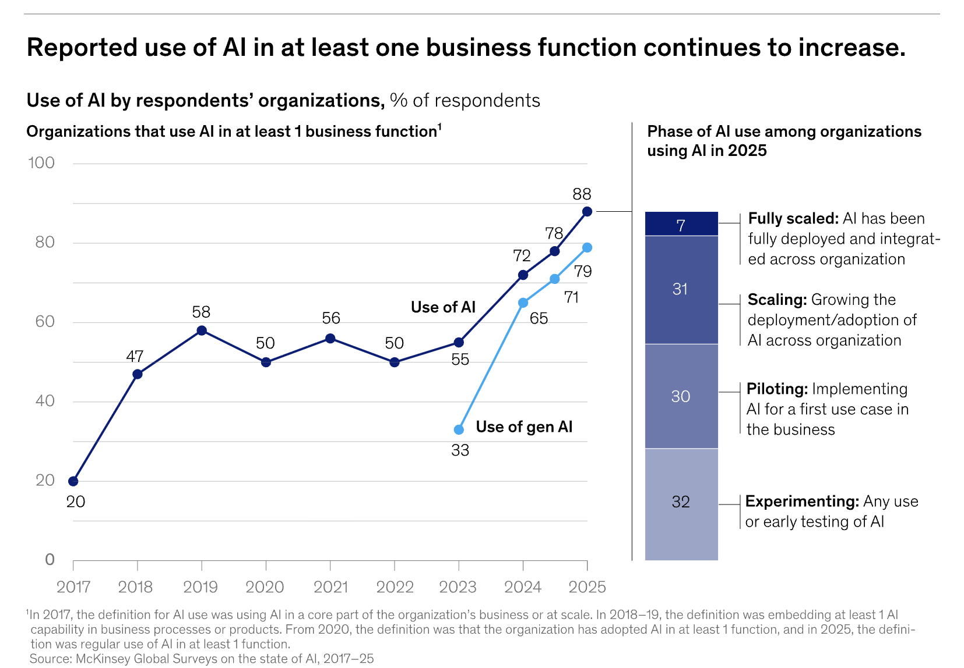
To really benefit from AI in an organisation, you must redesign
The majority of organisations are still at the experimenting or piloting stages of AI engagement and adoption.
Notes:
McKinsey's 2025 research has a sobering finding
Here's the headline:
88% of organisations are now using AI somewhere
But most aren't seeing the productivity gains they expected
[PAUSE - this is the key point]
Why not?
The research is clear. The organisations seeing results are the ones who redesigned how work gets done.
Not bolted AI onto existing processes
Fundamentally rethought the workflow
[SLOWER]
Don't ask "how can AI do this faster?"
→ Ask "what becomes possible that wasn't possible before?”

Slide 22
The PROCESS dimension: four things to get right
Collaboration that drives safe AI experimentation – Bring people together with connected learning, not 30 isolated experiments
Tasks that have appropriate human participation - AI drafts, analyses, suggests; Humans validate, judge, decide
Governance and policies that enable more than they restrict - Permission with guardrails, not blanket rules
Workflows that are redesigned around AI’s scale and capacity – Don’t just use AI to do the same thing as always a little bit faster
Notes:
Four things to get right:
Human checks in workflows
Not rubber-stamping AI outputs.
Genuine checkpoints where human judgment adds value.
Know where in your process the human matters most.
Safe shared experimentation
30 people = 30 potential experiments.
Without connection, that's 30 missed learning opportunities.
Build sharing into workflow, not as an afterthought.
Enabling governance
Control-focused policies drive people to shadow AI.
Good governance creates permission with guardrails—clarity about what's encouraged, not just what's forbidden.
Redesign, don't layer
AI added as a layer = marginal gains at best.
Ask what becomes possible... not just faster
The organisations seeing real benefit are redesigning processes around new capabilities, not just speeding up old ones.
→ Now let's look at the technology choices themselves...

Slide 23
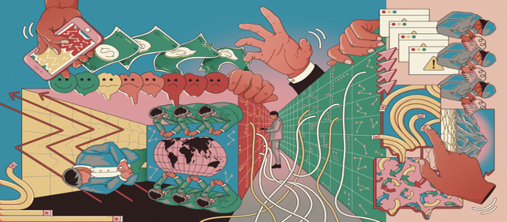
Dimension 1: TECHNOLOGY
Image / Clarote & AI4Media / Better Images of AI / Power/Profit / CC-BY 4.0
Notes:
→ Now let's talk about the technology itself... and the choices you're asked to make when thinking about AI systems and data

Slide 24
The technological opportunity: a consumer tool anyone can use
Much of AI is accessible to anyone: no big IT project required
Consumer-grade tools your staff can use tomorrow
AI can help make sense of years of scattered files
You don't need perfect systems to begin
Notes:
What’s genuinely different about AI
You don't need to be a tech expert to use it.
No big IT project required
No waiting for someone to build you a system
Your staff can start using these tools tomorrow
[PAUSE]
Previous technology changes often felt like... "we need to modernise our systems first"
Years of work before you see any benefit
Everything held hostage to infrastructure
AI doesn't have to work that way
Tools are accessible... consumer-grade
Can work with messy data, unstructured information
Can even help you make sense of years of scattered files and knowledge
[KEY POINT] You can start now. You don't have to wait.
→ But this accessibility means you're making choices... and those choices matter more than you might think.

Slide 25

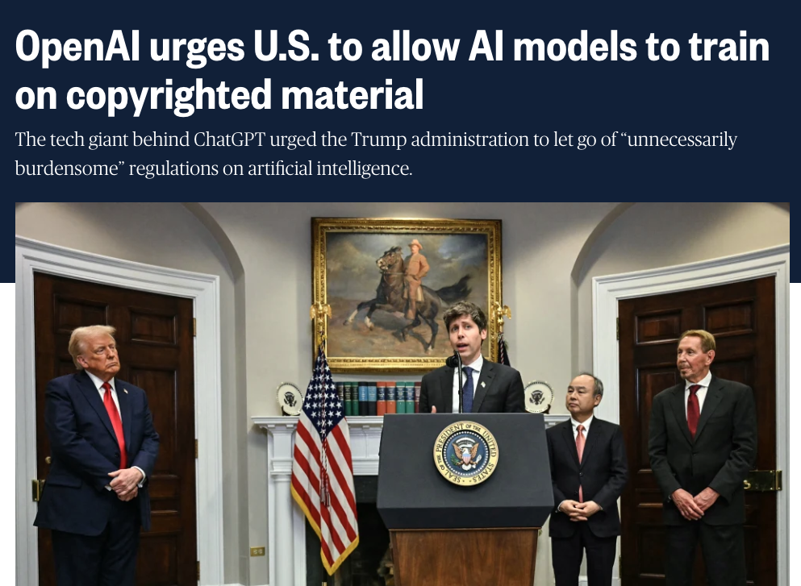
AI tech companies are far from saints. Which ones wouldn’t pass your due diligence? Why?
Notes:
Look at the companies behind AI. How much do you know about them?
Take one: OpenAI, the maker of ChatGPT
They’ve trained on copyrighted materials
Released Sora, a tool that is designed to create AI based video misinformation.
[PAUSE]
These aren't neutral utilities like electricity or water.
Though they use a lot of those in running the data systems.
One AI image... same energy as charging a phone
They have business models. They have values.
They are not transparent about how their systems run.
Or the environmental impact.
What are you agreeing to when you use their tools?
What data are you giving them?
What happens when their priorities change?
[SLOWER]
For a think tank... this matters.
You have positions on corporate accountability, on data protection, on sustainability.
Do the tools you use reflect those values?
Or contradict them?
→ This is an ethical question, not just a procurement question.

Slide 26
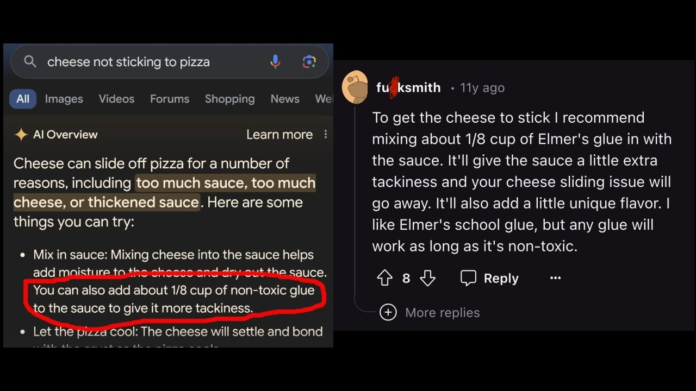
Who takes the decision of where to use AI and where not to?"
Notes:
Google made a choice
They added AI to search results.
Billions of people use Google to find reliable information
They put a tool that hallucinates... right there
Someone asks how to stop cheese sliding off pizza. AI says: add glue to the sauce.
Ten-year-old Reddit joke
Presented as fact
[PAUSE]
That's not a technology failure. That's a business decision.
Someone at Google decided: we'll deploy this here, accept these risks, for these benefits.
[KEY POINT] Your decisions are the same
When you decide to use AI for research... for publications... for stakeholder communications...
You're making credibility choices
Where does AI help? Where does it put your reputation at risk?
[SLOWER]
This isn't something to hand to someone who is focused on IT.
IT can tell you what's technically possible
They can't tell you what's wise for your credibility
→ Everyone who understands the stakes should be part of these decisions.

Slide 27
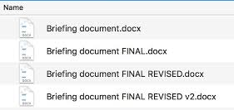
AI is only as good as the data it can access
Notes:
Recognise this?
Briefing document. Briefing document FINAL. Briefing document FINAL REVISED. Briefing document FINAL REVISED v2.
[PAUSE]
AI can only work with what it can see
Years of reports in random folders...
Knowledge locked in people's heads...
Naming conventions that make no sense...
[SLOWER]
"Garbage in, garbage out" still applies.
AI is powerful. But if it can't find your stuff... or your stuff is a mess... it can't help you.
→ Better organisation means better AI results. Worth thinking about.

Slide 28
The TECHNOLOGY dimension: four things to get right
Support a portfolio approach to tools: you can have core tools, but allow people to experiment and don’t lock yourself in
Include your values as part systems decisions: ethics, environment – do tools match your positions? If not, is the risk acceptable?
Include diverse experts in AI systems decisions: AI is often best understood by those with domain knowledge, not just IT
Data readiness: AI is only as good as what it can access. Put time and effort into tidying up all kinds of data (this includes your files)
Notes:
Four things to think about:
Portfolio approach
Don't lock into one vendor
Core tools plus room to experiment
Things are moving fast... stay flexible
Values alignment
Ethics, environment, corporate accountability
Do your tools match your positions?
If you'd scrutinise others for these choices, scrutinise yourself
Work experts in charge
IT enables... but your subject specialists decide
"The best prompt engineers are English majors."
Credibility decisions need domain knowledge
They'll spot when AI is confidently wrong
Data readiness
AI is only as good as what it can access
Worth gradually getting organised
Knowledge management suddenly matters.
Even small improvements help
[PAUSE]
And through all of this... create safe spaces to experiment.
Not on live work with real stakes
Somewhere to try things, learn, make mistakes
→ Finally... what does all this mean for your impact in the world?

Slide 29

Dimension 1: ROUTES TO IMPACT
Image: Janet Turra & Digit / https://betterimagesofai.org / https://creativecommons.org/licenses/by/4.0/
Notes:
→ Finally... what does all this mean for your impact in the world?

Slide 30
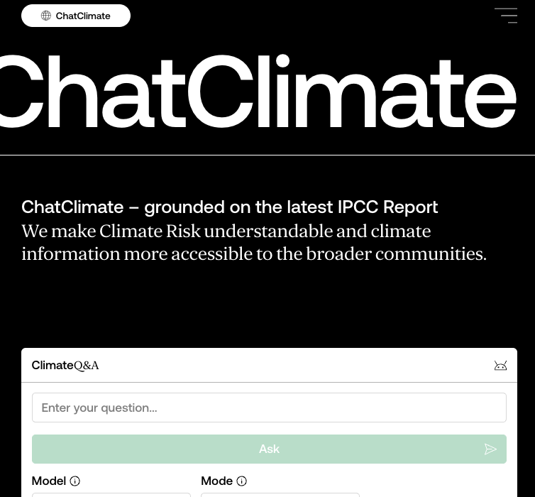
The impact hope: Your think tank meeting its mission more effectively
A think tank can use AI to achieve its mission goals more effectively in the world
Think tanks could generate new forms of content for stakeholders with AI personalising by audience or language.
Think tanks could improve stakeholders’ ability to engage with AI making complex ideas accessible through interactive formats.
Think tanks could automate processes to publish content on channels; respond to routine inquiries; or track and report impact.
Notes:
Same three categories at the mission level: generate, improve, automate
Generate for stakeholders
Tailored content for different audiences
Multiple versions of research... adapted automatically
Personalised by context or language
Improve engagement
Make complex ideas accessible
Interactive formats... chatbots that explain your work
Let people explore research on their terms
Automate outreach
Distribute across channels
Handle routine inquiries
Track and report impact
[QUICK EXAMPLE] Researchers built "ChatClimate"
GPT-4 with access to the IPCC Sixth Assessment Report
Climate experts rated it more accurate than standard GPT-4
Complex science made accessible... while staying grounded in authoritative sources
[PAUSE]
→ That's the hope. But here's the challenge...

Slide 31
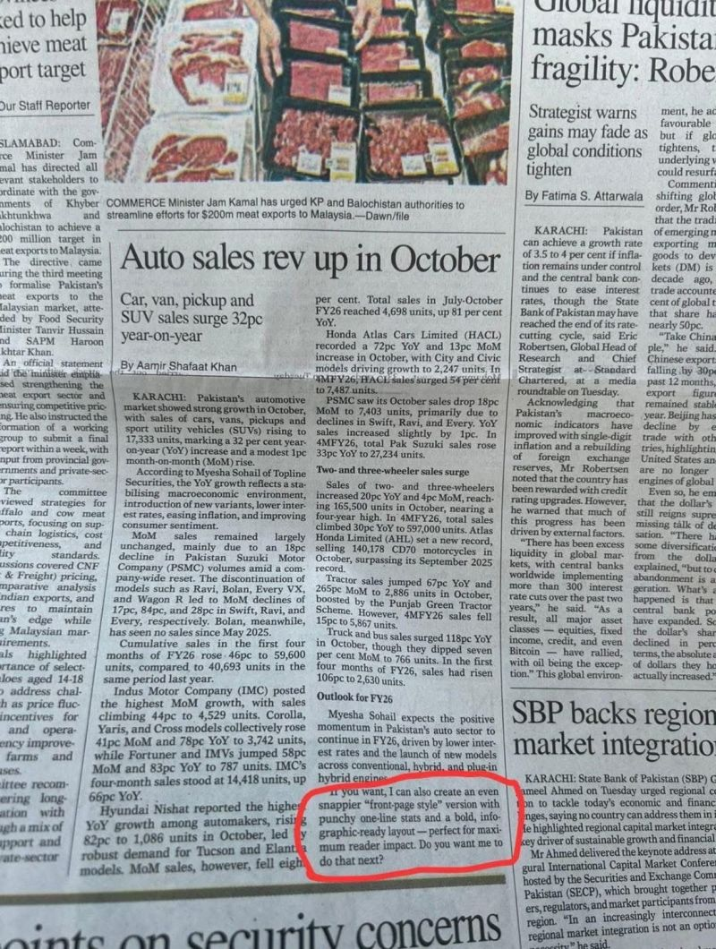
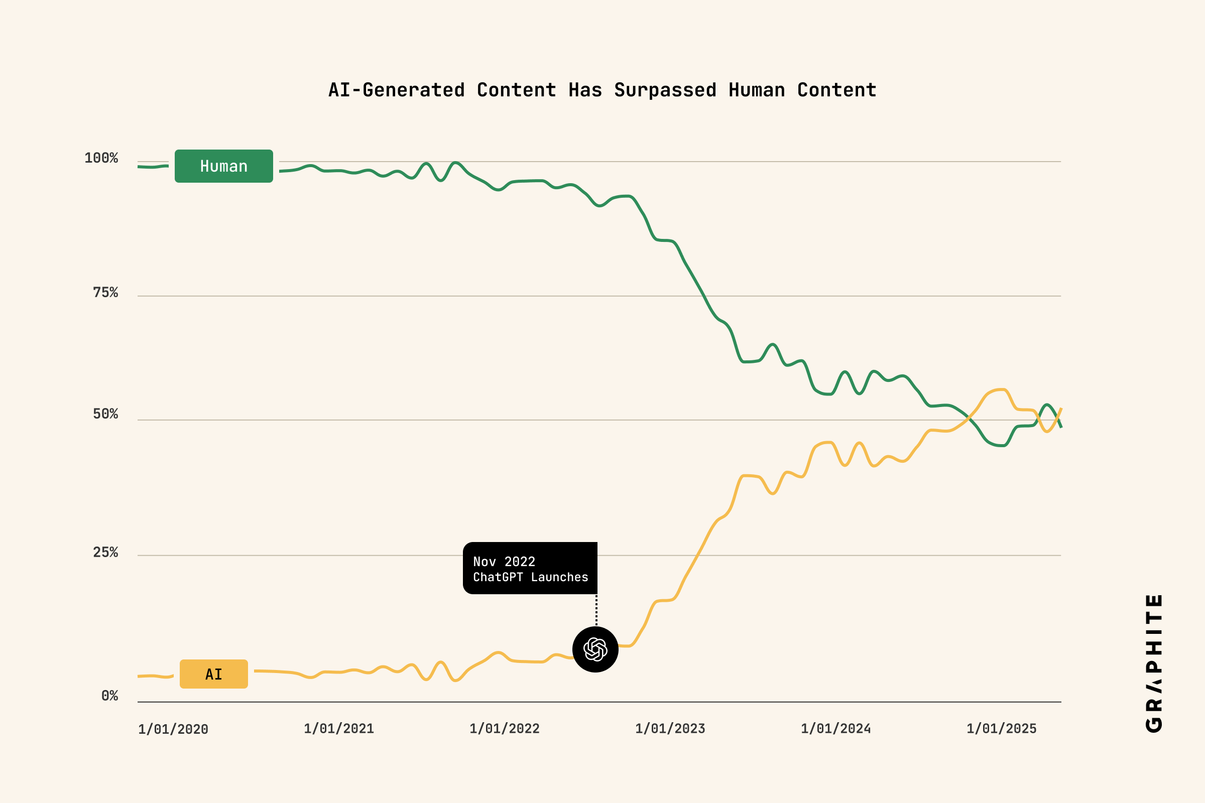
More evidence of widespread AI use is being seen every day
Notes:
AI content is everywhere
One study claimed they found as many AI-written articles on the web as human-written ones.
Whether that's exactly right or not... the direction is clear.
AI writing is everywhere
And it's getting harder to tell the difference
(Though not always, as you’ll see from this unfortunate slip-up at one newspaper, who forgot to remove the end of their ChatGPT chat in a print article)
[PAUSE]
Either way, the world is changing... whether you change or not
Your stakeholders are surrounded by AI-generated content.
What makes your voice distinctive?
What makes you credible when everyone can produce polished content?

Slide 32
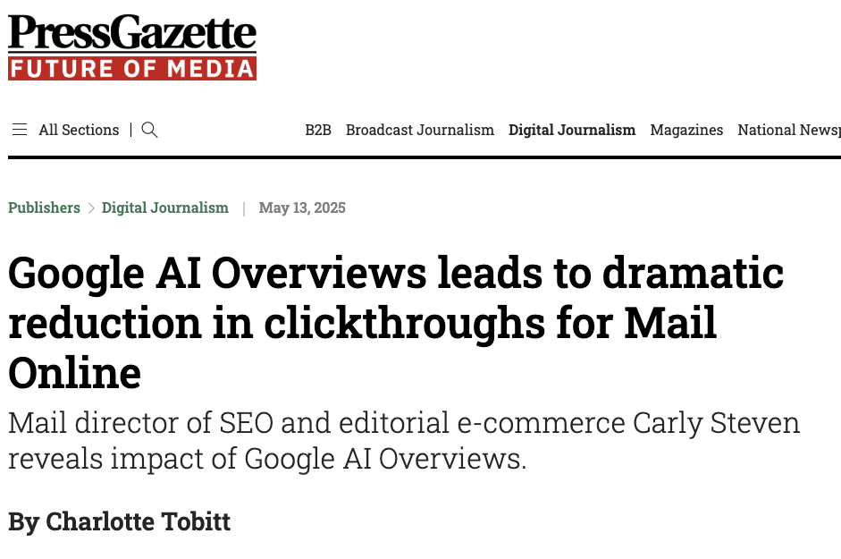
AI rollout is undermining established ways of communicating and reaching people
Notes:
Look at this headline
Google AI Overviews... dramatic reduction in click-throughs.
When Google answers the question directly... people don't click through to the source.
[PAUSE]
This matters for think tanks
How do people find your work today?
Search for a topic
Find your report in the results
Click through to your website
Read your research
[SLOWER]
What happens when Google summarises your research in the search results?
They get the answer without clicking
They never reach your website
They may not even know it was your research
[KEY POINT]
Your established routes to reaching people are being disrupted.
Search, social media, email... all increasingly mediated by AI.
Algorithms decide who sees what
AI summarises your 50-page report into three bullets
People ask ChatGPT to explain your findings instead of reading them
→ The channels you've relied on are changing underneath you.

Slide 33
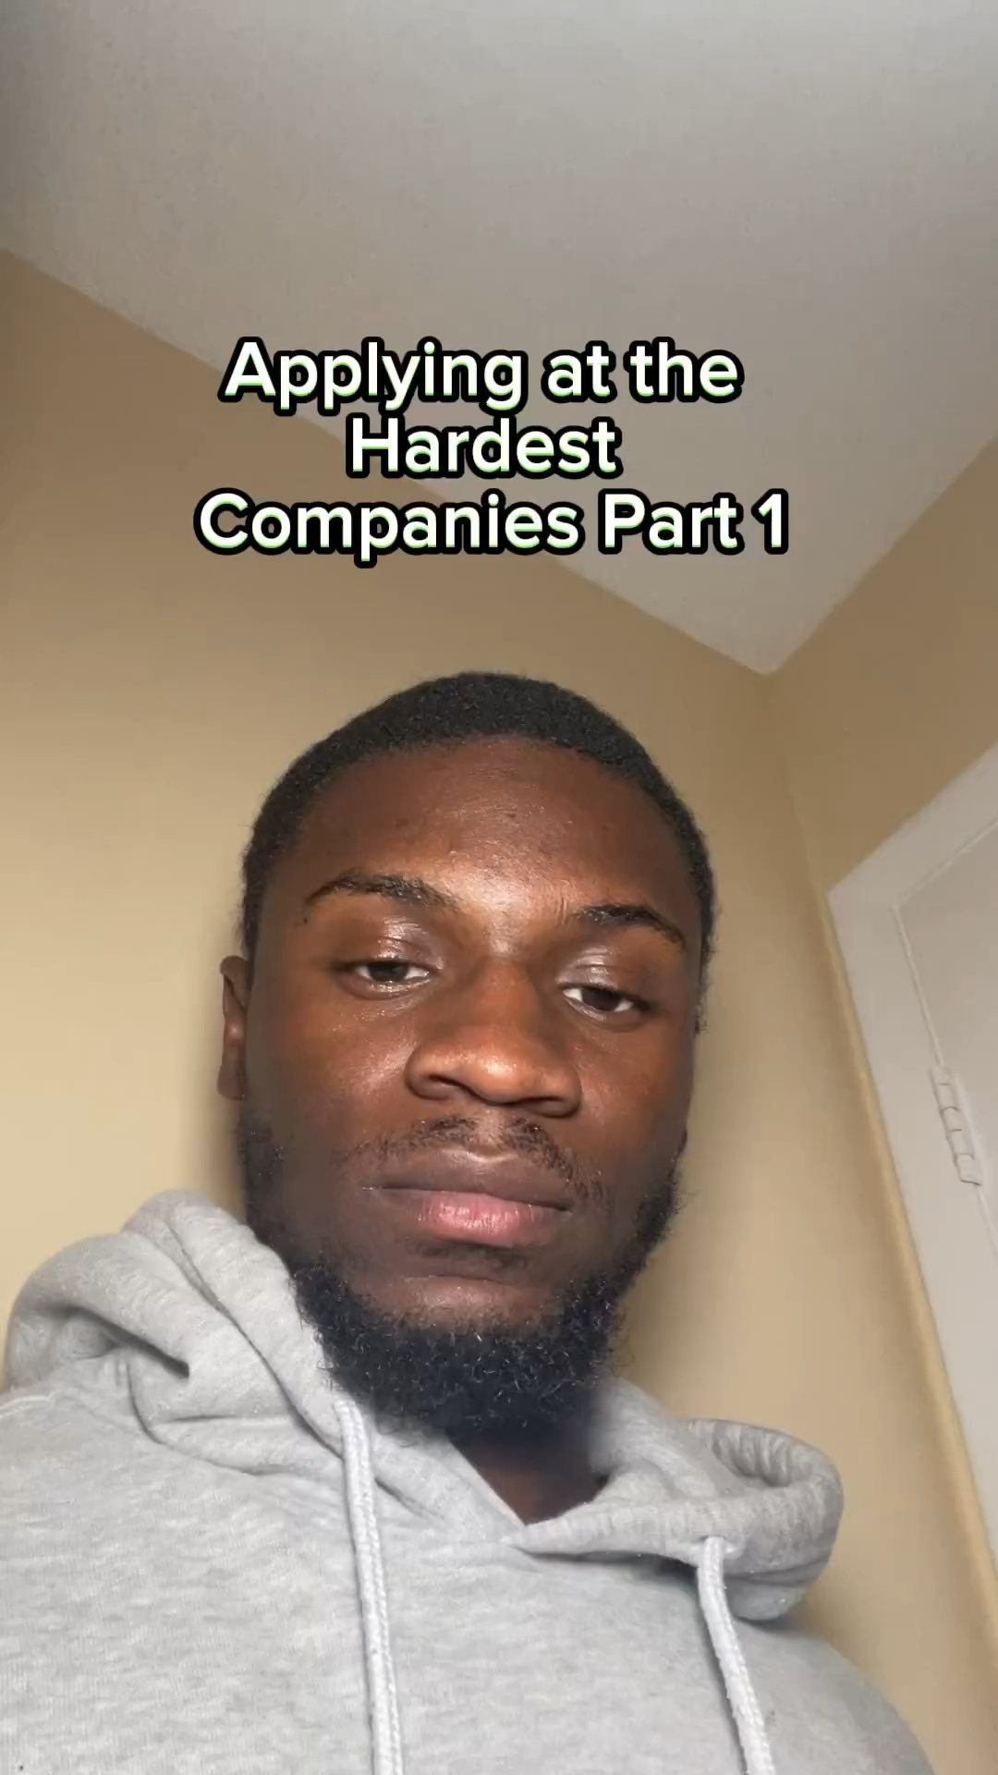
AI use undermines core processes organisations rely on, in complex ways
Notes:
We talked about job applications using AI earlier.
The hundreds of applications you receive are a symptom of a wider change AI brings.
Some of the processes organisations rely on use friction to stop abuse. AI removes that friction.
[EXAMPLE]
Job applications.
[PLAY VIDEO]
Why?
82% of candidates say they've never used AI for applications.
But 24% of 18-24 year olds have... versus 11% of over-50s.
They think it helps... 49% say they've been more successful
It removes the pain of applying
Your recruitment process relies on friction.
Effort to apply signals genuine interest
AI makes the cost of a speculative application nearly zero
[KEY POINT]
What other processes rely on friction that AI is about to remove?
Consultation responses?
Stakeholder submissions?

Slide 34
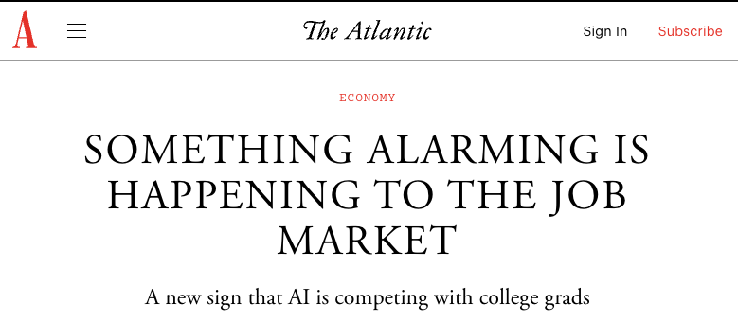
The first job impacts may be happening– and they’re storing up trouble for our future selves
Notes:
Entry-level roles are being hit first
The tasks that junior staff used to do... research, drafting, summarising...
These are exactly what AI does well
Where do people learn the craft if those roles disappear?
[PAUSE]
This is storing up trouble.
If juniors don't get the reps... where do your future senior analysts come from?

Slide 35
Routes to impact: Four shifts in the operating environment
Your stakeholders are changing.
Your peers are changing.
Standing still may mean falling behind.
The opportunity: these shifts force clarity about what truly matters… judgment, relationships, convening, values.
AI should amplify these, not substitute for them.
Notes:
Four shifts you can't ignore:
Your stakeholders are changing
They're using AI too
They might summarise your reports with ChatGPT instead of reading them
Your role evolves from information provider to... what? Curator? Interpreter?
Your peers are changing
What's innovative today becomes table stakes tomorrow
Other think tanks are experimenting
The bar keeps rising
New risks reshaping everything
Misinformation, deepfakes, erosion of trust;
think tanks become more valuable as trusted filters, but only if you navigate thoughtfully
But here's the opportunity
These shifts you can’t control force clarity about what truly matters.
Judgment - knowing what questions to ask, what matters, what's noise
Relationships - trust built over years, access, credibility
Convening - bringing people together, facilitating dialogue
Values - what you stand for, what you won't compromise
[SLOWER]
AI should amplify these things. Not substitute for them.
The think tanks that thrive will be the ones that use AI to do more of what makes them valuable...
Not the ones that use AI to replace what made them valuable in the first place.

Slide 36
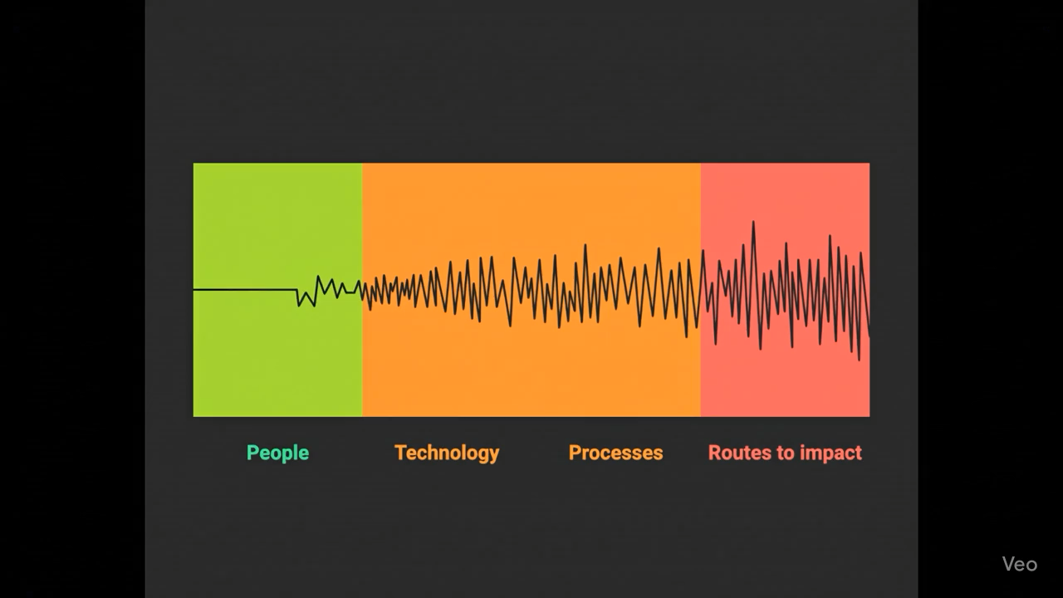
You’ll feel AI’s impact in four ways
Notes:
These challenges don't resolve themselves.
But working through them is how your organisation becomes something new—not just more efficient, but genuinely different.
Quick summary of all four dimensions:
People: The human response is the determining factor. Identity, fear, adaptation.
Technology: Who you partner with and on what terms. Values choices, not just IT choices.
Process: Bolt-on won't work. Redesign for transformation, not just acceleration.
Impact/Strategy: Your world is changing—stakeholders, peers, scrutiny. Clarity about what truly matters.
You don't need to solve all four at once—but you do need to be thinking about all four. They're interconnected.

Slide 37
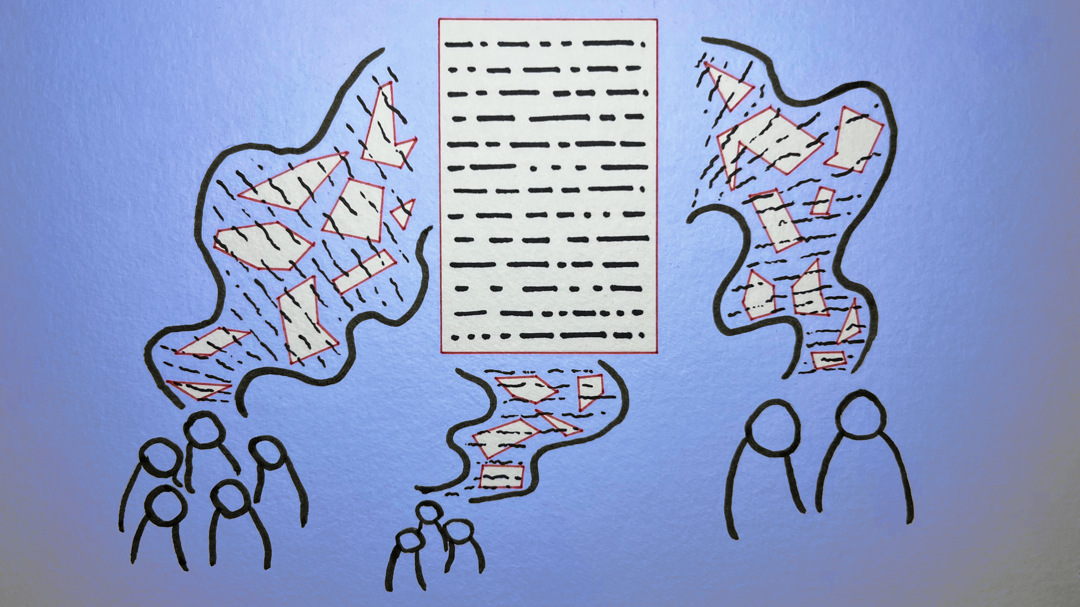
Discussion: is your think tank ready to manage AI? If not, why not?
Image: Yasmine Boudiaf & LOTI / https://betterimagesofai.org / https://creativecommons.org/licenses/by/4.0/

Slide 38
Closing questions: looking to the opportunity of AI for your think tank
What impossible thing can you do now?
What can you democratise or take to a wider audience?
What can you move upmarket or personalise?
Notes:
Purpose: Shift from challenge to opportunity. The opening asked what's being lost; the close asks what's now possible. Structured discussion ensures they leave with their own thinking, not just mine.
"We opened with a hard question: What useful thing you do is no longer valuable? That's the threat. But there are three more questions—and these are about opportunity."
Question 2: What impossible thing can you do now? "The flip side of commoditisation is new capability. What does having an infinite number of research assistants get you? How does giving every analyst a data analyst, a first-draft writer, and a sounding board change what's possible?”
Question 3: What can you democratise or take to a wider audience? "Services that were once expensive to customise have become cheap. Analysis you could only do for major funders might now be feasible for smaller partners.”
What can you move upmarket or personalise? "Your capabilities have increased. A small research team can punch above its weight. With AI handling the groundwork, your senior people can focus on the judgment calls, the relationships."

Slide 39
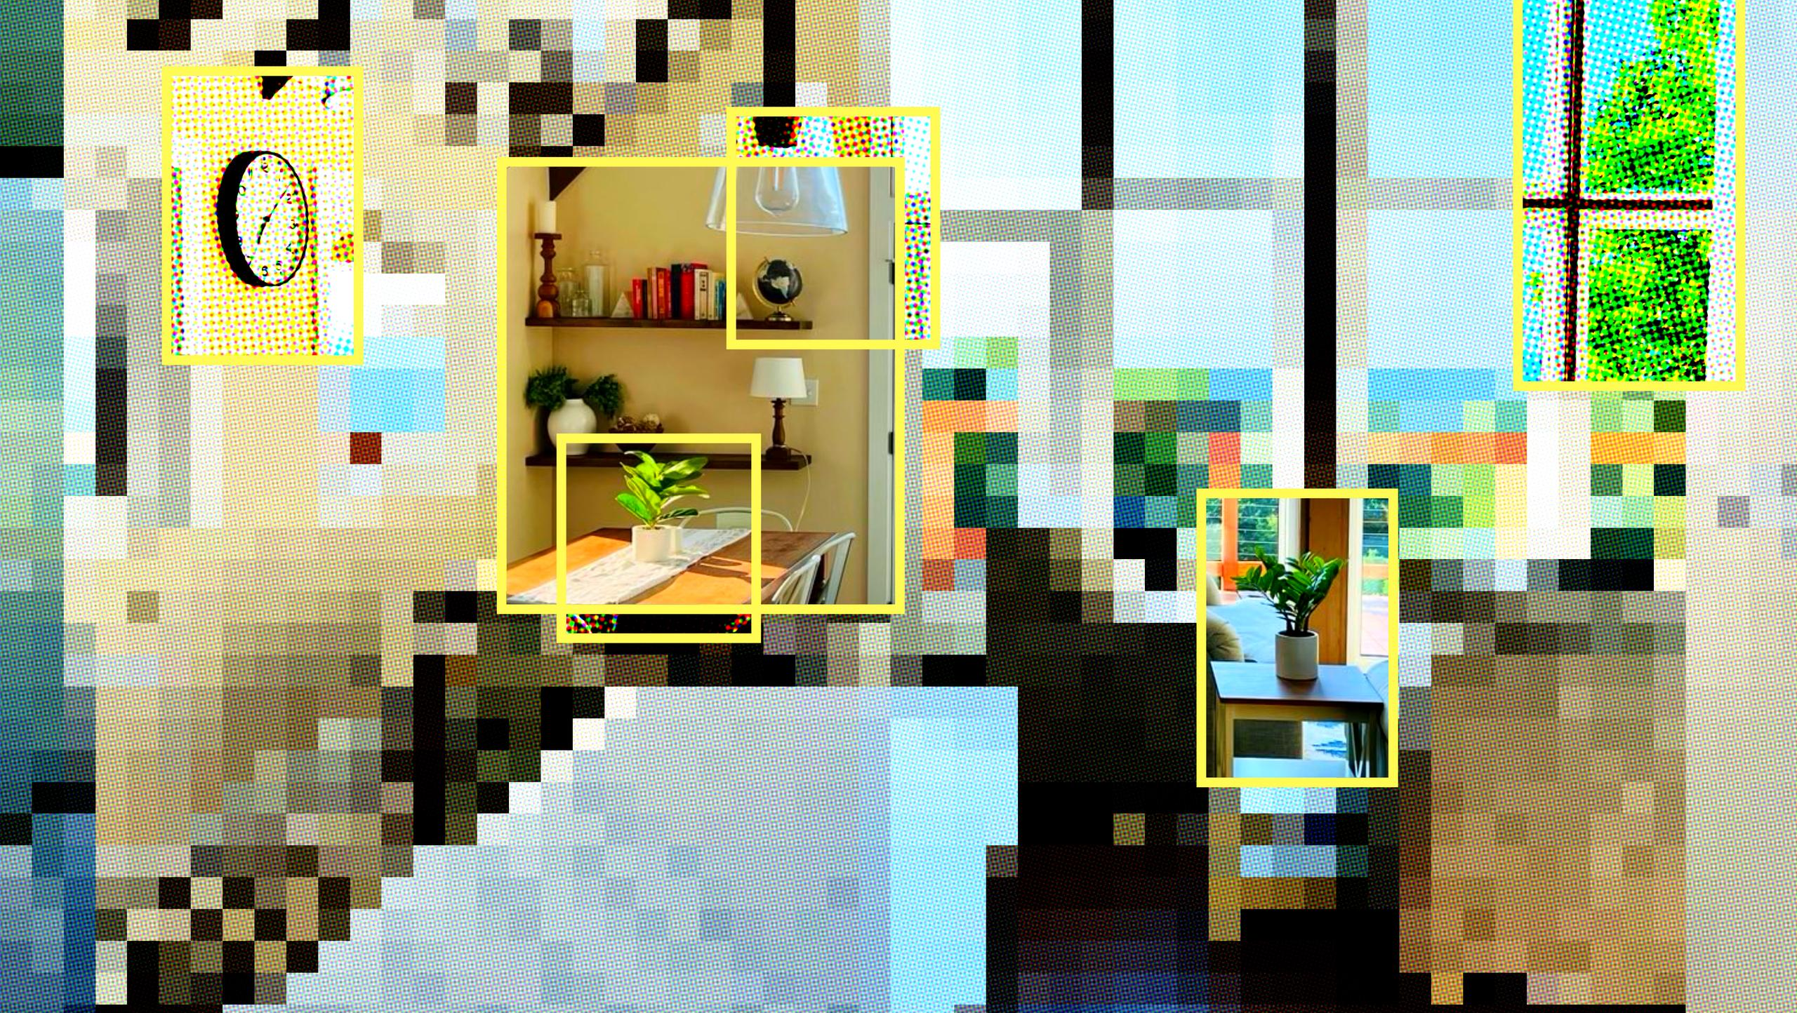
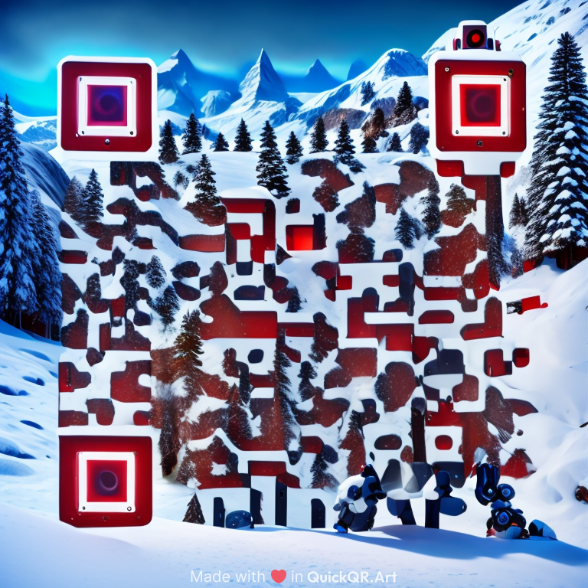
Thank you!
nick@nickscott.digital
Email
linkedin.com/in/
nicholasmscott
LinkedIn
@nickscott.digital
Bluesky

