Slide 1
Funding think tanks
Enrique Mendizabal (OTT)
2025

Slide 2

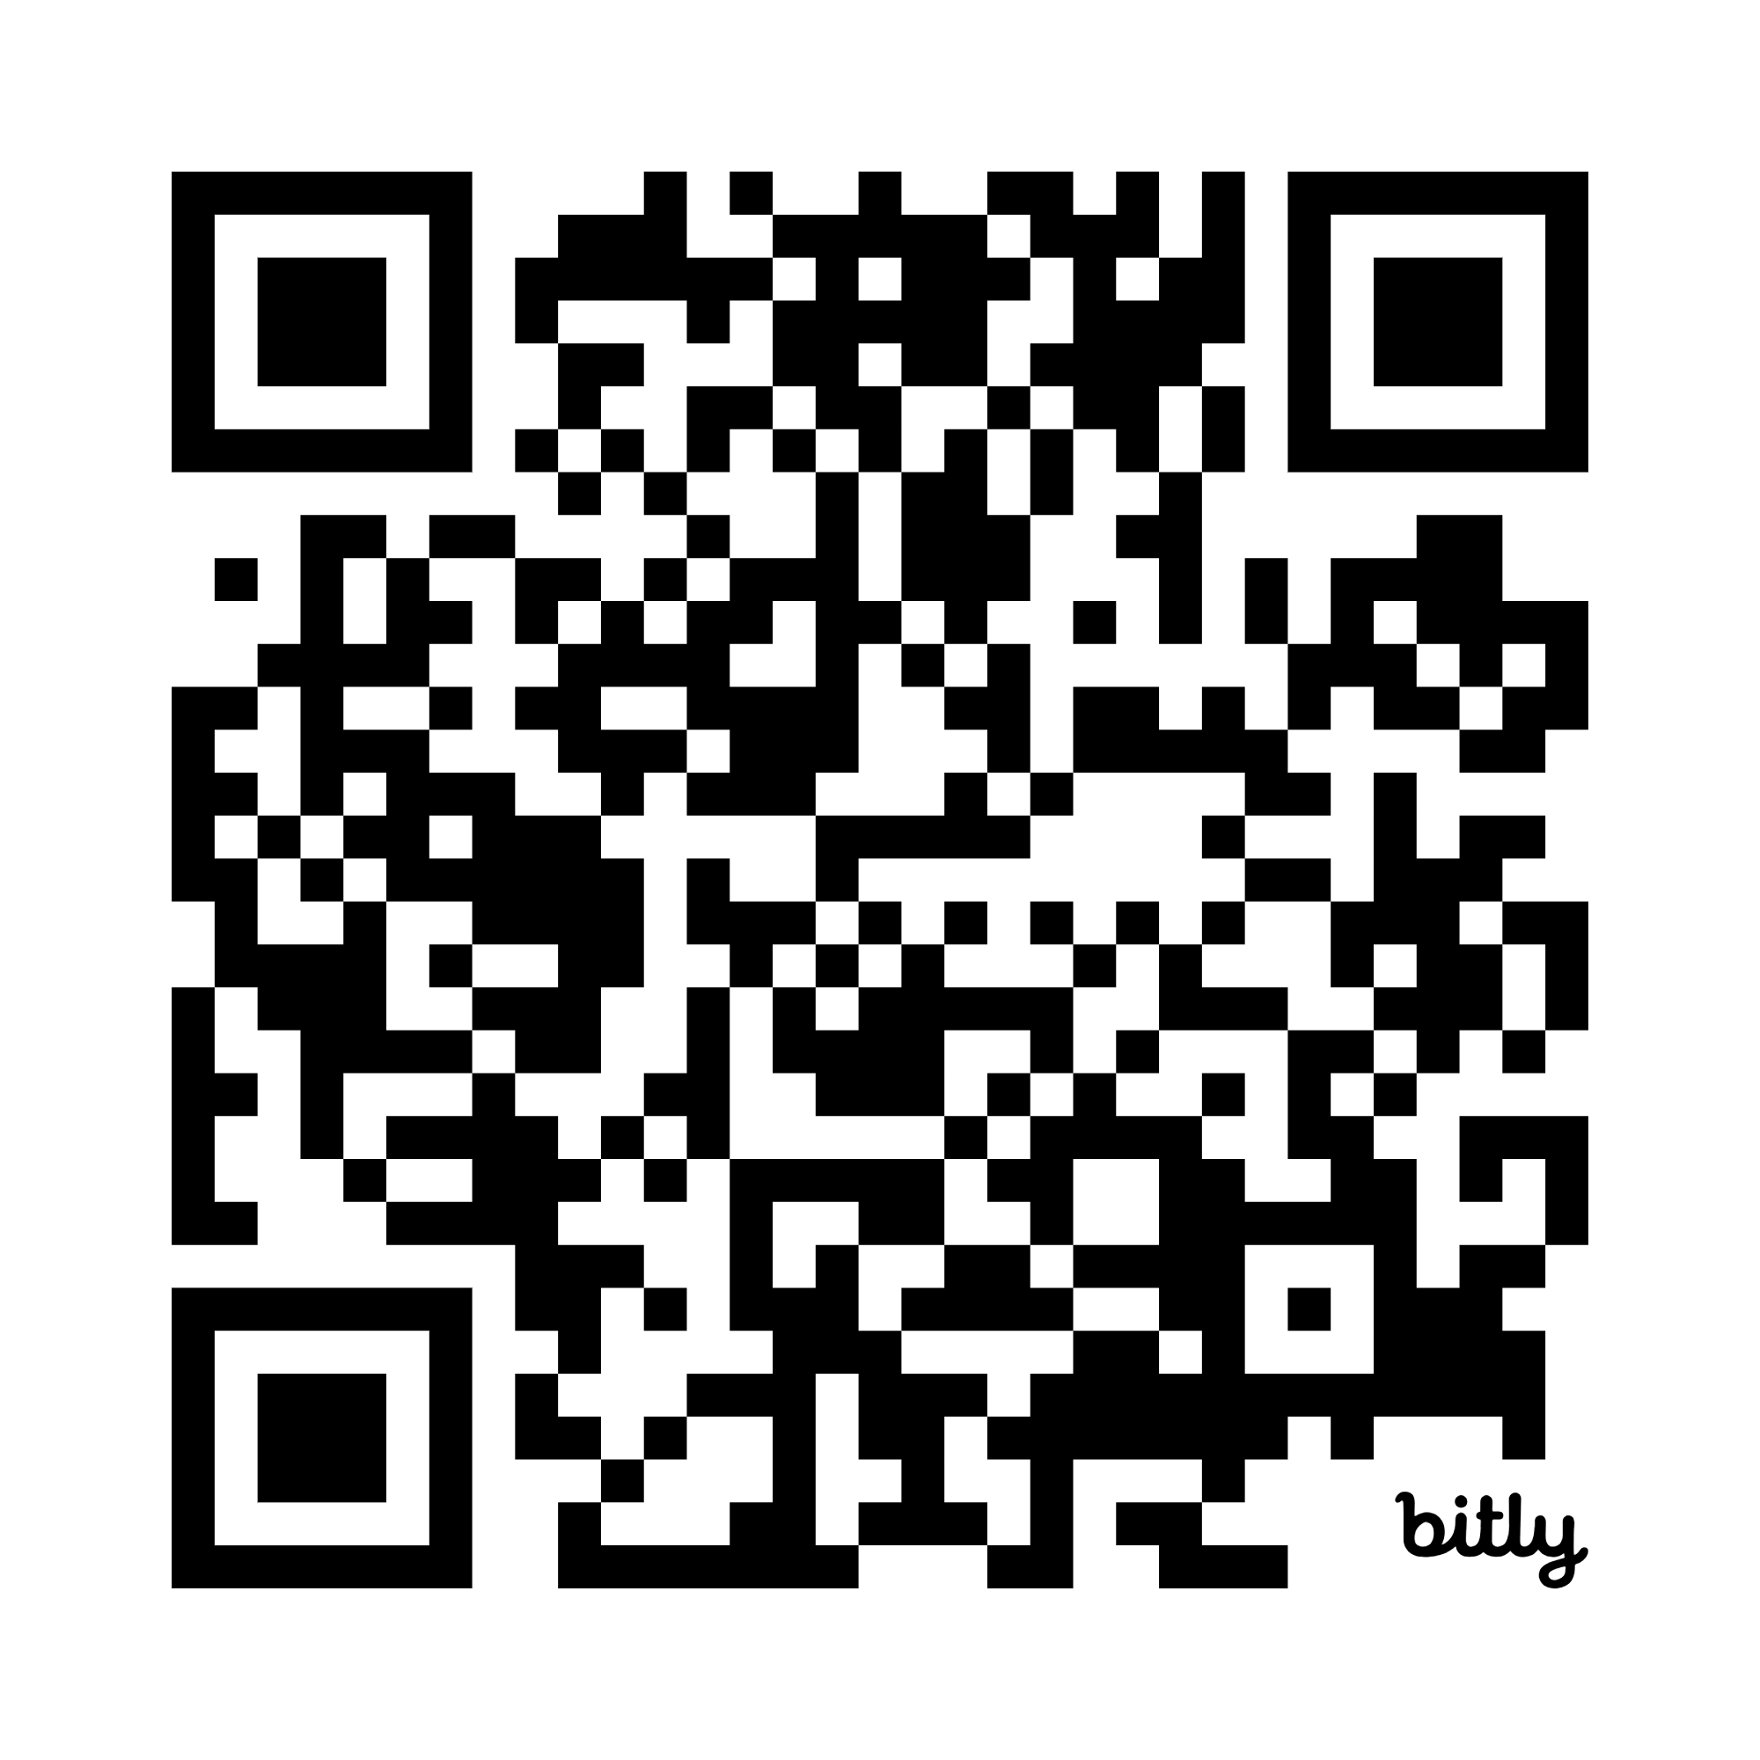
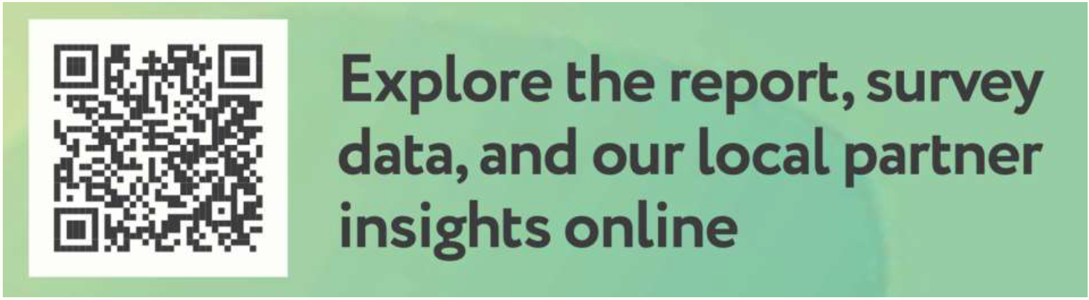
On Think Tanks is the leading global source of information, support and community for people working in, with, and funding think tanks. We create a space to connect, learn and exchange knowledge, ideas and resources.
Check out the 2025 State of the Sector Report:
onthinktanks.org/sos2025

Slide 3


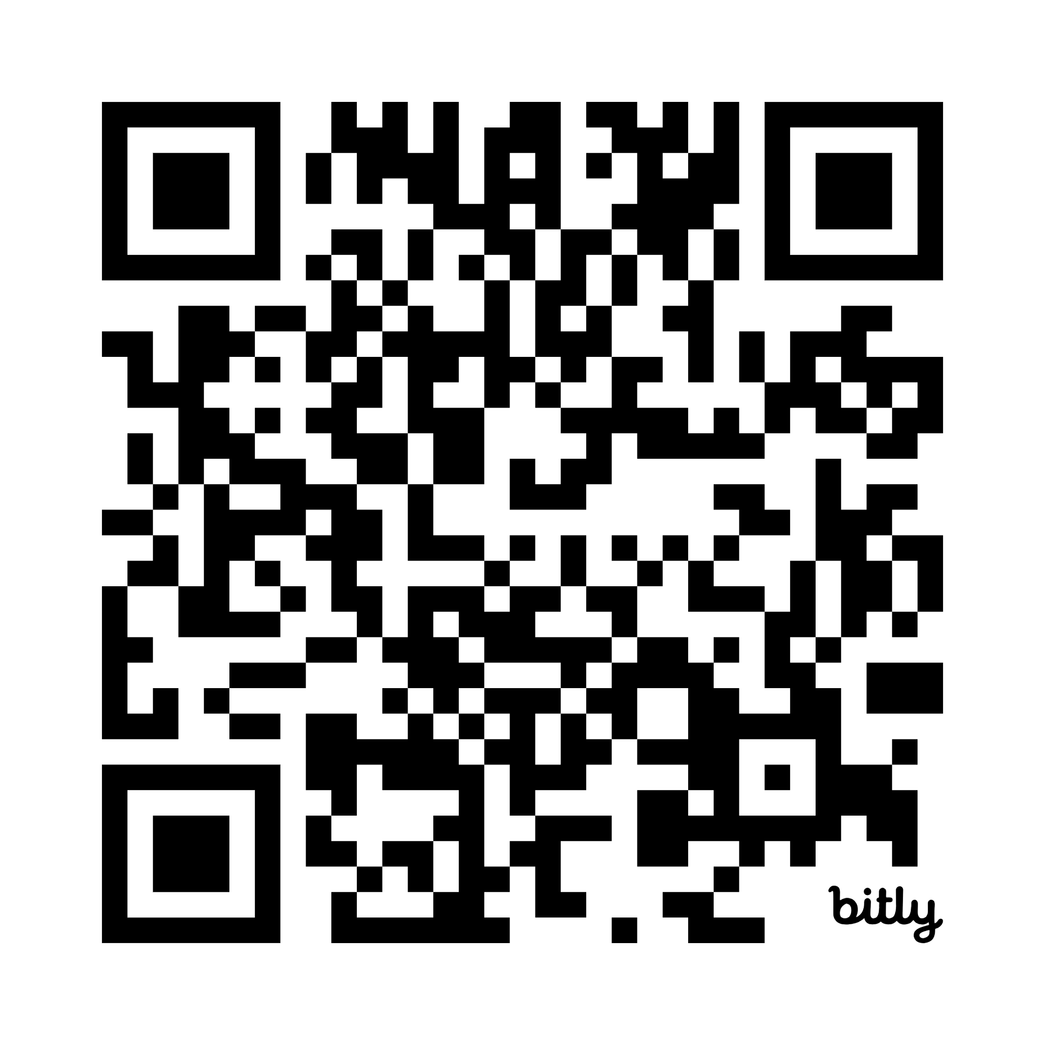
The only global publication of its kind, this annual report offers a unique snapshot of the think tank sector—globally and regionally. Discover trends in funding, policy priorities, institutional growth, and the biggest challenges facing think tanks. Dive into current and past editions.
Explore the State of the Sector Reports

Slide 4
Content
The think tank funding landscape - funding by income and region
Financial resilience is more than about having multiple sources
What is the value added of think tanks?
Income streams - pros and cons (participatory)
Funding sources - pros and cons (participatory)
Think tank competencies and skills

Slide 5
Funding think tanks

Slide 6
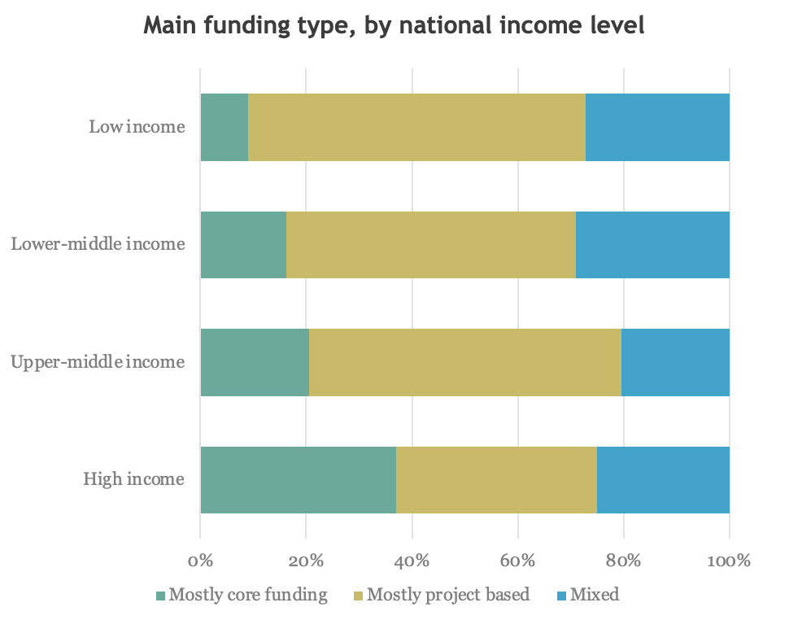
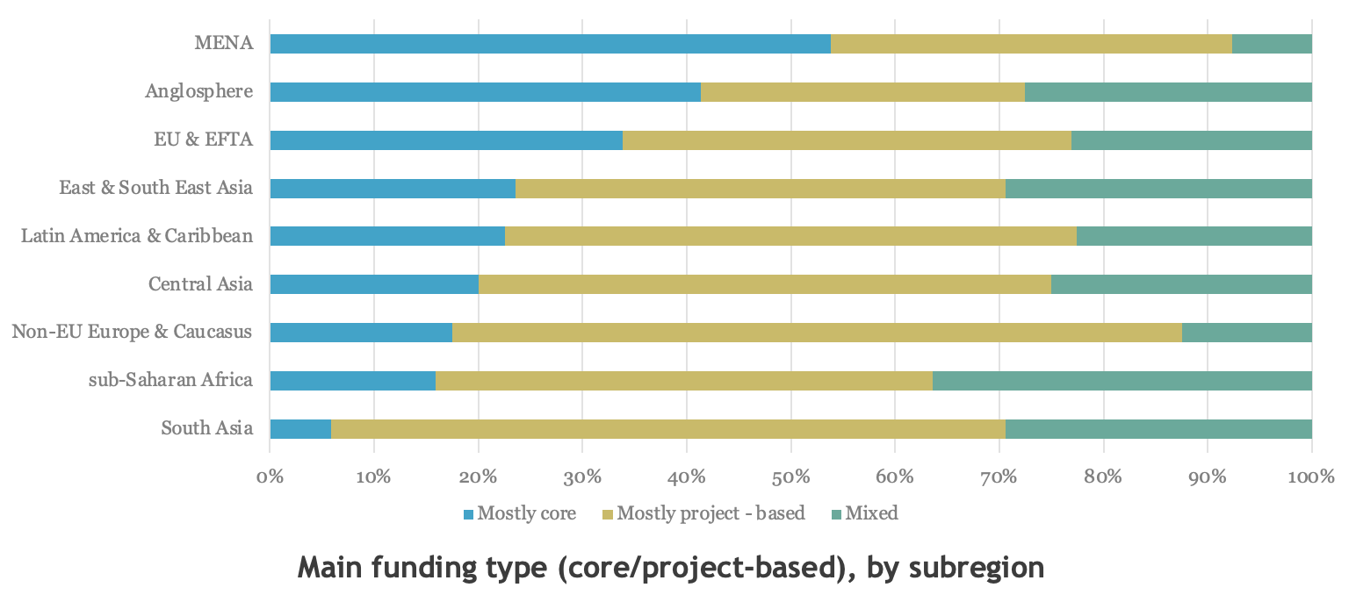
Funding by type of income and region (2025)
The “Global South” more likely to depend on foreign funding
Higher income countries more likely to depend on domestic funding

Slide 7
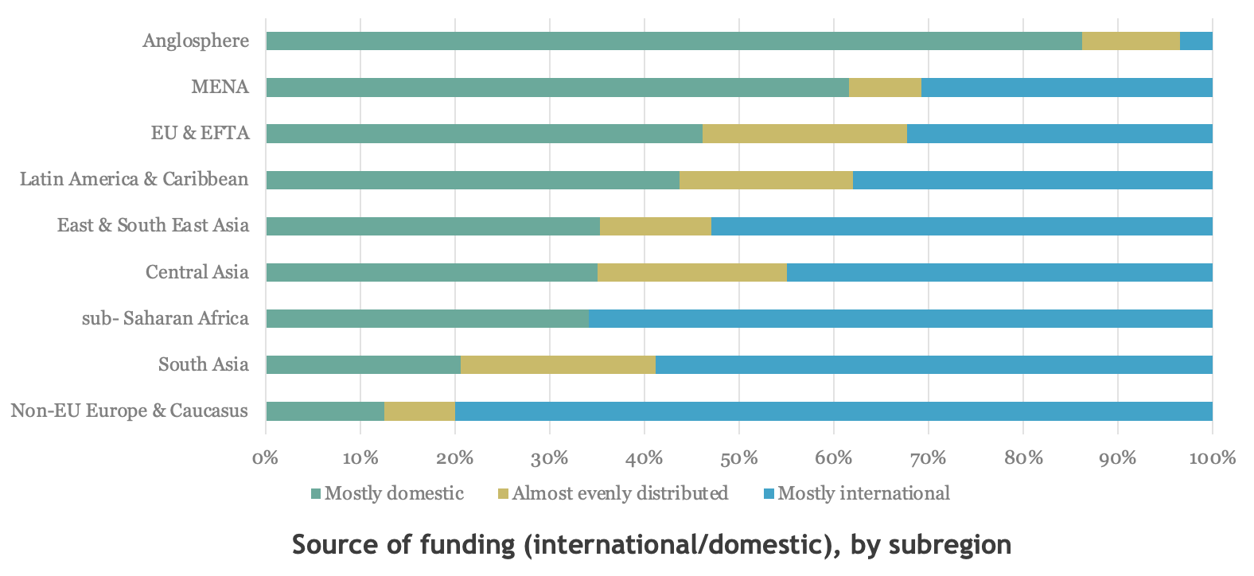
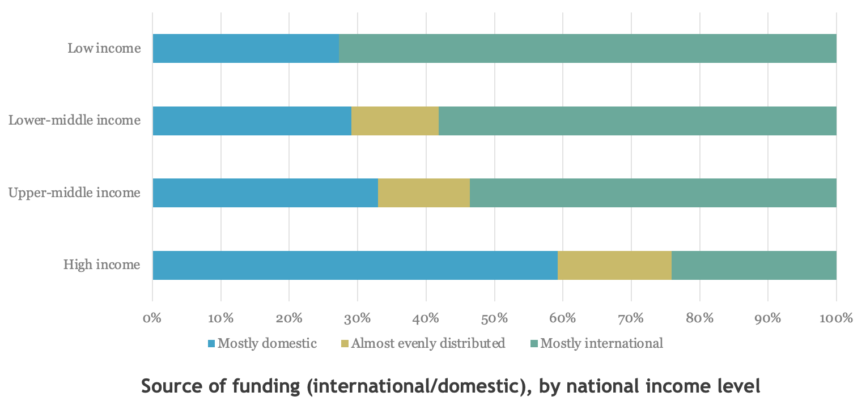
Funding by source and region (2025
The “Global South” more likely to receive project funding
Higher income countries more likely to receive core funding

Slide 8
Funding disparities: Education policy research in Africa
When we looked at the funding for research on education in Africa, we found that, although the African grantees in our sample receive 45% of the number of education research grants, they only receive 19% of the total funding. Conversely, North American grantees receive 38% of the grants and a staggering 81% of the total research funding.
https://onthinktanks.org/articles/local-research-for-local-problems-who-gets-the-money/
North American grantees received nearly all (82%) of the long-term funding commitments (defined as grants lasting over five years), compared to none in Africa.
Most grants to African organisations are made in response to funders’ calls for proposals. However, grants to North American and European grantees are often the result of funders seeking them out or grantees submitting unsolicited proposals.
https://onthinktanks.org/articles/unveiling-the-disparities-revisiting-education-research-funding-for-africa/

Slide 9
Financial resilience is more than about having multiple sources
Organisational resilience:
Adaptive leadership
Operational agility
Strategic communication - to funders, stakeholders and public
Team wellbeing
Financial sustainability - diversified income, reserves, cost-effective practices. Critically:
Multiple sources
Multiple income streams
Funding model

Slide 10
First, consider what is the added value of think tanks?
Evidence
Policy and decision-making inputs and advice
Capacity development
Elite and public education
Resistance to change and reform
Legitimation
Channelling of resources
Creation and nurturing of spaces
Access to key individuals
Other?

Slide 11
Income streams - pros and cons
 | Pros | Cons
Membership fees | Can add up and connects think tanks to a loyal audience | Takes time, requires scale to work, demands new skills
Participation fees | Can contribute to sustainability of events, encourages buy-in from participants | Small amounts and may exclude a large audience
Consulting | Can generate significant income and keeps think tanks relevant | Can be a distraction from the mission, requires different competencies and skills
Polling | Can be highly profitable and very good to raise think tank’s visibility | Can be highly political and at the same time demand neutrality from the think tank. Very specific skills are required.
Sponsorship | Can be used to fund events or to raise funds at annual events | Could generate internal tensions or public critique depending on the sponsors.
Education and training | Can raise funds and is a great way to inform policy and build capacity | Requires strong marketing capabilities or partnerships with education providers
Sale of books and other | Can deliver a more focused audience – willing to pay | Small amounts and may exclude a large audience
Grants | Often come with little reporting restrictions | Can make the organisations too dependent on them and disconnected them from more practical work and stifle innovation – also, increasingly unlikely for think tanks to rely on
Other: investments, rental of space, etc.

Slide 12
Income sources – pros and cons
 | Pros | Cons
Individuals | Lower reputational risk, less reporting | Takes time to reach scale and to manage
Diaspora | Used to funding think tanks, politically aware, high-income funder even if low-income country think tank | Takes time to reach scale and to manage
Private sector, inc. business associations - local | Politically aware, close and informed funder, limited reporting | Reputational risk, often with strings attached
Private sector - global | Lower reputational risk, high ticket | More strings attached
NGOs, Universities | Limited reporting, alignment | Often small ticket, conflicting agendas
Private foundations or philanthropists - local | Politically aware, responsive, limited reporting | Small ticket, limited scope
Private foundations or philanthropists - global | Large ticket, non-aligned | Non-responsive to local needs, politically detached, potentially high reporting burden

Slide 13
Income sources – pros and cons
 | Pros | Cons
Bilateral / Multilateral – local missions | More responsive to local needs, limited reputational risk, could award credibility, middle to high ticket | Some reporting, medium reputational risk, limited agendas
Bilateral / Multilateral | Could awards credibility, high ticket. | Non-responsive to local needs, politically detached, potentially high reporting burden
Public - government | Access to policymakers | Reputational risk, strings attached, high procurement and reporting burden
Public – Science granting councils | Long term funding, lower political risk | Limited scope, high procurement and reporting burden, limits political action
Other

Slide 14
Funding model
Your funding model will be the mix of income streams and sources that meet your organisational needs
E.g.:
 | Percentage | Detail
Membership fees | 10% | 50% students 20% from Embassies
Participation fees | 5% | Annual conference
Consulting | 20% | Min 50% multi-annual Focus on few clients Research/advisory to corporations
Polling | -
Sponsorship | 10% | 5 long term partners Business associations
Education and training | 10% | 80% from longer/ higher fee courses
Sale of books and other | -
Grants | 40 | Min 50% multi-annual Min 5 sources Private foundations
Investments or reserves | 5% | ~ 7% annual return

Slide 15
Funding strategy
The funding strategy refers to how the think tank plans to achieve its model.
E.g.:
 | Percentage | Detail | How
Membership fees | 10% | 50% students | Partner with local universities
Participation fees | 5% | Annual conference | Target senior participants with ability to pay
Consulting | 20% | Min 50% multi-annual Focus on few clients | Develop research support service to keep clients informed and MEL practice
Polling | -
Sponsorship | 10% | 5 long term partners | Annual public event series and annual conference
Education and training | 10% | 80% from longer higher fee courses | Partner with local School of Government
Sale of books and other | -
Grants | 40 | Min 50% multi-annual Min 5 sources | Apply to national science council and build rapport with domestic philanthropy
Investments or reserves | 5% | ~ 7% annual return | Invest reserves in S&P and cash

Slide 16
Organisational skills required
Board
Members with skills and experience in fundraising, business development, marketing, grantmaking, etc.
Members with responsibility for supporting the development of new funding relationships and funding streams.
Senior management
CEO responsible for overall funding model and strategy.
Director of Communications / Director of Research / Programme directors with responsibility to deliver on model and strategy.
Senior researchers
Responsibility to deliver on model and strategy.

Slide 17
Organisational skills required
Business development
Potential team or function within the organisation.
Communications and marketing
Not enough to develop research communications competencies and skills
Think tanks need marketing competencies and skills.
Strategic planning and financial management
Targets are defined as part of a comprehensive strategic planning process to define income target, direct and indirect costs, and desired profit or reserves policy
Delivery of targets is supported by careful programme and project budgeting that incorporates organisational targets.
Sign up to our Strategic planning and financial management course!

Slide 18
Organisational skills required
Project management
Team leaders need to know how to manage a project according to the budget
Or be supported by project managers who can.
Funders “who get it” – and can tell than 15% indirect cost rate is never enough!
Most think tank funders do not cover all indirect costs.
Their policies often contradict best practice or best advice.

Slide 19
Group work

Slide 20
Individual work
In similar contexts
Consider
Who could pay for each income stream and in the future.
What can you do now to mobilise/ cultivate/ activate those fund in the future?
Together:
Share
So, what is different and what is similar?

Slide 21
 | Who would pay for this now? | Who could pay for this in the future? | What to do now?
Membership fees
Participation fees
Consulting
Sponsorship
Education and training
Sale of books and other
Grants
Other

